Slide 1
Discrete Optimization
MA2827
Fondements de l’optimisation discrète
Constraint programming
https://project.inria.fr/2015ma2827/
Material based on the lectures of Pascal Van Hentenryck at Coursera

Slide 2
Outline
Computational paradigm
More constraints
linear constraints over integers
redundant constraints
symmetry breaking
Global constraints
Feasibility
Pruning
Search strategies

Slide 3
Constraint programming
Computational paradigm
use constraints to reduce the set of values that each variable can take
make a choice if no deduction can be made
Modelling technology
convey the structure of the problem as explicitly as possible
express substructures of the problem
give solvers as much information as possible

Slide 4
Example: 8-queen problem
Task: place 8 queens on the chess board such that they do not attack each other
Good
Bad

Slide 5
8 queens
Task: place 8 queens on the chess board such that they do not attack each other
Guess the first queen
Try the first spot

Slide 6
8 queens
Task: place 8 queens on the chess board such that they do not attack each other
Guess the first queen
Apply constraints

Slide 7
8 queens
Task: place 8 queens on the chess board such that they do not attack each other
Guess the first queen
Guess the second queen
Try the first available spot

Slide 8
8 queens
Task: place 8 queens on the chess board such that they do not attack each other
Guess the first queen
Guess the second queen
Apply constraints

Slide 9
8 queens
Task: place 8 queens on the chess board such that they do not attack each other
Guess the first queen
Guess the second queen
Guess the third queen
Apply constraints

Slide 10
8 queens
Task: place 8 queens on the chess board such that they do not attack each other
Guess the first queen
Guess the second queen
Guess the third queen
Only one possibility!

Slide 11
8 queens
Task: place 8 queens on the chess board such that they do not attack each other
Guess the first queen
Guess the second queen
Guess the third queen
Place the fourth queen
Apply constraints

Slide 12
8 queens
Task: place 8 queens on the chess board such that they do not attack each other
Guess the first queen
Guess the second queen
Guess the third queen
Place the fourth queen
Only one possibility!

Slide 13
8 queens
Task: place 8 queens on the chess board such that they do not attack each other
Guess the first queen
Guess the second queen
Guess the third queen
Place the fourth queen
Place the fifth queen
Apply constraints

Slide 14
8 queens
Task: place 8 queens on the chess board such that they do not attack each other
Guess the first queen
Guess the second queen
Guess the third queen
Place the fourth queen
Place the fifth queen
Only one possibility!

Slide 15
8 queens
Task: place 8 queens on the chess board such that they do not attack each other
Guess the first queen
Guess the second queen
Guess the third queen
Place the fourth queen
Place the fifth queen
Place the sixth queen
Apply constraints

Slide 16
8 queens
Task: place 8 queens on the chess board such that they do not attack each other
Guess the first queen
Guess the second queen
Guess the third queen
Place the fourth queen
Place the fifth queen
Place the sixth queen
Only one possibility!

Slide 17
8 queens
Task: place 8 queens on the chess board such that they do not attack each other
Guess the first queen
Guess the second queen
Guess the third queen
Place the fourth queen
Place the fifth queen
Place the sixth queen
Place the seventh queen
Apply constraints

Slide 18
8 queens
Task: place 8 queens on the chess board such that they do not attack each other
Guess the first queen
Guess the second queen
Guess the third queen
Place the fourth queen
Place the fifth queen
Place the sixth queen
Place the seventh queen
FAILURE!

Slide 19
8 queens
Task: place 8 queens on the chess board such that they do not attack each other
Guess the first queen
Guess the second queen
Guess the third queen
Try another guess!

Slide 20
8 queens
Task: place 8 queens on the chess board such that they do not attack each other
Guess the first queen
Guess the second queen
Guess the third queen
Apply constraints

Slide 21
Constraint programming
Computational paradigm
use constraints to reduce the set of values that each variable can take
make a choice if no deduction can be made
What is the choice?
there are many choices!
for the moment, assume a choice assigns a value to a variable
give solvers as much information as possible
Choices can go wrong!
Try another one

Slide 22
Computational paradigm
Branch and prune
pruning: reduce the search space as much as possible
branching: decompose the problem into subproblems and explore the subproblems
Pruning
use constraints to remove values that cannot belong to any solution from the variable domains
Branching
try all the possible values of a variable until a solution is found or it can be proven that no solution exists

Slide 23
Computational paradigm
Complete method, not a heuristic
given enough time, it will find a solution to a satisfaction problem
Focus on feasibility
how to use constraints to prune the search space by eliminating values that cannot belong to any solution

Slide 24
Computational paradigm
Search
Constraint Store
X = 5
Y ≠ 2
Success
Failure

Slide 25
Computational paradigm
Search
Constraint Store
C₃
C₄
C₅
C₂
Domain Store
C₁
Constraints

Slide 26
Computational paradigm
What does a constraint do?
feasibility checking
pruning
Feasibility checking
a constraint checks if it can be satisfied given the values in the domains of its variables
Branching
if satisfiable, a constraint determines which values in the domains cannot be part of any solution

Slide 27
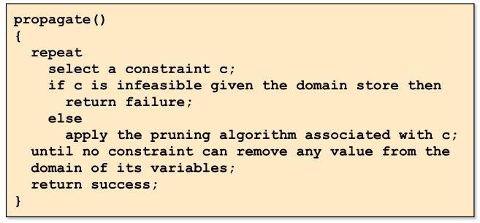
Computational paradigm
Propagation engine
the core of any constraint programming solver
a simple iterative algorithm to reach a stable state

Slide 28
8-queen problem
Task: place 8 queens on the chess board such that they do not attack each other
Many ways to model
Associate a decision variable with each column
the variable denotes the row of the queen in that column
no two queens can be placed on the same column
What are the constraints?
the queens cannot be placed on the same
row
upward diagonal
downward diagonal

Slide 29
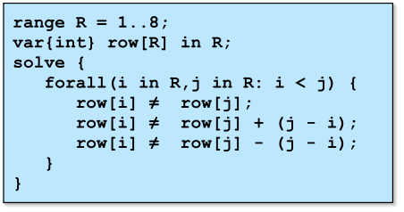
8-queen problem
Task: place 8 queens on the chess board such that they do not attack each other
Constraints: the queens cannot be placed on the same
row
upward diagonal
downward diagonal

Slide 30
Computational paradigm
Consider two variables X and Y
Domains: D(X) = {0,1,2}, D(Y) = {1,2,3}
Consider constraint X ≠ Y
Feasibility checking:
|D(X) ∪ D(Y)| ≥ 2
|{0,1,2,3}| ≥ 2
4 ≥ 2
Pruning?
when variables take only one value
If D(X) = {1}
Then D(Y) := D(Y) \ {1}

Slide 31
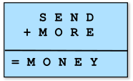
More constraints: Send More Money
Task: assign different digits to letters to satisfy the addition
What are the decision variables?
there is a variable for each letter to denote the value

Slide 32
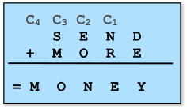
Send More Money
Task: assign different digits to letters to satisfy the addition
What are the decision variables?
there is a variable for each letter to denote the value
there is a variable for each carry

Slide 33
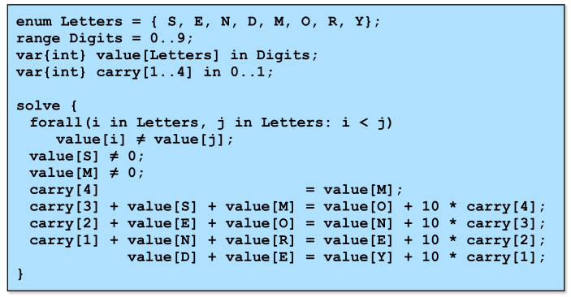
Send More Money
Task: assign different digits to letters to satisfy the addition
Constraints?

Slide 34
Send More Money
Task: assign different digits to letters to satisfy the addition
Search space?
 | 0 | 1 | 2 | 3 | 4 | 5 | 6 | 7 | 8 | 9
S
E
N
D
M
O
R
Y
C₄
C₃
C₂
C₁

Slide 35
Send More Money
Task: assign different digits to letters to satisfy the addition
value[S] ≠ 0
value[M] ≠ 0
carry[4] = value[M]
 | 0 | 1 | 2 | 3 | 4 | 5 | 6 | 7 | 8 | 9
S
E
N
D
M
O
R
Y
C₄
C₃
C₂
C₁

Slide 36
Send More Money
Task: assign different digits to letters to satisfy the addition
value[S] ≠ 0
value[M] ≠ 0
carry[4] = value[M]
 | 0 | 1 | 2 | 3 | 4 | 5 | 6 | 7 | 8 | 9
S
E
N
D
M
O
R
Y
C₄
C₃
C₂
C₁

Slide 37
Send More Money
Task: assign different digits to letters to satisfy the addition
value[S] ≠ 0
value[M] ≠ 0
carry[4] = value[M]
 | 0 | 1 | 2 | 3 | 4 | 5 | 6 | 7 | 8 | 9
S
E
N
D
M
O
R
Y
C₄
C₃
C₂
C₁

Slide 38
Send More Money
Task: assign different digits to letters to satisfy the addition
value[S] ≠ 0
value[M] ≠ 0
carry[4] = value[M]
 | 0 | 1 | 2 | 3 | 4 | 5 | 6 | 7 | 8 | 9
S
E
N
D
M
O
R
Y
C₄
C₃
C₂
C₁

Slide 39
Send More Money
Task: assign different digits to letters to satisfy the addition
value[S] ≠ 0
value[M] ≠ 0
carry[4] = value[M]
 | 0 | 1 | 2 | 3 | 4 | 5 | 6 | 7 | 8 | 9
S
E
N
D
M
O
R
Y
C₄
C₃
C₂
C₁

Slide 40
Send More Money
Task: assign different digits to letters to satisfy the addition
value[i] ≠ value[j]
 | 0 | 1 | 2 | 3 | 4 | 5 | 6 | 7 | 8 | 9
S
E
N
D
M
O
R
Y
C₄
C₃
C₂
C₁

Slide 41
Send More Money
Task: assign different digits to letters to satisfy the addition
value[i] ≠ value[j]
 | 0 | 1 | 2 | 3 | 4 | 5 | 6 | 7 | 8 | 9
S
E
N
D
M
O
R
Y
C₄
C₃
C₂
C₁

Slide 42
Send More Money
Task: assign different digits to letters to satisfy the addition
carry[3]+value[S]+value[M]=
=value[O]+10*carry[4]
 | 0 | 1 | 2 | 3 | 4 | 5 | 6 | 7 | 8 | 9
S
E
N
D
M
O
R
Y
C₄
C₃
C₂
C₁

Slide 43
Send More Money
Task: assign different digits to letters to satisfy the addition
carry[3]+value[S]+1=
=value[O]+10*1
 | 0 | 1 | 2 | 3 | 4 | 5 | 6 | 7 | 8 | 9
S
E
N
D
M
O
R
Y
C₄
C₃
C₂
C₁

Slide 44
Send More Money
Task: assign different digits to letters to satisfy the addition
carry[3]+value[S]+1=
=value[O]+10*1
lhs ∈ [3, …, 11]
rhs ∈ [10, …, 19]
=> lhs = rhs ∈ [10, 11]
 | 0 | 1 | 2 | 3 | 4 | 5 | 6 | 7 | 8 | 9
S
E
N
D
M
O
R
Y
C₄
C₃
C₂
C₁

Slide 45
Send More Money
Task: assign different digits to letters to satisfy the addition
carry[3]+value[S]+1=
=value[O]+10 ∈ [10, 11]
=>
9 ≤ carry[3]+value[S] ≤ 10
=>
8 ≤ value[S] ≤ 10
 | 0 | 1 | 2 | 3 | 4 | 5 | 6 | 7 | 8 | 9
S
E
N
D
M
O
R
Y
C₄
C₃
C₂
C₁

Slide 46
Send More Money
Task: assign different digits to letters to satisfy the addition
carry[3]+value[S]+1=
=value[O]+10 ∈ [10, 11]
=>
9 ≤ carry[3]+value[S] ≤ 10
=>
8 ≤ value[S] ≤ 10
 | 0 | 1 | 2 | 3 | 4 | 5 | 6 | 7 | 8 | 9
S
E
N
D
M
O
R
Y
C₄
C₃
C₂
C₁

Slide 47
Send More Money
Task: assign different digits to letters to satisfy the addition
carry[3] + value[S] + 1
= value[O] + 10 *carry[4]
rhs ∈ [10, 19]
lhs ∈ [8, 11]
=>
rhs = lhs ∈ [10, 11]
 | 0 | 1 | 2 | 3 | 4 | 5 | 6 | 7 | 8 | 9
S
E
N
D
M
O
R
Y
C₄
C₃
C₂
C₁

Slide 48
Send More Money
Task: assign different digits to letters to satisfy the addition
value[O] ∈ [0, 1]
=>
value[O] = 0
 | 0 | 1 | 2 | 3 | 4 | 5 | 6 | 7 | 8 | 9
S
E
N
D
M
O
R
Y
C₄
C₃
C₂
C₁

Slide 49
Send More Money
Task: assign different digits to letters to satisfy the addition
value[i] ≠ value[j]
 | 0 | 1 | 2 | 3 | 4 | 5 | 6 | 7 | 8 | 9
S
E
N
D
M
O
R
Y
C₄
C₃
C₂
C₁

Slide 50
Send More Money
Task: assign different digits to letters to satisfy the addition
value[i] ≠ value[j]
 | 0 | 1 | 2 | 3 | 4 | 5 | 6 | 7 | 8 | 9
S
E
N
D
M
O
R
Y
C₄
C₃
C₂
C₁

Slide 51
Send More Money
Task: assign different digits to letters to satisfy the addition
carry[2]+value[E]+value[O]
=value[N]+10*carry[3]
 | 0 | 1 | 2 | 3 | 4 | 5 | 6 | 7 | 8 | 9
S
E
N
D
M
O
R
Y
C₄
C₃
C₂
C₁

Slide 52
Send More Money
Task: assign different digits to letters to satisfy the addition
carry[2]+value[E]
=value[N]+10*carry[3]
lhs ∈ [2, 10]
=>
carry[3] = 0
 | 0 | 1 | 2 | 3 | 4 | 5 | 6 | 7 | 8 | 9
S
E
N
D
M
O
R
Y
C₄
C₃
C₂
C₁

Slide 53
Send More Money
Task: assign different digits to letters to satisfy the addition
carry[2]+value[E]
=value[N]+10*carry[3]
lhs ∈ [2, 10]
=>
carry[3] = 0
 | 0 | 1 | 2 | 3 | 4 | 5 | 6 | 7 | 8 | 9
S
E
N
D
M
O
R
Y
C₄
C₃
C₂
C₁

Slide 54
Send More Money
Task: assign different digits to letters to satisfy the addition
carry[3]+value[S]+value[M]
=value[O]+10*carry[4]
=>
value[S] = 9
 | 0 | 1 | 2 | 3 | 4 | 5 | 6 | 7 | 8 | 9
S
E
N
D
M
O
R
Y
C₄
C₃
C₂
C₁

Slide 55
Send More Money
Task: assign different digits to letters to satisfy the addition
carry[3]+value[S]+value[M]
=value[O]+10*carry[4]
=>
value[S] = 9
value[i] ≠ value[j]
 | 0 | 1 | 2 | 3 | 4 | 5 | 6 | 7 | 8 | 9
S
E
N
D
M
O
R
Y
C₄
C₃
C₂
C₁

Slide 56
Linear constraints over integers
Consider a constraint
a₁ x₁ + … + a_{n} x_{n} ≥ b₁ y₁ + … + b_{m} y_{m}
a_{i}, b_{j} ≥ are constants
x_{i}, y_{j} are variables with domains D(x_{i}), D(y_{j})
Feasibility test:
a₁ max(D(x₁)) + … + a_{n} max(D(x_{n})) ≥ b₁ min(D(y₁)) + … + b_{m} min(D(y_{m}))
Pruning:
a_{i} x_{i} ≥ B – ( A – a_{i} max(D(x_{i})) )
b_{j} y_{j} ≤ A – ( B – b_{j} max(D(y_{j})) )

Slide 57
Symmetry breaking
Many problems naturally exhibit symmetries
Exploring symmetrical parts of the search space is useless
Many kinds of symmetries
Variable symmetries
Value symmetries
Symmetry breaking constraints

Slide 58
Symmetry breaking: variable symmetries
Balanced Incomplete Block Designs (BIBDs)
Input: (v, b, r, k, l)
Output: v × b matrix of 0/1 with exactly r ones per row, k ones per column, and a scalar product of rows is l
Why BIBDs?
Example of combinatorial design
Full of variable symmetries
(3, 3, 2, 2, 1)
1 | 1 | 0
0 | 1 | 1
1 | 0 | 1

Slide 59
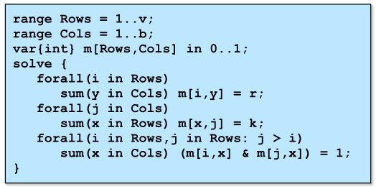
Symmetry breaking: BIBDs
Balanced Incomplete Block Designs (BIBDs)
Input: (v, b, r, k, l)
Output: v × b matrix of 0/1 with exactly r ones per row, k ones per column, and a scalar product of rows is l
(3, 3, 2, 2, 1)
1 | 1 | 0
0 | 1 | 1
1 | 0 | 1

Slide 60
Symmetry breaking: BIBDs
(7, 7, 3, 3, 1)
Swapping rows
0 | 1 | 1 | 0 | 0 | 1 | 0
1 | 0 | 1 | 0 | 1 | 0 | 0
0 | 0 | 1 | 1 | 0 | 0 | 1
1 | 1 | 0 | 0 | 0 | 0 | 1
0 | 0 | 0 | 0 | 1 | 1 | 1
1 | 0 | 0 | 1 | 0 | 1 | 0
0 | 1 | 0 | 1 | 1 | 0 | 0
1 | 0 | 1 | 0 | 1 | 0 | 0
0 | 1 | 1 | 0 | 0 | 1 | 0
0 | 0 | 1 | 1 | 0 | 0 | 1
1 | 1 | 0 | 0 | 0 | 0 | 1
0 | 0 | 0 | 0 | 1 | 1 | 1
1 | 0 | 0 | 1 | 0 | 1 | 0
0 | 1 | 0 | 1 | 1 | 0 | 0

Slide 61
Symmetry breaking: BIBDs
(7, 7, 3, 3, 1)
Swapping columns
0 | 1 | 1 | 0 | 0 | 1 | 0
1 | 0 | 1 | 0 | 1 | 0 | 0
0 | 0 | 1 | 1 | 0 | 0 | 1
1 | 1 | 0 | 0 | 0 | 0 | 1
0 | 0 | 0 | 0 | 1 | 1 | 1
1 | 0 | 0 | 1 | 0 | 1 | 0
0 | 1 | 0 | 1 | 1 | 0 | 0
0 | 1 | 1 | 0 | 0 | 1 | 0
1 | 0 | 1 | 0 | 1 | 0 | 0
0 | 0 | 1 | 1 | 0 | 0 | 1
1 | 0 | 0 | 0 | 0 | 1 | 1
0 | 1 | 0 | 0 | 1 | 0 | 1
1 | 1 | 0 | 1 | 0 | 0 | 0
0 | 0 | 0 | 1 | 1 | 1 | 0

Slide 62
Symmetry breaking: BIBDS
How to break variable symmetries
Impose an ordering on the variables
Consider the row symmetries
Impose a lexicographic constraint
Lexicographic ordering
a : 0 1 1 0 0 1 0 1 1 1 0 0 1 0
b : 1 0 1 0 1 0 0 1 0 1 0 1 0 0
a ≤ b a ≥ b

Slide 63
Symmetry breaking: BIBDs
(7, 7, 3, 3, 1)
Lexicographic Ordering
0 | 1 | 1 | 0 | 0 | 1 | 0
1 | 0 | 1 | 0 | 1 | 0 | 0
0 | 0 | 1 | 1 | 0 | 0 | 1
1 | 1 | 0 | 0 | 0 | 0 | 1
0 | 0 | 0 | 0 | 1 | 1 | 1
1 | 0 | 0 | 1 | 0 | 1 | 0
0 | 1 | 0 | 1 | 1 | 0 | 0
0 | 0 | 0 | 0 | 1 | 1 | 1
0 | 0 | 1 | 1 | 0 | 0 | 1
0 | 1 | 0 | 1 | 1 | 0 | 0
0 | 1 | 1 | 0 | 0 | 1 | 0
1 | 0 | 0 | 1 | 0 | 1 | 0
1 | 0 | 1 | 0 | 1 | 0 | 0
1 | 1 | 0 | 0 | 0 | 0 | 1

Slide 64
Symmetry breaking: BIBDs
(7, 7, 3, 3, 1)
Break column symmetries
0 | 0 | 0 | 0 | 1 | 1 | 1
0 | 0 | 1 | 1 | 0 | 0 | 1
0 | 1 | 0 | 1 | 1 | 0 | 0
0 | 1 | 1 | 0 | 0 | 1 | 0
1 | 0 | 0 | 1 | 0 | 1 | 0
1 | 0 | 1 | 0 | 1 | 0 | 0
1 | 1 | 0 | 0 | 0 | 0 | 1
0 | 0 | 0 | 0 | 1 | 1 | 1
0 | 0 | 1 | 1 | 0 | 0 | 1
0 | 1 | 0 | 1 | 0 | 1 | 0
0 | 1 | 1 | 0 | 1 | 0 | 0
1 | 0 | 0 | 1 | 1 | 0 | 0
1 | 0 | 1 | 0 | 0 | 1 | 0
1 | 1 | 0 | 0 | 0 | 0 | 1

Slide 65
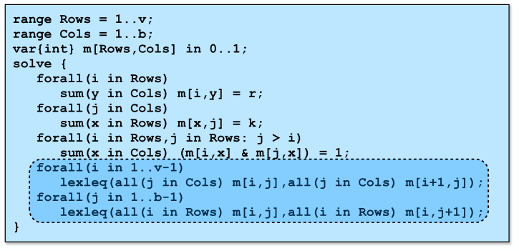
Symmetry breaking: BIBDs

Slide 66
Symmetry breaking: value symmetries
Scene allocation problem
Shooting scenes for a movie
an actor plays in some of the scenes
at most k scenes can be shot per day
each actor is paid by the day
scenes are different, actors are different
Objective
Minimize the total cost
Symmetries
What kind of symmetries do we have here?

Slide 67
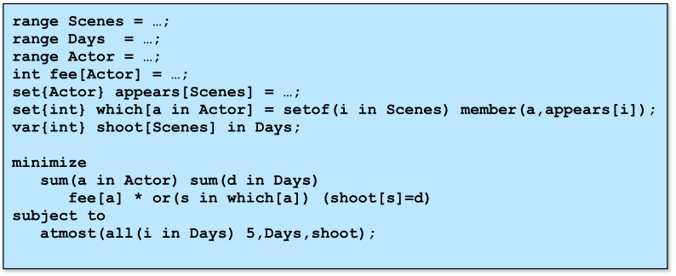
Symmetry breaking: scene allocation

Slide 68
Symmetry breaking: scene allocation
Value symmetries
the days are interchangeable
can swap all the scenes in day 1 and all the scenes in day 2 and still have a solution
if s is a solution, then p(s) is a solution where the days of s have been permuted by permutation p
How do we eliminate these symmetries?
Consider the scene 1. What are the days that we consider for this scene?
Only day 1 for scene 1.
Where do we schedule the second scene?
Day 1 or day 2.

Slide 69
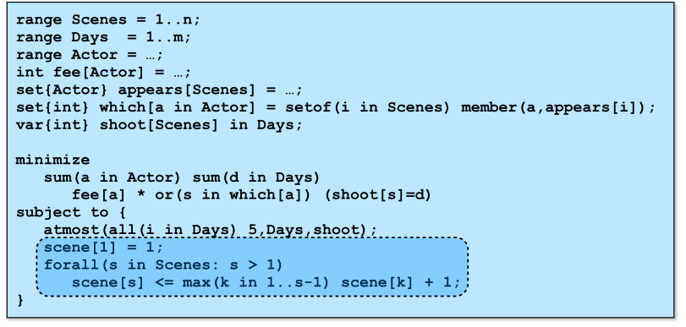
Symmetry breaking: scene allocation
How do we eliminate these symmetries?
Choose between the days already used and one new day.

Slide 70
Optimization in constraint programming?
Focus of constraint programming
Feasibility
How to optimize?
Solve a sequence of satisfaction problems
Find a solution
Impose a constraint that the new solution mush be better
Guaranteed to find an optimal solution
at least theoretically
Strong when the new constraint reduces the search space
Works well for scheduling problems

Slide 71
Redundant constraints
Motivation
Semantically redundant (do not exclude any solution)
Computationally significant (reduce the search space)
How do we find redundant constraints?
they express properties of the solutions not captures by the model
Critical aspect of constraint programming!

Slide 72
Redundant constraints: magic series
A series S = (S₀, …, S_{n}) is magic if S_{i} represents the number of occurrences of i in S
 | 0 | 1 | 2 | 3 | 4
Occurences | ? | ? | ? | ? | ?

Slide 73
Redundant constraints: magic series
A series S = (S₀, …, S_{n}) is magic if S_{i} represents the number of occurrences of i in S
How to find magic series?
 | 0 | 1 | 2 | 3 | 4
Occurences | 2 | 1 | 2 | 0 | 0

Slide 74
Redundant constraints: magic series
A series S = (S₀, …, S_{n}) is magic if S_{i} represents the number of occurrences of i in S
Redundant constraints:
The decision variables denote a number of occurrences
The number of occurrences is bounded
 | 0 | 1 | 2 | 3 | 4
Occurences | ? | ? | ? | ? | 17

Slide 75
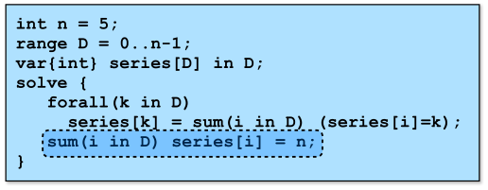
Redundant constraints: magic series
A series S = (S₀, …, S_{n}) is magic if S_{i} represents the number of occurrences of i in S

Slide 76
Redundant constraints: magic series
A series S = (S₀, …, S_{n}) is magic if S_{i} represents the number of occurrences of i in S
What does “series[2]=3” mean?
That there are three “2” in the array “series”
Constraint:
 | 0 | 1 | 2 | 3 | 4
Occurences | ? | ? | 3 | ? | ?

Slide 77
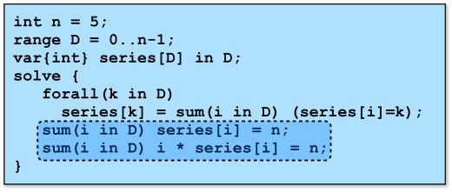
Redundant constraints: magic series
A series S = (S₀, …, S_{n}) is magic if S_{i} represents the number of occurrences of i in S

Slide 78
Redundant constraints: magic series
A series S = (S₀, …, S_{n}) is magic if S_{i} represents the number of occurrences of i in S
The redundant constraint implies:
series[4] ≤ 1
series[3] ≤ 1
series[2] ≤ 2
series[1] ≤ 5

Slide 79
Redundant constraints: magic series
A series S = (S₀, …, S_{n}) is magic if S_{i} represents the number of occurrences of i in S
Choice: assume that series[0] = 2
It follows that series[2] ≥ 1
series[1] + 3 series[3] + 4 series[4] ≤ 4
series[4] ≤ 0; series[3] ≤ 1

Slide 80
Redundant constraints
First role
express properties of the solutions
boost the propagation of other constraints
Second role
provide a more global view
combine existing constraints
improve communication

Slide 81
Global constraints
Critical feature of constraint programming
Capture combinatorial substructures arising in may applications
Modeling
Make modeling easier and more natural
Problem solving
Convey the problem structure to the solver that does not have to rediscover it
Give the ability to exploit dedicated algorithms

Slide 82
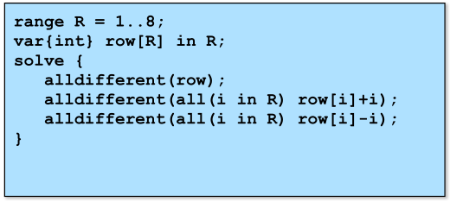
Global constraints: alldifferent
alldifferent(x₁,…,x_{n})
specifies that x₁,…,x_{n} take values that are different
8 queens:

Slide 83
Global constraints: all different
alldifferent(x₁,…,x_{n})
specifies that x₁,…,x_{n} take values that are different
Constraint c(x₁,…,x_{n}) where x₁ ∈ D₁=D(x₁), x_{n} ∈ D_{n}=D(x_{n})
Feasibility testing:
find values in the variable domains such that the constraint holds

Slide 84
Global constraints: all different
Example:
a constraint alldifferent(x₁, x₂, x₃)
x₁ ∈ {1, 2}, x₂ ∈ {1, 2}, x₃ ∈ {1, 2}
Is this feasible?
No, only two values for 3 variables
(pigeon hole principle)
Each of the local constraints
x₁≠x₂, x₂≠x₃, x₃≠x₁
can be satisfied

Slide 85
Global constraints: all different
alldifferent(x₁,…,x_{n})
specifies that x₁,…,x_{n} take values that are different
Constraint c(x₁,…,x_{n}) where x₁ ∈ D₁=D(x₁), x_{n} ∈ D_{n}=D(x_{n})
Pruning
given v_{i} in D_{i}, does there exist a solution such that x_{i}=v_{i}?
For each value search for the values of variables such that the constraint holds

Slide 86
Global constraints: alldifferent
Example:
a constraint alldifferent(x₁, x₂, x₃)
x₁ ∈ {1, 2}, x₂ ∈ {1, 2}, x₃ ∈ {1, 2, 3}
Pruning?
x₃≠1, x₃≠2 => D(x₃) = {3}
Local constraints x₁≠x₂, x₂≠x₃, x₃≠x₁ do not produce pruning

Slide 87
Global constraints
Global constraints deal with many variables at the same time
Global constraints make it possible to discover infeasibilities earlier
Global constraints make it possible to prune the search space more

Slide 88
Global constraints
Million-dollar question:
Can we detect feasibility and prune global constraints efficiently?
It depends on the constraints
Sometimes we can
Sometimes we need to relax standards
The pruning may be suboptimal
The pruning make take exponential time

Slide 89
Example: sudoku
 |  |  | 1 |  | 2 | 9
 |  |  |  | 9 |  | 3 |  | 1
 |  |  |  |  | 8 |  |  | 6
 |  |  |  | 3
 | 6 | 2
 | 7 | 9 |  | 1 | 6
 |  | 8 |  | 6 |  |  |  | 7
 |  | 4 |  |  |  | 1 | 9
 |  |  |  |  | 4 |  | 2

Slide 90
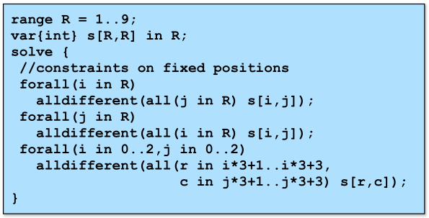
Example: sudoku

Slide 91
Example: sudoku
 |  |  | 1 |  | 2 | 9
 |  |  |  | 9 |  | 3 |  | 1
 |  |  |  |  | 8 |  |  | 6
 |  |  |  | 3
 | 6 | 2
 | 7 | 9 |  | 1 | 6
 |  | 8 |  | 6 |  |  |  | 7
 |  | 4 |  |  |  | 1 | 9
 |  |  |  |  | 4 |  | 2

Slide 92
Example: sudoku
 |  |  | 1 |  | 2 | 9
 |  |  |  | 9 |  | 3 |  | 1
 |  |  |  |  | 8 |  |  | 6
 |  |  |  | 3
 | 6 | 2
 | 7 | 9 |  | 1 | 6
 |  | 8 |  | 6 |  |  |  | 7
 |  | 4 |  | 2 |  | 1 | 9
 |  |  |  |  | 4 |  | 2

Slide 93
Example: sudoku
8 | 3 | 6 | 1 |  | 2 | 9 |  | 4
2 | 4 |  | 6 | 9 |  | 3 | 8 | 1
 | 9 |  | 3 | 4 | 8 | 2 |  | 6
 | 8 |  |  | 3 |  |  | 6
 | 6 | 2 |  |  |  |  | 1
 | 7 | 9 |  | 1 | 6 |  | 4
9 | 2 | 8 | 5 | 6 | 1 | 4 | 3 | 7
6 | 5 | 4 | 7 | 2 | 3 | 1 | 9 | 8
7 | 1 | 3 | 9 | 8 | 4 |  | 2 | 5

Slide 94
Example: sudoku
8 | 3 | 6 | 1 | 5 | 2 | 9 |  | 4
2 | 4 |  | 6 | 9 |  | 3 | 8 | 1
 | 9 |  | 3 | 4 | 8 | 2 |  | 6
 | 8 |  |  | 3 |  |  | 6
 | 6 | 2 |  |  |  |  | 1
 | 7 | 9 |  | 1 | 6 |  | 4
9 | 2 | 8 | 5 | 6 | 1 | 4 | 3 | 7
6 | 5 | 4 | 7 | 2 | 3 | 1 | 9 | 8
7 | 1 | 3 | 9 | 8 | 4 |  | 2 | 5

Slide 95
Example: sudoku
8 | 3 | 6 | 1 | 5 | 2 | 9 | 7 | 4
2 | 4 | 5 | 6 | 9 | 7 | 3 | 8 | 1
1 | 9 | 7 | 3 | 4 | 8 | 2 | 5 | 6
 | 8 | 1 |  | 3 |  | 7 | 6
 | 6 | 2 |  | 7 |  |  | 1
 | 7 | 9 |  | 1 | 6 |  | 4
9 | 2 | 8 | 5 | 6 | 1 | 4 | 3 | 7
6 | 5 | 4 | 7 | 2 | 3 | 1 | 9 | 8
7 | 1 | 3 | 9 | 8 | 4 | 6 | 2 | 5

Slide 96
Example: sudoku
8 | 3 | 6 | 1 | 5 | 2 | 9 | 7 | 4
2 | 4 | 5 | 6 | 9 | 7 | 3 | 8 | 1
1 | 9 | 7 | 3 | 4 | 8 | 2 | 5 | 6
4 | 8 | 1 |  | 3 |  | 7 | 6
 | 6 | 2 |  | 7 |  |  | 1
 | 7 | 9 |  | 1 | 6 |  | 4
9 | 2 | 8 | 5 | 6 | 1 | 4 | 3 | 7
6 | 5 | 4 | 7 | 2 | 3 | 1 | 9 | 8
7 | 1 | 3 | 9 | 8 | 4 | 6 | 2 | 5

Slide 97
Example: sudoku
8 | 3 | 6 | 1 | 5 | 2 | 9 | 7 | 4
2 | 4 | 5 | 6 | 9 | 7 | 3 | 8 | 1
1 | 9 | 7 | 3 | 4 | 8 | 2 | 5 | 6
4 | 8 | 1 | 2 | 3 | 5 | 7 | 6 | 9
5 | 6 | 2 | 4 | 7 | 9 | 8 | 1 | 3
3 | 7 | 9 | 8 | 1 | 6 | 5 | 4 | 2
9 | 2 | 8 | 5 | 6 | 1 | 4 | 3 | 7
6 | 5 | 4 | 7 | 2 | 3 | 1 | 9 | 8
7 | 1 | 3 | 9 | 8 | 4 | 6 | 2 | 5

Slide 98
Global constraints: table constraints
The simplest global constraint
Example: X ∈{1, 2}, Y ∈{1, 2}, Z ∈{3, 4, 5}
Total possibilities: |{1,2}| × |{1, 2}| × |{3, 4, 5}| = 12
Table constraint | X | Y | Z
Combination 1 | 1 | 1 | 5
Combination 2 | 1 | 2 | 4
Combination 3 | 2 | 2 | 3
Combination 4 | 1 | 2 | 3

Slide 99
Global constraints: table constraints
The simplest global constraint
Example: X ∈{1, 2}, Y ∈{1, 2}, Z ∈{3, 4, 5}
Total possibilities: |{1,2}| × |{1, 2}| × |{3, 4, 5}| = 12
Table constraint | X | Y | Z
Combination 1 | 1 | 1 | 5
Combination 2 | 1 | 2 | 4
Combination 3 | 2 | 2 | 3
Combination 4 | 1 | 2 | 3
Given Z ≠ 5
=>
Y = 2

Slide 100
How to implement global constraints?
Two types of global constraints:
knapsack
alldifferent
Significant area of research:
over 100 global constraints proposed so far

Slide 101
The Gold Standard for Pruning
After pruning
if value v is in the domain of variable x, then there exists a solution to the constraint with value v assigned to variable x
Optimal pruning
cannot prune more if only domains are considered
Complexity
in general, can’t be enforced in polynomial time

Slide 102
Binary knapsack
The constraint
Example
Feasibility
Can we find a solution satisfying the constraint?
Pruning
Can we eliminate values from the domains?

Slide 103
Binary knapsack
The constraint
Feasibility
Use dynamic programming (pseudo-polynomial)
Pruning
Exploit the dynamic programming table to prune the search
Forward phase (keep dependency links)
Backward phase (update dependency links to keep only feasible values)
Combine feasibility with pruning

Slide 104
Binary knapsack: forward phase
The constraint
x₁
x₂
x₃
x₄
w
12
11
10
9
8
7
6
5
4
3
2
1
0

Slide 105
Binary knapsack: forward phase
The constraint
x₁
x₂
x₃
x₄
w
12
11
10
9
8
7
6
5
4
3
2
1
0

Slide 106
Binary knapsack: forward phase
The constraint
x₁
x₂
x₃
x₄
w
12
11
10
9
8
7
6
5
4
3
2
1
0

Slide 107
Binary knapsack: forward phase
The constraint
x₁
x₂
x₃
x₄
w
12
11
10
9
8
7
6
5
4
3
2
1
0

Slide 108
Binary knapsack: forward phase
The constraint
x₁
x₂
x₃
x₄
w
12
11
10
9
8
7
6
5
4
3
2
1
0

Slide 109
Binary knapsack: backward phase
The constraint
x₁
x₂
x₃
x₄
w
12
11
10
9
8
7
6
5
4
3
2
1
0

Slide 110
Binary knapsack: backward phase
The constraint
x₁
x₂
x₃
x₄
w
12
11
10
9
8
7
6
5
4
3
2
1
0

Slide 111
Binary knapsack: backward phase
The constraint
x₁
x₂
x₃
x₄
w
12
11
10
9
8
7
6
5
4
3
2
1
0

Slide 112
Binary knapsack: backward phase
The constraint
x₁
x₂
x₃
x₄
w
12
11
10
9
8
7
6
5
4
3
2
1
0

Slide 113
Binary knapsack: backward phase
The constraint
x₄=1
x₁
x₂
x₃
x₄
w
12
11
10
9
8
7
6
5
4
3
2
1
0

Slide 114
Alldifferent constraint
The constraint
Alldifferent(x₁, …, x_{n})
Feasibility
can we find values in the domains of the variables so that each two variables are assigned a different value?
Pruning
are there values in the domain of a variable that the variable cannot take, i.e., if the variable takes that value, then there is no solution.

Slide 115
Alldifferent representation
x₁
∈ {1, 2}
If all the variables take different values can x₄ take the value 2?
x₂
∈ {2, 3}
x₃
∈ {1, 3}
x₄
∈ {2, 4}
x₅
∈ {3, 4, 5, 6}
x₆
∈ {6, 7}

Slide 116
Alldifferent representation
x₁
1
Can x₄ take the value 2?
∈ {1, 2}
x₂
∈ {2, 3}
2
x₃
3
∈ {1, 3}
x₄
4
∈ {2, 4}
x₅
5
∈ {3, 4, 5, 6}
x₆
6
∈ {6, 7}
7

Slide 117
Alldifferent feasibility
x₁
1
x₂
2
x₃
3
x₄
4
x₅
5
x₆
6
7

Slide 118
Alldifferent feasibility
x₁
1
Created a bipartite graph
nodes for variables
nodes for values
edges between variables and values
x₂
2
x₃
3
x₄
4
x₅
5
x₆
6
7

Slide 119
Alldifferent and matching
A matching for a graph G=(V,E) is a set of edges in E such that no two edges in E share a vertex.
A maximum matching M for a graph G is a matching with the largest number of edges.
Feasibility
finding a maximum matching in a bipartite graph.
if the maximum matching has a size equal to the number of variables, then the constraint is feasible; otherwise, it is not feasible

Slide 120
Alldifferent feasibility
x₁
1
Feasible constraint
x₂
2
x₃
3
x₄
4
x₅
5
x₆
6
7

Slide 121
Alldifferent feasibility
x₁
1
Not feasible constraint
x₂
2
x₃
3
x₄
4
x₅
5
x₆
6
7

Slide 122
Alldifferent and matching
How to find a maximum matching?
Start with any matching
Improve the matching
When no improvement is possible
We have a maximum matching

Slide 123
Maximum matching
How to find a maximum matching?
Start with any matching
Improve the matching
How to find an improvement?
Start from a free vertex x
If there us an edge (x,v) where v is not matched, then insert (x,v) in the matching
Otherwise, take a vertex v matched to y.
remove (y, v) and add (x,v) from the matching and restart at step 2 with y instead of x

Slide 124
Maximum matching
x₁
1
Start with a matching
x₂
2
x₃
3
x₄
4
x₅
5
x₆
6
7

Slide 125
Maximum matching
x₁
1
Start with a matching
Select x₂ and 2
x₂
2
x₃
3
x₄
4
x₅
5
x₆
6
7

Slide 126
Maximum matching
x₁
1
Start with a matching
Select x₂ and 2
Remove edge x₄ – 2
Start again with x₄
x₂
2
x₃
3
x₄
4
x₅
5
x₆
6
7

Slide 127
Maximum matching
x₁
1
Start with a matching
Select x₂ and 2
Remove edge x₄ – 2
Start again with x₄
Add x₄ - 4
x₂
2
x₃
3
x₄
4
x₅
5
x₆
6
7

Slide 128
Alternating path
An alternating path P for a matching M is a path from a vertex x in X to a vertex v in V (both of which are free) such that the edges in the path are alternatively in E\M and M
Alternating path has odd number of edges
Alternating path improves a matching

Slide 129
Finding an alternating path
Create a directed graph
Edges in the matching are oriented from right to left
Edges not in the matching are oriented from left to right
An alternating path is thus a path starting from a free vertex x and ending in another free vertex v
Find such a path with Depth-First Search
Complexity O(|V| + |E|) where V is the set of vertices and E is the set of edges

Slide 130
Maximum matching
x₁
1
Directed graph
x₂
2
x₃
3
x₄
4
x₅
5
x₆
6
7

Slide 131
Maximum matching
x₁
1
Directed graph
An alternating path
Change the direction
x₂
2
x₃
3
x₄
4
x₅
5
x₆
6
7

Slide 132
Maximum matching
x₁
1
Directed graph
An alternating path
Change the direction
Repeat
x₂
2
x₃
3
x₄
4
x₅
5
x₆
6
7

Slide 133
Maximum matching
x₁
1
Directed graph
An alternating path
Change the direction
Repeat
x₂
2
x₃
3
x₄
4
x₅
5
x₆
6
7

Slide 134
Maximum matching
x₁
1
Directed graph
An alternating path
Change the direction
Repeat
Maximum matching
x₂
2
x₃
3
x₄
4
x₅
5
x₆
6
7

Slide 135
Feasibility of the Alldifferent constraint
Use a bipartite graph
Vertex set for the variables
Vertex set for the values
Edge (x,v) if v is in D(x)
Feasibility
Alldifferent is feasible iff the size of the maximum matching equals the number of variables
Finding a maximum matching
Improve a matching using alternating paths in the directed graph obtained by the proper orientation of the edges

Slide 136
Alldifferent constraint: pruning
The constraint
Alldifferent(x₁, …, x_{n})
How to prune?
v must be removed from the domain of x if the edge (x, v) appears in no maximum matching
Only need to look at the edges not present in the maximum matching
Naïve approach
Force the edge (x,v) in the matching, i.e., remove all other edges (x,w)
Search for a maximum matching
If it is smaller than the number of vars,
v can be removed from D(x)

Slide 137
Alldifferent constraint: pruning
Basic property (Berge, 1970)
An edge belongs to some but not all maximum matchings iff, given a maximum matching M, it belongs to either
An even alternative path starting at a free vertex
An even alternating cycle
Note that
The edges not in the maximum matching do not belong to all maximum matchings
The above property tells us whether they belong to at least one maximum matching
The free vertices are the values

Slide 138
Alldifferent constraint: pruning
Create a directed graph like before but reverse the direction of the edges
Given a matching
Edges in the matching are oriented from left to right
Edges not in the matching are oriented from bottom to top

Slide 139
Maximum matching
x₁
1
x₂
2
x₃
3
x₄
4
x₅
5
x₆
6
7

Slide 140
Maximum matching
x₁
1
An even alternative path starting at a free vertex
x₂
2
x₃
3
x₄
4
x₅
5
x₆
6
7

Slide 141
Maximum matching
x₁
1
An even alternating cycle
x₂
2
x₃
3
x₄
4
x₅
5
x₆
6
7

Slide 142
Alldifferent constraint: pruning
Given a maximum matching M, create a directed graph like before but reverse the direction of edges
Search for even alternating path starting from a free label vertex: P
Search for all loops and collect all the edges belonging to them: C
Remove all edges belonging to M, P, C

Slide 143
Maximum matching
x₁
1
Edges that can be removed
x₂
2
x₃
3
x₄
4
x₅
5
x₆
6
7

Slide 144
Search in constraint programming

Slide 145
Computational paradigm
Search
Constraint Store
X = 5
Y ≠ 2
Success
Failure

Slide 146
Search in constraint programming
Key idea
Use feasibility information for branching
First-fail principle
Try first where you are the most likely to fail
Why first-fail principle?
Do not spend time doing easy stuff first and avoid redoing the difficult path
The ultimate goal
Creating small search trees

Slide 147
First-fail search in 8 queens
Hard position
only one option

Slide 148
Trial and error
When a constraint fails
that is, when adding a constraint to the constraint store returns a failure
The solver goes back to the last guess
and assigns a value that has not been tried before
If no such value is left, the system backtracks to an earlier guessing instruction

Slide 149
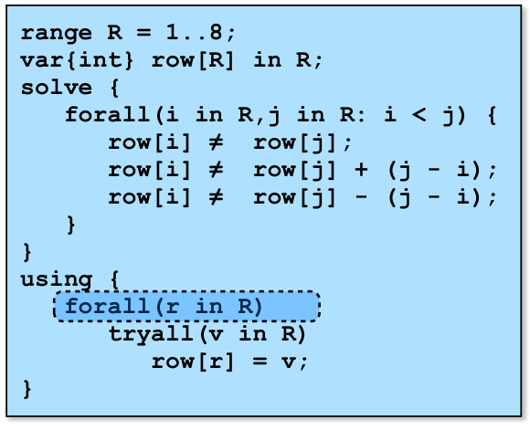
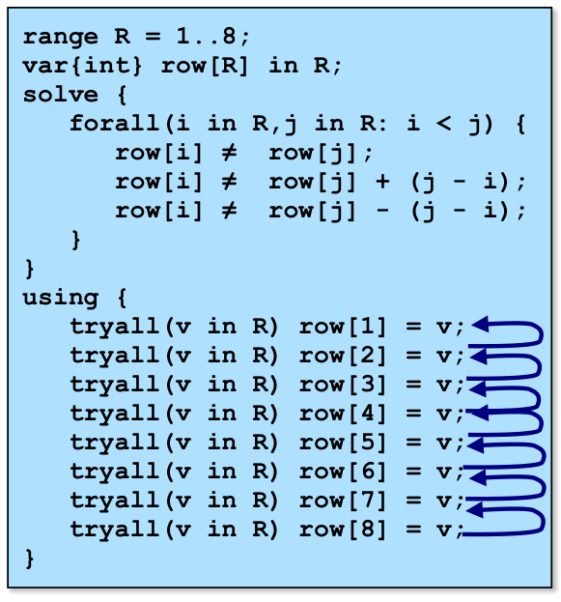
Trial and error

Slide 150
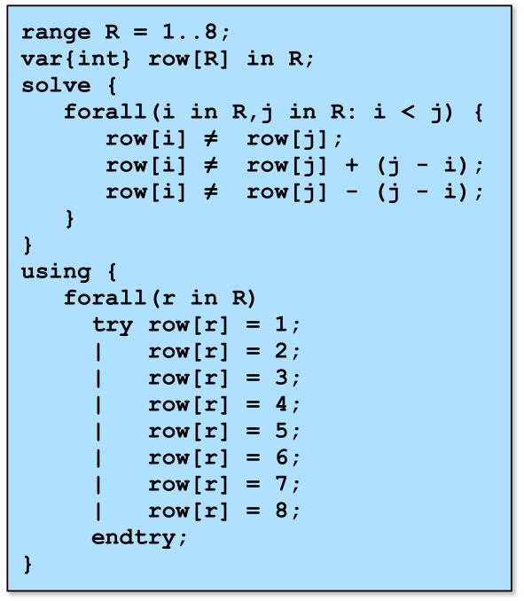
Trial and error

Slide 151
Search strategies
Active research area. Some approaches:
Variable/value labeling
Value/variable labeling
Symmetry breaking during search
Randomization and restarts
Domain splitting
Focusing on the objective
…
…
…

Slide 152
Variable/value labeling
Two steps
Choose the variable to assign next
Choose the value to assign
First-fail principle
Choose the variable with the smallest domain
The variable ordering is dynamic
Reconsider the selection after each choice

Slide 153
Variable/value labeling
Two steps
Choose the variable to assign next
Choose the value to assign
First-fail principle
Choose the variable to with the smallest domain
Choose the most constrained variable
Use a lexicographic criterion
First the domain size
Next the proximity to the middle of the board

Slide 154
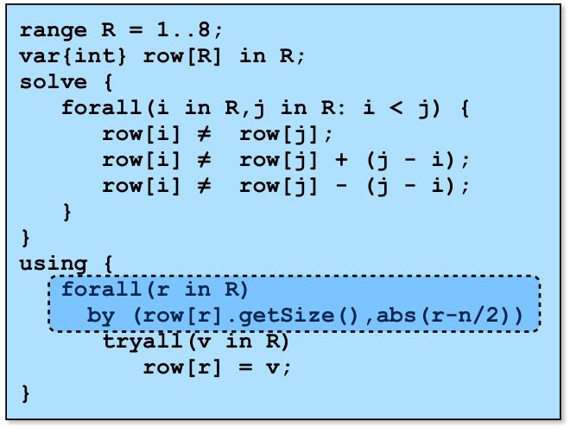
Variable/value labeling
Two steps
Choose the variable to assign next
Choose the value to assign

Slide 155
Variable/value labeling
Two steps
Choose the value to assign next
Choose the variable to assign to this value
Why it is useful?
You may know that a value must be assigned
Often the case in scheduling and resource allocation problems

Slide 156
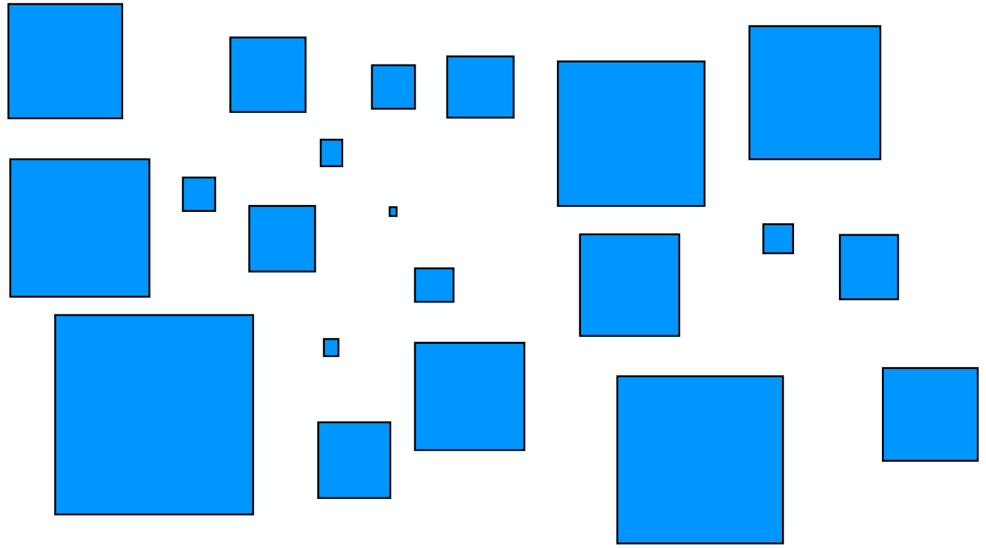
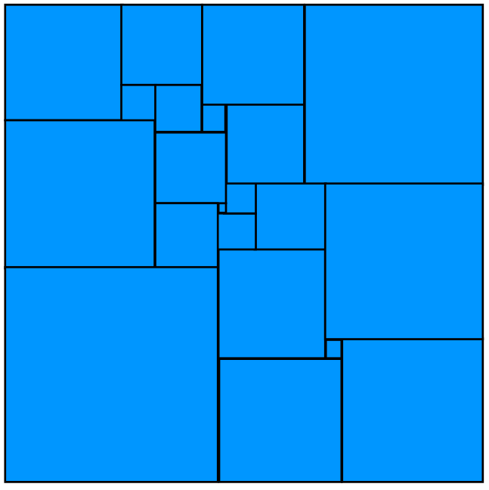
The perfect square problem
Task: arrange small squares into a big square

Slide 157
The perfect square problem
What are the decision variables?
x and y-coordinates of the bottom-left corner of every square
What are the constraints?
The squares fit in the larger square
The squares do not overlap

Slide 158
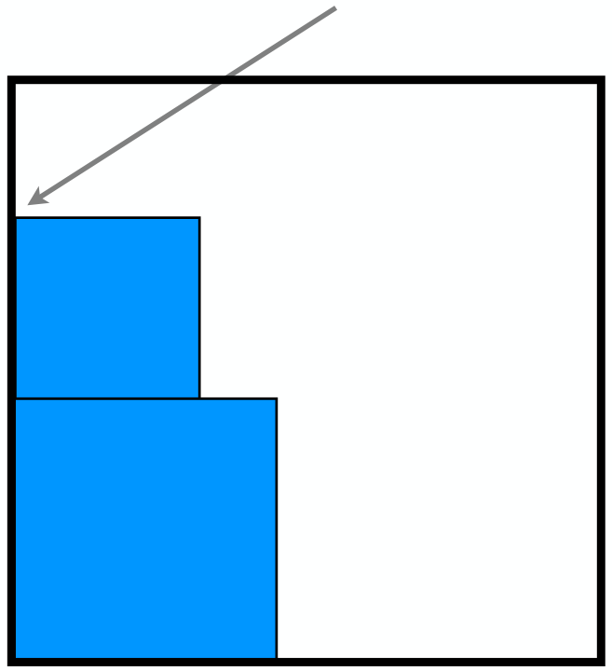
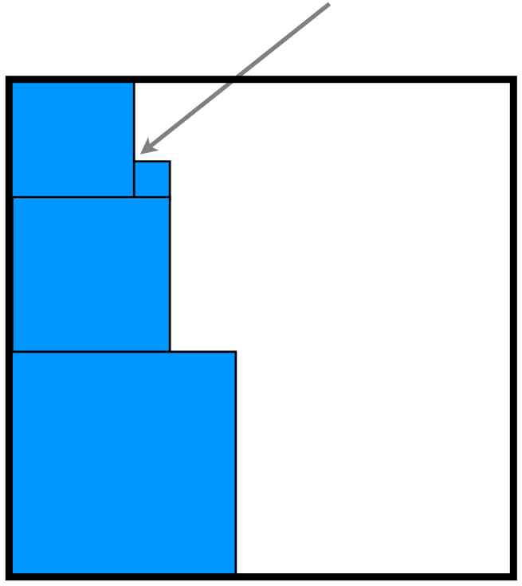
The value/variable labeling
Why a value/variable labeling
We know that there is no empty space in the square to be filled

Slide 159
The value/variable labeling
Why a value/variable labeling
We know that there is no empty space in the square to be filled
What is the labeling doing?
Choose a x-coordinate p
For all square i, decide whether to place i at coordinate p
That is, whether the bottom-left corner of i has x-coordinate p
Repeat for all x-coordinates
Repeat for all y-coordinates

Slide 160
Symmetry breaking during search
Scene allocation problem
Shooting scenes for a movie
an actor plays in some of the scenes
at most k scenes can be shot per day
each actor is paid by the day
scenes are different, actors are different
Objective
Minimize the total cost
Symmetries
What kind of symmetries do we have here?

Slide 161
Symmetry breaking: scene allocation
Value symmetries
the days are interchangeable
How do we eliminate these symmetries?
For each scene we consider only the used days and one new day
Side effect
Interferes with the search heuristics
Can we avoid this?
Symmetry-breaking during search
Dynamically impose the symmetry-breaking constraints
Same constraints, the order is different and discovered dynamically

Slide 162
Symmetry breaking: scene allocation
Choose a scene to shoot
Use good heuristics
First-fail
Expensive scene
Consider existing days + 1 new day
To label the scene
Advantages
Break symmetries
Does not interfere with the search heuristics

Slide 163
Randomization and restarts
Sometimes there is no obvious search ordering
But there exist some good ones
How to find them?
Brute force
Randomization and restarts
Key idea
Try a random ordering
If no solution is found after some limit, restart the search
and possibly increase the limit

