Slide 1
Discrete Optimization
MA2827
Fondements de l’optimisation discrète
Dynamic programming (Part 2)
https://project.inria.fr/2015ma2827/
Material based on the lectures of Erik Demaine at MIT and Pascal Van Hentenryck at Coursera

Slide 2
Outline
Dynamic programming
Guitar fingering
More dynamic programming
Tetris
Blackjack
Quiz: bracket sequences

Slide 3
Dynamic programming
DP ≈ “careful brute force”
DP ≈ recursion + memoization + guessing
Divide the problem into subproblems that are connected to the original problem
Graph of subproblems has to be acyclic (DAG)
Time = #subproblems · time/subproblem

Slide 4
5 easy steps of DP
Analysis:
#subproblems
#choices
time/subproblem
time
extra time
Define subproblems
Guess part of solution
Relate subproblems (recursion)
Recurse + memoize
OR build DP table bottom-up
- check subprobs be acyclic / topological order
Solve original problem

Slide 5
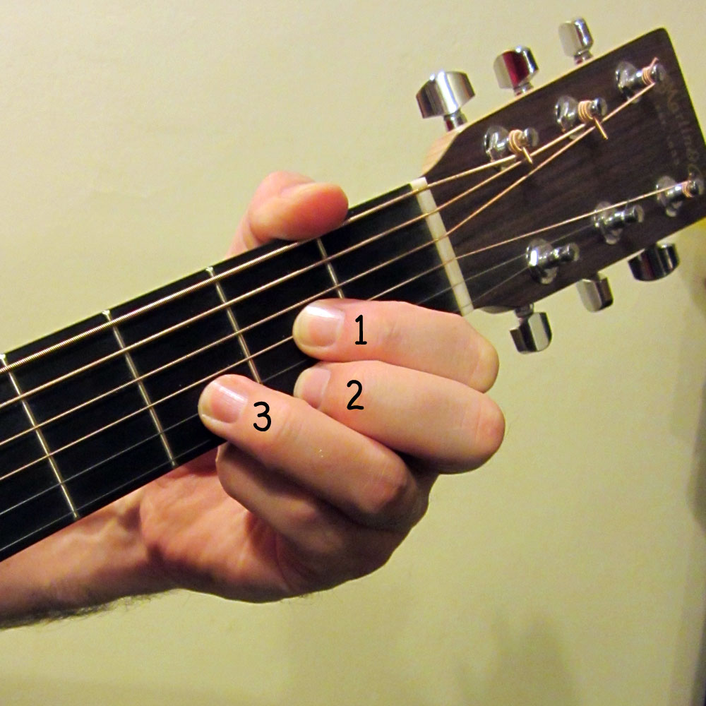
Guitar fingering
Task: find the best way to play a melody

Slide 6
Guitar fingering
Task: find the best way to play a melody
Input: sequence of notes to play with right hand
One note at a time!
Which finger to use? 1, 2, …, F = 5 for humans
Measure d( f, p, g, q ) of difficulty to go
from note p with finger f
to note q with finger g
Examples of rules:
crossing fingers: 1 < f < g and p > q => uncomfortable
stretching: p << q => uncomfortable
legato (smooth): ∞ if f = g

Slide 7
Guitar fingering
Task: find the best way to play a melody
Goal: minimize overall difficulty
Subproblems:
min. difficulty for suffix note[ i : ]
#subproblems = O( n ) where n = #notes
Guesses:
finger f for the first note[ i ]
#choices = F
Recurrence:
DP[ i ] = min{ DP[ i + 1 ] + d( note[ i ], f, note[ i +1 ], next finger ) }

Slide 8
Guitar fingering
Task: find the best way to play a melody
Goal: minimize overall difficulty
Subproblems:
min. difficulty for suffix note[ i : ]
#subproblems = O( n ) where n = #notes
Guesses:
finger f for the first note[ i ]
#choices = F
Recurrence:
DP[ i ] = min{ DP[ i + 1 ] + d( note[ i ], f, note[ i +1 ], next finger ) }
Not enough information!

Slide 9
Guitar fingering
Task: find the best way to play a melody
Goal: minimize overall difficulty
Subproblems:
min. difficulty for suffix note[ i : ] when finger f is on note[ i ]
#subproblems = O( n F )
Guesses:
finger f for the next note, note[ i + 1 ]
#choices = F
Recurrence:
DP[ i, f ] = min{ DP[ i + 1, g ] + d( note[ i ], f, note[ i +1 ], g ) | all g }
Base-case: DP[ n, f ] = 0
time/subproblem = O( F )

Slide 10
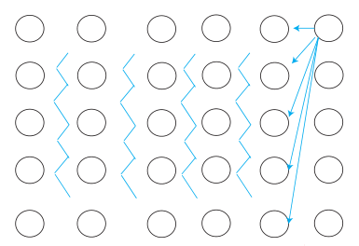
Guitar fingering
Task: find the best way to play a melody
Topological order:
for i = n-1, n-2, …, 0:
for f = 1, …, F:
total time = O( n F² )
Final problem:
find minimal DP[ 0, f ] for f = 1, …, F
guessing the first finger
notes
fingers

Slide 11
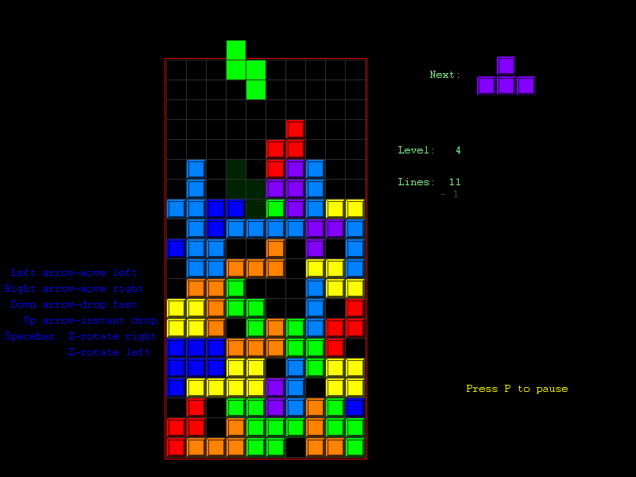
Tetris
Task: win in the game of Tetris!

Slide 12
Tetris
Task: win in the game of Tetris!
Input: a sequence of n Tetris pieces and an empty board of small width w
Choose orientation and position for each piece
Must drop piece till it hits something
Full rows do not clear
Goal: survive i.e., stay within height h

Slide 13
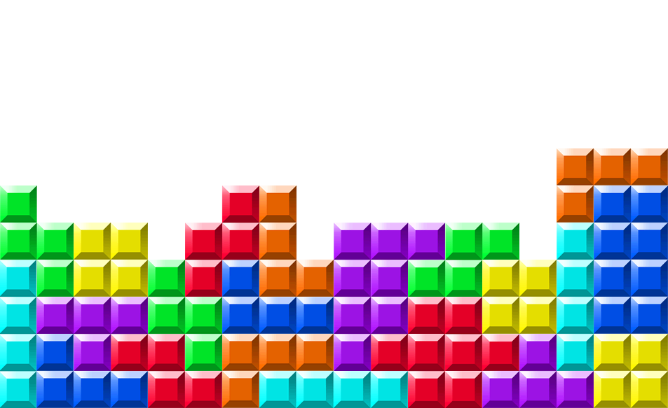
Tetris
Task: stay within height h
Subproblem:
survival? in suffix [ i : ]
given a particular column profile
#subproblems = O( n (h+1)^{w} )
Guesses:
where to drop piece i?
#choices = O( w )
Recurrence:
DP[ i, p ] = max { DP[ i + 1, q ] | q is a valid move from p }
Base-case: DP[ n+1, p ] = true for all profiles p
time/subproblem = O( w )

Slide 14
Tetris
Task: stay within height h
Topological order:
for i = n – 1, n – 2, …, 0:
for p = 0, …, (h+1)^{w} – 1:
total time O( n w (h+1)^{w} )
Final problem:
DP[ 0, empty ]
pieces
profiles

Slide 15
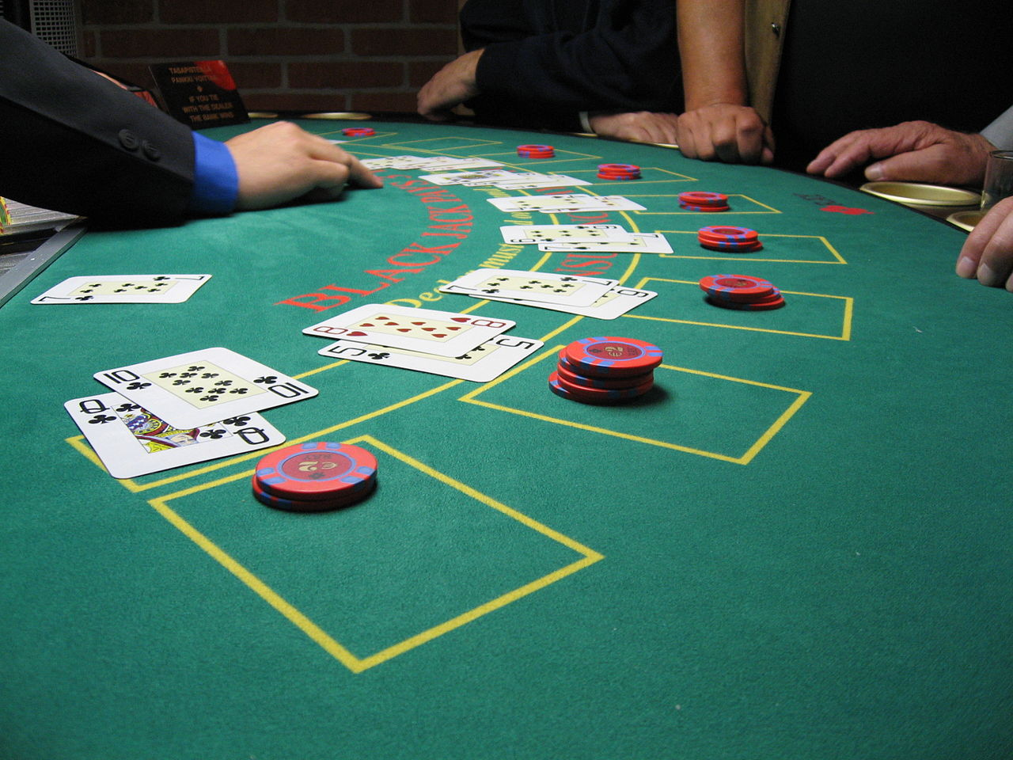
Blackjack
Task: beat the blackjack (twenty-one)!

Slide 16
Blackjack
Task: beat the blackjack!
Rules of Blackjack (simplified):
The player and the dealer are initially given 2 cards each
Each card gives points:
Cards 2-10 are valued at the face value of the card
Face cards (King, Queen, Jack) are valued at 10
The Ace card can be valued either at 11 or 1
The goal of the player is to get more points than the dealer, but less than 21, if more than 21 than he looses (busts)
Player can take any number of cards (hits)
After that the dealer hits deterministically: until ≥ 17 points

Slide 17
Perfect-information Blackjack
Task: beat the blackjack with a marked deck!
Input: a deck of cards c₀, …, c_{n-1}
Player vs. dealer one-on-one
Goal: maximize winning for a fixed bet $1
Might benefit from loosing to get a better deck

Slide 18
Quiz (as homework)
Write the DP for perfect-information blackjack
Derive the number of subproblems for the tetris problem

