Slide 1
Discrete Optimization
MA2827
Fondements de l’optimisation discrète
https://project.inria.fr/2015ma2827/
Material from M. Pawan Kumar, E. Demaine

Slide 2
Outline
Preliminaries
Random Access Machine (RAM)
Polynomial-time Algorithm
Decision Problems
P, NP, and NP-Complete Problems

Slide 3
Random Access Machine
Given an array f with elements = 0, 1 strings
RAM executes a set of instructions
Each instruction can
Read entries from prescribed positions
Perform arithmetic operation on read entries
Write answers to prescribed positions

Slide 4
Random Access Machine
Given an array f with elements = 0, 1 strings
Finite set of variables z₀, z₁, … , z_{k}
Initially, z_{i} = 0 and f contains input
Instructions numbered 0, 1, …, t
Variable z₀ stores the instruction to execute

Slide 5
Random Access Machine
Given an array f with elements = 0, 1 strings
Finite set of variables z₀, z₁, … , z_{k}
Initially, z_{i} = 0 and f contains input
Instructions numbered 0, 1, …, t
Stop if z₀ > t

Slide 6
Random Access Machine
Given an array f with elements = 0, 1 strings
Finite set of variables z₀, z₁, … , z_{k}
Initially, z_{i} = 0 and f contains input
Read instruction
z_{i} := f(z_{j})

Slide 7
Random Access Machine
Given an array f with elements = 0, 1 strings
Finite set of variables z₀, z₁, … , z_{k}
Initially, z_{i} = 0 and f contains input
Write instruction
f(z_{i}) := z_{j}

Slide 8
Random Access Machine
Given an array f with elements = 0, 1 strings
Finite set of variables z₀, z₁, … , z_{k}
Initially, z_{i} = 0 and f contains input
Add instruction
z_{i} := z_{j} + z_{k}

Slide 9
Random Access Machine
Given an array f with elements = 0, 1 strings
Finite set of variables z₀, z₁, … , z_{k}
Initially, z_{i} = 0 and f contains input
Subtract instruction
z_{i} := z_{j} - z_{k}

Slide 10
Random Access Machine
Given an array f with elements = 0, 1 strings
Finite set of variables z₀, z₁, … , z_{k}
Initially, z_{i} = 0 and f contains input
Multiply instruction
z_{i} := z_{j} z_{k}

Slide 11
Random Access Machine
Given an array f with elements = 0, 1 strings
Finite set of variables z₀, z₁, … , z_{k}
Initially, z_{i} = 0 and f contains input
Divide instruction
z_{i} := z_{j} / z_{k}

Slide 12
Random Access Machine
Given an array f with elements = 0, 1 strings
Finite set of variables z₀, z₁, … , z_{k}
Initially, z_{i} = 0 and f contains input
Increment instruction
z_{i} := z_{i} + 1

Slide 13
Random Access Machine
Given an array f with elements = 0, 1 strings
Finite set of variables z₀, z₁, … , z_{k}
Initially, z_{i} = 0 and f contains input
Binarize instruction
z_{i} := 1, if z_{i} > 0
z_{i} := 0, otherwise

Slide 14
Random Access Machine
z₁ = 0
z₂ := f(z₁)
z₁ := z₁+1
z₃ := f(z₁)
z₄ := z₂ + z₃
z₁ := z₁+1
f(z₁) := z₄
z₂ = 0
z₃ = 0
z₄ = 0
Array f
10 | 3 | 0

Slide 15
Random Access Machine
z₁ = 0
z₂ := f(z₁)
z₁ := z₁+1
z₃ := f(z₁)
z₄ := z₂ + z₃
z₁ := z₁+1
f(z₁) := z₄
z₂ = 10
z₃ = 0
z₄ = 0
Array f
10 | 3 | 0

Slide 16
Random Access Machine
z₁ = 0
z₂ := f(z₁)
z₁ := z₁+1
z₃ := f(z₁)
z₄ := z₂ + z₃
z₁ := z₁+1
f(z₁) := z₄
z₂ = 10
z₃ = 0
z₄ = 0
Array f
10 | 3 | 0

Slide 17
Random Access Machine
z₁ = 1
z₂ := f(z₁)
z₁ := z₁+1
z₃ := f(z₁)
z₄ := z₂ + z₃
z₁ := z₁+1
f(z₁) := z₄
z₂ = 10
z₃ = 0
z₄ = 0
Array f
10 | 3 | 0

Slide 18
Random Access Machine
z₁ = 1
z₂ := f(z₁)
z₁ := z₁+1
z₃ := f(z₁)
z₄ := z₂ + z₃
z₁ := z₁+1
f(z₁) := z₄
z₂ = 10
z₃ = 0
z₄ = 0
Array f
10 | 3 | 0

Slide 19
Random Access Machine
z₁ = 1
z₂ := f(z₁)
z₁ := z₁+1
z₃ := f(z₁)
z₄ := z₂ + z₃
z₁ := z₁+1
f(z₁) := z₄
z₂ = 10
z₃ = 3
z₄ = 0
Array f
10 | 3 | 0

Slide 20
Random Access Machine
z₁ = 1
z₂ := f(z₁)
z₁ := z₁+1
z₃ := f(z₁)
z₄ := z₂ + z₃
z₁ := z₁+1
f(z₁) := z₄
z₂ = 10
z₃ = 3
z₄ = 0
Array f
10 | 3 | 0

Slide 21
Random Access Machine
z₁ = 1
z₂ := f(z₁)
z₁ := z₁+1
z₃ := f(z₁)
z₄ := z₂ + z₃
z₁ := z₁+1
f(z₁) := z₄
z₂ = 10
z₃ = 3
z₄ = 13
Array f
10 | 3 | 0

Slide 22
Random Access Machine
z₁ = 1
z₂ := f(z₁)
z₁ := z₁+1
z₃ := f(z₁)
z₄ := z₂ + z₃
z₁ := z₁+1
f(z₁) := z₄
z₂ = 10
z₃ = 3
z₄ = 13
Array f
10 | 3 | 0

Slide 23
Random Access Machine
z₁ = 2
z₂ := f(z₁)
z₁ := z₁+1
z₃ := f(z₁)
z₄ := z₂ + z₃
z₁ := z₁+1
f(z₁) := z₄
z₂ = 10
z₃ = 3
z₄ = 13
Array f
10 | 3 | 0

Slide 24
Random Access Machine
z₁ = 2
z₂ := f(z₁)
z₁ := z₁+1
z₃ := f(z₁)
z₄ := z₂ + z₃
z₁ := z₁+1
f(z₁) := z₄
z₂ = 10
z₃ = 3
z₄ = 13
Array f
10 | 3 | 0

Slide 25
Random Access Machine
z₁ = 2
z₂ := f(z₁)
z₁ := z₁+1
z₃ := f(z₁)
z₄ := z₂ + z₃
z₁ := z₁+1
f(z₁) := z₄
z₂ = 10
z₃ = 3
z₄ = 13
Array f
10 | 3 | 13

Slide 26
Outline
Preliminaries
Random Access Machine (RAM)
Polynomial-time Algorithm
Decision Problems
P, NP, and NP-Complete Problems

Slide 27
Polynomial Time Algorithm
Input size = Number of bits b
Polynomial time algorithm
Number of instructions = t
t is bounded by a polynomial in b
Good algorithm
Efficient algorithm

Slide 28
Outline
Preliminaries
Random Access Machine (RAM)
Polynomial-time Algorithm
Decision Problems (Answered by ‘yes’ or ‘no’)
P, NP, and NP-Complete Problems
Reduction

Slide 29
Decision Problem
Finite set Σ called alphabet of size ≥ 2
{0,1}
{a,b,c,d,e,…,x,y,z}
Set Σ* of all finite length strings (called words)
0, 1, 00, 01, 10, 11, 000,….
discrete, optimization
Size of word size(w) = number of letters
size(00) = 2
size(discrete) = 8

Slide 30
Decision Problem
Problem Π is a subset of Σ*
All words with the answer “yes”
Informal problem
Given input word x ∈ Σ*, does x ∈ Π ?
Polynomial-time solvable problem Π
There exists a polynomial-time algorithm for the informal problem
Polynomial in size(x)

Slide 31
Shortest Path
v₀
v₀,v₁,v₂ … v_{n} ∈ Σ
3
5
v₁
v₃
{ ∈ Σ
} ∈ Σ
, ∈ Σ
4
5
1
0,1,2, … N ∈ Σ
v₂
v₄
6
{v₀,v₁,v₂,v₃,v₄,v₅},
{{v₀,v₁},{v₀,v₃},{v₁,v₂},{v₂,v₃},{v₂,v₄},{v₃,v₄}},
{3,5,5,4,6,1},
∈ Σ*
{v₀,v₃,v₄,v₂}

Slide 32
Shortest Path
v₀
v₀,v₁,v₂ … v_{n} ∈ Σ
3
5
v₁
v₃
{ ∈ Σ
} ∈ Σ
, ∈ Σ
4
5
1
0,1,2, … N ∈ Σ
v₂
v₄
6
{v₀,v₁,v₂,v₃,v₄,v₅},
{{v₀,v₁},{v₀,v₃},{v₁,v₂},{v₂,v₃},{v₂,v₄},{v₃,v₄}},
{3,5,5,4,6,1},
∈ Σ*
{v₀,v₃,v₂}

Slide 33
Shortest Path
v₀
v₀,v₁,v₂ … v_{n} ∈ Σ
3
5
v₁
v₃
{ ∈ Σ
} ∈ Σ
, ∈ Σ
4
5
1
0,1,2, … N ∈ Σ
v₂
v₄
6
{v₀,v₁,v₂,v₃,v₄,v₅},
{{v₀,v₁},{v₀,v₃},{v₁,v₂},{v₂,v₃},{v₂,v₄},{v₃,v₄}},
{3,5,5,4,6,1},
∈ Σ*
{v₀,v₁,v₂}

Slide 34
Shortest Path
v₀
v₀,v₁,v₂ … v_{n} ∈ Σ
3
5
v₁
v₃
{ ∈ Σ
} ∈ Σ
, ∈ Σ
4
5
1
0,1,2, … N ∈ Σ
v₂
v₄
6
{v₀,v₁,v₂,v₃,v₄,v₅},
{{v₀,v₁},{v₀,v₃},{v₁,v₂},{v₂,v₃},{v₂,v₄},{v₃,v₄}},
{3,5,5,4,6,1},
∈ Π
{v₀,v₁,v₂}

Slide 35
Shortest Path
v₀
v₀,v₁,v₂ … v_{n} ∈ Σ
3
5
v₁
v₃
{ ∈ Σ
} ∈ Σ
, ∈ Σ
4
5
1
0,1,2, … N ∈ Σ
v₂
v₄
6
Given graph G and path P, is P a shortest path in G?
{v₀,v₁,v₂,v₃,v₄,v₅},
{{v₀,v₁},{v₀,v₃},{v₁,v₂},{v₂,v₃},{v₂,v₄},{v₃,v₄}},
{3,5,5,4,6,1},
∈ Π
{v₀,v₃,v₄}

Slide 36
Hamiltonian Circuit
v₀
3
5
Circuit consisting of all vertices
5
v₁
v₃
4
5
1
v₂
v₄
6

Slide 37
Hamiltonian Graph
v₀
3
5
Has a Hamiltonian Circuit
5
v₁
v₃
4
✔
5
1
v₂
v₄
6

Slide 38
Hamiltonian Graph
v₀
5
Has a Hamiltonian Circuit
3
5
v₁
v₃
4
✖
5
1
v₂
v₄
6
Given graph G, is the graph Hamiltonian?

Slide 39
Hamiltonian Graph
v₀
v₀,v₁,v₂ … v_{n} ∈ Σ
5
3
5
v₁
v₃
{ ∈ Σ
} ∈ Σ
, ∈ Σ
4
5
1
0,1,2, … N ∈ Σ
v₂
v₄
6
{v₀,v₁,v₂,v₃,v₄,v₅},
{{v₀,v₃},{v₁,v₃},{v₂,v₁},{v₃,v₀},{v₃,v₄},{v₄,v₂}},
∈ Σ*

Slide 40
Hamiltonian Graph
v₀
v₀,v₁,v₂ … v_{n} ∈ Σ
3
5
5
v₁
v₃
{ ∈ Σ
} ∈ Σ
, ∈ Σ
4
5
1
0,1,2, … N ∈ Σ
v₂
v₄
6
{v₀,v₁,v₂,v₃,v₄,v₅},
{{v₀,v₃},{v₁,v₀},{v₂,v₁},{v₃,v₀},{v₃,v₄},{v₄,v₂}},
∈ Σ*

Slide 41
Hamiltonian Graph
v₀
v₀,v₁,v₂ … v_{n} ∈ Σ
3
5
5
v₁
v₃
{ ∈ Σ
} ∈ Σ
, ∈ Σ
4
5
1
0,1,2, … N ∈ Σ
v₂
v₄
6
{v₀,v₁,v₂,v₃,v₄,v₅},
{{v₀,v₃},{v₁,v₀},{v₂,v₁},{v₃,v₀},{v₃,v₄},{v₄,v₂}},
∈ Π

Slide 42
Outline
Preliminaries
P, NP, and NP-Complete Problems

Slide 43
P
Polynomial-time solvable problem Π
There exists a polynomial-time algorithm that decides whether x ∈ Σ* belongs to Π or not.
Polynomial in size(x)
P = {all Π, Π is polynomial time solvable}
For example
Shortest path with +ve lengths ∈ P
Shortest path with no –ve length circuit ∈ P

Slide 44
NP
Π ∈ NP
There exists a problem Π’ ∈ P
There exists a polynomial p
There exists an x, size(x) ≤ p(size(w)) such that
w ∈ Π if and only if wx ∈ Π’
Polynomial-time checkable ‘certificate’
For example
Hamiltonian graph problem ∈ NP

Slide 45
NP
Relationship between P and NP?
P is a subset of NP
“P = NP or not” is an open problem
One of Clay Institute’s Millennium Prize problems
For example
Shortest path with +ve lengths ∈ NP
Shortest path with no –ve length circuit ∈ NP

Slide 46
NP-Complete
Hardest problems in NP
All problems in NP can be reduced to an NP-complete problem
Π is reducible to Λ
There exists a polynomial time algorithm
Given w, returns x
w ∈ Π if and only if x ∈ Λ
If Λ ∈ P then Π ∈ P

Slide 47
NP-Complete
Hardest problems in NP
All problems in NP can be reduced to an NP-complete problem
Π is reducible to Λ
There exists a polynomial time algorithm
Given w, returns x
w ∈ Π if and only if x ∈ Λ
If Λ ∈ NP then Π ∈ NP

Slide 48
NP-Complete
Hardest problems in NP
All problems in NP can be reduced to an NP-complete problem
Π is reducible to Λ
There exists a polynomial time algorithm
Given w, returns x
w ∈ Π if and only if x ∈ Λ
If Λ ∈ NP-complete and Λ ∈ P, then P = NP

Slide 49
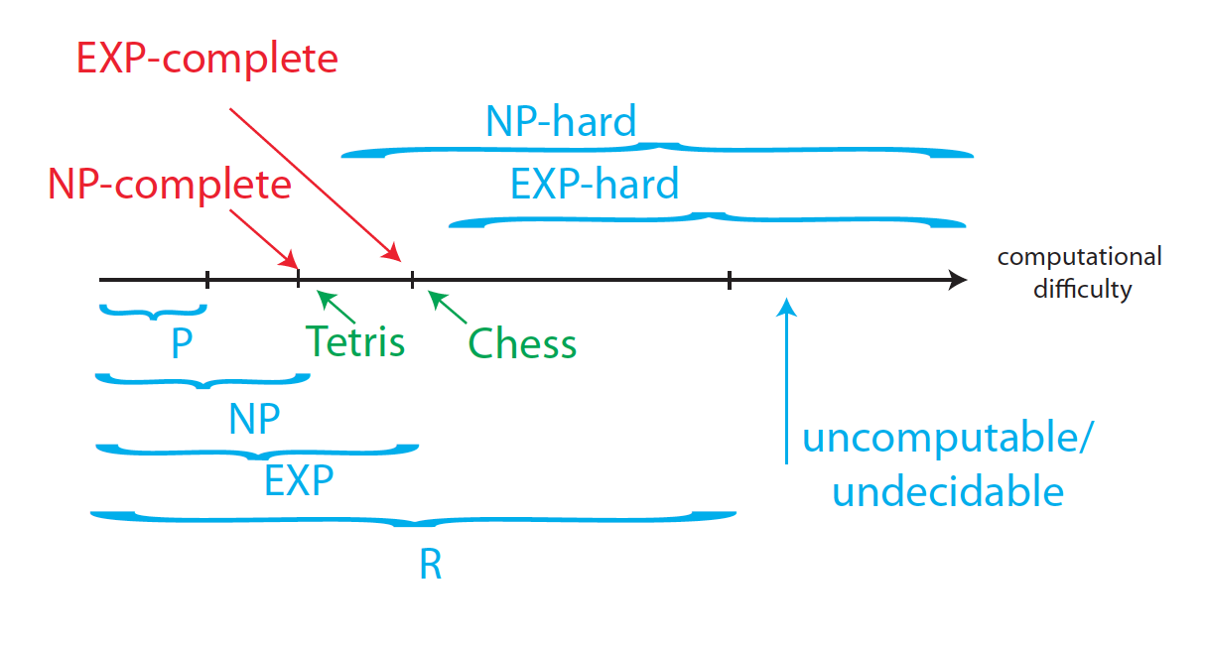
P, NP, EXP, etc.
Image Courtesy of E. Demaine

Slide 50
Outline
Reduction
“SAT” is reducible to “3-SAT”
“3-SAT” is reducible to “Partition”
“Partition” is reducible to “Hamiltonian Path”
NP-hard Problems
NP-completeness of SAT

Slide 51
Boolean Expression
Alphabet Σ containing variables x₁,x₂,…,x_{n}
And special symbols (, ), ∧,∨,~
And not containing 0 and 1
A variable is a Boolean expression

Slide 52
Boolean Expression
Alphabet Σ containing variables x₁,x₂,…,x_{n}
And special symbols (, ), ∧,∨,~
And not containing 0 and 1
If v and w are Boolean expressions then
(v ∧ w) is a Boolean expression

Slide 53
Boolean Expression
Alphabet Σ containing variables x₁,x₂,…,x_{n}
And special symbols (, ), ∧,∨,~
And not containing 0 and 1
If v and w are Boolean expressions then
(v ∨ w) is a Boolean expression

Slide 54
Boolean Expression
Alphabet Σ containing variables x₁,x₂,…,x_{n}
And special symbols (, ), ∧,∨,~
And not containing 0 and 1
If v and w are Boolean expressions then
~v is a Boolean expression
~w is a Boolean expression

Slide 55
Boolean Expression
Alphabet Σ containing variables x₁,x₂,…,x_{n}
And special symbols (, ), ∧,∨,~
And not containing 0 and 1
For example, f(x₁,x₂,…,x_{n})
((x₂ ∧ x₃) ∨ ~(x₃ ∨ x₅) ∧ x₂) ∨ ~(x₂ ∧ x₅)
~(~x₂ ∨ ~x₃) ∧ ~x₁

Slide 56
Satisfiability
f(x₁,x₂,…,x_{n}) is satisfiable if
there exists an assignment x₁ = α₁, …, x_{n} = α_{n}
where α_{i} ∈ {0,1}
such that f(x₁,x₂,…,x_{n}) = 1
The following identities hold
0∧0 = 0, 0∧1 = 0, 1∧0 = 0, 1∧1 = 1
0∨0 = 0, 0∨1 = 1, 1∨0 = 1, 1∨1 = 1
~0 = 1, ~1 = 0
(0) = 0, (1) = 1

Slide 57
SAT
Given the alphabet Σ
Given the identities for 0 and 1
SAT is a subset of Σ* that is satisfiable
Informal Problem
Given a Boolean expression w, is w satisfiable

Slide 58
3-SAT
A special case of SAT
Given variables x₁,x₂,…,x_{n} ∈ Σ
B₁ consists of x₁,~x₁,…,x_{n},~x_{n}
B₂ consists of (w₁∨…∨w_{k}), w_{i} ∈ B₁, 1≤k≤3
B₃ consists of w₁∧w₂∧…∧w_{m}, w_{i} ∈ B₂
e.g., (x₁∨~x₂∨x₃) ∧ (x₂∨~x₃∨x₄) ∧ (~x₁∨~x₂)
3-SAT is the subset of B₃ that is satisfiable

Slide 59
SAT is reducible to 3-SAT
x₁ = x₂ ∨ x₃
(x₁∨~x₂) ∧ (x₁∨~x₃) ∧ (~x₁∨x₂∨x₃)
x₁ = x₂ ∧ x₃
(~x₁∨x₂) ∧ (~x₁∨x₃) ∧ (x₁∨~x₂∨~x₃)
x₁ = ~x₂
(x₁∨x₂) ∧ (~x₁∨~x₂)

Slide 60
SAT is reducible to 3-SAT
Example on the board
(x₁∧x₂) ∨ ~((~x₁∨x₃) ∧x₄∧~x₅) ∧ ~x₂

Slide 61
SAT is reducible to 3-SAT
Example on the board
(x₁∧x₂) ∨ ~((~x₁∨x₃) ∧x₄∧~x₅) ∧ ~x₂
(Using new variables + truth table)

Slide 62
Outline
Reduction
“SAT” is reducible to “3-SAT”
“3-SAT” is reducible to “Partition”
“Partition” is reducible to “Hamiltonian Path”
NP-hard Problems
NP-completeness of SAT

Slide 63
3-SAT
A special case of SAT
Given variables x₁,x₂,…,x_{n} ∈ Σ
B₁ consists of x₁,~x₁,…,x_{n},~x_{n}
B₂ consists of (w₁∨…∨w_{k}), w_{i} ∈ B₁, 1≤k≤3
B₃ consists of w₁∧w₂∧…∧w_{m}, w_{i} ∈ B₂
e.g., (x₁∨~x₂∨x₃) ∧ (x₂∨~x₃∨x₄) ∧ (~x₁∨~x₂)
3-SAT is the subset of B₃ that is satisfiable

Slide 64
Partition
A finite set X
Partition of X is a collection of subsets
Mutually exclusive
Collectively exhaustive
For example, X = {a,b,c,d,e,f}
{{a,b},{c},{d,e,f}} is a partition
{{a,b},{a,c},{d,e,f}} is not a partition
{{a,b},{c},{d,e}} is not a partition

Slide 65
Partition
A finite set X
Partition of X is a collection of subsets
Mutually exclusive
Collectively exhaustive
Problem: Given collection of subsets C
Does C contain a partition of X?
Or not?

Slide 66
3-SAT is reducible to Partition
f = w₁ ∧ w₂ ∧ … w_{m}
Bipartite undirected graph with V = V₁ U V₂
V₁ are variables x₁,x₂,…,x_{n}
V₂ are words w₁,w₂,…,w_{m}
Edges E = E₁ U E₂
E₁ = {(w_{i},x_{j})}, x_{j} ∈ w_{i}
E₂ = {(w_{i},x_{j})}, ~x_{j} ∈ w_{i}

Slide 67
3-SAT is reducible to Partition
Collection C₁ of sets {w_{i}} U E_{i}
E_{i} is non-empty
E_{i} is a subset of edge set incident with w_{i}
Collection C₂ of sets {x_{j}} U E_{j} and {x_{j}} U E’_{j}
E_{j} is the set of all edges in E₁ incident with x_{j}
E’_{j} is the set of all edges in E₂ incident with x_{j}
f is satisfiable iff C₁ U C₂ contains a partition

Slide 68
Outline
Reduction
“SAT” is reducible to “3-SAT” (review)
“3-SAT” is reducible to “Partition”
“Partition” is reducible to “Hamiltonian Path”
NP-hard Problems
NP-completeness of SAT

Slide 69
Partition
A finite set X
Partition of X is a collection of subsets
Mutually exclusive
Collectively exhaustive
Problem: Given collection of subsets C
Does C contain a partition of X?
Or not?

Slide 70
Hamiltonian Path
Digraph D = (V, A)
Path P is Hamiltonian if
It traverses each vertex in V
All vertices in the path are distinct
Problem: Given D
Does it contain a Hamiltonian Path?
Or not?
Connection to Shortest Path?

Slide 71
Partition is reducible to Hamiltonian
Partition Problem: Set X, Collection C
X = {1,2,…,k}
C = {C₁,C₂,…,C_{m}}
Let C_{i} = {j₁,…,j_{t}}
Introduce r₀ and s₀. Connect r_{m} to s₀.

Slide 72
Partition is reducible to Hamiltonian
Partition Problem: Set X, Collection C
X = {1,2,…,k}
C = {C₁,C₂,…,C_{m}}
Let C_{i} = {j₁,…,j_{t}}
C has a partition iff G has Hamiltonian r₀-s_{k} path

Slide 73
Partition is reducible to Hamiltonian
Partition Problem: Set X, Collection C
X = {1,2,…,k}
C = {C₁,C₂,…,C_{m}}
Let C_{i} = {j₁,…,j_{t}}
Left as Exercise !!

Slide 74
Outline
Reduction
NP-hard Problems
NP-completeness of SAT

Slide 75
NP-hard
Need not be in NP
No polynomial-time checkable certificate
Not even a decision problem (e.g. optimization)
At least as hard as NP-complete problems
Λ ∈ NP-hard
There exists Π ∈ NP-complete
Π is reducible to Λ

Slide 76
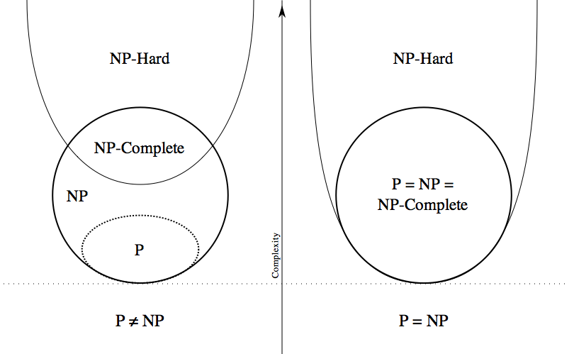
NP-hard
Image Courtesy of Wikipedia

Slide 77
Examples of NP-complete problems
3-Partition: given n integers, can you divide them into triples of equal sum?
Travelling salesman problem
Tetris
Minesweeper, Sudoku
SAT
Knapsack (pseudopoly, not poly)
…

Slide 78
Outline
Reduction
NP-hard Problems
NP-completeness of SAT (todo)

