Slide 1
Discrete Optimization
MA2827
Fondements de l’optimisation discrète
Approximate methods: local search
https://project.inria.fr/2015ma2827/
Material based on the lectures of Pascal Van Hentenryck at Coursera

Slide 2
Introduction
Many important problems are provably not solvable in polynomial time (NP and harder)
But, these results are based on the worst-case analysis
Practical instances are often easier
Approximate methods can often obtain good solutions

Slide 3
Approximate methods
Local search (today)
Relaxation
Constraint programming

Slide 4
Outline
Simple neighborhoods
queens on the chess board
warehouse location
Travelling salesman problem
Escaping local minima
randomization
tabu search
Graph coloring
Complex neighborhoods
sports scheduling
image segmentation

Slide 5
Local search
Moves between configurations by performing local moves
Works with complete assignments of the variables
Optimization problems:
Start from a suboptimal configuration
Move towards better solutions
Satisfaction problems:
Start from an infeasible configuration
Move towards feasibility
No guarantees
Can work great in practice!

Slide 6
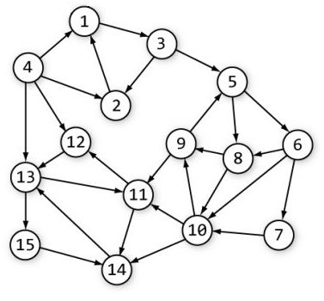
Neighborhood
Optimizing a function f
Local moves define a neighborhood
Configurations that are close
N: C -> 2^{C}
Local search is a graph exploration

Slide 7
Example: satisfaction problem
Task: place 8 queens on the chess board such that they do not attack each other
Good
Bad

Slide 8
Example: satisfaction problem
Task: place 8 queens on the chess board such that they do not attack each other
Representation: the row of the queen in each column
Local steps: move one of the queens in its column

Slide 9
Example: satisfaction problem
Task: place 8 queens on the chess board such that they do not attack each other
Representation: the row of the queen in each column
Local steps: move one of the queens in its column
Local search:
start with infeasible configuration
move towards feasibility

Slide 10
8 queens
Task: place 8 queens on the chess board such that they do not attack each other
Max/min conflict:
Count constraint violations

Slide 11
8 queens
Task: place 8 queens on the chess board such that they do not attack each other
Count constraint violations

Slide 12
8 queens
Task: place 8 queens on the chess board such that they do not attack each other
Count constraint violations
1

Slide 13
8 queens
Task: place 8 queens on the chess board such that they do not attack each other
Count constraint violations
1 | 2

Slide 14
8 queens
Task: place 8 queens on the chess board such that they do not attack each other
Count constraint violations
1 | 2 | 2 | 3 | 2 | 2 | 2 | 0 | 7

Slide 15
8 queens
Task: place 8 queens on the chess board such that they do not attack each other
Count constraint violations
Queen with most violations
1 | 2 | 2 | 3 | 2 | 2 | 2 | 0 | 7

Slide 16
8 queens
Task: place 8 queens on the chess board such that they do not attack each other
Count constraint violations
Queen with most violations
Possible moves
1 | 2 | 2 | 3 | 2 | 2 | 2 | 0 | 7

Slide 17
8 queens
Task: place 8 queens on the chess board such that they do not attack each other
Count constraint violations
Queen with most violations
Possible moves
 |  |  |  |  |  |  |  | -1
 |  |  |  |  |  |  |  | 0
 |  |  |  |  |  |  |  | -1
 |  |  |  |  |  |  |  | 0
 |  |  |  |  |  |  |  | 0
 |  |  |  |  |  |  |  | -2
 |  |  |  |  |  |  |  | -2
 |  |  |  |  |  |  |  | -2
1 | 2 | 2 | 3 | 2 | 2 | 2 | 0 | 7

Slide 18
8 queens
Task: place 8 queens on the chess board such that they do not attack each other
Count constraint violations
Queen with most violations
Possible moves
Find the best move
 |  |  |  |  |  |  |  | -1
 |  |  |  |  |  |  |  | 0
 |  |  |  |  |  |  |  | -1
 |  |  |  |  |  |  |  | 0
 |  |  |  |  |  |  |  | 0
 |  |  |  |  |  |  |  | -2
 |  |  |  |  |  |  |  | -2
 |  |  |  |  |  |  |  | -2
1 | 2 | 2 | 3 | 2 | 2 | 2 | 0 | 7

Slide 19
8 queens
Task: place 8 queens on the chess board such that they do not attack each other
Count constraint violations
Queen with most violations
Possible moves
Find the best move

Slide 20
8 queens
Task: place 8 queens on the chess board such that they do not attack each other
Count constraint violations
0 | 1 | 1 | 1 | 2 | 2 | 2 | 1 | 5

Slide 21
8 queens
Task: place 8 queens on the chess board such that they do not attack each other
Count constraint violations
Queen with most violations
0 | 1 | 1 | 1 | 2 | 2 | 2 | 1 | 5

Slide 22
8 queens
Task: place 8 queens on the chess board such that they do not attack each other
Count constraint violations
Queen with most violations
Possible moves
 |  |  |  |  |  |  |  | 0
 |  |  |  |  |  |  |  | 0
 |  |  |  |  |  |  |  | 0
 |  |  |  |  |  |  |  | 0
 |  |  |  |  |  |  |  | 0
 |  |  |  |  |  |  |  | 0
 |  |  |  |  |  |  |  | -1
 |  |  |  |  |  |  |  | 0
0 | 1 | 1 | 1 | 2 | 2 | 2 | 1 | 5

Slide 23
8 queens
Task: place 8 queens on the chess board such that they do not attack each other
Count constraint violations
Queen with most violations
Possible moves
Find the best move
 |  |  |  |  |  |  |  | 0
 |  |  |  |  |  |  |  | 0
 |  |  |  |  |  |  |  | 0
 |  |  |  |  |  |  |  | 0
 |  |  |  |  |  |  |  | 0
 |  |  |  |  |  |  |  | 0
 |  |  |  |  |  |  |  | -1
 |  |  |  |  |  |  |  | 0
0 | 1 | 1 | 1 | 2 | 2 | 2 | 1 | 5

Slide 24
8 queens
Task: place 8 queens on the chess board such that they do not attack each other
Count constraint violations
Queen with most violations
Possible moves
Find the best move

Slide 25
8 queens
Task: place 8 queens on the chess board such that they do not attack each other
Count constraint violations
0 | 1 | 1 | 2 | 1 | 1 | 1 | 1 | 4

Slide 26
8 queens
Task: place 8 queens on the chess board such that they do not attack each other
Count constraint violations
Queen with most violations
0 | 1 | 1 | 2 | 1 | 1 | 1 | 1 | 4

Slide 27
8 queens
Task: place 8 queens on the chess board such that they do not attack each other
Count constraint violations
Queen with most violations
Possible moves
 |  |  |  |  |  |  |  | -1
 |  |  |  |  |  |  |  | 0
 |  |  |  |  |  |  |  | 0
 |  |  |  |  |  |  |  | 1
 |  |  |  |  |  |  |  | 1
 |  |  |  |  |  |  |  | 0
 |  |  |  |  |  |  |  | 0
 |  |  |  |  |  |  |  | 0
0 | 1 | 1 | 2 | 1 | 1 | 1 | 1 | 4

Slide 28
8 queens
Task: place 8 queens on the chess board such that they do not attack each other
Count constraint violations
Queen with most violations
Possible moves
Find the best move
 |  |  |  |  |  |  |  | -1
 |  |  |  |  |  |  |  | 0
 |  |  |  |  |  |  |  | 0
 |  |  |  |  |  |  |  | 1
 |  |  |  |  |  |  |  | 1
 |  |  |  |  |  |  |  | 0
 |  |  |  |  |  |  |  | 0
 |  |  |  |  |  |  |  | 0
0 | 1 | 1 | 2 | 1 | 1 | 1 | 1 | 4

Slide 29
8 queens
Task: place 8 queens on the chess board such that they do not attack each other
Count constraint violations
Queen with most violations
Possible moves
Find the best move

Slide 30
8 queens
Task: place 8 queens on the chess board such that they do not attack each other
Count constraint violations
0 | 1 | 1 | 1 | 0 | 1 | 2 | 0 | 3

Slide 31
8 queens
Task: place 8 queens on the chess board such that they do not attack each other
Count constraint violations
Queen with most violations
0 | 1 | 1 | 1 | 0 | 1 | 2 | 0 | 3

Slide 32
8 queens
Task: place 8 queens on the chess board such that they do not attack each other
Count constraint violations
Queen with most violations
Possible moves
 |  |  |  |  |  |  |  | 0
 |  |  |  |  |  |  |  | 0
 |  |  |  |  |  |  |  | -1
 |  |  |  |  |  |  |  | 0
 |  |  |  |  |  |  |  | 1
 |  |  |  |  |  |  |  | -1
 |  |  |  |  |  |  |  | 0
 |  |  |  |  |  |  |  | 0
0 | 1 | 1 | 1 | 0 | 1 | 2 | 0 | 3

Slide 33
8 queens
Task: place 8 queens on the chess board such that they do not attack each other
Count constraint violations
Queen with most violations
Possible moves
Find the best move
 |  |  |  |  |  |  |  | 0
 |  |  |  |  |  |  |  | 0
 |  |  |  |  |  |  |  | -1
 |  |  |  |  |  |  |  | 0
 |  |  |  |  |  |  |  | 1
 |  |  |  |  |  |  |  | -1
 |  |  |  |  |  |  |  | 0
 |  |  |  |  |  |  |  | 0
0 | 1 | 1 | 1 | 0 | 1 | 2 | 0 | 3

Slide 34
8 queens
Task: place 8 queens on the chess board such that they do not attack each other
Count constraint violations
Queen with most violations
Possible moves
Find the best move

Slide 35
8 queens
Task: place 8 queens on the chess board such that they do not attack each other
Count constraint violations
0 | 1 | 1 | 0 | 0 | 1 | 1 | 0 | 2

Slide 36
8 queens
Task: place 8 queens on the chess board such that they do not attack each other
Count constraint violations
Local minimum!
0 | 1 | 1 | 0 | 0 | 1 | 1 | 0 | 2

Slide 37
Local search: no guarantees
Local minima:
no step improves the objective
No guarantees for global optimality
Escaping local optima is a critical issue in local search

Slide 38
Example: optimization problem
Task: where to place warehouses?
Cost for opening warehouse at position w: f_{w}
Cost for transportation from w to c: t_{w,c}
– warehouse possibility – customer

Slide 39
Warehouse location
Task: where to place warehouses?
Cost for opening warehouse at position w: f_{w}
Cost for transportation from w to c: t_{w,c}
– warehouse possibility – customer

Slide 40
Warehouse location
Task: where to place warehouses?
Cost for opening warehouse at position w: f_{w}
Cost for transportation from w to c: t_{w,c}
– warehouse possibility – customer

Slide 41
Warehouse location
Task: where to place warehouses? ( input: f_{w} , t_{w,c} )
Decision variables:
o_{w} ∈ {0, 1} : whether warehouse w is open
a[c] ∈ {1, …, W} : the warehouse assigned to customer c
Objective:
Constraints:
customers can be assigned only to open warehouses

Slide 42
Warehouse location
Task: where to place warehouses? ( input: f_{w} , t_{w,c} )
Key observation:
once the warehouse locations have been chosen, the problem is easy
it’s enough to assign customers to warehouses minimizing the transportation costs
Objective:

Slide 43
Warehouse location
Task: where to place warehouses? ( input: f_{w} , t_{w,c} )
Neighborhood:
open/close warehouses (flip the value of o_{w})
swap warehouses (close one and open the other)
simultaneous swap of k warehouses

Slide 44
Travelling salesman problem (TSP)
Task: find the shortest path to visit all cities exactly once
Hamiltonian cycle in a graph
simplification: cities are points in 2D

Slide 45
Travelling salesman problem (TSP)
Task: find the shortest path to visit all cities exactly once
Hamiltonian cycle in a graph
simplification: cities are points in 2D

Slide 46
Travelling salesman problem (TSP)
Task: find the shortest path to visit all cities exactly once
Hamiltonian cycle in a graph
simplification: cities are points in 2D

Slide 47
Travelling salesman problem (TSP)
Task: find the shortest path to visit all cities exactly once
Hamiltonian cycle in a graph
simplification: cities are points in 2D
Decision variables:
where to go next after every city
TSP if probably the most well-studied combinatorial problem!

Slide 48
Local search for TSP: 2-OPT
Task: find the shortest path to visit all cities exactly once
Local move:
select two edges and replace them by two other edges

Slide 49
Local search for TSP: 2-OPT
Task: find the shortest path to visit all cities exactly once
Local move:
select two edges and replace them by two other edges
Crossings are bad!

Slide 50
Local search for TSP: 2-OPT
Task: find the shortest path to visit all cities exactly once
Local move:
select two edges and replace them by two other edges

Slide 51
Local search for TSP: 2-OPT
Task: find the shortest path to visit all cities exactly once
Local move:
select two edges and replace them by two other edges

Slide 52
Local search for TSP: 3-OPT
Task: find the shortest path to visit all cities exactly once
Local move:
select three edges and replace them by three other edges

Slide 53
Local search for TSP: 3-OPT
Task: find the shortest path to visit all cities exactly once
Local move:
select three edges and replace them by three other edges

Slide 54
Local search for TSP: 3-OPT
Task: find the shortest path to visit all cities exactly once
Local move:
select three edges and replace them by three other edges

Slide 55
Local search for TSP
Task: find the shortest path to visit all cities exactly once
2-OPT:
the neighborhood is a set of all tours that can be reached by swapping two edges
3-OPT:
the neighborhood is a set of all tours that can be reached by swapping three edges
much better than 2-OPT in quality but more expensive
4-OPT?
marginally better but even more expensive

Slide 56
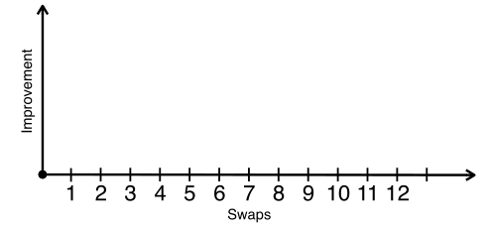
Local search for TSP: K-OPT
Task: find the shortest path to visit all cities exactly once
K-OPT:
replace the notion of one favorable swap by a sequence of favorable swaps
do not search for the entire set of sequences but build them incrementally

Slide 57
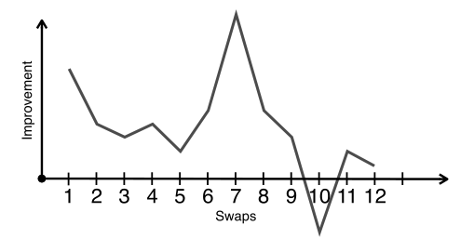
Local search for TSP: K-OPT
Task: find the shortest path to visit all cities exactly once
K-OPT:
replace the notion of one favorable swap by a sequence of favorable swaps
do not search for the entire set of sequences but build them incrementally

Slide 58
Local search for TSP: K-OPT
Task: find the shortest path to visit all cities exactly once
K-OPT:
Choose a vertex t₁ and an edge (t₁, t₂)
Choose a vertex t₃ with d(t₂, t₃) < d(t₁, t₂)
If non exist, restart
Consider solution by removing (t₃, t₄) and adding (t₁, t₄)
Compute the cost but do not connect

Slide 59
Local search for TSP: K-OPT
Task: find the shortest path to visit all cities exactly once
K-OPT:
t₂
t₁

Slide 60
Local search for TSP: K-OPT
Task: find the shortest path to visit all cities exactly once
K-OPT:
t₂
t₁
t₃
t₄

Slide 61
Local search for TSP: K-OPT
Task: find the shortest path to visit all cities exactly once
K-OPT:
t₂
t₁
t₃
t₄

Slide 62
Local search for TSP: K-OPT
Task: find the shortest path to visit all cities exactly once
K-OPT:
t₂
t₁
t₃
t₄

Slide 63
Local search for TSP: K-OPT
Task: find the shortest path to visit all cities exactly once
K-OPT:
t₂
t₁
t₃
t₄

Slide 64
Local search for TSP: K-OPT
Task: find the shortest path to visit all cities exactly once
K-OPT:
Choose a vertex t₁ and an edge (t₁, t₂)
Choose a vertex t₃ with d(t₂, t₃) < d(t₁, t₂)
If non exist, restart
Consider solution by removing (t₃, t₄) and adding (t₁, t₄)
Compute the cost but do not connect
Restart with t₁ and edge (t₁, t₄)

Slide 65
Local search for TSP: K-OPT
Task: find the shortest path to visit all cities exactly once
K-OPT:
t₂
t₁
t₃
t₄

Slide 66
Local search for TSP: K-OPT
Task: find the shortest path to visit all cities exactly once
K-OPT:
t₂
t₁
t₆
t₃
t₄
t₅

Slide 67
Local search for TSP: K-OPT
Task: find the shortest path to visit all cities exactly once
K-OPT:
t₂
t₁
t₆
t₃
t₄
t₅

Slide 68
Local search for TSP: K-OPT
Task: find the shortest path to visit all cities exactly once
K-OPT:
t₂
t₁
t₆
t₃
t₄
t₅

Slide 69
Local search for TSP: K-OPT
Task: find the shortest path to visit all cities exactly once
K-OPT:
Choose a vertex t₁ and an edge (t₁, t₄)
Choose a vertex t₅ with d(t₄, t₅) < d(t₁, t₄)
If non exist, restart
Consider solution by removing (t₆, t₅) and adding (t₁, t₆)
Compute the cost but do not connect
Restart with t₁ and edge (t₁, t₆)

Slide 70
Local search for TSP: K-OPT
Task: find the shortest path to visit all cities exactly once
K-OPT:
t₂
t₁
t₆
t₃
t₄
t₅

Slide 71
Local search for TSP: K-OPT
Task: find the shortest path to visit all cities exactly once
K-OPT:
t₂
t₈
t₁
t₆
t₇
t₃
t₄
t₅

Slide 72
Local search for TSP: K-OPT
Task: find the shortest path to visit all cities exactly once
K-OPT:
t₂
t₈
t₁
t₆
t₇
t₃
t₄
t₅

Slide 73
Local search for TSP: K-OPT
Task: find the shortest path to visit all cities exactly once
K-OPT:
t₂
t₈
t₁
A good move!
t₆
t₇
t₃
t₄
t₅

Slide 74
Local search for TSP: hints
Task: find the shortest path to visit all cities exactly once
Start with simple ideas
Use common sense
Which moves are likely to be good?
Which moves are likely to be bad?
What connections do you need?
Visualize the path
Profile code before running for long
Escape local minima

Slide 75
How to make local search work?
Local search has no guarantees.
How to make local search work well?
Connectivity
Escaping local minima

Slide 76
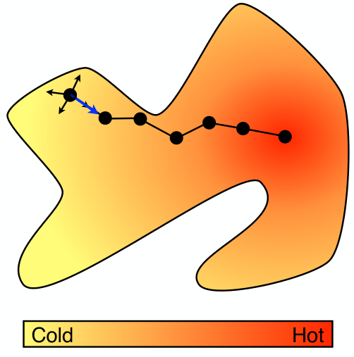
Local search

Slide 77
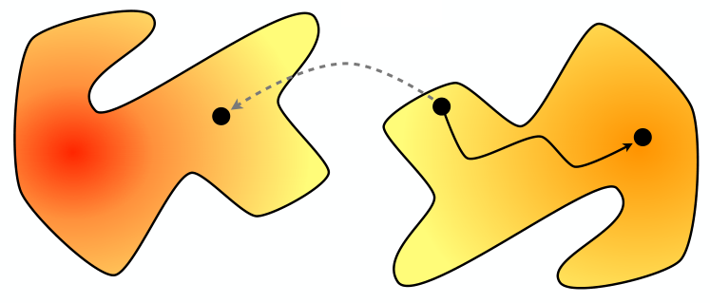
Connectivity
Important property of local neighborhoods
A neighborhood N is connected if, from every configuration S, some optimal solution O can be reached by a sequence of moves

Slide 78
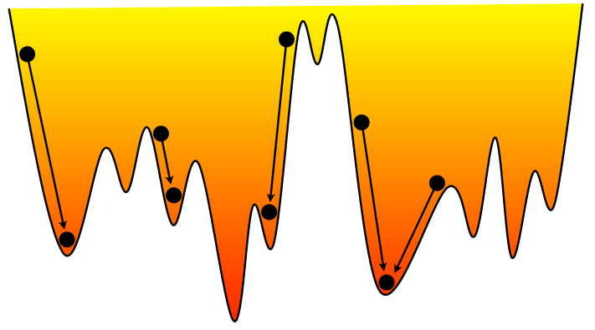
Connectivity
Connectivity does not guarantee optimality

Slide 79
Connectivity of 8-queens
Any two configurations can be linked in at most 8 moves

Slide 80
Connectivity of TSP
Is 2-OPT connected?
Simple algorithm:
loop other the points along
the optimal path and fix
edges of the initial path
one by one

Slide 81
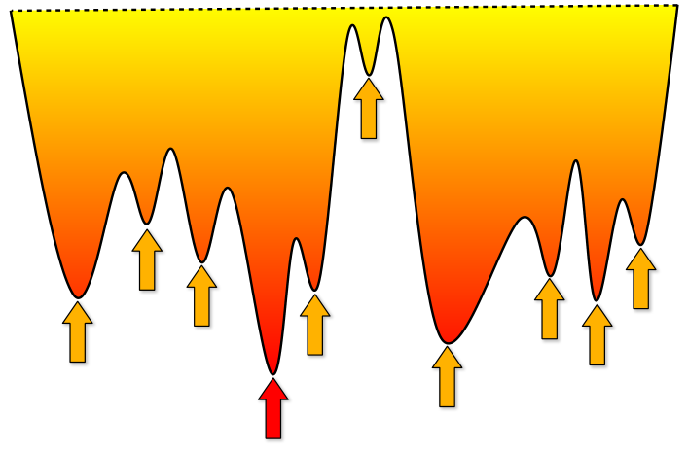
Local minima
Greedy local search can easily get stuck in local minima.
How to find a good one?

Slide 82
Local search
States
configurations
Moving from state s to one of its neighbors
N(s): neighborhood of s
Some neighbors are legal; others are not
L( N(s), s ): set of legal neighbors
Select one of the legal neighbors
S( L(N(s), s), s ); selection function
Objective function
minimizing f(s)

Slide 83
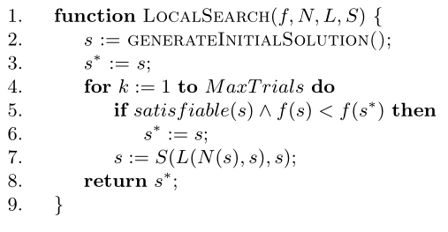
Basic local search
Example:
Legal moves: local improvements
L(N, s) = {n in N | f(n) < f(s) }
Selection function: greedy selection
S(L, s) = argmin_{n in L} f(n)

Slide 84
Heuristics and Metaheuristics
Heuristics
choose the next neighbor
use local information (state s and its neighborhood)
drive the search towards a local minimum
Metaheuristics
aim at escaping local minima
drive the search towards a global minimum
typically include some memory of learning

Slide 85
Properties of the neighbors
Legal neighbors
conditions on the value of the objective function
Local improvement
L(N, s) = { n in N | f(n) < f(s) }
No degradation
L(N, s) = { n in N | f(n) <= f(s) }
Potential degradation
L(N, s) = N

Slide 86
Selecting a neighbor
How to select the neighbor?
exploring the whole or part of the neighborhood
Best neighbor
select “the” best neighbor in the neighborhood
First neighbor
select the first “legal” neighbor
avoid scanning the entire neighborhood
Multi-stage selection
first, select one “part” of neighborhood
second, select from the remaining “part” of neighborhood

Slide 87
Multi-stage selection
Select the variable
with the most violations
Select the position with
the fewest resulting violations
O( n ) runtime against O( n² ) of the full search
 |  |  |  |  |  |  |  | -1
 |  |  |  |  |  |  |  | 0
 |  |  |  |  |  |  |  | -1
 |  |  |  |  |  |  |  | 0
 |  |  |  |  |  |  |  | 0
 |  |  |  |  |  |  |  | -2
 |  |  |  |  |  |  |  | -2
 |  |  |  |  |  |  |  | -2
1 | 2 | 2 | 3 | 2 | 2 | 2 | 0 | 7

Slide 88
Escaping local minima
Randomization
Random restarts
generic, can be always tried
Metropolis scheme
Simulated annealing
Tabu search

Slide 89
Metropolis heuristics
Basic idea
accept a move if it improves the objective value
accept “bad moves” as well with some probability
the probability depends on how “bad” the move is
inspired by statistical physics
How to choose the probability?
t is a scaling parameter (called temperature)
Δ is the difference f(n) – f(s)
a degrading move is accepted with probability

Slide 90
Metropolis heuristics
What happens for a large t ?
probability of accepting a degrading move is large
What happens for a small t ?
probability of accepting a degrading move is small
Finding the correct temperature is hard
Let us gradually change the temperature
simulated annealing

Slide 91
Simulated annealing
Based on statistical physics
Heating and cooling schedules of crystals
Key idea
Use Metropolis algorithm but adjust the temperature dynamically
Start with a high temperature (random moves)
Decrease the temperature
When the temperature is low becomes a local search

Slide 92
Simulated annealing
Guaranteed to converge to a global optimum
connected neighborhood
slow cooling schedule
slower than the exhaustive search
In practice
can give excellent results
need to tune a temperature schedule
default choice: t_{k+1} = α t_{k}
Additional tools
restarts
reheats

Slide 93
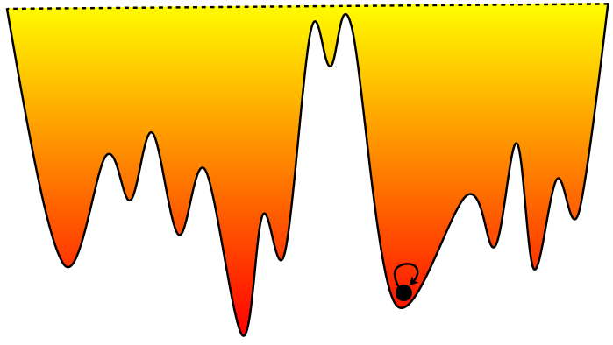
Tabu search
Key idea
maintain the sequence of nodes already visited
tabu lists and tabu nodes

Slide 94
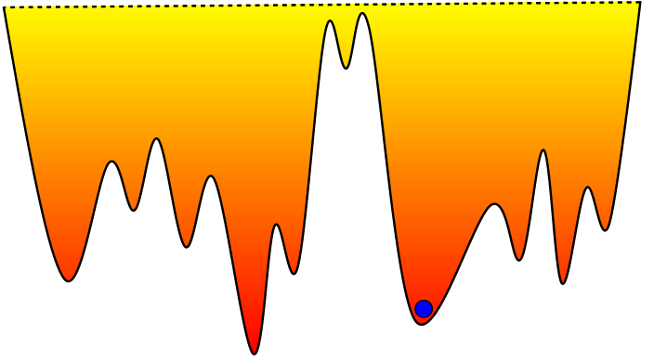
Tabu search
Key idea
maintain the sequence of nodes already visited
tabu lists and tabu nodes
Tabu nodes : nodes already visited

Slide 95
Tabu search
Key idea
maintain the sequence of nodes already visited
tabu lists and tabu nodes
Select the best configurations that is not tabu,
i.e., has not been visited before

Slide 96
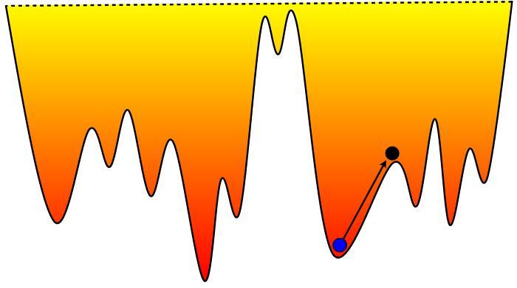
Tabu search
Key idea
maintain the sequence of nodes already visited
tabu lists and tabu nodes
Tabu nodes : nodes already visited

Slide 97
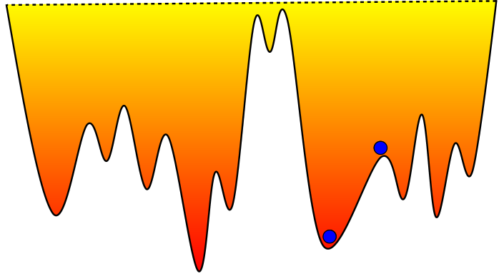
Tabu search
Key idea
maintain the sequence of nodes already visited
tabu lists and tabu nodes
Tabu nodes : nodes already visited

Slide 98
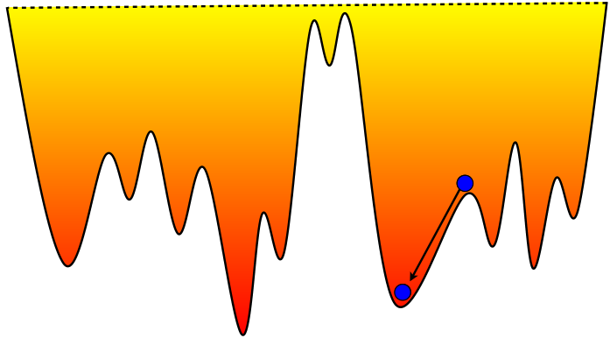
Tabu search
Key idea
maintain the sequence of nodes already visited
tabu lists and tabu nodes
Tabu nodes : nodes already visited

Slide 99
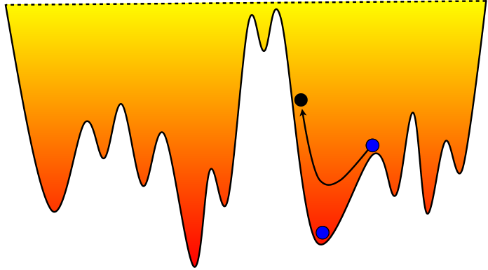
Tabu search
Key idea
maintain the sequence of nodes already visited
tabu lists and tabu nodes
Tabu nodes : nodes already visited

Slide 100
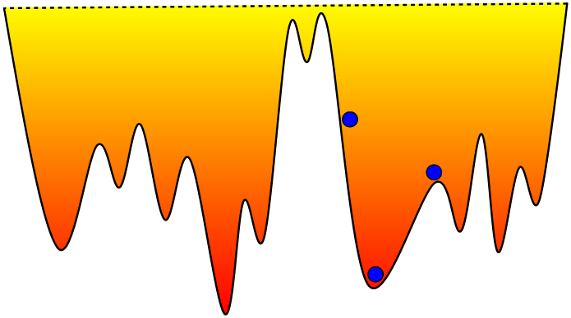
Tabu search
Key idea
maintain the sequence of nodes already visited
tabu lists and tabu nodes
Tabu nodes : nodes already visited

Slide 101
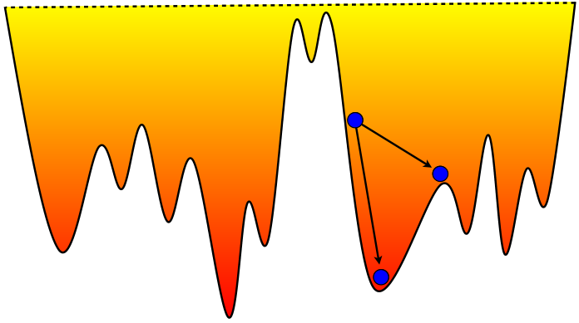
Tabu search
Key idea
maintain the sequence of nodes already visited
tabu lists and tabu nodes
Tabu nodes : nodes already visited

Slide 102
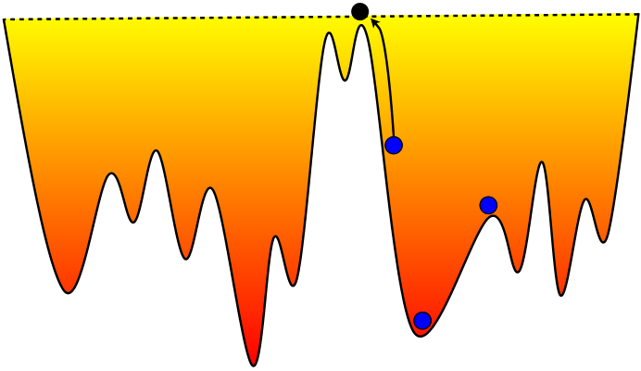
Tabu search
Key idea
maintain the sequence of nodes already visited
tabu lists and tabu nodes
Tabu nodes : nodes already visited

Slide 103
Tabu search
Key issue with tabu search
expensive to maintain all the visited nodes
Short-term memory
only keep a small set of recently visited nodes (tabu list)
Keep an abstraction of the nodes
many possibilities
store the transitions instead of the states
store the transitions and the objective values

Slide 104
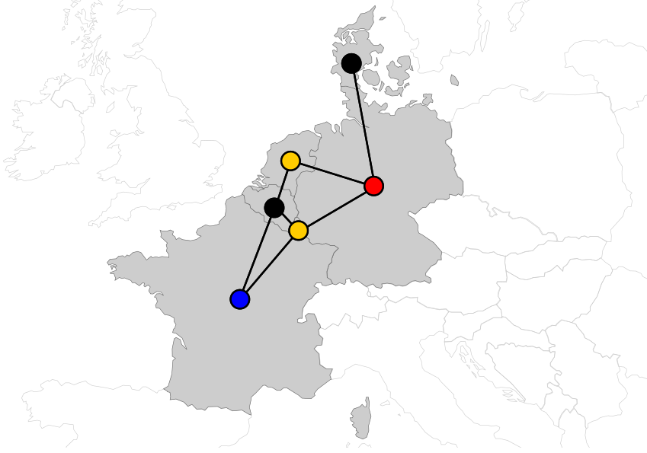
Optimization under constrains
Task: color the nodes of the graph such that the neighboring nodes are colored differently

Slide 105
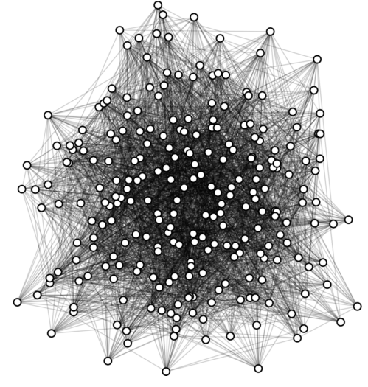
Graph coloring
Task: color the nodes of the graph such that the neighboring nodes are colored differently

Slide 106
Graph coloring
Task: color the nodes of the graph such that the neighboring nodes are colored differently
Two aspects:
optimization: reducing the number of colors
feasibility: two adjacent vertices must be colored differently
How to combine them in local search?
sequence of feasibility problems
staying in the space of solutions
considering feasible and infeasible configurations

Slide 107
Graph coloring
Task: color the nodes of the graph such that the neighboring nodes are colored differently
Sequence of feasibility problems:
find an initial solution with k colors (e.g. greedy method)
remove one color (randomly reassign the nodes)
find a feasible solution with k-1 colors
repeat
How to find a solution with k-1 colors?
minimize the violations

Slide 108
Graph coloring
Task: color the nodes of the graph such that the neighboring nodes are colored differently
Staying in the feasible Space:
simple neighborhood
change the color of a vertex
objective function
minimizing the number of colors
how to guide the search?

Slide 109
Staying in the feasible space
Task: color the nodes of the graph such that the neighboring nodes are colored differently
How to drive the search?
use a proxy as objective function
favor large classes
Objective:
C_{i} is the set of vertices colored with i

Slide 110
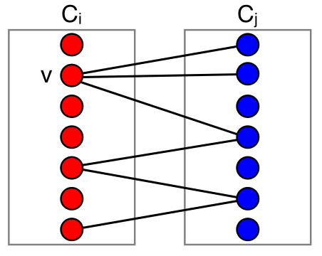
Staying in the feasible space
Task: color the nodes of the graph such that the neighboring nodes are colored differently
Richer neighborhoods:
chains of variables

Slide 111
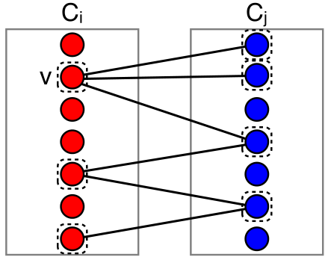
Staying in the feasible space
Task: color the nodes of the graph such that the neighboring nodes are colored differently
Richer neighborhoods:
chains of variables

Slide 112
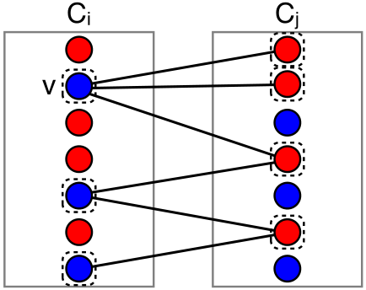
Staying in the feasible space
Task: color the nodes of the graph such that the neighboring nodes are colored differently
Richer neighborhoods:
chains of variables

Slide 113
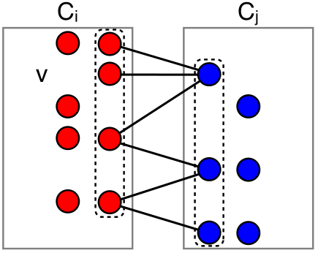
Staying in the feasible space
Task: color the nodes of the graph such that the neighboring nodes are colored differently
Richer neighborhoods:
chains of variables

Slide 114
Feasible and infeasible colorings
Task: color the nodes of the graph such that the neighboring nodes are colored differently
Explore both feasible and infeasible colorings
Search must focus on reducing the number of colors and on ensuring feasibility
Use an objective function than balances feasibility and optimality

Slide 115
Feasible and infeasible colorings
Task: color the nodes of the graph such that the neighboring nodes are colored differently
Use an objective function than balances feasibility and optimality
Decreasing the number of colors
Removing violations
B_{i} is a set of bad edges between vertices colored with i

Slide 116
Feasible and infeasible colorings
Task: color the nodes of the graph such that the neighboring nodes are colored differently
Use an objective function than balances feasibility and optimality
Why?
All local minima of this objective are legal colorings
Neighborhood: changing the color of one node
If there is a bad edge with color i
The left term:
The right term:

Slide 117
Examples of complex neighborhoods

Slide 118
Sports scheduling
Practical applications
football, hockey, basketball, baseball
radio and TV: €€€
The travelling tournament problem (TTP)
abstraction of major league tournament
proposed by Easton, Nemhauser, and Trick

Slide 119
Travelling Tournament Problem (TTP)
Input
n teams
a matrix d of distances between teams
Output: a double all-play-all schedule
each team plays each home and away
minimize travel distance

Slide 120
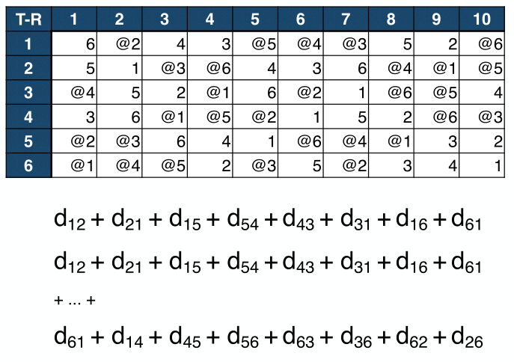
Travelling Tournament Problem (TTP)

Slide 121
Travelling Tournament Problem (TTP)
Moves:
swap homes
swap rounds
swap teams
partial swap rounds
partial swap teams

Slide 122
TTP: swap homes

Slide 123
TTP: swap rounds

Slide 124
TTP: swap teams

Slide 125
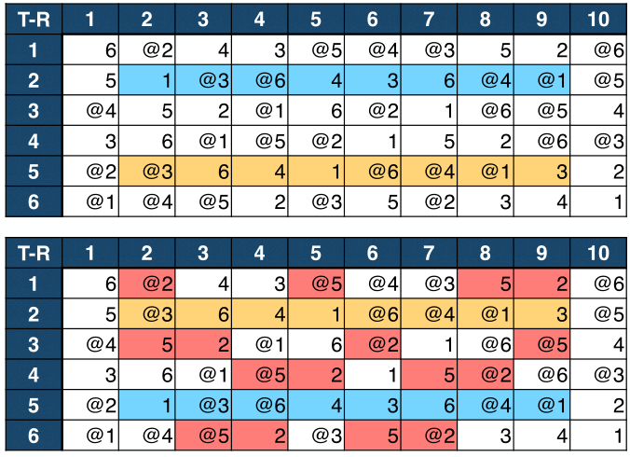
TTP: swap teams

Slide 126
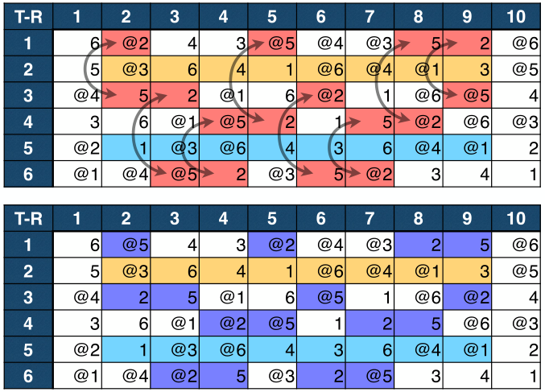
TTP: swap teams

Slide 127
TTP: swap partial rounds

Slide 128
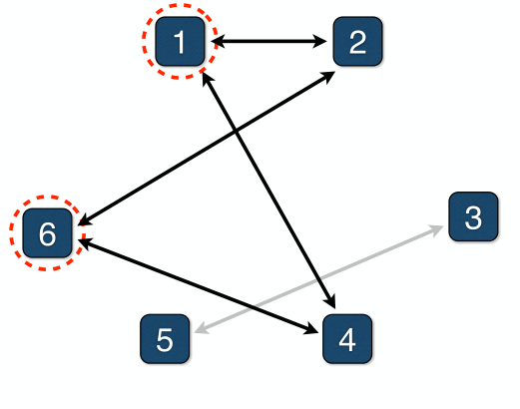
TTP: swap partial rounds

Slide 129
TTP: swap partial rounds

Slide 130
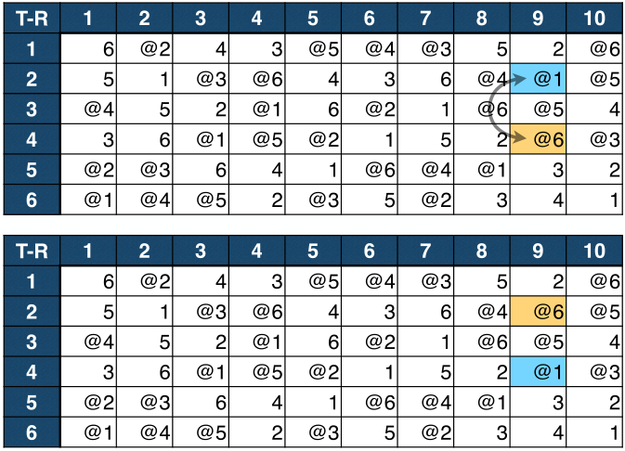
TTP: swap partial teams

Slide 131
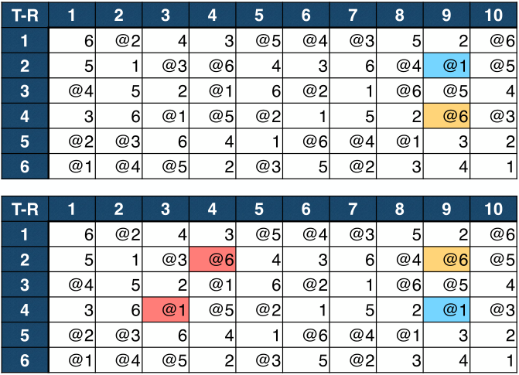
TTP: swap partial teams

Slide 132
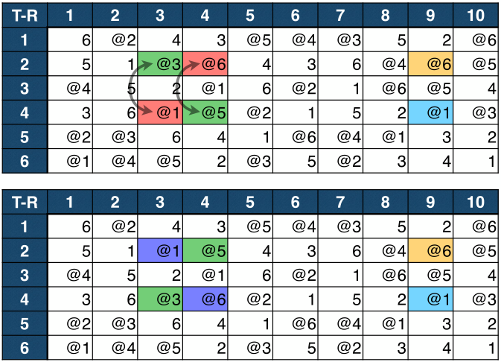
TTP: swap partial teams

Slide 133
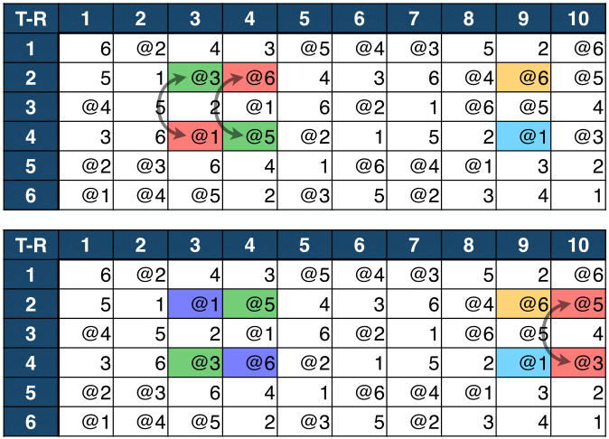
TTP: swap partial teams

Slide 134
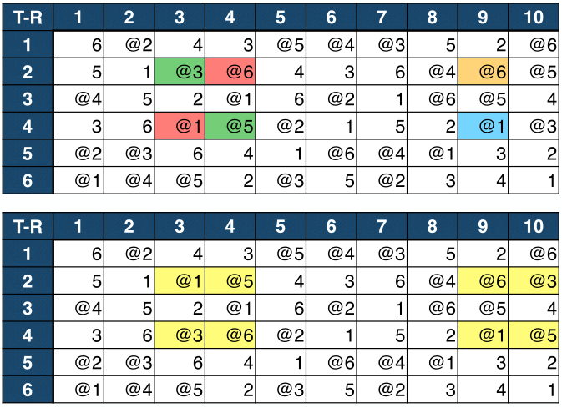
TTP: swap partial teams

Slide 135
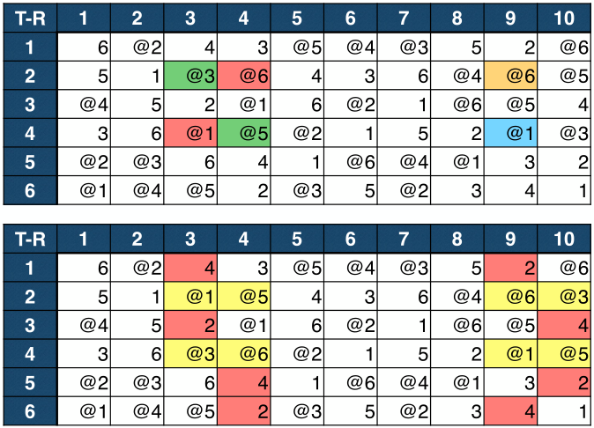
TTP: swap partial teams

Slide 136
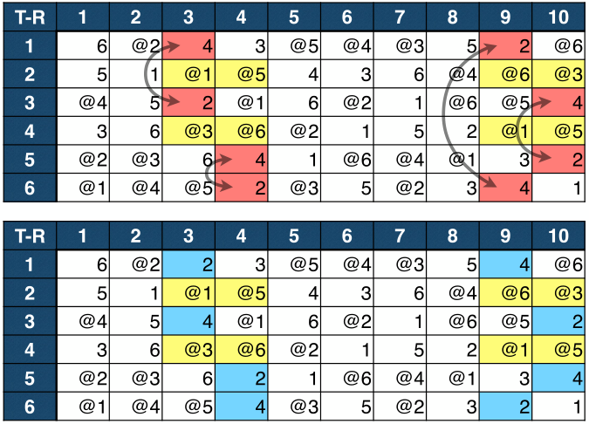
TTP: swap partial teams

Slide 137
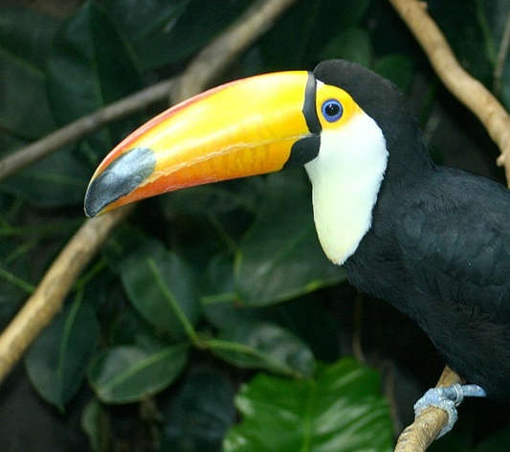
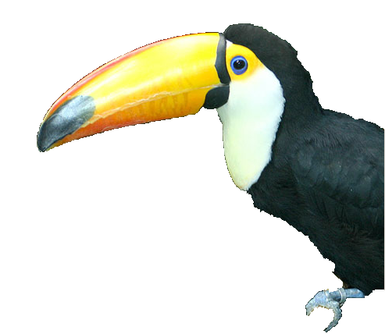
Image segmentation
Image
Segmentation
Following slides based on the tutorial by P. Kohli

Slide 138
Image segmentation
S
T
Image
Construct a graph

Slide 139
Image segmentation
S
T
Set the edge weights

Slide 140
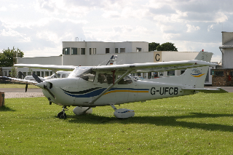
Image segmentation
What if we have multiple objects?
Image
Segmentation
Minimization is NP-hard if
P > 2 and the graph is cyclic

Slide 141
Image segmentation
Task: assign label to each pixel of an image
Local search:
maintain labeling x
make a move such that the objective decreases

Slide 142
Image segmentation
Task: assign a label to each pixel of the input image
Simple moves:
change value of a variable x_{i}
change values of several variables
exponential in the number of variables
global moves: α-expansion

Slide 143
MRF-based segmentation

Slide 144
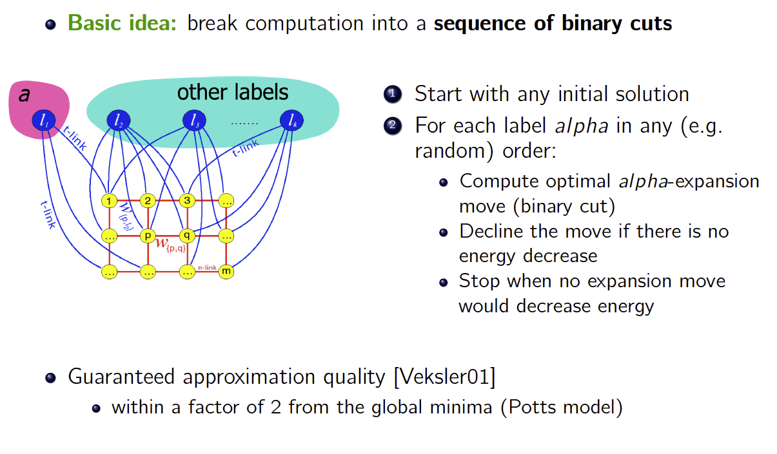
α-expansion

Slide 145
α-expansion

Slide 146
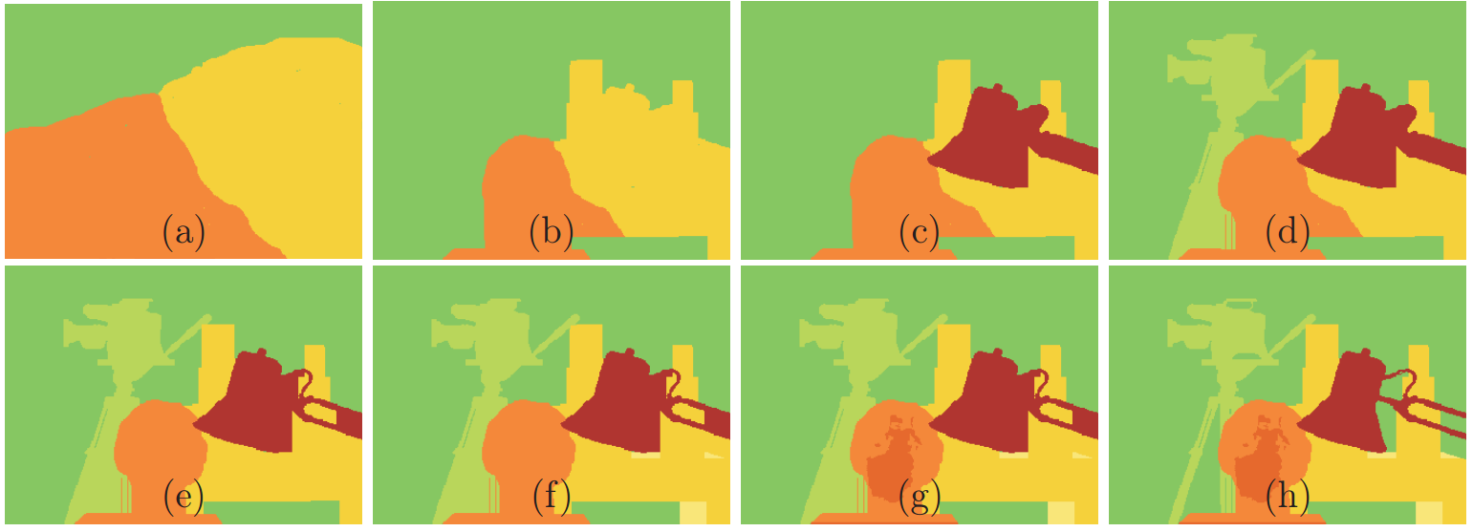
α-expansion
Task: assign label to each pixel of an image
Expansion move:
allow all the variables to take label α

Slide 147
α-expansion
Task: assign label to each pixel of an image
Expansion move: allow all the variables to take label α
Convert function E(x) into F(y) where y are binary:
y_{i} = 1 when x_{i} = α

Slide 148
α-expansion
Task: assign label to each pixel of an image
Expansion move: allow all the variables to take label α
Build a graph to minimize F(y) with s-t min-cut
Unary potentials as in the binary case
Source (0)
U_{i}(α)
U_{j}(α)
y_{i}
y_{j}
U_{i}(x_{i})
U_{j}(x_{j})
Sink (1)

Slide 149
α-expansion
Task: assign label to each pixel of an image
Expansion move: allow all the variables to take label α
Build a graph to minimize F(y) with s-t min-cut
Arc j -> i: c_{ij} [α ≠ x_{j}]
Arc i -> j: c_{ij} [x_{i} ≠ α]
Source (0)
U_{i}(α)
U_{j}(α)
y_{i}
y_{j}
U_{i}(x_{i})
U_{j}(x_{j})
Sink (1)

Slide 150
α-expansion
Task: assign label to each pixel of an image
Expansion move: allow all the variables to take label α
Build a graph to minimize F(y) with s-t min-cut
Arc j -> i: c_{ij} [α ≠ x_{j}]
Arc i -> j: c_{ij} [x_{i} ≠ α] – c_{ij} [x_{i} ≠ x_{j}]
positive if x_{i} ≠ α and c_{ij} ≥ 0
Source (0)
c_{ij}[x_{i} ≠ x_{j}] + U_{i}(α)
U_{j}(α)
y_{i}
y_{j}
U_{i}(x_{i})
U_{j}(x_{j})
Sink (1)

