Slide 1





Decoding the Secrets of Features in Windows Malware Classification
Yufei Han
INRIA CIDRE Team (https://team.inria.fr/cidre/)
November 29 @ ENST Bordeaux

Slide 2


Pipeline of malware classification
Dataset labelling, diversity, packing/obfuscation efforts
The quality of the extracted feature
Static analysis
PE header / sections / imported DLL/API / raw bytes / opocode / file entropy
Family Classification
Dynamic analysis
Network activity / File IO / Mutexe / Registry operation / services / processes / threads
Machine Learning Engine
Malware Detection
Windows PE malware
Trojan, backdoor, downloader, worm, spyware, dropper, virus…
Decoding the Secrets of Features in Windows Malware Classification

Slide 3
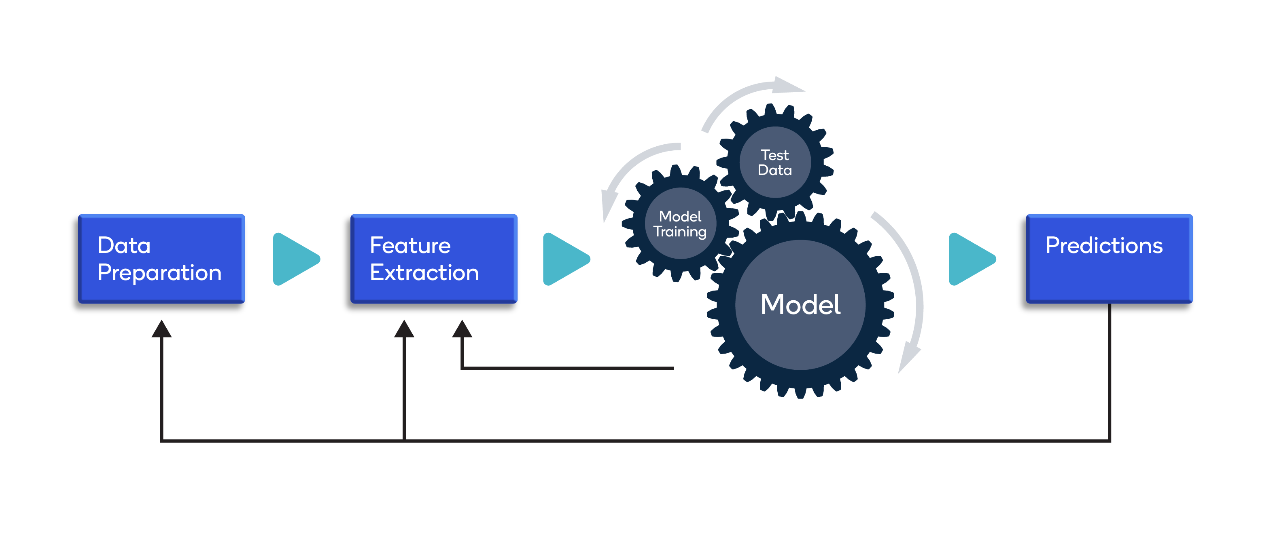
Pipeline of malware classification
Many works declare very high accuracy of classification / detection. Some reviewers even think malware classification is a problem “well addressed”. But is it true ?
Oversensitive/incorrect labelling, family diversity, packing/obfuscation efforts
The quality of the extracted feature
How the testing data is organised
Decoding the Secrets of Features in Windows Malware Classification

Slide 4
Research methodology
We collaborate with AVAST to collect PE malware exeuctables from VirusTotal (VT) composed by 227,296 samples from 13,894 families, out of which 780 families had at least 100 samples.
We organise a measurement study with different testing scenarios, aiming to answer the following 4 research questions (we have more, but let’s save some space here☺):
  RQ1: What is the contribution of static and dynamic features to the classification accuracy ?
  RQ2: Does the presence of off-the-shelf packers and protectors harm the accuracy (Static features )?
  RQ3: Do missing feature values in the run-time behaviours negatively impact the classification results ?(Dynamic features)
  RQ4: How do static and dynamic features perform on different malware families in detection and family classification tasks?
Feature quality
Decoding the Secrets of Features in Windows Malware Classification

Slide 5
Features and models
Static features
  PE header: 29 Bag-of-words features defined over Optional and COFF headers of the executable
  PE Section: 590 boolean features from each section of the executable
  Imported functions / DLLs: 3,863 boolean features extracted from the imported libraries and imported functions in these libraries.
  N-grams of raw bytes: 13,000 features defined by 4-grams, 5-grams and 6-grams extracted from the raw bytes.
  Opocodes: 2,500 n-gram features extracted from the opocdes disassembled using Capstone.
  String: 10,402 boolean features capturing strings of at least 4 characters appearing in over 1% of the files
  File entropy
Decoding the Secrets of Features in Windows Malware Classification

Slide 6
Features and models
Dynamic features
  Network activities: 438 features capturing unique domains contcted by the malware and HTTP user agent strings used, as well as the number of HTTP requests, TCP connections and UDP pseudo-sessions. We also include 5 randomness-related features describing the mean/median/min/max/std likelihood of domain names / URL names (we can use Markov Chain to evaluate the randomness.)
  File I/O: 60,555 features capturing the name and extentions of files created / accessed by malware samples
  Mutex: 7 features capturing the number of mutex objects created and the randomness of the mutex names
  Registry: 60 features capturing 55 unqiue registry keys written, adn the count of keys created, opened, read, written and deleted
  Service: 736 features capruing the number of unique names of services and service managers
  Process: 28,198 features capturing the number of unique names of processes created, terminated and shell command invoked
  Thread: 7 featuress capturing the number of unique names of threads opened, created, resumed, terminated and suspended, as well as the number of asynchronous procedure calls (APC) queued to a thread
Decoding the Secrets of Features in Windows Malware Classification

Slide 7
Features and models
Models: Random Forest and Gradient Boosted Trees-based Classification, as well as a 5-layered CNN / Sigmoid activated feedforward neural network (thought DNN does not bring further improvement over accuracy)
  Tree-like classifiers can handle categorical features.
  Easy to get the feature-wise contribution to the classification output
Training and testing scenarios
  Training and testing with the same balanced malware data (of course via cross-validation)
  Training and testing with the extremly imbalanced malware data
  Training with the balanced mawlare data, yet testing with the out-of-distribution data
Decoding the Secrets of Features in Windows Malware Classification

Slide 8
Some lessons learnt…
Feature class Importance (What is the contribution of static and dynamic features to the classification accuracy ?)
Alignment with manual malware analysis
Static features: The most contributing static feature classes for both classification tasks are s-bytegrams, s-opcodegrams, and s-strings. This confirms what was previously observed in the literature, with raw and opcode n-grams dominating over other static features. Packing / obfuscation does not bring considerable impact the usefulness of static features (any explanation?)
Dynamic features: The most contributing dynamic feature classes for both classification tasks are d-file and d-process. It is interesting to note that even expert human analysts used widely file and processes operations to identify malicious behaviours.
Decoding the Secrets of Features in Windows Malware Classification

Slide 9
Some lessons learnt…
Missing features are harmful. Over 50% of the malware samples contain missing features values in the d-network and d-service feature classes, thus having missing feature values is likely the reason for their low importance
Different tasks need different features. d-registry is helpful for binary classification, but rarely useful for family classification. This means that registry operations are useful to differentiate malware from goodware, but they do not provide enough diversity to separate different malware families.
  This likely happens because multiple malware families operate on the same registry keys such as those related to achieving persistence (e.g., auto-start) and those that disable OS security features. In contrast, goodware does not need to operate on those keys.
Decoding the Secrets of Features in Windows Malware Classification

Slide 10
Some lessons learnt…
Some families are difficult to classify (grayware and viruses)
  Viruses typically append their code to benign files results in a wide variation in terms of static features among samples of the same family, and this can explain why it is hard for a static classifier to differentiate them from goodware and from other families.
  Grayware is defined as undesirable code, which is not outright malicious per se, therefore making it difficult to find a clear boundary to isolate these families.
  We can observe a similar pattern in the results using dynamic features: grayware and virus dominate the list.
  For the results using dynamic features, we can also find that 4 families belonging to downloader, backdoor, spyware and adware also rank the worst. The failure of classification over these families is probably due to the high feature incompleteness (high FMR).
Decoding the Secrets of Features in Windows Malware Classification

Slide 11
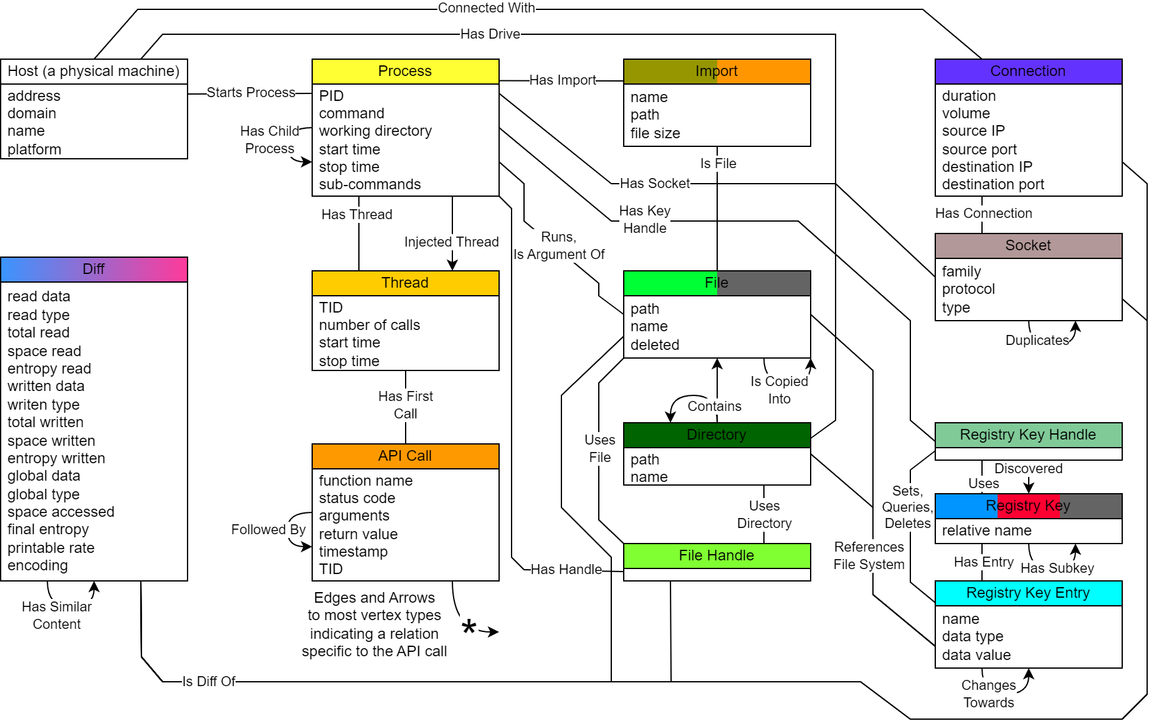
Graph-structured malware features: Not just more explanability
Unveil semantic explanation to cyber attacks
Ransomeware Lockbit
https://gitlab.inria.fr/vraulin/baguette-verse
Graph Neural Networks based subgraph matching
Unveil new attack behaviours
Detect evading techniques
Explaining attack process to reduce false alarms
Structured representation of cyber attacks

Slide 12
Thanks !
It is the Q&A time now
yufei.han@inria.fr
https://arxiv.org/abs/2307.14657, collaborated with Eurecom, IMEDIA and Gendigital,
accepted by ACM CCS this year (presented yesterday ☺)

