Slide 1
Why Machine Learning is needed for Cyber Security Research and Applications ?
Yufei Han
CIDRE Team (https://team.inria.fr/cidre/)
December 1 @ ENSC Bordeaux

Slide 2
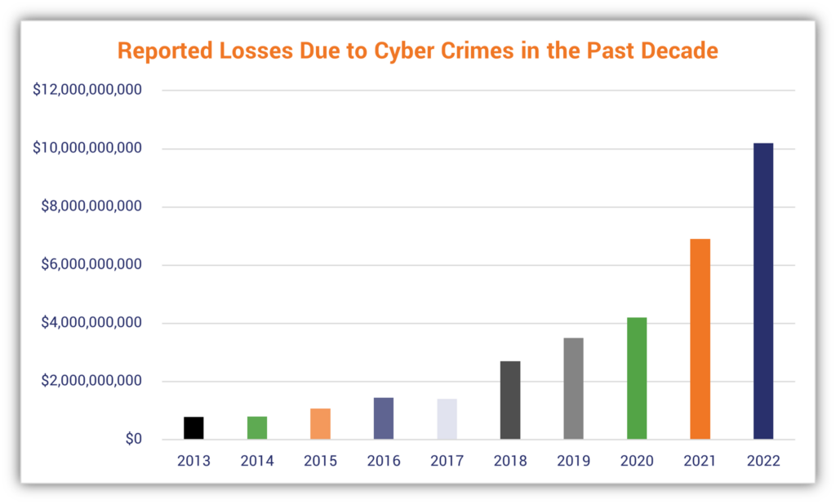
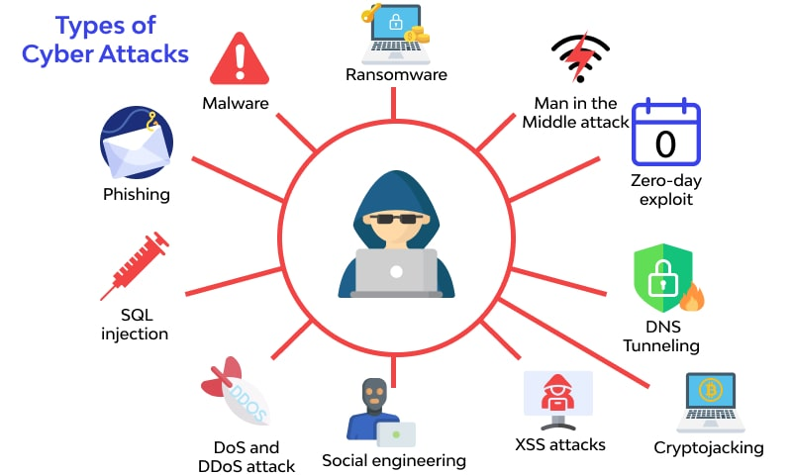
Cyber Attacks on the rise of 2023
Cyber settacks causing increasingly expenseive loss across big to small, public to private entities
Why ML is needed for Cyber Security ?

Slide 3
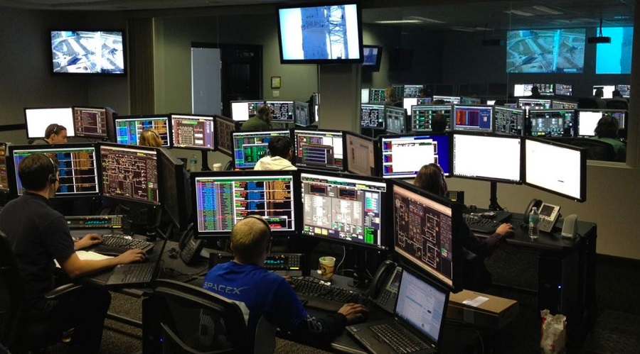
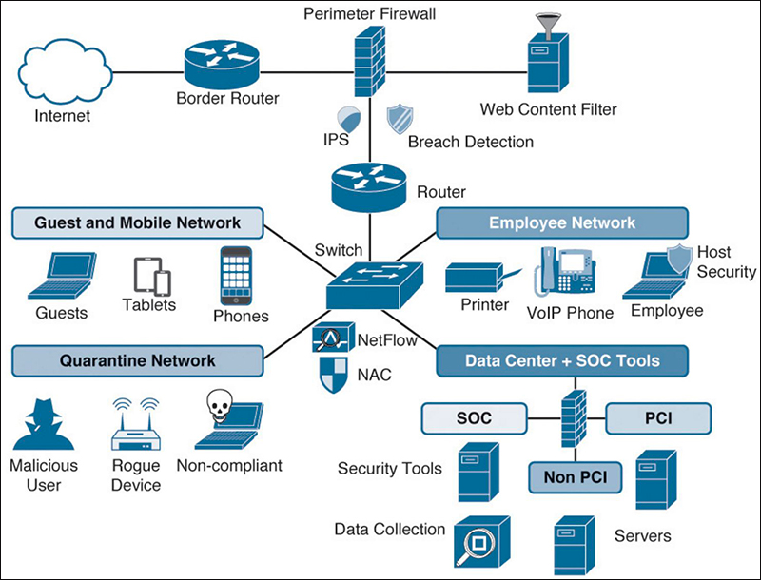
Challenges to Cyber Security Service
Security Operation Center (SOC) of Managed Security Service
Detection
Mitigation Prevention Monitoring
Challenge raised by fast increasing cyber threats:
Huge volume of data input of SOC. For example SOC of Norton recevie reports of 3.7 million spear-phishing and website hijacking events. Human experts can not verify all of them.
1/3 reported incidents originate from zero-day vulnerability. Prediction of potential threats is thus important for active defense
Privacy regulation: GDPR compliance in data usage
Why ML is needed for Cyber Security ?

Slide 4
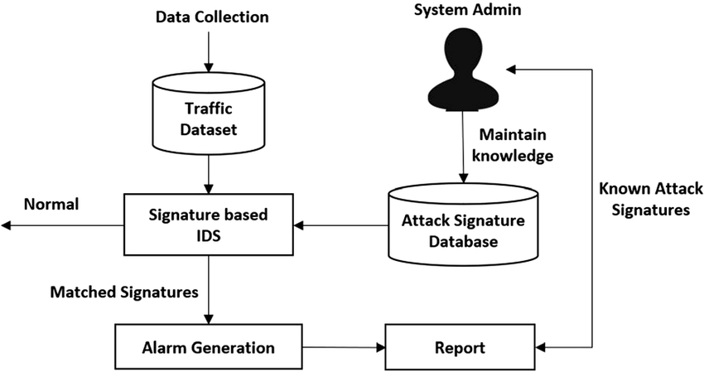
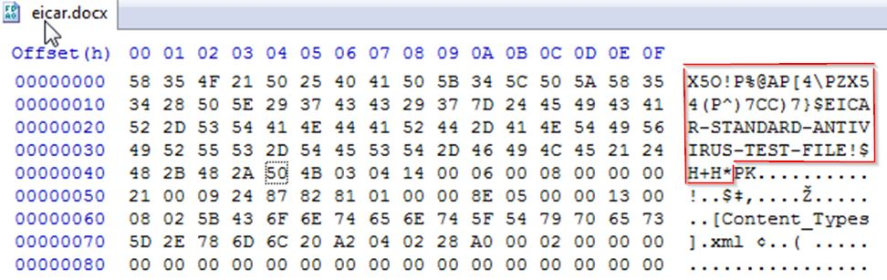
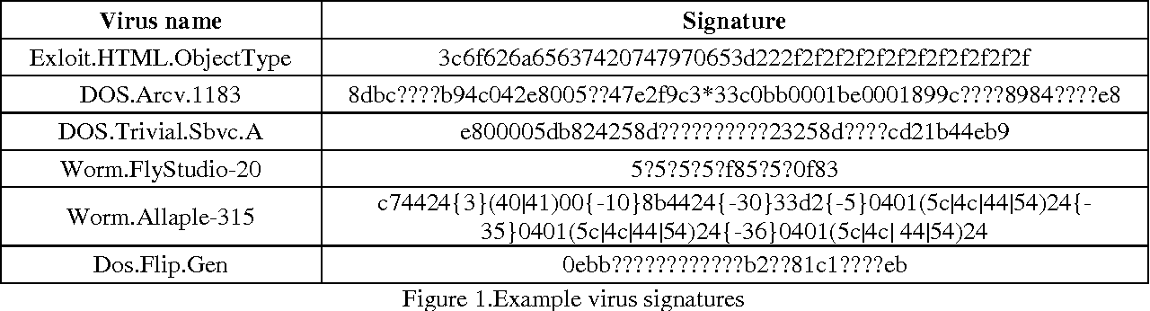
Traditional approaches may fail
Signature-based cyber attack detection (like intrusion detection / malware classification )
Human experts explore signatures
Attack signature database
Why ML is needed for Cyber Security ?

Slide 5
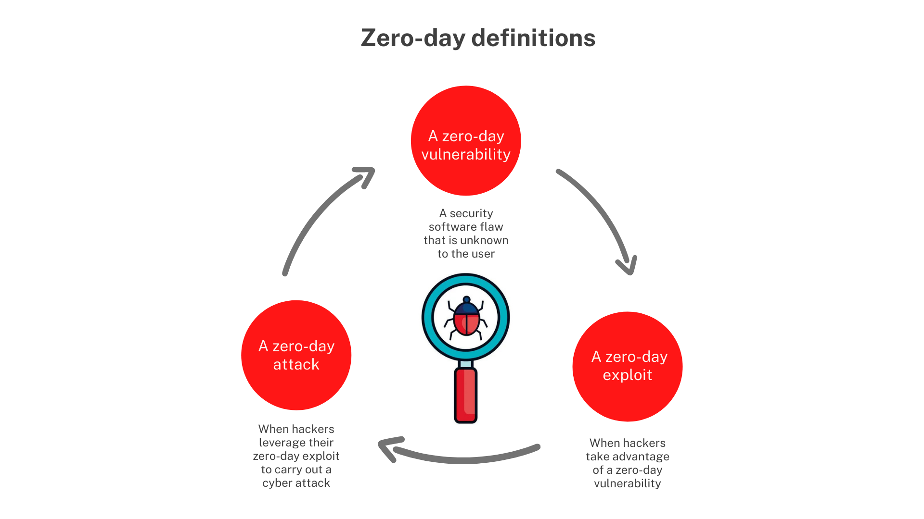
Traditional approaches may fail
New attacks emerge rapidly: 1/3 of cyber attacks observed belong to zero-day exploitation
Unknown attack signature
We can detect unknown attacks via signature / rule matching
Why ML is needed for Cyber Security ?

Slide 6

Traditional approaches may fail
High False Positive Rate: 25% to 75% alerts produced by SOCs are false positives
Benign network traffics / executables could be flagged as malicious if it happened to share similar characteristics to a known threat.
Complex IT environments—SOC must monitor an ever-increasing number of alerts generated by all those security tools.
Lack of context—Alerts arrive, usually in someone’s email inbox, without any context or actionable information.
Alert redundancy—Different security tools may be issuing alerts for the same issue.
Why ML is needed for Cyber Security ?
Notes:
—Today’s organizations have a global footprint of IT resources (including databases, and cloud, virtualization, and big data sites) and countless applications, requiring a variety of security tools to protect those resources and applications. As a result, you must monitor an ever-increasing number of alerts generated by all those security tools.

Slide 7
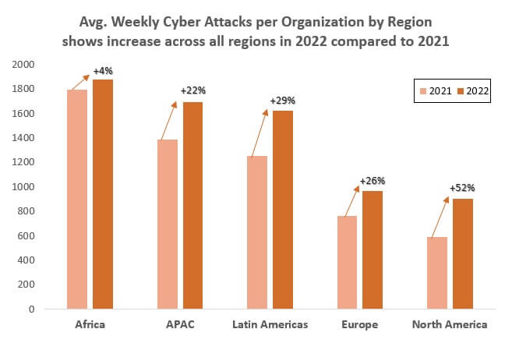
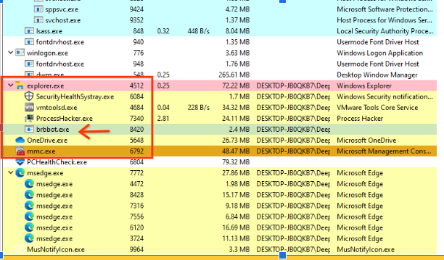
Traditional appraoches may fail
Signature / rule-based detection heavilly rely on manual signature encoding
SOC teams don’t have enough human resources to address all of the reported incidents.
38% increase of 2022 global cyber attacks

Slide 8
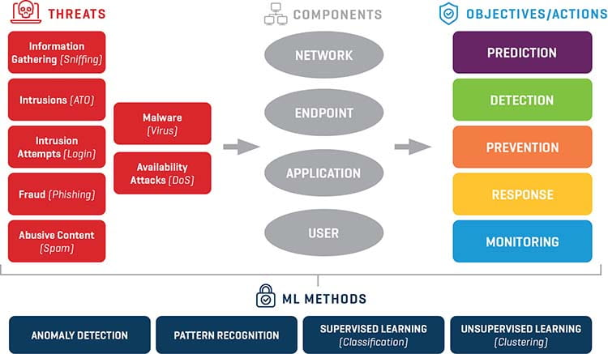
Use of Machine Learning in Cyber Security
Why ML is needed for Cyber Security ?

Slide 9
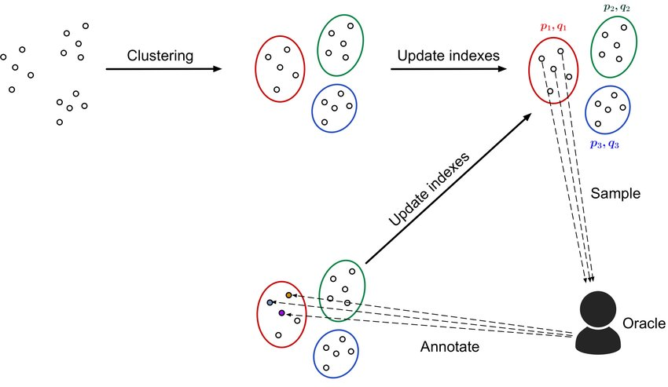
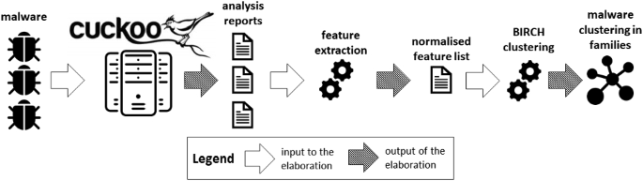
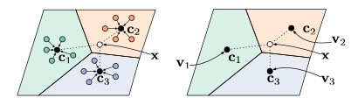
Use of Machine Learning in Cyber Security
Triage of attack campaigns
Self-Supervised Learning + Clustering: Triage attack campaigns in the observed security incident logs.
Active Learning: Reduce human manual investigation efforts (Human experts only need to focus on the most representative samples in each cluster )

Slide 10
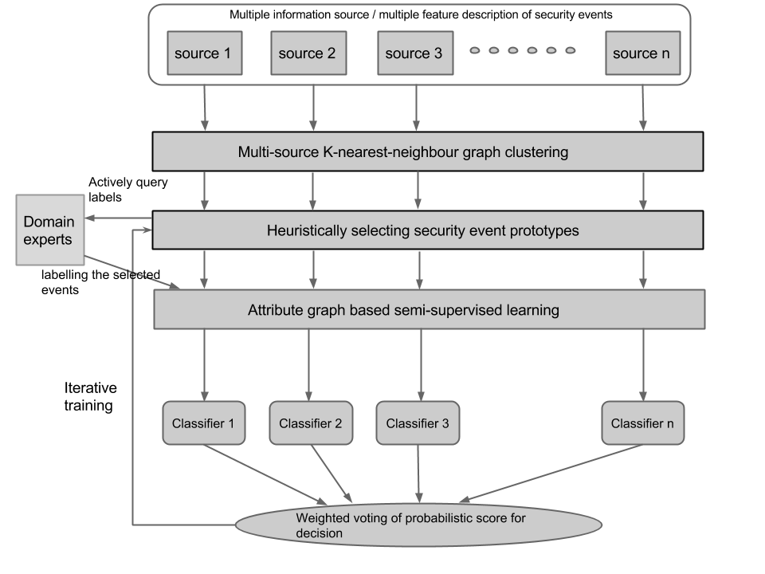
Use of Machine Learning in Cyber Security
Triage of attack campaigns
  Real-world use case for phishing email classification: 660,000 suspicious emails, with only 0.01% of them labeled from 10 spear-phishing families, we are able to achieve 95% detection rate with FP = 0.08%, much better compared to rule-based detectors (Detection rate: 83% with the same FP)

Slide 11
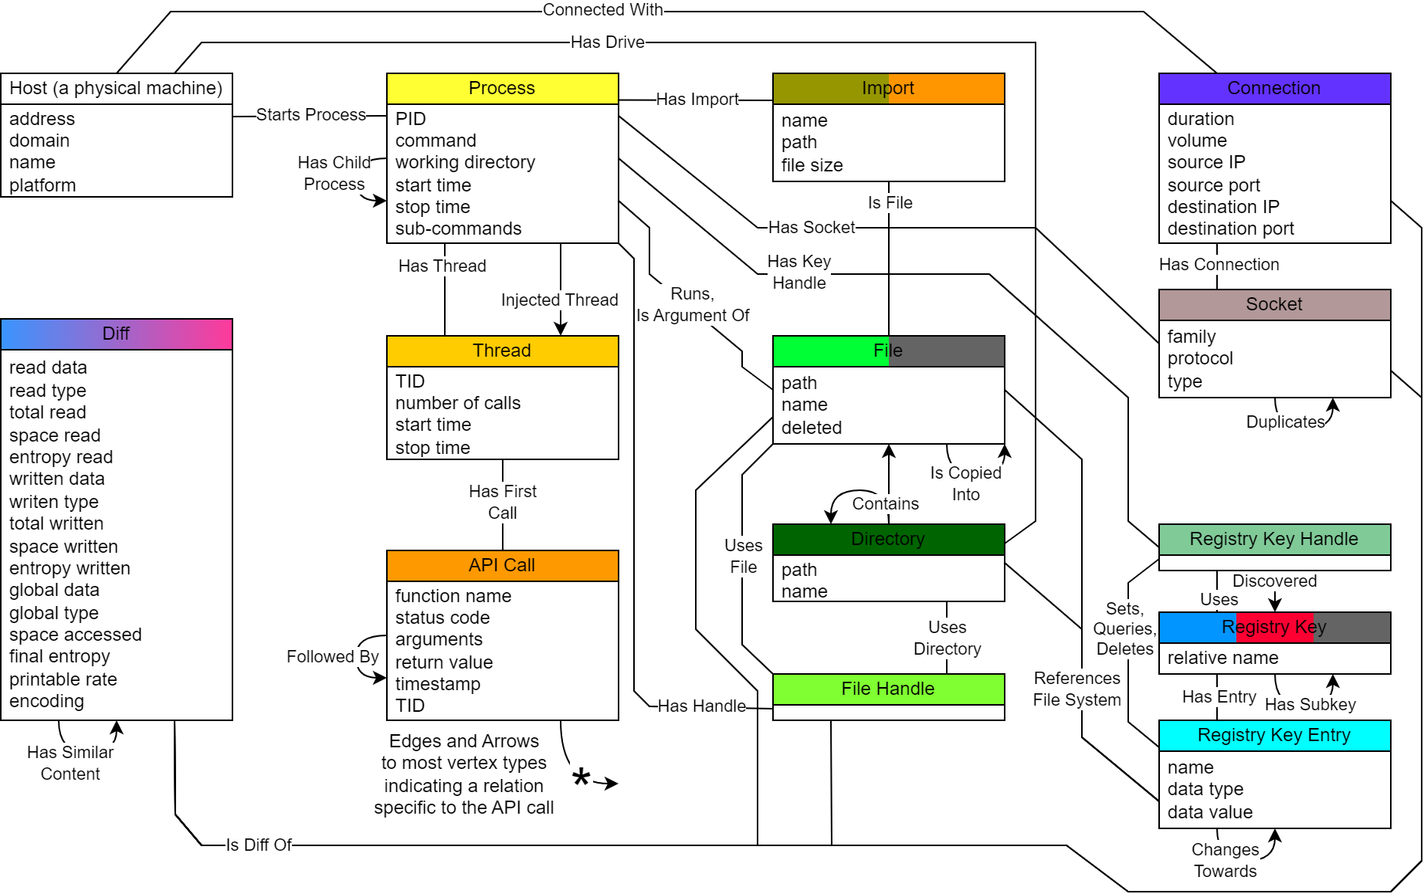
Use of Machine Learning in Cyber Security
Unveil semantic explanation to cyber attacks
Ransomeware Lockbit
Graph Neural Networks based subgraph matching
Unveil new attack behaviours
Detect evading techniques
Explaining attack process to reduce false alarms
Structured representation of cyber attacks
Why ML is needed for Cyber Security ?

Slide 12
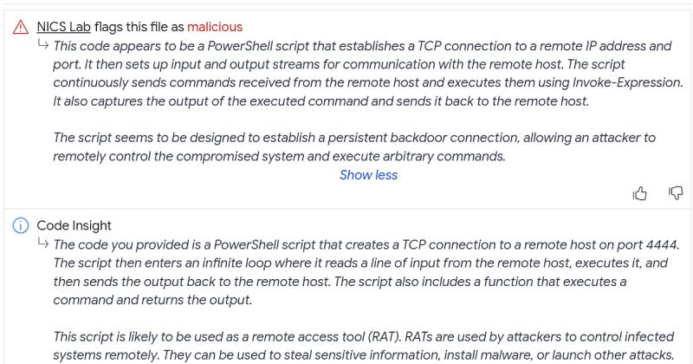
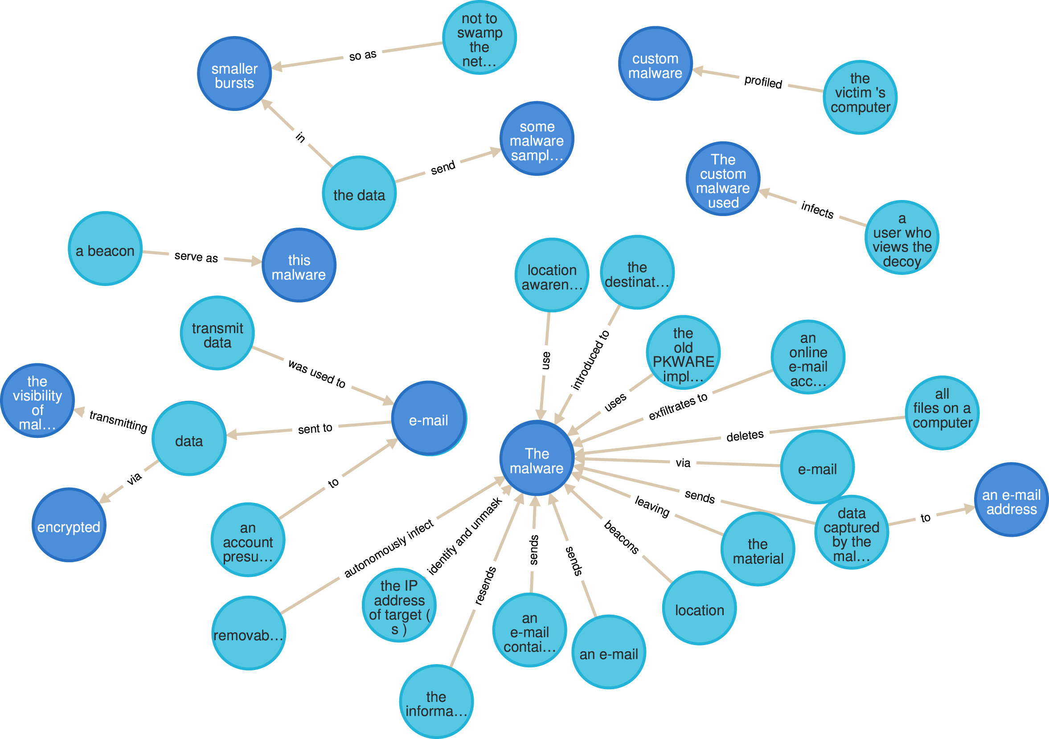

Use of Machine Learning in Cyber Security
Explore knowledge of cyber attacks and perform causality reasoning
Large Language Models
Threat intelligence reports of cyber attacks
Knowledge Graph of cyber attacks
Why ML is needed for Cyber Security ?

Slide 13
Use of Machine Learning in Cyber Security
Explore knowledge of cyber attacks and perform causality reasoning
  Predict attack behaviours with causality reasoning
    For remote access attacks, if we observe AnyDesk remote desktop application is installed onto the compromised device, we will be probably able to detect the execution of legitimate programs such as AmmyyAdmin and Team Viewer for remote interactive C2 to the victim device. Finally, the victim device will be controlled remotely via vncDll module or cloud service apps like LogMeIn. (Executable File Dropping – C2 connection – Remote Control session established)
    Risk Assessment and Proactive Mitigation
      Cyber Insurance
      Active Defense
Why ML is needed for Cyber Security ?

Slide 14
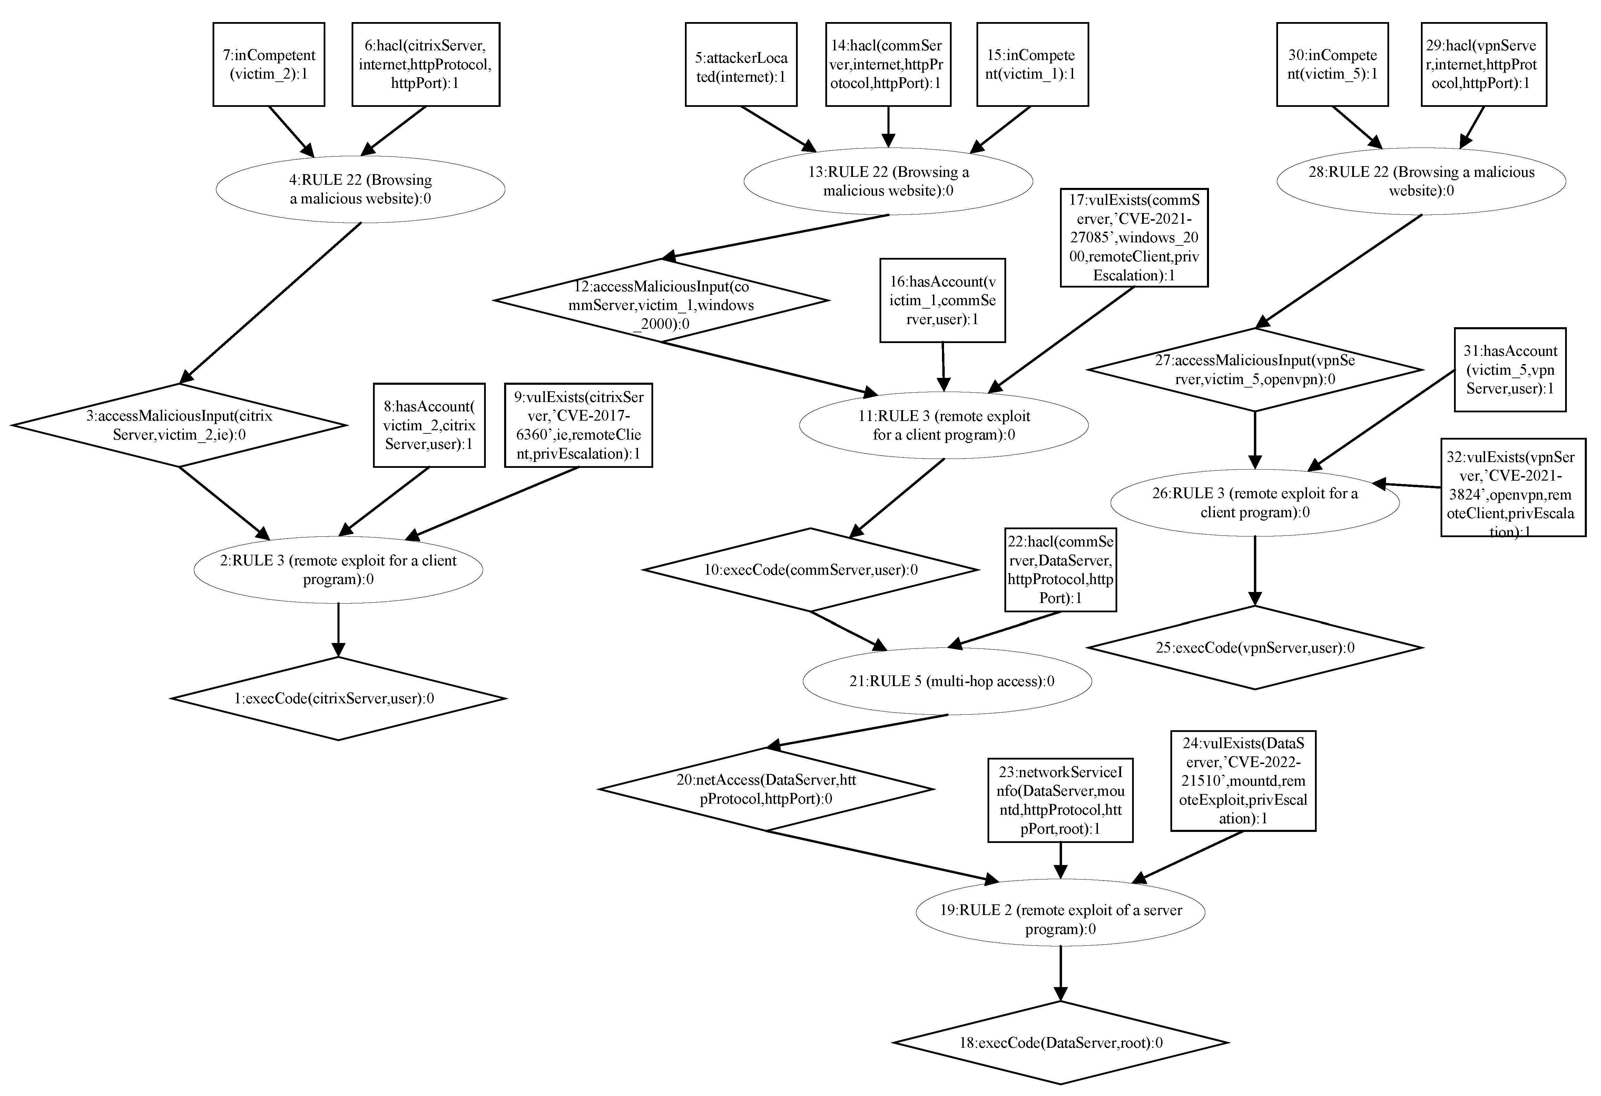
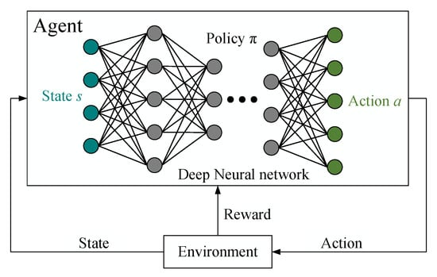
Use of Machine Learning in Cyber Security
Attack paths unveiled by an automated pentest agent
Automated Penetration Test
Deep Reinfrocement Learning as an automated agent to explore attack strategies
Why ML is needed for Cyber Security ?

Slide 15
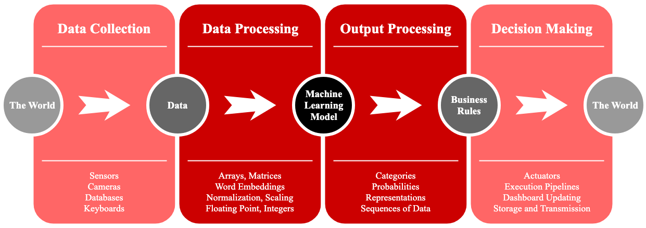
Machine Learning EcoSystem
A life cycle of a Machine Learning-based data analytical system
Why ML is needed for Cyber Security ?

Slide 16





Thanks !
It is the Q&A time now ☺
https://team.inria.fr/cidre/

