Slide 1
Extraction and Transfer of Knowledge in Reinforcement Learning
LAZARIC
Inria “30 minutes de Science” Seminars
SequeL
Inria Lille – Nord Europe
December 10th, 2014
Notes:
Hello everybody, I’m A. Lazaric and I’m going to present the Extra-learn project, which focuses on the problem ofExtraction and Transfer of Knowledge in the Reinforcement Learning framework

Slide 2
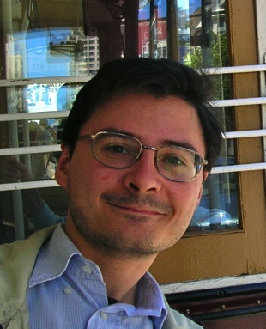
Tools
Online optimization
Optimal control theory
Stochastic approximation
Dynamic programming
Statistics
SequeL
Sequential Learning
Master @PoliMi+UIC (2005)
PhD @PoliMi (2008)
Post-doc @SequeL (2010)
CR @SequeL since Dec. 2010
Problems
Multi-arm bandit
Reinforcement Learning
Sequence Prediction
Online Learning
Results
Theory
(learnability, sample complexity, regret)
Algorithms
(online/batch RL, bandit with structure)
Applications
(finance, recommendation systems, computer games)

Slide 3
Extraction and Transfer of Knowledge in Reinforcement Learning

Slide 4

Good transfer
Positive transfer
No
transfer
Negative transfer

Slide 5
Can we design algorithms able to learn from experience and transfer knowledge across different problems to improve their learning performance?

Slide 6
Outline
Transfer in Reinforcement Learning
Improving the Exploration Strategy
Improving the Accuracy of Approximation
Conclusions
Notes:
ExTra-Learn is funded by ANR through the JCJC program and it will be hosted at INRIA Lille within the SequeL team. I am the PI and I will closely collaborate with Munos, Valko and Mary, who are also permanent members of the group. Extra-learn will also benefit from the collaboration of a PhD student and a post-doc researcher over two years hired through the ANR funding.

Slide 7
Outline
Transfer in Reinforcement Learning
Improving the Exploration Strategy
Improving the Accuracy of Approximation
Conclusions
Notes:
ExTra-Learn is funded by ANR through the JCJC program and it will be hosted at INRIA Lille within the SequeL team. I am the PI and I will closely collaborate with Munos, Valko and Mary, who are also permanent members of the group. Extra-learn will also benefit from the collaboration of a PhD student and a post-doc researcher over two years hired through the ANR funding.

Slide 8

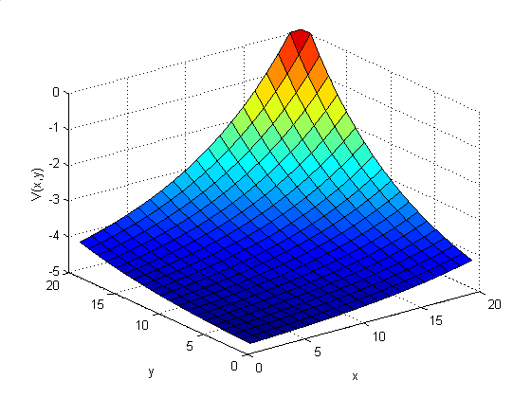
Reinforcement Learning
agent
delay
critic
environment
<position, speed>
<handlebar, pedals>
<new position, new speed>, advancement
Control
Policy
Value Function

Slide 9
Markov Decision Process (MDP)
A Markov Decision Process is
Set of states
Set of actions
Dynamics (probability of transition)
Reward
Policy
Objective: maximize the value function

Slide 10
Reinforcement Learning Algorithms
Over time
Observe state
Take an action
Observe next state and reward
Update policy and value function
Exploration/exploitation dilemma
Approximation
RL algorithms often require many samples and careful design and hand-tuning

Slide 11
Reinforcement Learning
agent
delay
critic
environment
<position, speed>
<handlebar, pedals>
<new position, new speed>, advancement
Very inefficient!

Slide 12
Transfer in Reinforcement Learning
agent
transfer of knowledge
delay
critic
environment

Slide 13
Transfer in Reinforcement Learning
agent
transfer of knowledge
delay
critic
environment

Slide 14
Transfer in Reinforcement Learning
agent
transfer of knowledge
delay
critic
environment

Slide 15
Transfer in Reinforcement Learning
agent
transfer of knowledge
delay
critic
environment

Slide 16
Transfer in Reinforcement Learning
agent
transfer of knowledge
delay
critic
environment

Slide 17
Outline
Transfer in Reinforcement Learning
Improving the Exploration Strategy
Improving the Accuracy of Approximation
Conclusions
Notes:
ExTra-Learn is funded by ANR through the JCJC program and it will be hosted at INRIA Lille within the SequeL team. I am the PI and I will closely collaborate with Munos, Valko and Mary, who are also permanent members of the group. Extra-learn will also benefit from the collaboration of a PhD student and a post-doc researcher over two years hired through the ANR funding.

Slide 18
Multi-arm Bandit: a “Simple” RL Problem
The Multi-armed bandit problem
Set of states: no state
Set of actions (eg, movies, lessons)
Dynamics: no dynamics
Reward (eg, rating, grade)
Policy
Objective:
maximize the reward over time
Online optimization of an unknown stochastic function under computational constraints…

Slide 19




Sequential Transfer in Bandit
explore and exploit

Slide 20



Sequential Transfer in Bandit
Current user
Future users
Past users

Slide 21




Sequential Transfer in Bandit
Current user
Future users
Past users
Idea: although the type of the user is unknown, we may collect knowledge about users and exploit their similarity to identify the type and speed-up the learning process

Slide 22





Sequential Transfer in Bandit
Current user
Future users
Past users
Sanity check: develop an algorithm that given the information about possible users as prior knowledge can outperform a non-transfer approach

Slide 23
The model-Upper Confidence Bound Algorithm
Over time
Select action
Exploitation
the higher the (estimated) reward the higher the chance to select the action
Exploration
the higher the (theoretical) uncertainty the higher the chance to select the action

Slide 24
The model-Upper Confidence Bound Algorithm
Over time
Select action
“Transfer”
combine current estimates with prior knowledge about the users in Θ

Slide 25
Sequential Transfer in Bandit
Current user
Future users
Past users
Collect knowledge

Slide 26





Sequential Transfer in Bandit
Current user
Future users
Past users
Transfer knowledge

Slide 27





Sequential Transfer in Bandit
Current user
Future users
Past users
Collect & Transfer knowledge

Slide 28





Sequential Transfer in Bandit
Current user
Future users
Past users
Collect & Transfer knowledge

Slide 29





Sequential Transfer in Bandit
Current user
Future users
Past users
Collect & Transfer knowledge

Slide 30
The transfer-Upper Confidence Bound Algorithm
Over time
Select action
“Collect and transfer”
using a method of moment approach to solve a latent variable model problem

Slide 31
Results
Theoretical guarantees
  Improvement wrt no-transfer solution
  Reduction in the regret
  Dependency on number of “users” and their difference

Slide 32
Empirical Results
NIPS 2013, with E. Brunskill (CMU), M. Azar (Northwestern Univ)
Synthetic data
BAD
Currently testing on a “movie recommendation” dataset
GOOD

Slide 33
Outline
Transfer in Reinforcement Learning
Improving the Exploration Strategy
Improving the Accuracy of Approximation
Conclusions
Notes:
ExTra-Learn is funded by ANR through the JCJC program and it will be hosted at INRIA Lille within the SequeL team. I am the PI and I will closely collaborate with Munos, Valko and Mary, who are also permanent members of the group. Extra-learn will also benefit from the collaboration of a PhD student and a post-doc researcher over two years hired through the ANR funding.

Slide 34

Sparse Multi-task Reinforcement Learning
Learning to play poker
States: cards, chips, …
Action: stay, call, fold
Dynamics: deck, opponent
Reward: money
➔ Use RL to solve it!
Notes:
ExTra-Learn is funded by ANR through the JCJC program and it will be hosted at INRIA Lille within the SequeL team. I am the PI and I will closely collaborate with Munos, Valko and Mary, who are also permanent members of the group. Extra-learn will also benefit from the collaboration of a PhD student and a post-doc researcher over two years hired through the ANR funding.

Slide 35
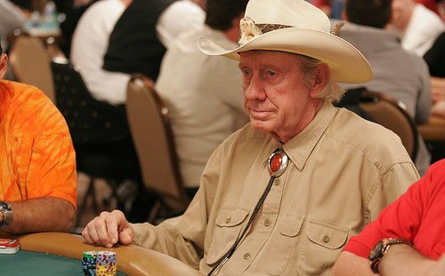
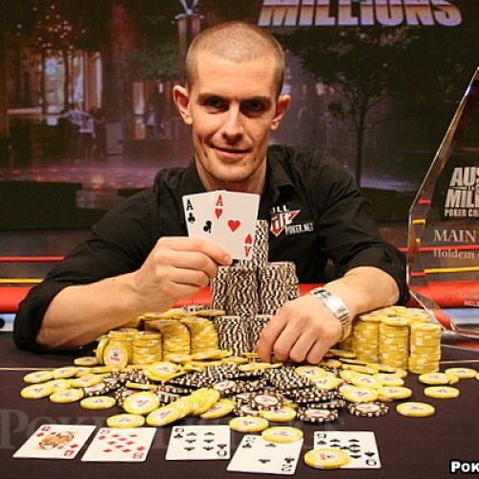

Sparse Multi-task Reinforcement Learning
This is a Multi-Task RL problem!
Notes:
ExTra-Learn is funded by ANR through the JCJC program and it will be hosted at INRIA Lille within the SequeL team. I am the PI and I will closely collaborate with Munos, Valko and Mary, who are also permanent members of the group. Extra-learn will also benefit from the collaboration of a PhD student and a post-doc researcher over two years hired through the ANR funding.

Slide 36

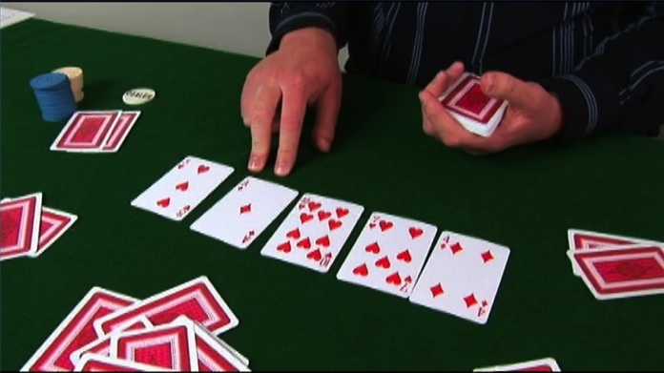

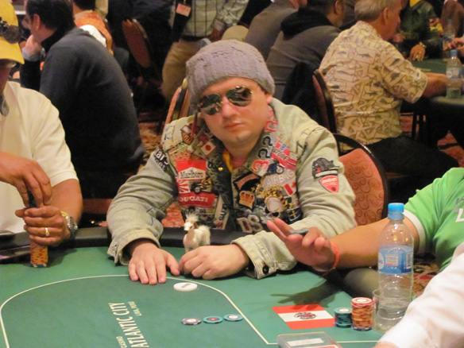

Sparse Multi-task Reinforcement Learning
Let’s use as much information as possible to solve the problem!
Not all the “features” are equally useful!
Notes:
ExTra-Learn is funded by ANR through the JCJC program and it will be hosted at INRIA Lille within the SequeL team. I am the PI and I will closely collaborate with Munos, Valko and Mary, who are also permanent members of the group. Extra-learn will also benefit from the collaboration of a PhD student and a post-doc researcher over two years hired through the ANR funding.

Slide 37


The linear Fitted Q-Iteration Algorithm
Collect samples from the environment
features
Create a regression dataset
Solve a linear regression problem
Return the greedy policy
Notes:
ExTra-Learn is funded by ANR through the JCJC program and it will be hosted at INRIA Lille within the SequeL team. I am the PI and I will closely collaborate with Munos, Valko and Mary, who are also permanent members of the group. Extra-learn will also benefit from the collaboration of a PhD student and a post-doc researcher over two years hired through the ANR funding.

Slide 38
Sparse Linear Fitted Q-Iteration
Collect samples from the environment
Create a regression dataset
The LASSO
Solve a sparse linear regression problem
Return the greedy policy
L1-regularized least-squares
Notes:
ExTra-Learn is funded by ANR through the JCJC program and it will be hosted at INRIA Lille within the SequeL team. I am the PI and I will closely collaborate with Munos, Valko and Mary, who are also permanent members of the group. Extra-learn will also benefit from the collaboration of a PhD student and a post-doc researcher over two years hired through the ANR funding.

Slide 39
The Multi-task Joint Sparsity Assumption
features
tasks
Notes:
ExTra-Learn is funded by ANR through the JCJC program and it will be hosted at INRIA Lille within the SequeL team. I am the PI and I will closely collaborate with Munos, Valko and Mary, who are also permanent members of the group. Extra-learn will also benefit from the collaboration of a PhD student and a post-doc researcher over two years hired through the ANR funding.

Slide 40
Multi-task Sparse Linear Fitted Q-Iteration
Collect samples from each task
Create T regression datasets
The Group LASSO
Solve a MT sparse linear regression problem
Return the greedy policies
L-(1,2)-regularized least-squares
Notes:
ExTra-Learn is funded by ANR through the JCJC program and it will be hosted at INRIA Lille within the SequeL team. I am the PI and I will closely collaborate with Munos, Valko and Mary, who are also permanent members of the group. Extra-learn will also benefit from the collaboration of a PhD student and a post-doc researcher over two years hired through the ANR funding.

Slide 41
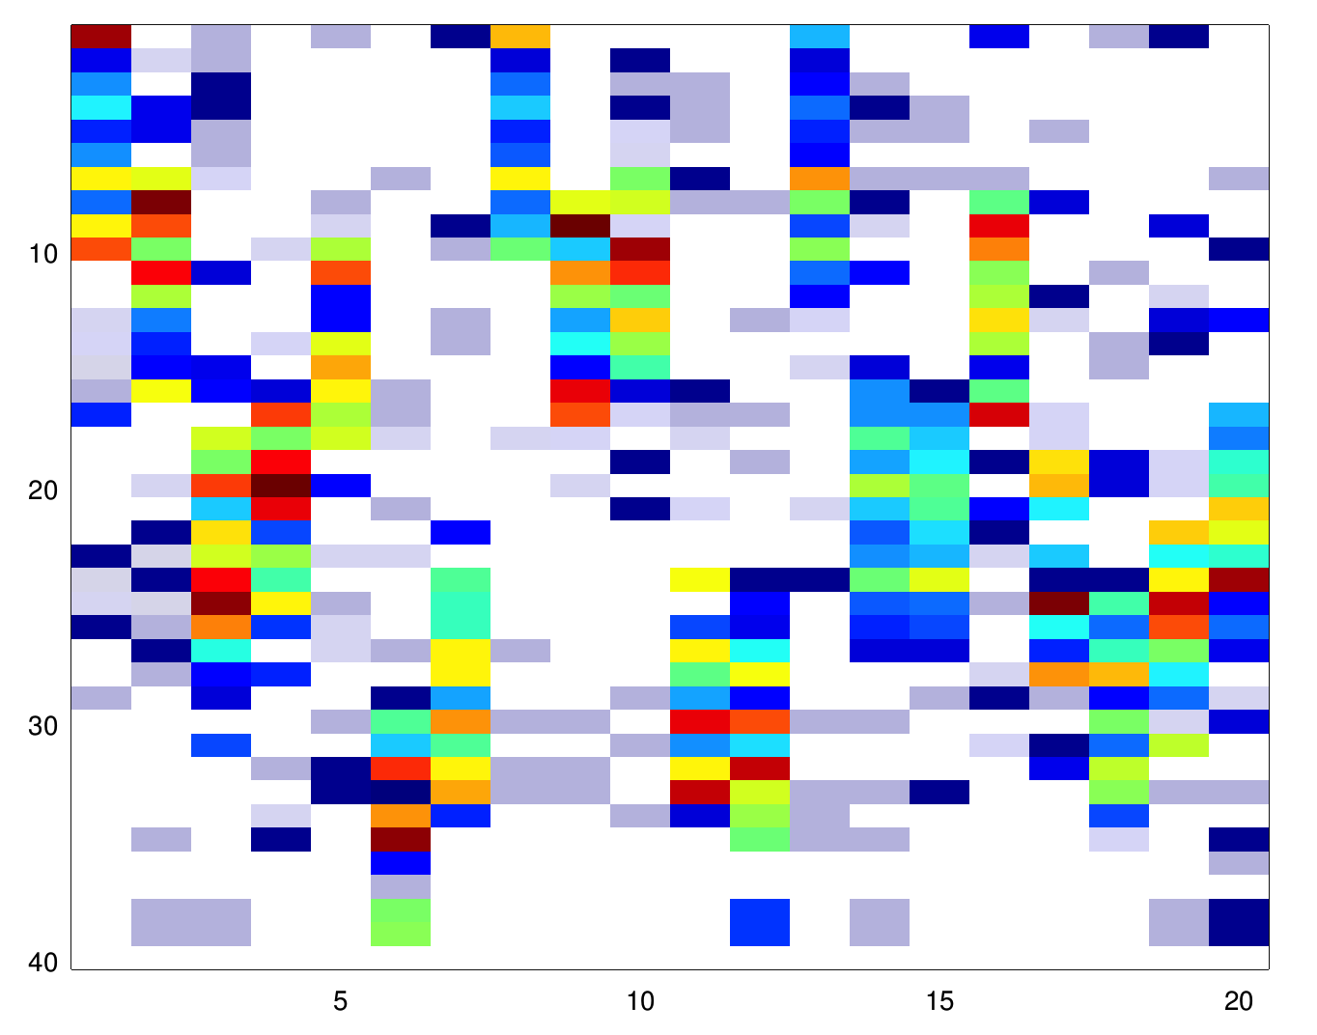
The Multi-task Joint Sparsity Assumption
features
tasks
Notes:
ExTra-Learn is funded by ANR through the JCJC program and it will be hosted at INRIA Lille within the SequeL team. I am the PI and I will closely collaborate with Munos, Valko and Mary, who are also permanent members of the group. Extra-learn will also benefit from the collaboration of a PhD student and a post-doc researcher over two years hired through the ANR funding.

Slide 42
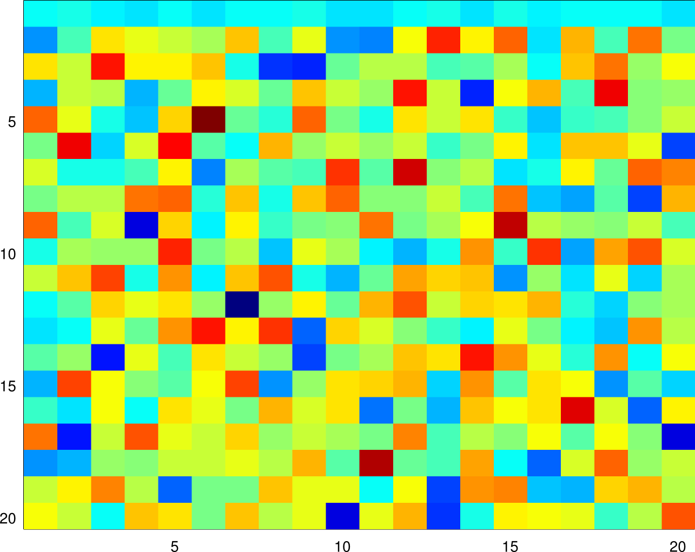
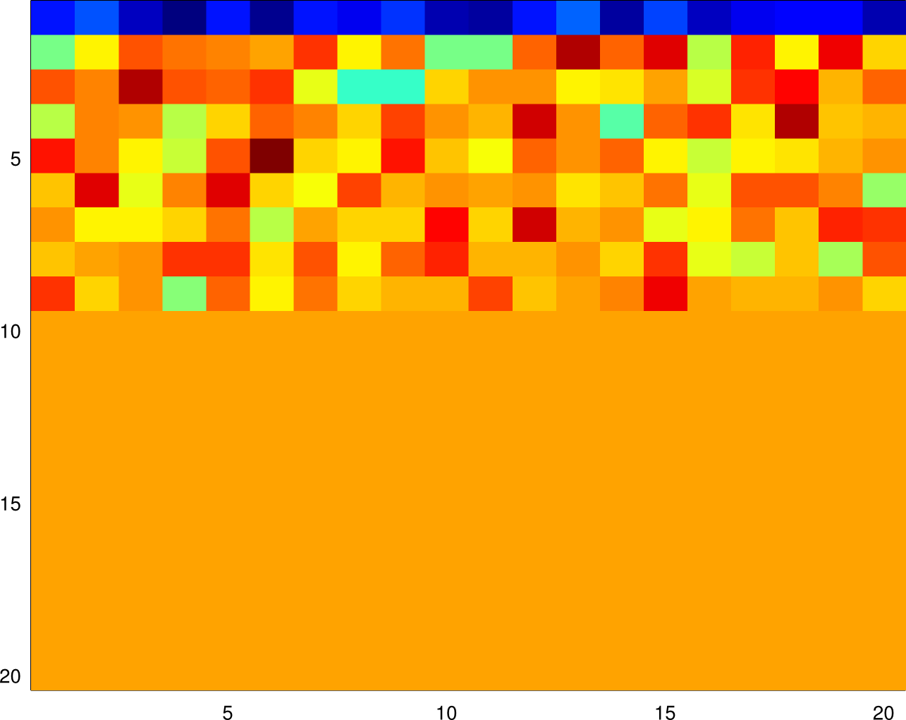
Learning a sparse representation
transformation of the features
(aka dictionary learning)
Notes:
ExTra-Learn is funded by ANR through the JCJC program and it will be hosted at INRIA Lille within the SequeL team. I am the PI and I will closely collaborate with Munos, Valko and Mary, who are also permanent members of the group. Extra-learn will also benefit from the collaboration of a PhD student and a post-doc researcher over two years hired through the ANR funding.

Slide 43
Multi-task Feature Learning Linear Fitted Q-Iteration
Collect samples from each task
Create T regression datasets
Learn a sparse representation
The MT-Feature Learning
Solve a MT sparse linear regression problem
Return the greedy policies
Notes:
ExTra-Learn is funded by ANR through the JCJC program and it will be hosted at INRIA Lille within the SequeL team. I am the PI and I will closely collaborate with Munos, Valko and Mary, who are also permanent members of the group. Extra-learn will also benefit from the collaboration of a PhD student and a post-doc researcher over two years hired through the ANR funding.

Slide 44
Theoretical Results
Number of samples (per task) needed to have an accurate approximation using d features
Std approach: Linearly proportional… too many samples!
Lasso: Only log(d)! But no advantage from multiple tasks…
G-Lasso: Decreasing in T! But joint sparsity may be poor…
Rep. learn.: Smallest number of important features! But learning the representation may be expensive…
Notes:
ExTra-Learn is funded by ANR through the JCJC program and it will be hosted at INRIA Lille within the SequeL team. I am the PI and I will closely collaborate with Munos, Valko and Mary, who are also permanent members of the group. Extra-learn will also benefit from the collaboration of a PhD student and a post-doc researcher over two years hired through the ANR funding.

Slide 45
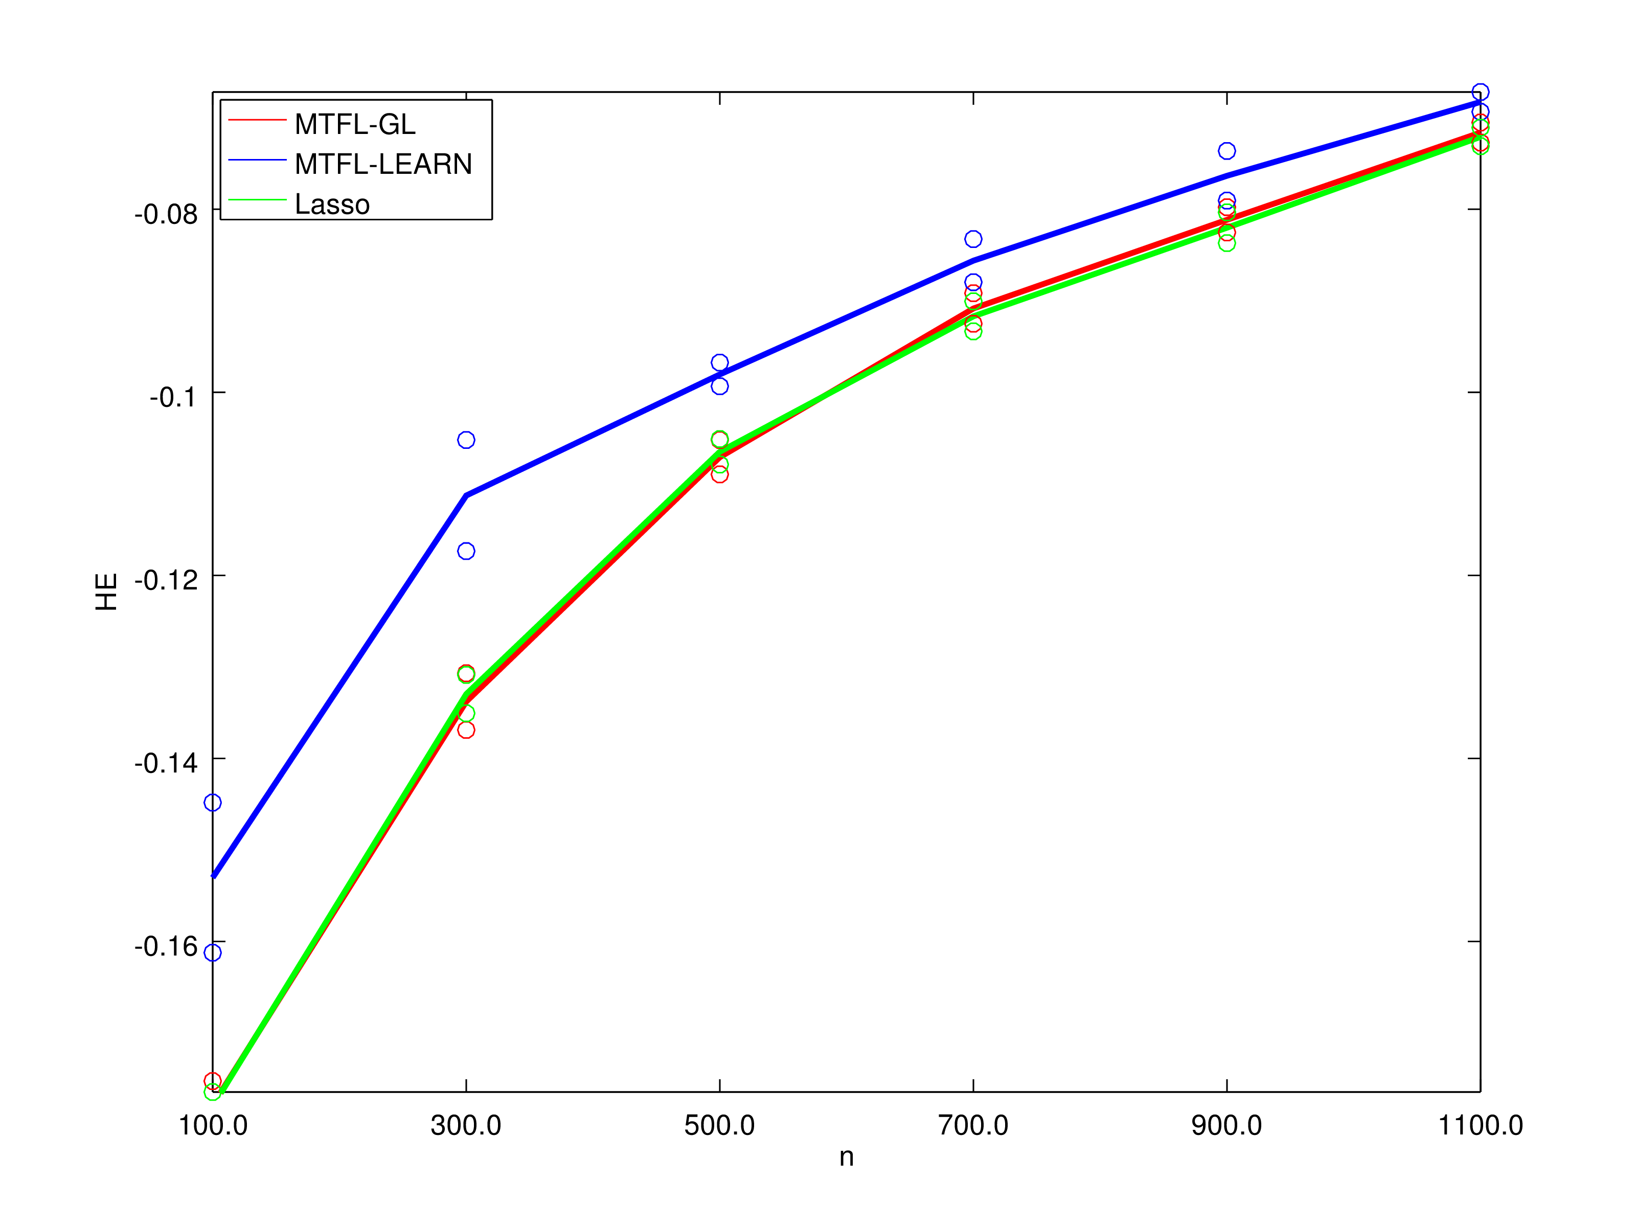
Empirical Results: the BlackJack
Under study: application to other computer games
NIPS 2014, with D. Calandriello and M. Restelli (PoliMi)
Notes:
ExTra-Learn is funded by ANR through the JCJC program and it will be hosted at INRIA Lille within the SequeL team. I am the PI and I will closely collaborate with Munos, Valko and Mary, who are also permanent members of the group. Extra-learn will also benefit from the collaboration of a PhD student and a post-doc researcher over two years hired through the ANR funding.

Slide 46
Outline
Transfer in Reinforcement Learning
Improving the Exploration Strategy
Improving the Accuracy of Approximation
Conclusions
Notes:
ExTra-Learn is funded by ANR through the JCJC program and it will be hosted at INRIA Lille within the SequeL team. I am the PI and I will closely collaborate with Munos, Valko and Mary, who are also permanent members of the group. Extra-learn will also benefit from the collaboration of a PhD student and a post-doc researcher over two years hired through the ANR funding.

Slide 47
Conclusions
Without Transfer
With Transfer
Notes:
ExTra-Learn is funded by ANR through the JCJC program and it will be hosted at INRIA Lille within the SequeL team. I am the PI and I will closely collaborate with Munos, Valko and Mary, who are also permanent members of the group. Extra-learn will also benefit from the collaboration of a PhD student and a post-doc researcher over two years hired through the ANR funding.

Slide 48


Thanks!!
  Inria Lille – Nord Europe
www.inria.fr

