Slide 1
Explainer Divergence Scores (EDS):
Some Post-Hoc Explanations May be Effective for Detecting Unknown Spurious Correlations
Shea Cardozo^{1, 2}, Gabriel Islas Montero^{1, 2}, Dmitry Kazhdan^{1,3}, Botty Dimanov¹, Maleakhi Wijaya¹, Mateja Jamnik³ and Pietro Lio³
¹ Tenyks
² University of Toronto
³ University of Cambridge

Slide 2
Presentation Breakdown
Motivation
Contributions
Background
Related Work
Explainer Divergence Scores (EDS)
Definition
Properties
Experimental Results
Conclusion and Future Directions

Slide 3
Motivation
Existing explanation-based spurious correlation detectors cannot compare performances across different explainers.
Why is this important? A comparable metric across explainers would enable us to select the best explanation approach in a variety of spurious scenarios.

Slide 4
Contributions
The first method able to compare the performance across different post-hoc explainers.
A novel Information Theory approach that relates the information extracted by a explainer to a model’s dependency on spurious correlations.
Our approach can evaluate non-apparent dependencies on spurious correlations .

Slide 5
Background - Post-Hoc Explanations
Aims to explain a black box model once a prediction has been made.
Types of explanations vary:
Feature Attribution (‘Heatmaps’)
Influential Examples
Concept Extraction
Many others…
Figure 1. A feature attribution heatmap, ‘explaining’ what a classifier pays attention to during inference.

Slide 6
Background - Spurious Correlations
Pattern present in training distribution, but does not generalize to production distribution
Motivation: We are interested in quantitatively analyzing the effectiveness of post-hoc explanations in identifying when a neural network suffers from a spurious correlation.
Figure 2. Left: training data with a classic example of a camel in a desert, and a cow on a green background. Right: test data with an unexpected camel on a green background: what will a classifier predict? Image credits: L. Moneda.

Slide 7
Related Work
Metrics to evaluate post-hoc explainers do exist….
Comparison with ‘ground truth’ expected explanations (Adebayo et. al. 2021)
Synthetic tasks (Error identification/Retrieval) (Argawal et. al. 2022, Liu et. al. 2021)
Feature attribution only (Alvarez-Melis et al. 2018, Dai et. al 2021)
…but they lack interpretability and comparability
Unclear what a ‘good’ or ‘bad’ result is
Only comparable between similar explainers within the same category (i.e. heatmaps)

Slide 8
Explainer Divergence Scores (EDS) - Definition
We define EDS as the performance of a binary classifier trained to predict whether a post-hoc explanation was generated from a defective (relying a spurious correlation) or non-defective neural network.

Slide 9
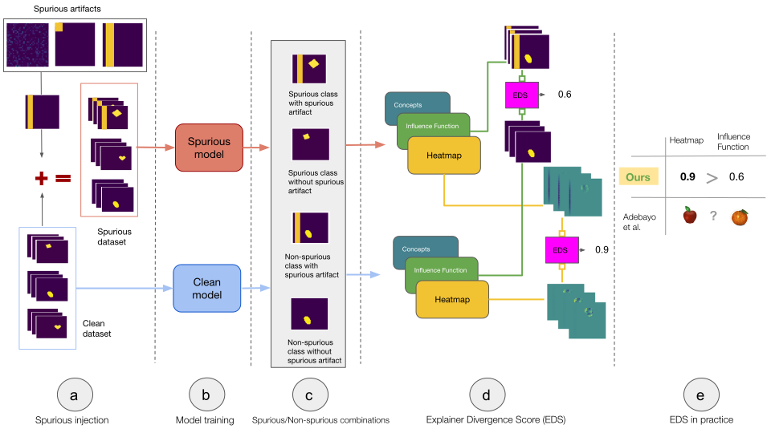
EDS - Experimental Setup

Slide 10
EDS - Properties
Comparable
EDS are comparable between wildly different types of explainers on any arbitrary task
E.g. comparing the performances of heatmaps and influential examples directly
Interpretable
An EDS of 80% would indicate a user trying to diagnose a neural network using a single given explanation would diagnose correctly 80% of the time
An EDS of 50% or less would indicate a useless explainer (cannot do better than random guessing)
The loss of our trained classifier can be shown to be an estimate of the Jensen-Shannon divergence between the distributions of explanations from defective and non-defective neural networks respectively.

Slide 11
Experimental Results
 |  | Heatmap | Influence | Concept
Ours: Explainer Divergence Scores | Overall | 0.799 | 0.887 | 0.715
 | Spurious class without artifact | 0.837 | 0.937 | 0.645
 | Non-spurious class without artifact | 0.590 | 0.860 | 0.578
 | Spurious class with artifact | 0.902 | 0.891 | 0.827
 | Non-spurious class with artifact | 0.916 | 0.887 | 0.831
Adebayo et al. Metrics | KSSD | 0.851 | 0.562 | -0.0062
 | CCM | 0.877 | 0.991 | -0.074
 | FAM | 0.837 | 0.989 | -0.076
Strong Results for Heatmaps and Influential Examples
Comparatively poor results for Concept Extraction
General drop in performance across all explainers for images from Non-Spurious Classes without the Spurious Artifact (still above 0.5, with strong results for Influential Examples)
We find better Explainer performance for more visible spurious artifacts
Limitations of the state-of-the-art vs our method
Table 1. EDS on the dSprites dataset for a Square spurious artifact.

Slide 12
Conclusion and Future Directions
We present Explainer Divergence Scores - an interpretable and comparable way to evaluate a post-hoc explainer’s ability to detect spurious correlations
We find our chosen heatmap and influential example methods consistently outperforming concept extraction methods at identifying spurious correlations across multiple tasks
We find high EDS performance in surprising circumstances
Human Uninterpretable Explanations - suggesting that a focus on extracting ‘hidden’ information from explanations may be just as important for effectively diagnosing problems
Non-Spurious Classes - suggesting that spurious correlations can affect a network’s ability to learn entirely unrelated classes in ways detectable by contemporary explainers

Slide 13
References
Julius Adebayo, Michael Muelly, Harold Abelson, and Been Kim. 2022. Post hoc Explanations may be Ineffective for Detecting Unknown Spurious Correlation. In International Conference on Learning Representations.
Julius Adebayo, Michael Muelly, Ilaria Liccardi, and Been Kim. 2020. Debugging Tests for Model Explanations. In Advances in Neural Information Processing Systems 33: Annual Conference on Neural Information Processing Systems 2020, NeurIPS 2020, December 6-12, 2020, virtual, Hugo Larochelle, Marc’Aurelio Ranzato, Raia Hadsell, Maria-Florina Balcan, and Hsuan-Tien Lin (Eds.)
Dmitry Kazhdan, Botty Dimanov, Mateja Jamnik, Pietro Liò, and Adrian Weller. 2020. Now You See Me (CME): Concept-based Model Extraction. In Proceedings of the CIKM 2020 Workshops co-located with 29th ACM International Conference on Information and Knowledge Management (CIKM 2020), Galway, Ireland, October 19-23, 2020 (CEUR Workshop Proceedings, Vol. 2699), Stefan Conrad and Ilaria Tiddi (Eds.). CEUR-WS.org.
Amirata Ghorbani, Abubakar Abid, and James Y. Zou. 2017. Interpretation of Neural Networks is Fragile. CoRR abs/1710.10547 (2017).
Pang Wei Koh and Percy Liang. 2017. Understanding Black-box Predictions via Influence Functions. In Proceedings of the 34th International Conference on Machine Learning, ICML 2017, Sydney, NSW, Australia, 6-11 August 2017 (Proceedings of Machine Learning Research, Vol. 70), Doina Precup and Yee Whye Teh (Eds.). PMLR, 1885–1894.
Yao-Yuan Yang and Kamalika Chaudhuri. 2022. Understanding Rare Spurious Correlations in Neural Networks. CoRR abs/2202.05189 (2022).
.

