Slide 1
Explainability for Graph Neural Networks
21/10/2022
Notes:
Good morning everyone. Before I start, I would like to deeply thank the organizers for inviting to this workshop and granting me the opportunity to give this keynote talk, it is a real pleasure. Among them, I will also like to give a special mention to Luis and Julien, who, to make things interesting, decided to warn me about the keynote only two days ago. This has made my yesterday night particularly special haha. Who would not love making slides on a Thursday night ? On a more serious note, I will be speaking about Explainability for Graph Neural Networks.

Slide 2
01
Explainable AI
Notes:
Since you have probably heard all day long and all week long what is explainability and why is it important, I will try not to spend too much time on that, or at least, to approach it from a different angle. Since it’s a keynote and that I can as I please, from what I understood at least, I will talk to you about a book instead. But not any book, the book made me work on explainable AI. Maybe some of you know it already, it is relatively famous and it is titled: “Wepons of Maths Destruction” by Cathy O’Neil.

Slide 3

Motivation
Cathy O’Neil raises question about ethics of algorithm and use many real world situations emphasising improper use of AI.
      COMPAS
      Car insurance market
      Teachers grading
Shared points: opacity, scale, and damage.
Great motivation for working on explainability.
Notes:
This book is written by O’Neil, an academic mathematician working as a Wall Street quant, which changed to be data scientist and has recently started an algorithmic auditing company. In this book, she raises question about ethics of algorithm and use many real world situations emphasising improper use of AI. More precisely, she describes different aspect of the world where we have implemented mathematical models, including AI models, which turned out to have undesirable and unpredicted effects.
COMPAS is a model that evaluates the risk of recidivism of a convict, as well as the risk of violence, from a questionnaire that he fills in, containing information about where he lives, if they are criminals in his family, etc. The results of this model are then used to determine if we shall release a convict or extend its sentence. And after a few years, we actually found out that the model discriminated against black criminals, augmenting their predicted risk of recidivism and violence; by using the region as a proxy. This triggers a vicious circle, where they get sentenced for longer times, and get rejected to the same old dangerous neighbourhood where the risk to commit a crime is higher. So it’s even more unlikely that they find a job, and they end up commiting crime again, validating the predictions of the model.
Car insurance market. She shares the galling statistic that “in Florida, adults with clean driving records and poor credit scores paid an average of $1552 more than the same drivers with excellent credit score but a drunk driving conviction.” As a result, Whether or not you’ve paid your phone bill can have more impact on auto insurance than getting hammered and sitting behind the wheel.
Teachers. Model grades teacher and that fires teachers based on the performance of students at school tests. Most teachers boosted their student grade to get promotions. Some did not and got fired because of poor performance.
She shows with these examples that conceiving models that we do not really understand and where we have not thought of the consequences can ruin the lives of millions of persons, often locking minorities into negative feedback loops which progressively degrade their living situations. This was a excellent motivation to start working on explanability.

Slide 4




Motivation
Ethics
  Model does the right thing for the right reasons.
  Think about deployment consequences.
  Example: COMPAS.
Legal right
  GDPR enforces the « right for explanation » of any individual.
  Example: bank loan application
Liability and safety
  Account for the decisions of the AI. Debug. Be robust to adversarial attacks.
  Example: autonomous car.
Business adoption
  Need trust to adopt a model and deploy it at scale.
Notes:
With the above book, we saw a clear ethical reason to comprehend the models, but it is not the only one. We shall now also do it for legal reasons.
Legal right. For example, imagine that you want to contract a loan at your bank. Your application is going to be processed by a ML algorithm, which will attribute you a score based on various variables: your income, your criminal record, you debt, etc. If you see your application refused, you now have the legal right to know why (GDPR), since this application greatly impacts your life. This is supposed to avoid bugs or discriminations. Black-box algorithms start making decisions previously entrusted to humans. Hence, itbecomes necessary for these mechanisms to explain themselves. In response to this reality,the European Parliament has adopted the General Data Protection Regulation (GDPR)
Second, Liability and safety. We desire the ability to rapidly identify and correct mistakes in critical situations, theability to debug and audit the model, the ability to guard against hacking and deliberate manipulation of learning and reward systems, the ability to find who is responsible for each aspect of the AI in case of a problem (self-driving car), and so on. Understanding the model is useful to improve it. Either by debugging it,
removing useless features, or by making it more robust to adversarial attacks. Classify images with spurrious correlations in the background. (slide)
Finally, for its adoption in the business world. Companies are reticent to adopt a technology that they do not understand. So to better spread the use and benfits of these technologies, we shall make them more explicable. Require trust to put in production.

Slide 5
02
Graph Neural Networks
Notes:
Despite telling you that I will not spend too much time on it, I believe I already talked a lot about the motivation for XAI in the end haha. So I believe it’s time to talk about the other main topic of this talk: GNNs.

Slide 6
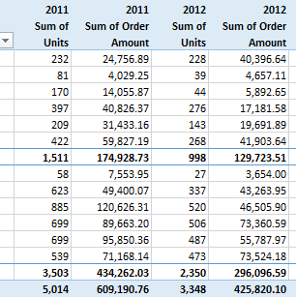
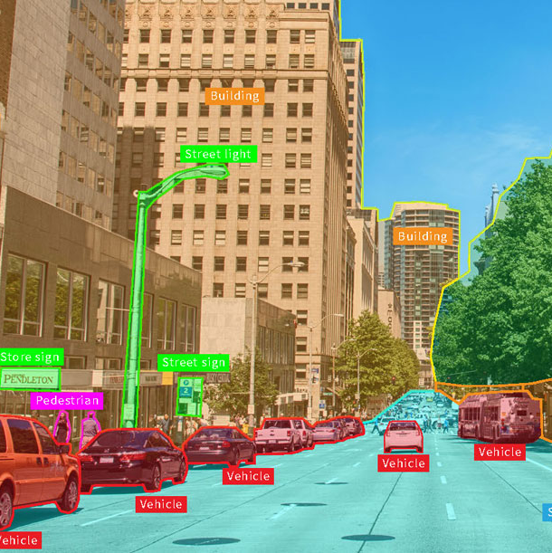
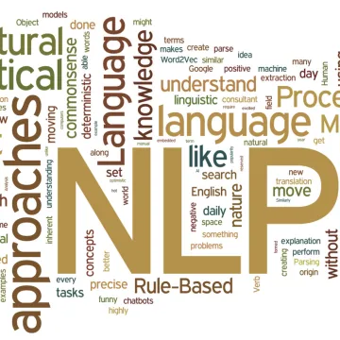
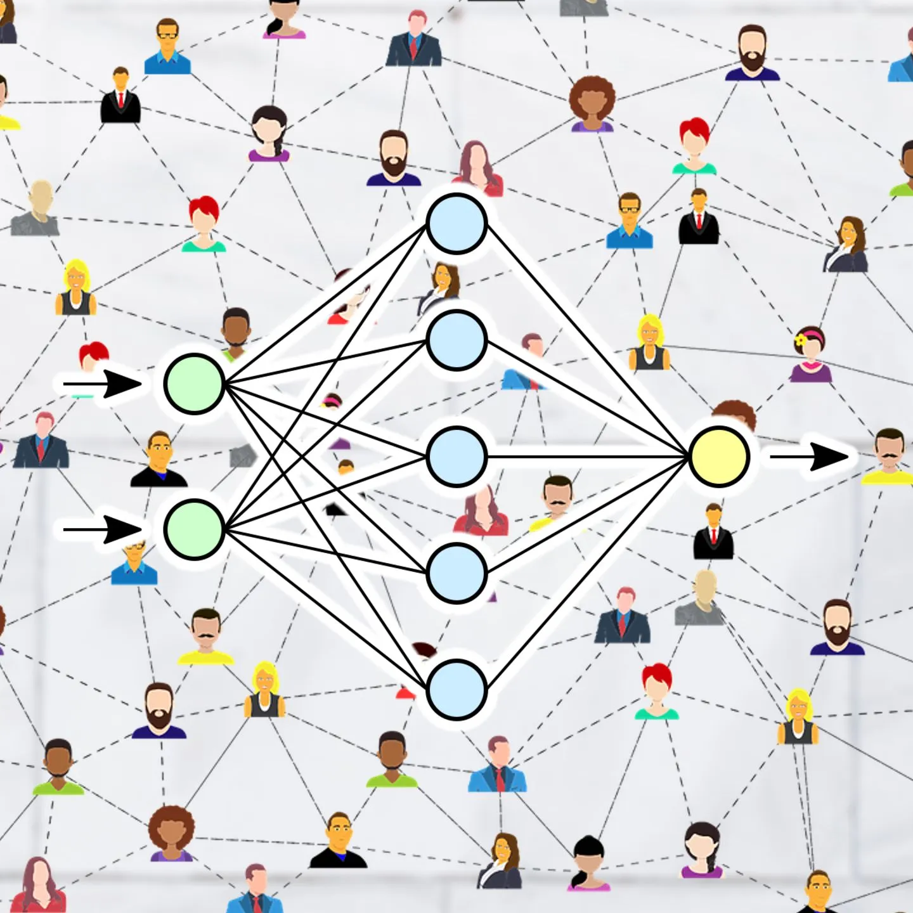
Data types
Tabular data
Images
Text
Networks

Slide 7
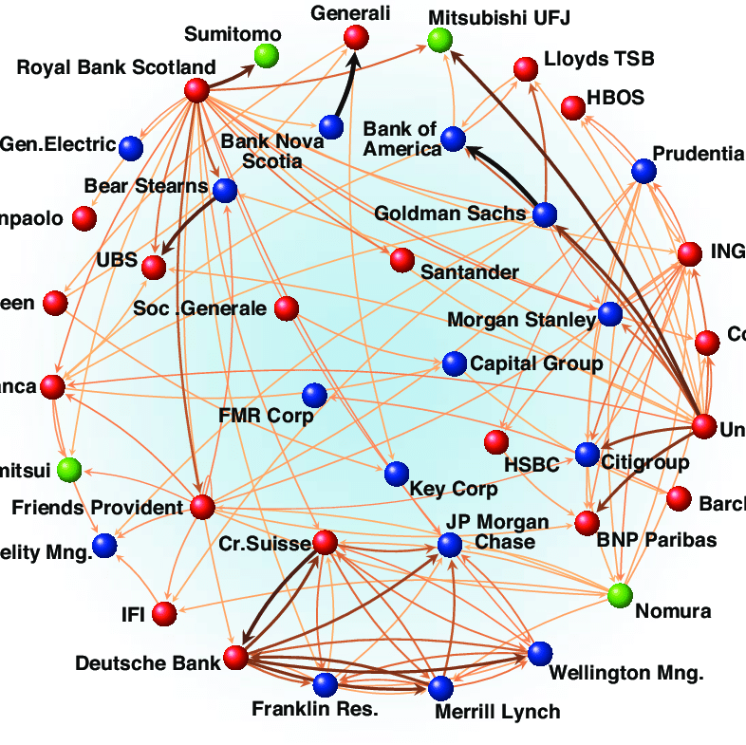
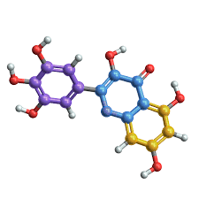
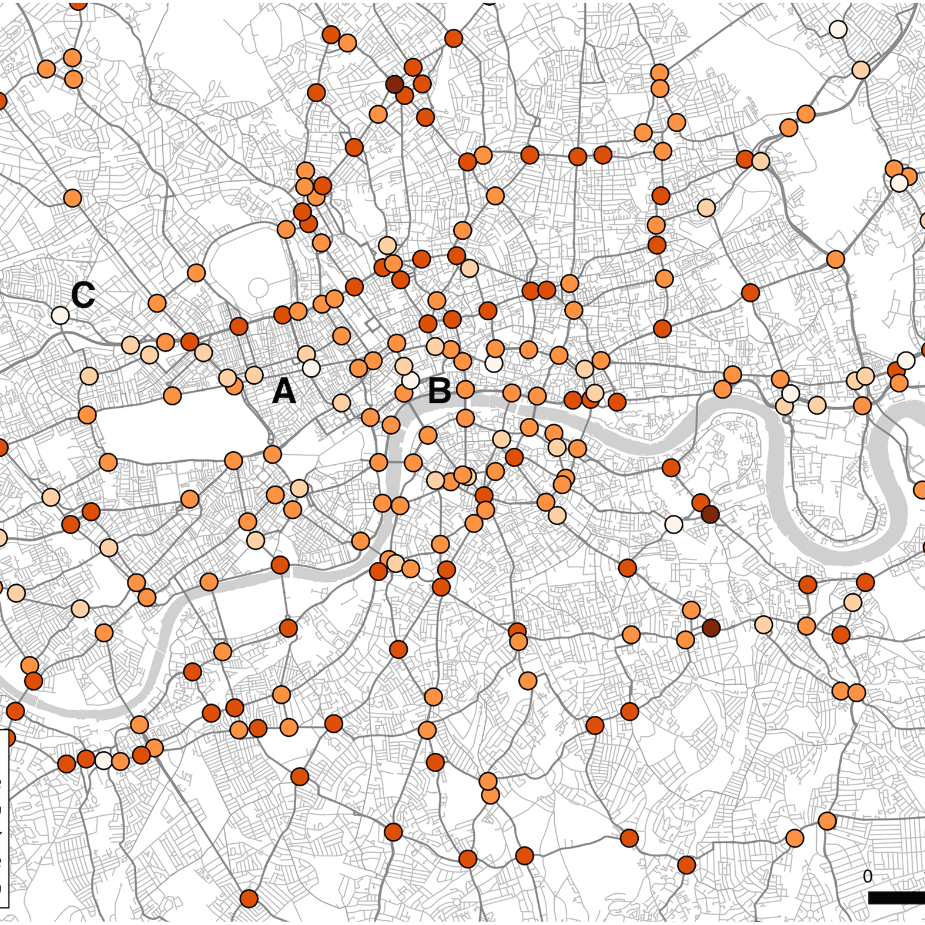
Applications
Financial networks
Molecules
Traffic networks
Notes:
Indeed, many aspects of our world can be represented as a graph, meaning as a collection of nodes related by a set of edges, without regular spatial structure, known as non-euclidean or geometric data. I will take a few minutes to emphasise some nice applications.

Slide 8

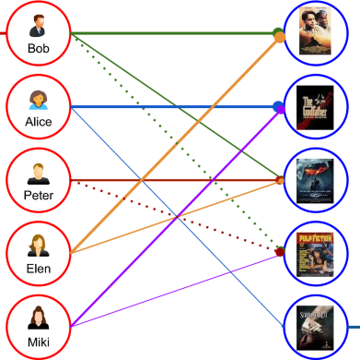

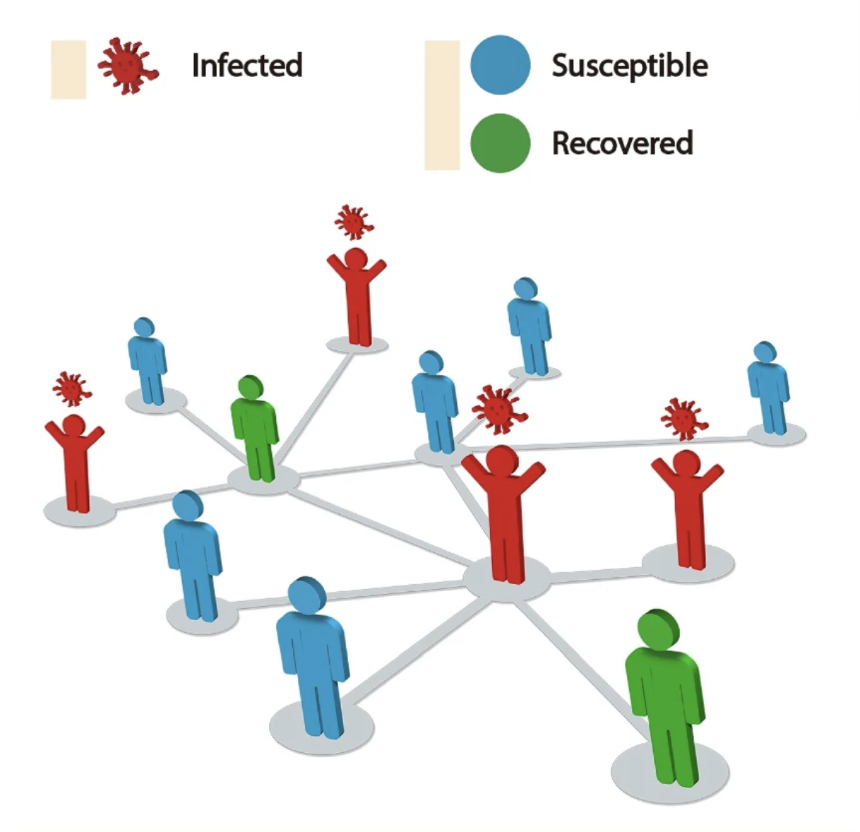
Other applications
Social networks
Recommender sytems
Fake news detection
Disease propagation
Notes:
These datasets, often represented as graphs, are challenging to work with because they require modelling rich relational information on top of node feature information.

Slide 9

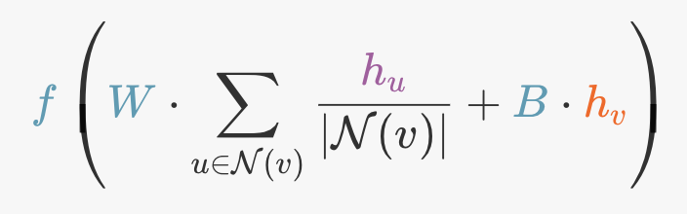
Graph Neural Networks
State-of-the-art performance for graph data.
Message Passing.
Example: facebook friendship recommendation
i

Slide 10
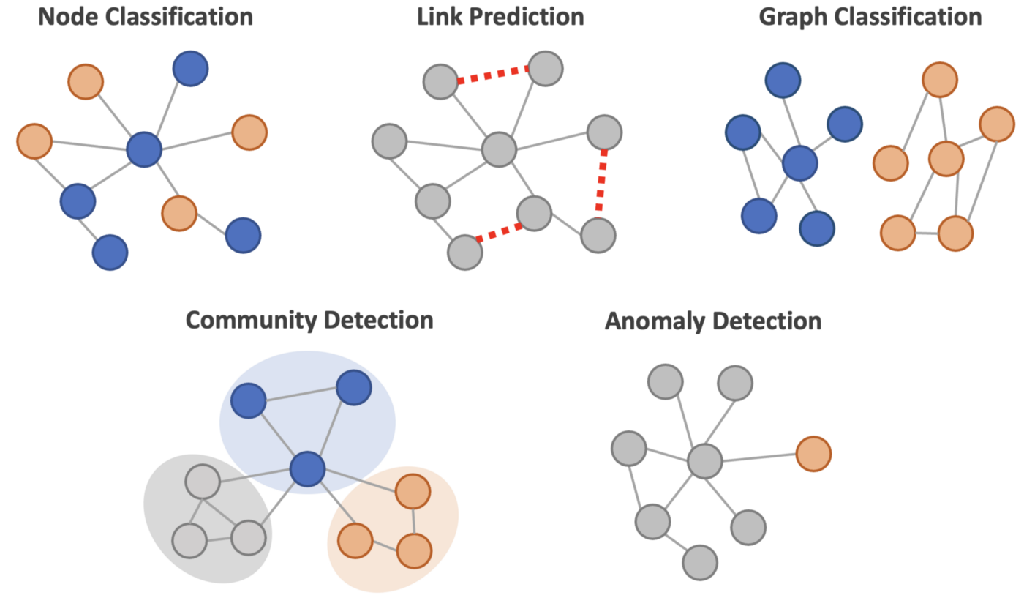
Tasks
Next netflix video ?
Does this person smokes ?
It this a suitable drug ?
Who are my customer segments ?
Is there a fraud ?
Notes:
While there exist a variety of explanation methods [12, 30, 32, 34, 35, 45], they are not well suited for geometric data as they fall short in their ability to incorporate graph topology information.

Slide 11
Warning
General explainability methods are not suited for GNNs
because of their specific functioning
where both node features and graph structure
contribute to a prediction.
Notes:
Relate to WOMD. For instance, recommender systems → feedback loop that show to a personal more and more extreme political videos on the plateform, because it makes him stay.

Slide 12
03
Overview of GNN explainers

Slide 13
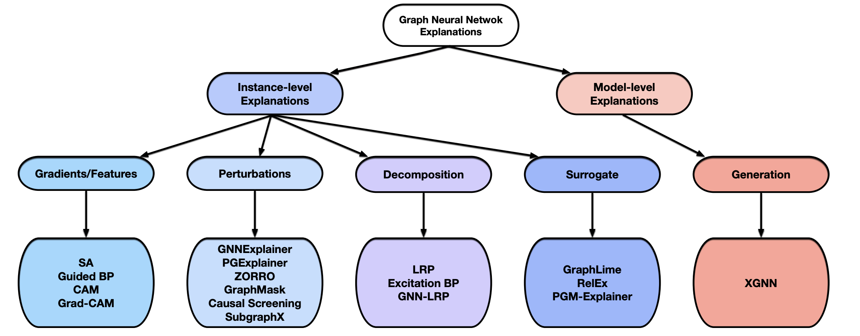
Method types
Notes:
Let’s now look at the different types of explanation methods that were proposed for graphs. These methods are very recent since the first one date from 2019. For most, they are not brand new methods but adapted versions of existing XAI methods for tabular data or images.
Explanations methods specific to GNNs are classified into five categories of methods according to a survey; gradient-based, perturbation, decomposition, surrogate, and model-level. We utilise the same taxonomy in this paper to position GraphSVX.
LOCAL MODEL AGNISTIC POST HOC

Slide 14
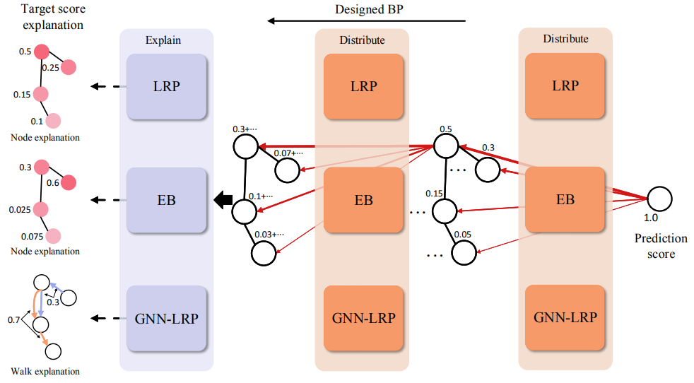
Decomposition methods
decompose the predictions into several terms, each regarded as the importance score of the corresponding input features.
Notes:
Decomposition methods distribute the prediction score among input features using the weights of the network architecture, through backpropagation. Despite offering a nice interpretation, they are not specific to GNNs and present several major limits such as requiring access to model parameters or being sensitive to small input changes, like gradient based. They indicate which input features had the highest impact on the output. (slide)
+: nice interpretation.
- : require model parameters, sensitive to small input changes.

Slide 15
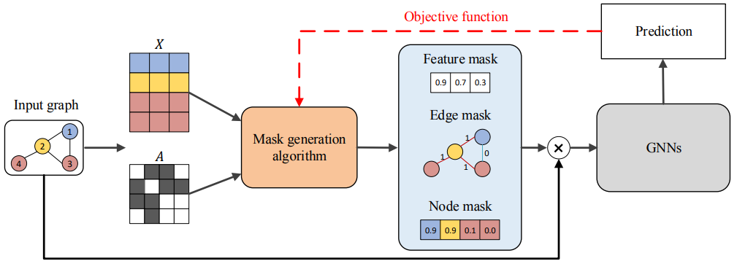
Perturbation methods
monitor variations in model prediction with respect to different input perturbations.
Notes:
Perturbation methods [21, 31, 42] monitor variations in model prediction with respect to different input perturbations. Such methods provide as explanation a continuous mask over edges (features) holding importance probabilities learned via a simple optimisation procedure, affected by the introduced-evidence problem. (slide)
In different terms, we apply perturbations on the input graph in order to analyse the reaction of the model. Doing this, we aim to find out which nodes and edges are most important for the prediction. Whenever these importants nodes/features are present, the model shall stick with the current prediction; when they are removed the prediction shall changed. How do you perturb the input graph ? This can be done my masking some elements out. It is the basis for most of the methods in this branch. They perturb the input graph and observe how the prediction changes.
+ : nice and simple pipeline
- : introduced evidence problem

Slide 16
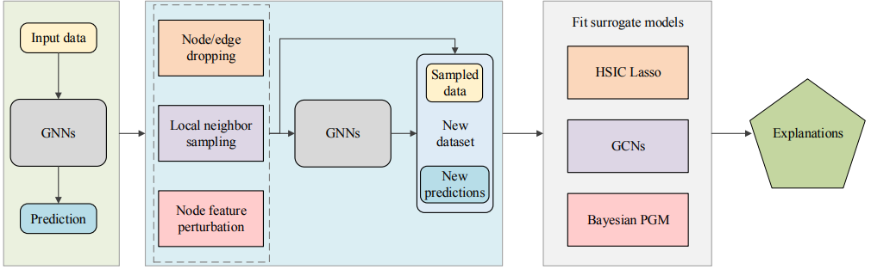
Surrogate methods
approximate the black box GNN model locally by learning an interpretable model on a dataset built around the instance of interest.
Notes:
Surrogate methods [15, 40] approximate the black box GNN model locally by learning an interpretable model on a dataset built around the instance of interest v (e.g., neighbours). Explanations for the surrogate model are used as explanations for the original model. For now, such approaches are rather intuition-based and consider exclusively node features or graph topology, not both. (slide)
Interpretable approximations for the GNN. Their idea is to fit another ML model in an area of the complex ML model.
- : intuition-based and consider exclusively node features or graph topology, not both.

Slide 17
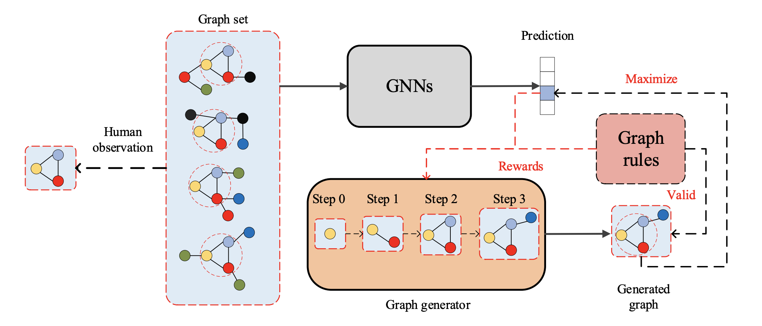
Generation methods
generate graphs that lead to a higher activation for a certain class.
Notes:
Say it’s a global explanation method

Slide 18
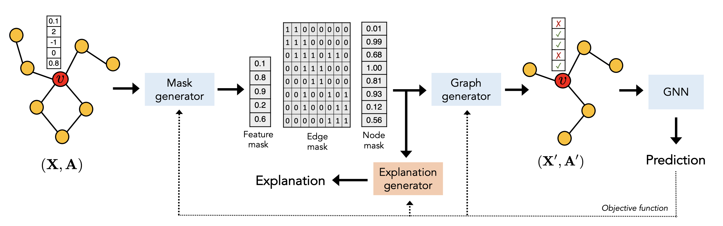
Unified Pipeline

Slide 19
0.1
2
-1
0
0.8
1 | 1 | 0 | 0 | 0 | 0 | 0 | 0
1 | 1 | 1 | 0 | 0 | 0 | 0 | 0
0 | 1 | 1 | 1 | 0 | 1 | 1 | 0
0 | 0 | 1 | 1 | 1 | 0 | 0 | 0
0 | 0 | 0 | 1 | 1 | 0 | 0 | 0
0 | 0 | 1 | 0 | 0 | 1 | 0 | 1
0 | 0 | 1 | 0 | 0 | 0 | 1 | 1
0 | 0 | 0 | 0 | 0 | 1 | 1 | 1
0.01
0.99
0.68
1.00
0.81
0.93
0.12
0.56
✗
✓
✓
✗
✓
0.1
0.8
0.9
0.2
0.6
Mask generator
Graph generator
GNN
Feature mask
Edge mask
Node mask
Explanation generator
Prediction
Explanation
Objective function

Slide 20
04
GraphSVX

Slide 21












GraphSVX
Post-hoc local model-agnostic explanation method for GNNs.
Takes as input
fully trained
GNN model
Explains
a single
prediction
Works with any GNN
(on any graph dataset)
Highlights GNN’s
inner workings,
helps understand it
Adapted to GNN. Considers jointly graph structure and node features
0.1
2
-1
0
0.8
$$φ_{12}$$
GNN
GraphSVX
$$φ_{6}$$
$$φ_{7}$$
$$φ_{1}$$
$$φ_{11}$$
$$φ_{2}$$
$$φ_{3}$$
$$φ_{10}$$
$$φ_{4}$$
$$φ_{8}$$
$$φ_{5}$$
$$φ_{9}$$
Notes:
In short, GraphSVX is a decomposition method that builds a surrogate explanation model on a
perturbed dataset, ultimately approximating the Shapley Values from Cooperative Game Theory, that
we extended to graphs. It thus outputs importance measures representing the ‘fair’ contribution of
each node / feature towards the explained prediction.

Slide 22
Shapley Values
Describe how to fairly distribute the gains of a game to the players, assuming that they all collaborate.
Extended to Machine Learning.
Compute the marginal contribution of each feature to the prediction wrt the average prediction.
Unique solution satisfy four axioms.
For graphs, both nodes and features are players of the game.
GraphSVX extends to graphs and computes the Shapley Values from Game Theory.

Slide 23
0.1
2
-1
0
0.8
1 | 1 | 0 | 0 | 0 | 0 | 0 | 0
1 | 1 | 1 | 0 | 0 | 0 | 0 | 0
0 | 1 | 1 | 1 | 0 | 1 | 1 | 0
0 | 0 | 1 | 1 | 1 | 0 | 0 | 0
0 | 0 | 0 | 1 | 1 | 0 | 0 | 0
0 | 0 | 1 | 0 | 0 | 1 | 0 | 1
0 | 0 | 1 | 0 | 0 | 0 | 1 | 1
0 | 0 | 0 | 0 | 0 | 1 | 1 | 1
0.01
0.99
0.68
1.00
0.81
0.93
0.12
0.56
✗
✓
✓
✗
✓
0.1
0.8
0.9
0.2
0.6
Mask generator
Graph generator
GNN
Feature mask
Edge mask
Node mask
Explanation generator
Prediction
Explanation
Objective function

Slide 24














Output explanations
$$E[f_{v}\left(X,A_{1}|X_{v1}, X_{v2}\right)]$$
$$E[f_{v}\left(X,A_{12}|X_{v1}, X_{v2}\right)]$$
$$E[f_{v}\left(X,A_{12}|X_{v1}, X_{v2}, X_{v3}\right)]$$
0
$$E[f_{v}\left(X,A\right)]$$
$$E[f_{v}\left(X,A|X_{v1}\right)]$$
$$E[f_{v}\left(X,A_{12}|X_{v1}\right)]$$
$$f_{v}\left(X,A\right)$$
1
$$φ_{4}$$
$$φ_{3}$$
$$φ_{0}$$
$$φ_{1}$$
$$φ_{2}$$
$$φ_{6}$$
$$φ_{5}$$
Ultimately, this method produces a unique deterministic explanation that decomposes the original prediction and has a real signification as well as other desirable properties.
It is proved that, under some properties, these explanations compute the extension of Shapley Values to graphs, where both features and nodes are considered as players.
In fact, it approximates the Shapley Values by cleverly sampling a small number of coalitions.
24

Slide 25
05
Evaluation

Slide 26
Metrics
        Metrics
Accuracy
  the explanation should accurately recover the ground truth explanations.
Fidelity
  the explainable model should have consistent predictions as the original GNN that is being explained.
Sparsity
  only a small fraction of nodes/edges/features are used as explanations.
Stability
  small changes to the input should not affect the explanation too much.

Slide 27
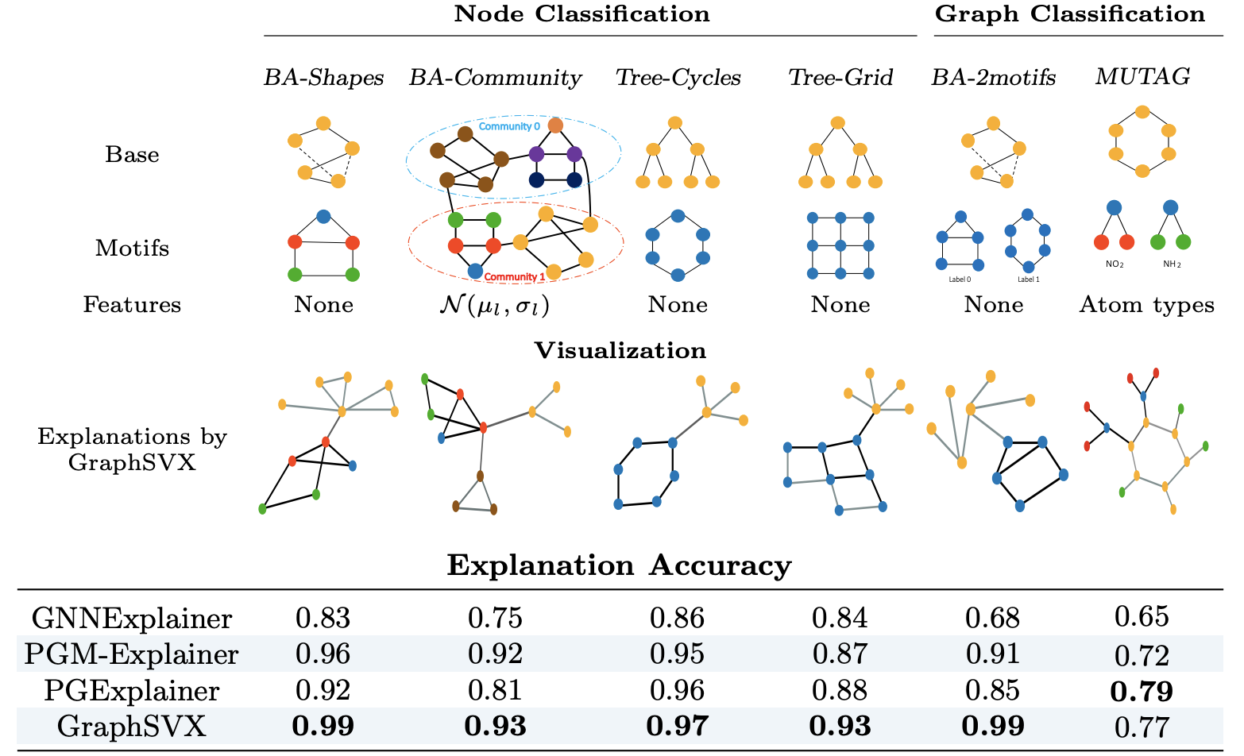


Graph-specific evaluation
Construct synthetic datasets where we ”know” the ground truth
Use of real-world datasets where we know the ground truth.
Notes:
Mention we pass a GNN to the task. We want to assess the accuracy of the explainer; not the the model. We create a ground-truth label for the topology explanation, for each given graph.

Slide 28
Example
1
2
2
Explain this node
3
3
Ground truth explanation because node labels are
designed based on this graph substructure.
0
0
0
STEPS
Train our GNN on this task
Train our explainer
Evaluate the explainer using this
ground truth explanation
0
0
0
0
0
Notes:
Mention we pass a GNN to the task. We want to assess the accuracy of the explainer; not the the model. We create a ground-truth label for the topology explanation, for each given graph.

Slide 29
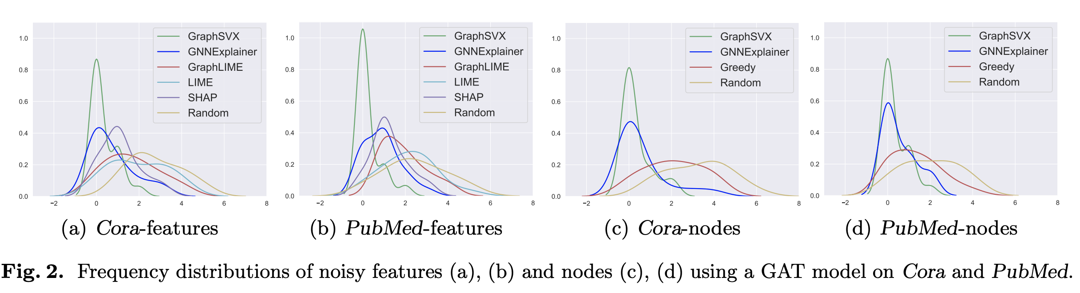
Graph-specific evaluation
Add noisy features.
Add noisy nodes.
Assumption: the model does not use them.
Evaluation: observe if they are provided as explanations by the explainer.

Slide 30
06
Properties

Slide 31
Properties
Contrastive
How does it compare with other instances.
Meaningful
Actually means something, not just a figure.
Adapted, social
Targeted to the explainee, to the use-case.
Selective
  A few explanations are preferable.
Stable
Robust to tiny changes in model or data.
Global
Reflect the model global behaviour.

Slide 32

The end
Thank you for listening

