Slide 1
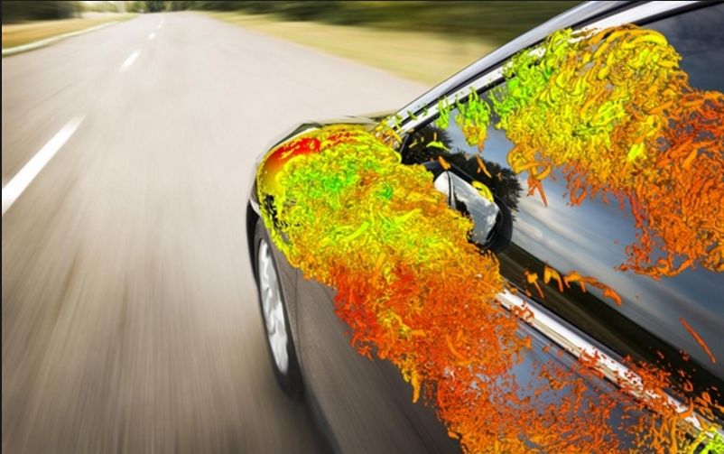
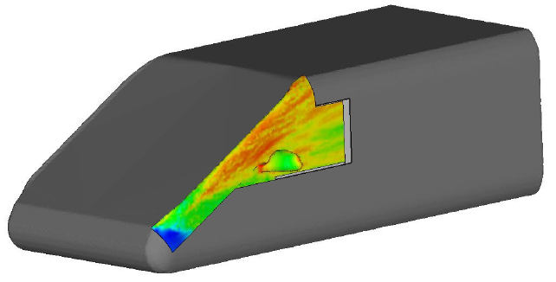
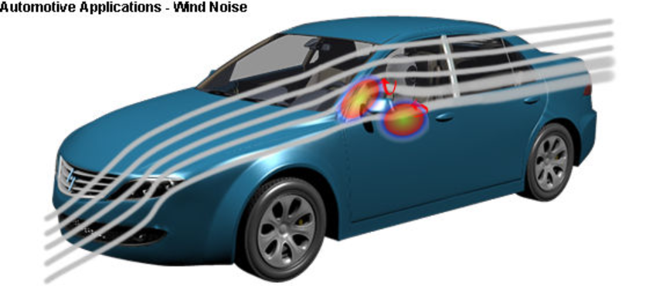
Use of OpenFOAM coupled with a Hybridization of Finite Element-Boundary Element Methods using an Adaptive Absorbing Boundary Condition for Wind Noise Simulation
Conference in Honor of
Professor Abderrahmane Bendali
PAU, December 12-14 2017
N. ZERBIB
ESI GROUP, VA CoE, 8 rue Clément Bayard, 60200 Compiegne, France, nicolas.zerbib@esi-group.com

Slide 2
Conference in Honor of Professor Abderrahmane Bendali
HYBRID FINITE AND BOUNDARY ELEMENT METHODS FOR AERO-ACOUSTIC APPLICATIONS
Scenario:
  Turbulent flow around structure (mirror/A-pillar for automotive)
  Pressure loadings on the structure (windows as elastic surfaces), the rest is considered rigid
  Transmission through the windows to the interior of the vehicule by vibration (interior noise) or pass-by noise contribution (other applications: pantograph for train, landing gear for aircraft)

Slide 3
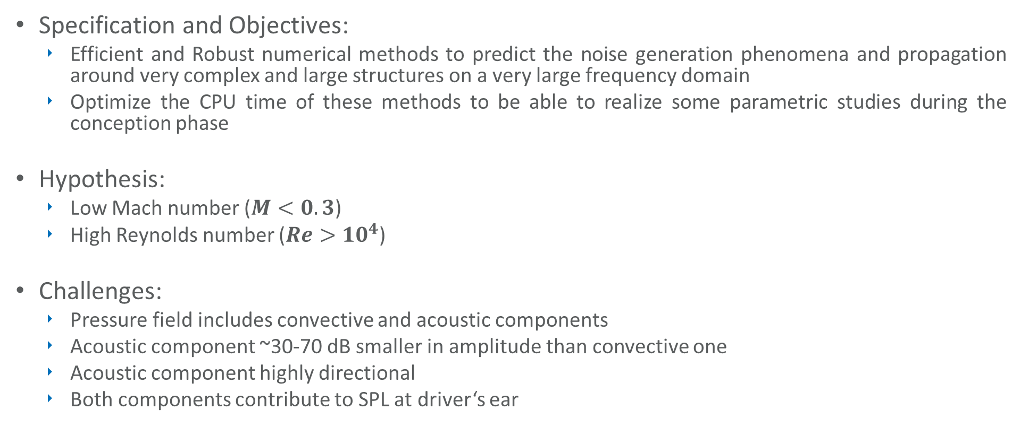
Conference in Honor of Professor Abderrahmane Bendali
HYBRID FINITE AND BOUNDARY ELEMENT METHODS FOR AERO-ACOUSTIC APPLICATIONS
Specification and Objectives:
  Efficient and Robust numerical methods to predict the noise generation phenomena and propagation around very complex and large structures on a very large frequency domain
  Optimize the CPU time of these methods to be able to realize some parametric studies during the conception phase
Hypothesis:
  Low Mach number ($M<0.3$)
  High Reynolds number ($Re>{10}^{4}$)
Challenges:
  Pressure field includes convective and acoustic components
  Acoustic component ~30-70 dB smaller in amplitude than convective one
  Acoustic component highly directional
  Both components contribute to SPL at driver‘s ear

Slide 4
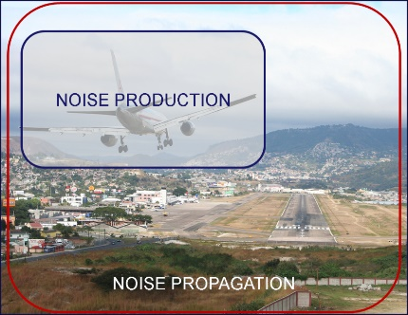
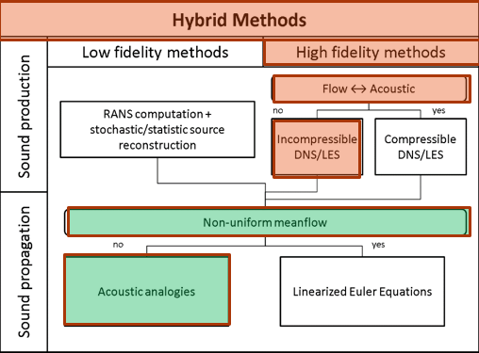
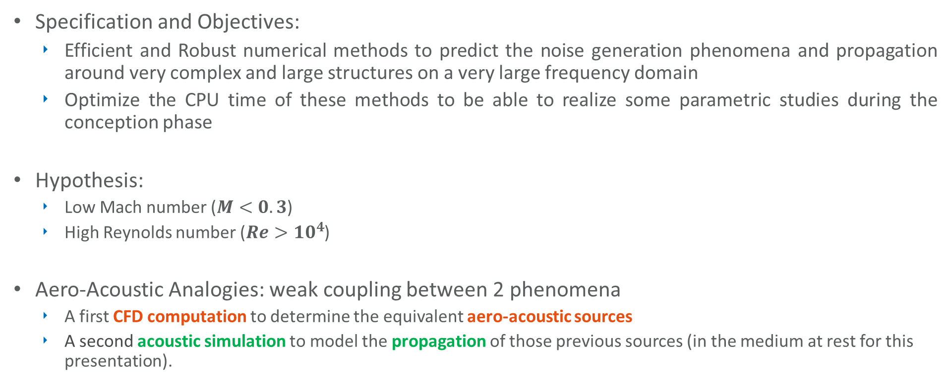
Conference in Honor of Professor Abderrahmane Bendali
HYBRID FINITE AND BOUNDARY ELEMENT METHODS FOR AERO-ACOUSTIC APPLICATIONS
Specification and Objectives:
  Efficient and Robust numerical methods to predict the noise generation phenomena and propagation around very complex and large structures on a very large frequency domain
  Optimize the CPU time of these methods to be able to realize some parametric studies during the conception phase
Hypothesis:
  Low Mach number ($M<0.3$)
  High Reynolds number ($Re>{10}^{4}$)
Aero-Acoustic Analogies: weak coupling between 2 phenomena
  A first CFD computation to determine the equivalent aero-acoustic sources
  A second acoustic simulation to model the propagation of those previous sources (in the medium at rest for this presentation).

Slide 5
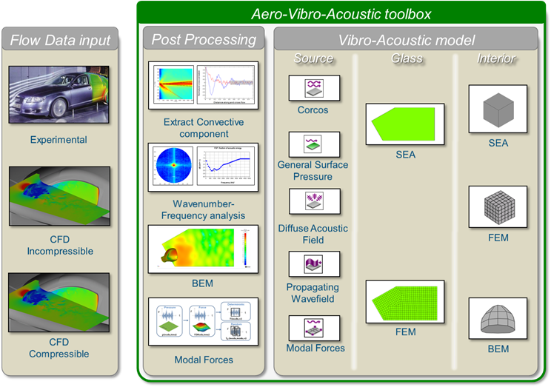
Conference in Honor of Professor Abderrahmane Bendali
HYBRID FINITE AND BOUNDARY ELEMENT METHODS FOR AERO-ACOUSTIC APPLICATIONS
Methodology:
Efficient and Robust
Optimize the CPU time
Aero-Acoustic Analogies

Slide 6
Conference in Honor of Professor Abderrahmane Bendali
HYBRID FINITE AND BOUNDARY ELEMENT METHODS FOR AERO-ACOUSTIC APPLICATIONS
Methodology:
Efficient and Robust
Optimize the CPU time
Aero-Acoustic Analogies

Slide 7
Conference in Honor of Professor Abderrahmane Bendali
HYBRID FINITE AND BOUNDARY ELEMENT METHODS FOR AERO-ACOUSTIC APPLICATIONS
Test Case: SAE Body
  Ref: “Wind Noise caused by the A-pillar and the Side Mirror flow of a Generic Vehicle Model”, AIAA2012, M. Hartmann, J. Ocker,T. Lemke, A. Mutzke, V. Schwarz, H. Tokuno, R. Toppinga, P. Unterlechner, G. Wickern
  The SAE body is a generic automotive geometry structure built out of stiff foam
  It allows competing automotive manufacturers to study physical phenomena without disclosing any confidential information related to a particular vehicle design
  An automotive type side glass fitted into the SAE body wall
  It reflects similar geometry conditions as in real vehicle, with the presence of a slope in the front (windshield), presence of A-Pillar and side mirror.

Slide 8
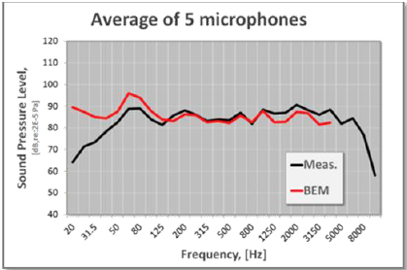
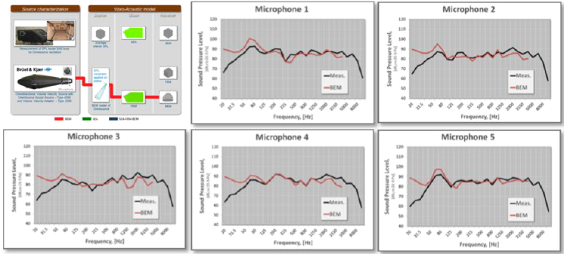
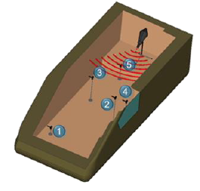
Conference in Honor of Professor Abderrahmane Bendali
HYBRID FINITE AND BOUNDARY ELEMENT METHODS FOR AERO-ACOUSTIC APPLICATIONS
Interior Vibro-Acoustic validation: reciprocity principle
An omnisource is located inside the SAE body to fill interior volume with a strong acoustic field
5 microphones are located inside SAE body to monitor interior sound field

Slide 9
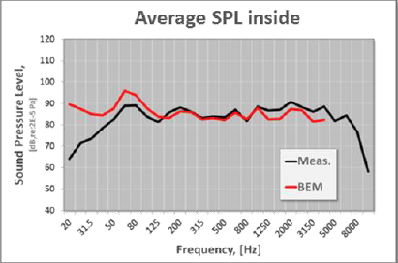
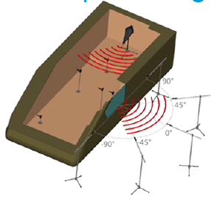
Conference in Honor of Professor Abderrahmane Bendali
HYBRID FINITE AND BOUNDARY ELEMENT METHODS FOR AERO-ACOUSTIC APPLICATIONS
Exterior Vibro-Acoustic validation: reciprocity principle
v

Slide 10
Conference in Honor of Professor Abderrahmane Bendali
HYBRID FINITE AND BOUNDARY ELEMENT METHODS FOR AERO-ACOUSTIC APPLICATIONS
Methodology:
Efficient and Robust
Optimize the CPU time
Aero-Acoustic Analogies

Slide 11
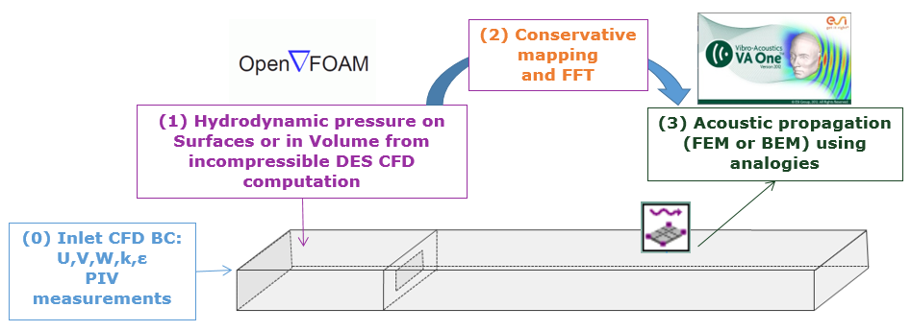
Conference in Honor of Professor Abderrahmane Bendali
HYBRID FINITE AND BOUNDARY ELEMENT METHODS FOR AERO-ACOUSTIC APPLICATIONS
Process of CAA for Flow induced noise:
CFD computation: incompressible DDES delivers the aerodynamic pressure (OpenFoam)
Conservative mapping from the source mesh (CFD) to the target mesh (acoustic). Use specific/adapted mesh for each physics. Fast Fourier Transform Time to Frequency domain
Acoustic propagation using analogies by Boundary Element, Finite Element Methods or FEM/BEM hybridization (VAOne)

Slide 12
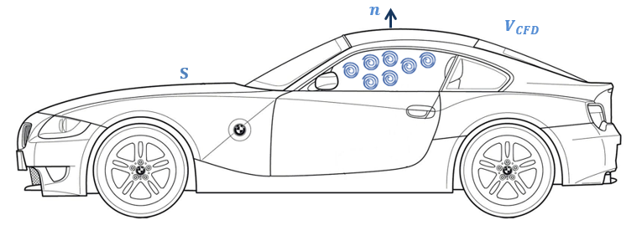

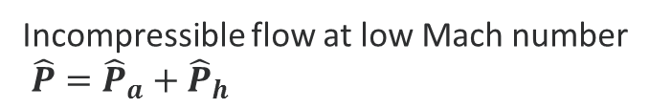
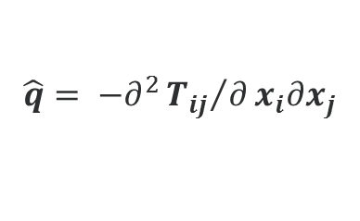



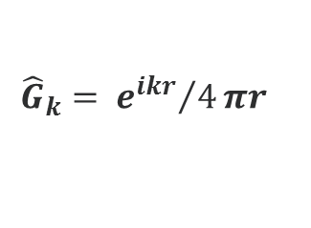
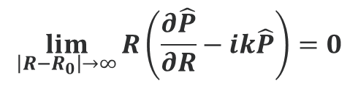
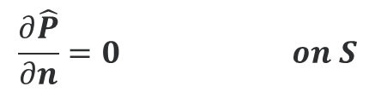

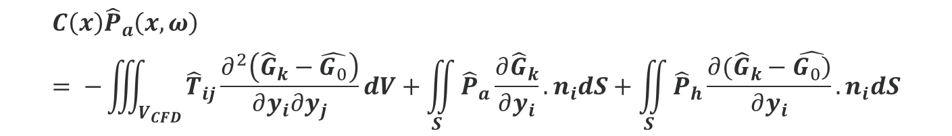

Conference in Honor of Professor Abderrahmane Bendali
HYBRID FINITE AND BOUNDARY ELEMENT METHODS FOR AERO-ACOUSTIC APPLICATIONS
Curle analogy [1,2,3,4]:
$${\hat{G}}_{k}= {e^{ikr}}/4πr$$
$$∆\hat{P}+k^{2}\hat{P}=\hat{q} in V_{CFD},$$
$$\hat{q}= −∂^{2}{T_{ij}}/∂x_{i}∂x_{j}$$
$$\frac{∂\hat{P}}{∂n}=0 on S$$
$$\lim_{\left|R−R_{0}\right|→∞}{R\left(\frac{∂\hat{P}}{∂R}−ik\hat{P}\right)=0}$$
Incompressible flow at low Mach number
$\hat{P}={\hat{P}}_{a}+{\hat{P}}_{h}$
Lighthill Tensor (high Reynolds number): $T_{ij}≈ ρ_{0}u_{i}u_{j}$
${\hat{P}}_{h}$ static solution ($k=0$)
$$C\left(x\right){\hat{P}}_{a}\left(x,ω\right)= −\iiint_{V_{CFD}}{{\hat{T}}_{ij}\frac{∂^{2}\left({\hat{G}}_{k}−\hat{G_{0}}\right)}{∂y_{i}∂y_{j}}dV}+\iint_{S}{{\hat{P}}_{a}\frac{∂{\hat{G}}_{k}}{∂y_{i}}.n_{i}dS}+\iint_{S}{{\hat{P}}_{h}\frac{∂({\hat{G}}_{k}−\hat{\left.G_{0}\right)}}{∂y_{i}}.n_{i}dS}$$
Acoustic pressure
Volume source term
Surface source term, aerodynamic pressure ${\hat{P}}_{h}$ from incompressible CFD

Slide 13
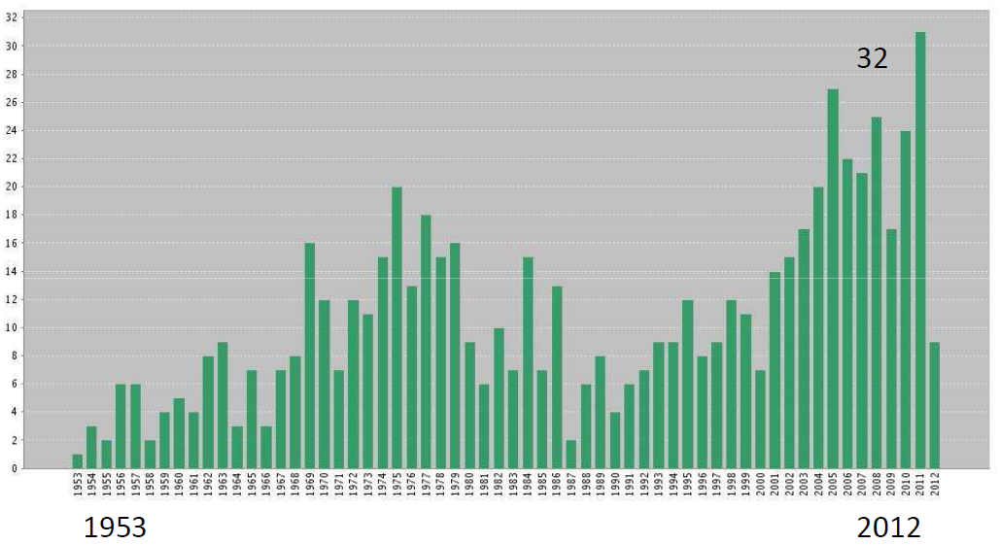
Conference in Honor of Professor Abderrahmane Bendali
HYBRID FINITE AND BOUNDARY ELEMENT METHODS FOR AERO-ACOUSTIC APPLICATIONS
Citations to the Curle’s work
Total number of citations to the 1955 paper: 482

Slide 14



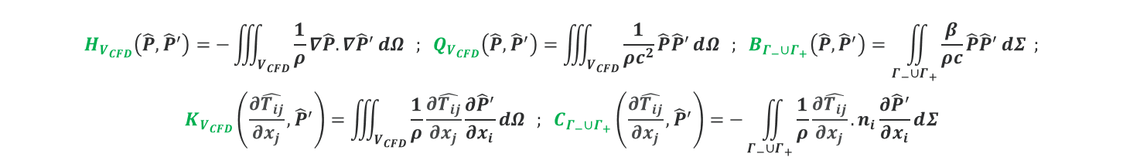


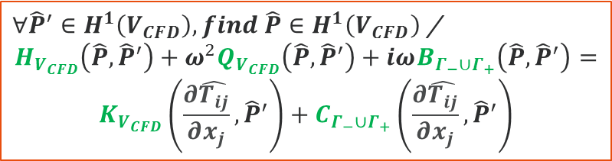






Conference in Honor of Professor Abderrahmane Bendali
HYBRID FINITE AND BOUNDARY ELEMENT METHODS FOR AERO-ACOUSTIC APPLICATIONS
Lighthill analogy [5,6,7]:
$$\left\{\begin{aligned}&∆\hat{P}+k^{2}\hat{P}=\hat{q} in V_{CFD} \\ &\hat{q}= −∂^{2}{T_{ij}}/∂x_{i}∂x_{j} \\ ∂_{n}\hat{P}=0 on Γ_{c} \\ &∂_{n}\hat{P}+ikβ\hat{P}=0 on Γ_{−}∪Γ_{+}\end{aligned}\right.$$
$∀{\hat{P}}^{′}∈H^{1}\left(V_{CFD}\right), find \hat{P}∈H^{1}\left(V_{CFD}\right)$ /
$$H_{V_{CFD}}\left(\hat{P},{\hat{P}}^{′}\right)+ω^{2}Q_{V_{CFD}}\left(\hat{P},{\hat{P}}^{′}\right)+iωB_{Γ_{−}∪Γ_{+}}\left(\hat{P},{\hat{P}}^{′}\right)=$$
$$K_{V_{CFD}}\left(\frac{∂\hat{T_{ij}}}{∂x_{j}},{\hat{P}}^{′}\right)+C_{Γ_{−}∪Γ_{+}}\left(\frac{∂\hat{T_{ij}}}{∂x_{j}},{\hat{P}}^{′}\right)$$
$$H_{V_{CFD}}\left(\hat{P},{\hat{P}}^{′}\right)=−\iiint_{V_{CFD}}{\frac{1}{ρ}∇\hat{P}.∇{\hat{P}}^{′}ⅆΩ} ; Q_{V_{CFD}}\left(\hat{P},{\hat{P}}^{′}\right)=\iiint_{V_{CFD}}{\frac{1}{ρc^{2}}\hat{P}{\hat{P}}^{′}ⅆΩ} ; B_{Γ_{−}∪Γ_{+}}\left(\hat{P},{\hat{P}}^{′}\right)=\iint_{Γ_{−}∪Γ_{+}}{\frac{β}{ρc}\hat{P}{\hat{P}}^{′}ⅆΣ} ;$$
$$K_{V_{CFD}}\left(\frac{∂\hat{T_{ij}}}{∂x_{j}},{\hat{P}}^{′}\right)=\iiint_{V_{CFD}}{\frac{1}{ρ}\frac{∂\hat{T_{ij}}}{∂x_{j}}\frac{∂{\hat{P}}^{′}}{∂x_{i}}ⅆΩ} ; C_{Γ_{−}∪Γ_{+}}\left(\frac{∂\hat{T_{ij}}}{∂x_{j}},{\hat{P}}^{′}\right)=−\iint_{Γ_{−}∪Γ_{+}}{\frac{1}{ρ}\frac{∂\hat{T_{ij}}}{∂x_{j}}.n_{i}\frac{∂{\hat{P}}^{′}}{∂x_{i}}ⅆΣ}$$
Sources : vectorField from the CFD
CFD Sources
$$y$$
$$Γ_{c}$$
$$\frac{∂\hat{T_{ij}}}{∂x_{j}}$$
Volume sources
at low cost
$$\frac{∂\hat{T_{ij}}}{∂x_{j}}$$
$$\frac{∂\hat{T_{ij}}}{∂x_{j}}$$
$$Γ_{−}$$
$$y$$
$$x$$
$$Γ_{+}$$

Slide 15


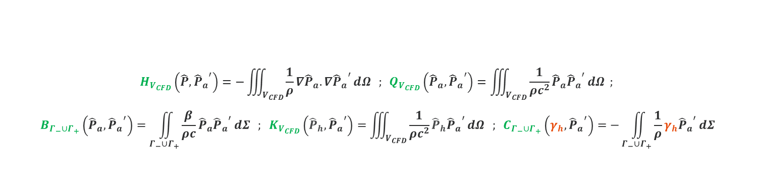

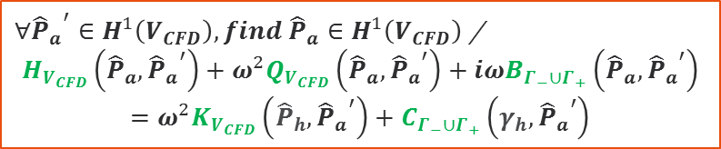




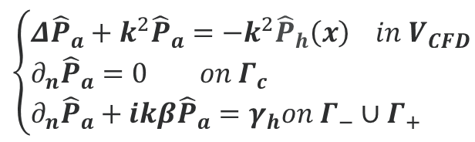

Conference in Honor of Professor Abderrahmane Bendali
HYBRID FINITE AND BOUNDARY ELEMENT METHODS FOR AERO-ACOUSTIC APPLICATIONS
Lighthill analogy [5,6,7]:
$∀{{\hat{P}}_{a}}^{′}∈H^{1}\left(V_{CFD}\right), find {\hat{P}}_{a}∈H^{1}\left(V_{CFD}\right)$ /
$$H_{V_{CFD}}\left({\hat{P}}_{a},{{\hat{P}}_{a}}^{′}\right)+ω^{2}Q_{V_{CFD}}\left({\hat{P}}_{a},{{\hat{P}}_{a}}^{′}\right)+iωB_{Γ_{−}∪Γ_{+}}\left({\hat{P}}_{a},{{\hat{P}}_{a}}^{′}\right)$$
$$=ω^{2}K_{V_{CFD}}\left({\hat{P}}_{h},{{\hat{P}}_{a}}^{′}\right)+C_{Γ_{−}∪Γ_{+}}\left(γ_{h},{{\hat{P}}_{a}}^{′}\right)$$
$$\left\{\begin{aligned}&Δ{\hat{P}}_{a}+k^{2}{\hat{P}}_{a}=−k^{2}{\hat{P}}_{h}\left(x\right) in V_{CFD} \\ &∂_{n}{\hat{P}}_{a}=0 on Γ_{c} \\ &∂_{n}{\hat{P}}_{a}+ikβ{\hat{P}}_{a}=γ_{h}on Γ_{−}∪Γ_{+}\end{aligned}\right.$$
$$γ_{h}\left(x\right)=−\left(∂_{n}{\hat{P}}_{h}\left(x\right)+ikβ{\hat{P}}_{h}\left(x\right)\right)$$
$$\hat{P}={\hat{P}}_{a}+{\hat{P}}_{h}$$
$$H_{V_{CFD}}\left(\hat{P},{{\hat{P}}_{a}}^{′}\right)=−\iiint_{V_{CFD}}{\frac{1}{ρ}∇{\hat{P}}_{a}.∇{{\hat{P}}_{a}}^{′}ⅆΩ} ; Q_{V_{CFD}}\left({\hat{P}}_{a},{{\hat{P}}_{a}}^{′}\right)=\iiint_{V_{CFD}}{\frac{1}{ρc^{2}}{\hat{P}}_{a}{{\hat{P}}_{a}}^{′}ⅆΩ} ;$$
$$B_{Γ_{−}∪Γ_{+}}\left({\hat{P}}_{a},{{\hat{P}}_{a}}^{′}\right)=\iint_{Γ_{−}∪Γ_{+}}{\frac{β}{ρc}{\hat{P}}_{a}{{\hat{P}}_{a}}^{′}ⅆΣ} ; K_{V_{CFD}}\left({\hat{P}}_{h},{{\hat{P}}_{a}}^{′}\right)=\iiint_{V_{CFD}}{\frac{1}{ρc^{2}}{\hat{P}}_{h}{{\hat{P}}_{a}}^{′}ⅆΩ} ; C_{Γ_{−}∪Γ_{+}}\left(γ_{h},{{\hat{P}}_{a}}^{′}\right)=−\iint_{Γ_{−}∪Γ_{+}}{\frac{1}{ρ}γ_{h}{{\hat{P}}_{a}}^{′}ⅆΣ}$$
CFD Sources
Sources : scalarField from the CFD
$${\hat{P}}_{h}$$
$$y$$
$$Γ_{c}$$
$${\hat{P}}_{h}$$
$${\hat{P}}_{h},∂_{n}{\hat{P}}_{h}$$
Volume sources
at low cost
$$Γ_{−}$$
$${\hat{P}}_{h},∂_{n}{\hat{P}}_{h}$$
$$y$$
$$x$$
$$Γ_{+}$$

Slide 16
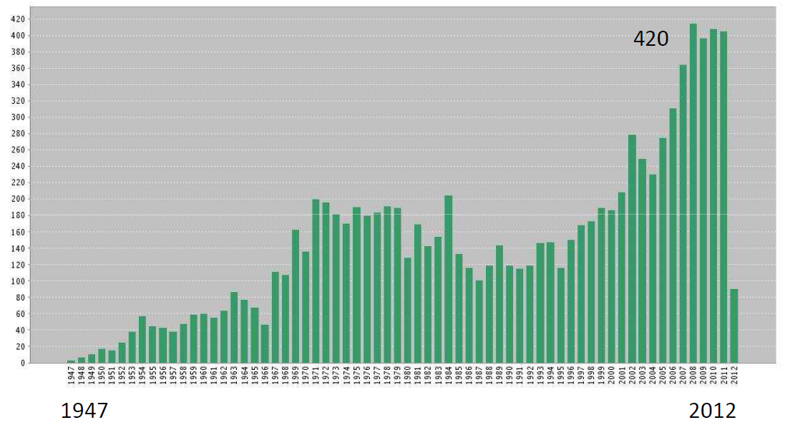
Conference in Honor of Professor Abderrahmane Bendali
HYBRID FINITE AND BOUNDARY ELEMENT METHODS FOR AERO-ACOUSTIC APPLICATIONS
Citations to the M.J. Lighthill ‘s work
Total number of citations to the 1952 paper: 1787

Slide 17
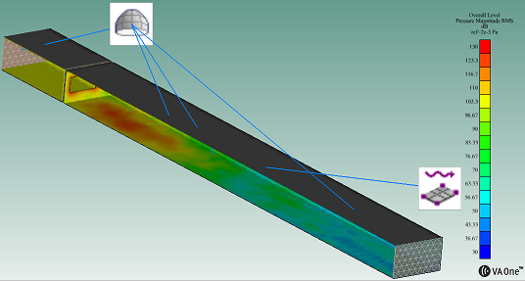
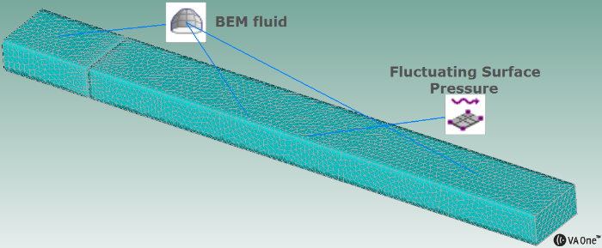

Conference in Honor of Professor Abderrahmane Bendali
HYBRID FINITE AND BOUNDARY ELEMENT METHODS FOR AERO-ACOUSTIC APPLICATIONS
Results for Simple Ducted Diaphragm
Results : SPL on a sensor downstream on the surface for [200:20:3500] Hz
BEM (Mesh: $3 001$ Nodes, T3: $6 198$, DMP16) : 1’05’’ / segment
FEM (Mesh: $88 298$ Nodes, TE4: $423 669$, $33 815$ Nodes, T3: $67 626$), DMP16: 0’09’’ / segment, Nodal (Direct Solve), DMP16: 0’03’’ / segment Modal (InDirect Solve)
Inlet/Outlet boundaries are set to non-reflective conditions

Slide 18
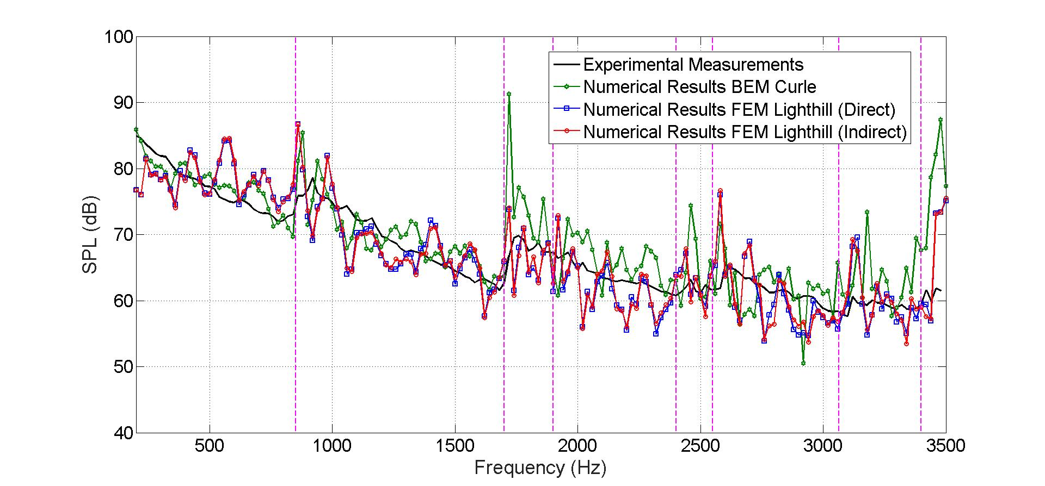

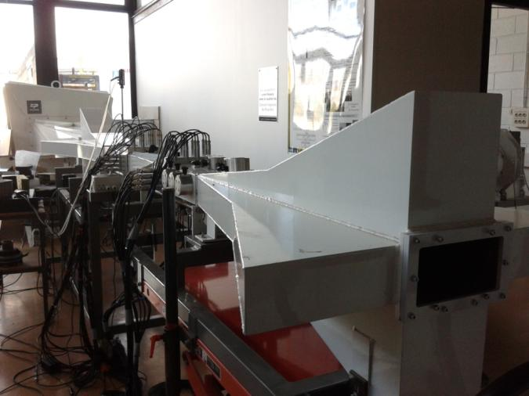
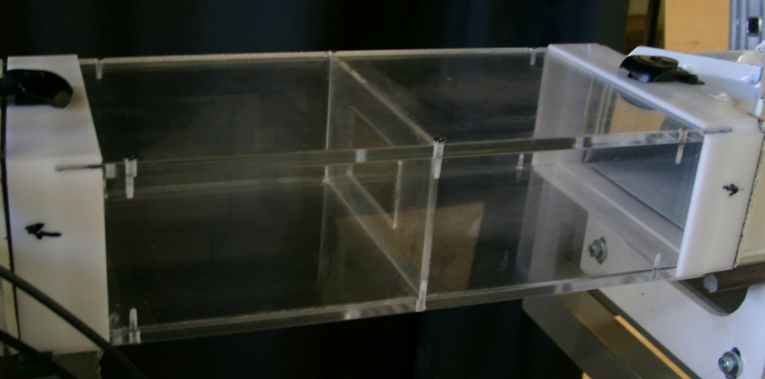
Conference in Honor of Professor Abderrahmane Bendali
HYBRID FINITE AND BOUNDARY ELEMENT METHODS FOR AERO-ACOUSTIC APPLICATIONS
Results for Simple Ducted Diaphragm
A
X = 0 m
Y = 0,0387 m
Z = 1,285 m
SPL at point A – Comparison between experimental measurements and both aero-acoutic analogies

Slide 19
Conference in Honor of Professor Abderrahmane Bendali
HYBRID FINITE AND BOUNDARY ELEMENT METHODS FOR AERO-ACOUSTIC APPLICATIONS
BEM Curle | FEM Lighthill
Only Surface Mesh (easy task) | 3D Volume Mesh (can be difficult)
Small Number of DoF | Large Number of DoF
Adapted for Interior and Exterior domain | Adpated for Interior Domain but not really for Exterior problem (PML)
Symmetric Dense Complex Matrices (RAM: O(N²) and CPU: O(N³)) | Symmetric Sparse Complex Matrices (RAM: O(N) and CPU: O(N²))
Equivalent Aero-acoustic Sources on the Surface (Dipoles) and in the Volume (Quadrupoles but not adapted for BEM) | Full 3D volume description of the Equivalent Aero-acoustic Sources
Direct Method | Direct (Nodal) and Indirect (Modal for cavity) Method

Slide 20
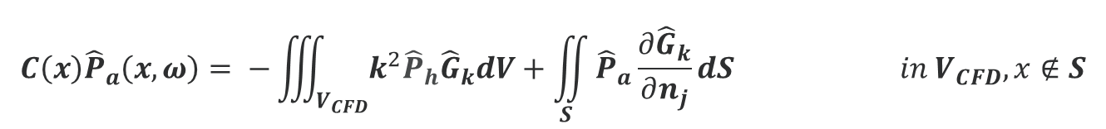
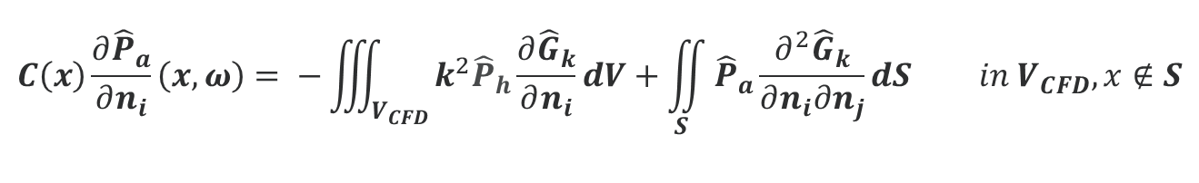

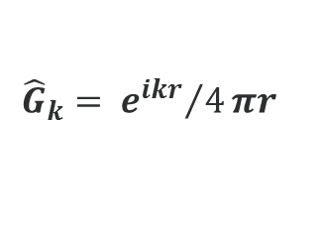



Conference in Honor of Professor Abderrahmane Bendali
HYBRID FINITE AND BOUNDARY ELEMENT METHODS FOR AERO-ACOUSTIC APPLICATIONS
$${\hat{G}}_{k}= {e^{ikr}}/4πr$$
Hybrid Lighthill analogy [8,9,10,11]:
$$\hat{P}={\hat{P}}_{a}+{\hat{P}}_{h}$$
$$\left\{\begin{aligned}&\left(Δ+k^{2}\right){\hat{P}}_{a}\left(x\right)=−k^{2}{\hat{P}}_{h}\left(x\right) in V_{CFD} \\ &∂_{n}{\hat{P}}_{a}\left(x\right)=0 on S \\ &\lim_{\left|R−R_{0}\right|→∞}{R\left(\frac{∂{\hat{P}}_{a}}{∂R}−ik{\hat{P}}_{a}\right)=0}\end{aligned}\right.$$
$$V_{CFD}=ℝ^{3} \backslash { Ω}_{S}$$
$$C\left(x\right){\hat{P}}_{a}\left(x,ω\right)= −\iiint_{V_{CFD}}{k^{2}{\hat{P}}_{h}{\hat{G}}_{k}dV}+\iint_{S}{{\hat{P}}_{a}\frac{∂{\hat{G}}_{k}}{∂n_{j}}dS} in V_{CFD}, x∉S$$
Acoustic pressure
Volume source term, aerodynamic pressure ${\hat{P}}_{h}$ from incompressible CFD
$$C\left(x\right)\frac{∂{\hat{P}}_{a}}{∂n_{i}}\left(x,ω\right)= −\iiint_{V_{CFD}}{k^{2}{\hat{P}}_{h}\frac{∂{\hat{G}}_{k}}{∂n_{i}}dV}+\iint_{S}{{\hat{P}}_{a}\frac{∂^{2}{\hat{G}}_{k}}{∂n_{i}∂n_{j}}dS} in V_{CFD}, x∉S$$

Slide 21
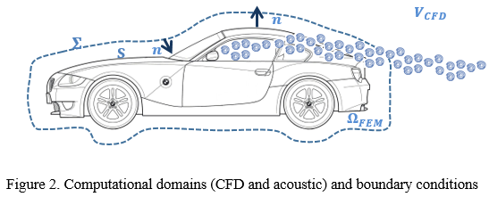

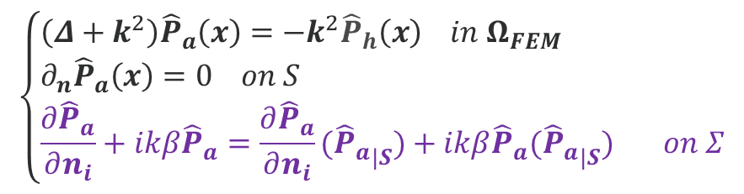



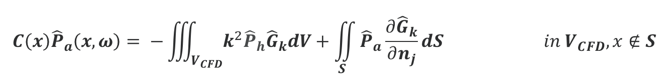

Conference in Honor of Professor Abderrahmane Bendali
HYBRID FINITE AND BOUNDARY ELEMENT METHODS FOR AERO-ACOUSTIC APPLICATIONS
Hybrid Lighthill analogy [8,9,10,11]:
$$\hat{P}={\hat{P}}_{a}+{\hat{P}}_{h}$$
$$\left\{\begin{aligned}&\left(Δ+k^{2}\right){\hat{P}}_{a}\left(x\right)=−k^{2}{\hat{P}}_{h}\left(x\right) in Ω_{FEM} \\ &∂_{n}{\hat{P}}_{a}\left(x\right)=0 on S \\ &\frac{∂{\hat{P}}_{a}}{∂n_{i}}+ikβ{\hat{P}}_{a}=\frac{∂{\hat{P}}_{a}}{∂n_{i}}({{\hat{P}}_{a}}_{|S})+ikβ{\hat{P}}_{a}({{\hat{P}}_{a}}_{|S}) on Σ\end{aligned}\right.$$
$$V_{CFD}=ℝ^{3} \backslash { Ω}_{S}$$
$Ω_{FEM}$ / $∂Ω_{FEM}=\left\{S∪Σ\right\}$
$$C\left(x\right){\hat{P}}_{a}\left(x,ω\right)= −\iiint_{V_{CFD}}{k^{2}{\hat{P}}_{h}{\hat{G}}_{k}dV}+\iint_{S}{{\hat{P}}_{a}\frac{∂{\hat{G}}_{k}}{∂n_{j}}dS} in V_{CFD}, x∉S$$
Acoustic pressure
Volume source term, aerodynamic pressure ${\hat{P}}_{h}$ from incompressible CFD
$$C\left(x\right)\frac{∂{\hat{P}}_{a}}{∂n_{i}}\left(x,ω\right)= −\iiint_{V_{CFD}}{k^{2}{\hat{P}}_{h}\frac{∂{\hat{G}}_{k}}{∂n_{i}}dV}+\iint_{S}{{\hat{P}}_{a}\frac{∂^{2}{\hat{G}}_{k}}{∂n_{i}∂n_{j}}dS} in V_{CFD}, x∉S$$

Slide 22
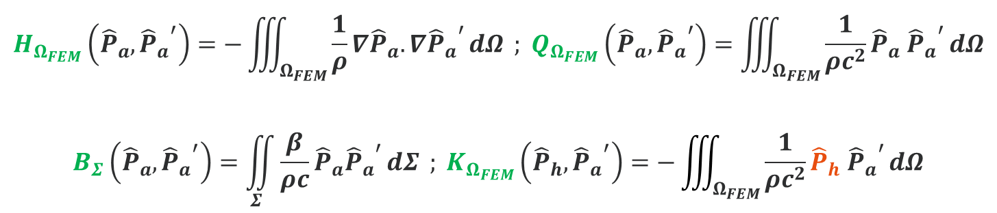
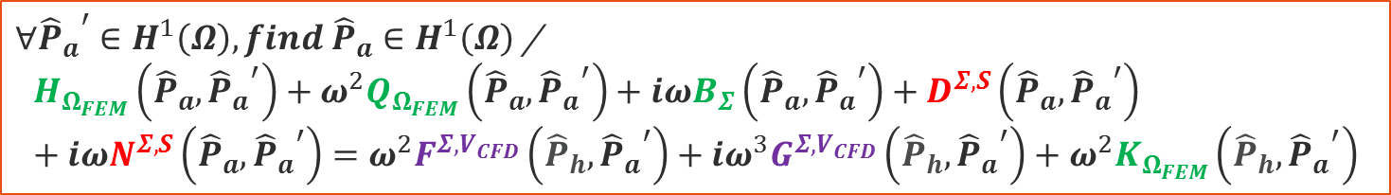


Conference in Honor of Professor Abderrahmane Bendali
HYBRID FINITE AND BOUNDARY ELEMENT METHODS FOR AERO-ACOUSTIC APPLICATIONS
Hybrid Lighthill analogy [8,9,10,11]:
$$\hat{P}={\hat{P}}_{a}+{\hat{P}}_{h}$$
$∀{{\hat{P}}_{a}}^{′}∈H^{1}\left(Ω\right), find {\hat{P}}_{a}∈H^{1}\left(Ω\right)$ /
$$H_{Ω_{FEM}}\left({\hat{P}}_{a},{{\hat{P}}_{a}}^{′}\right)+ω^{2}Q_{Ω_{FEM}}\left({\hat{P}}_{a},{{\hat{P}}_{a}}^{′}\right)+iωB_{Σ}\left({\hat{P}}_{a},{{\hat{P}}_{a}}^{′}\right)+D^{Σ,S}\left({\hat{P}}_{a},{{\hat{P}}_{a}}^{′}\right)+iωN^{Σ,S}\left({\hat{P}}_{a},{{\hat{P}}_{a}}^{′}\right)=ω^{2}F^{Σ,V_{CFD}}\left({\hat{P}}_{h},{{\hat{P}}_{a}}^{′}\right)+iω^{3}G^{Σ,V_{CFD}}\left({\hat{P}}_{h},{{\hat{P}}_{a}}^{′}\right)+ω^{2}K_{Ω_{FEM}}\left({\hat{P}}_{h},{{\hat{P}}_{a}}^{′}\right)$$
$$H_{Ω_{FEM}}\left({\hat{P}}_{a},{{\hat{P}}_{a}}^{′}\right)=−\iiint_{Ω_{FEM}}{\frac{1}{ρ}∇{\hat{P}}_{a}.∇{{\hat{P}}_{a}}^{′}ⅆΩ} ; Q_{Ω_{FEM}}\left({\hat{P}}_{a},{{\hat{P}}_{a}}^{′}\right)=\iiint_{Ω_{FEM}}{\frac{1}{ρc^{2}}{\hat{P}}_{a} {{\hat{P}}_{a}}^{′}ⅆΩ}$$
$$B_{Σ}\left({\hat{P}}_{a},{{\hat{P}}_{a}}^{′}\right)=\iint_{Σ}{\frac{β}{ρc}{\hat{P}}_{a}{{\hat{P}}_{a}}^{′}ⅆΣ} ; K_{Ω_{FEM}}\left({\hat{P}}_{h},{{\hat{P}}_{a}}^{′}\right)=−\iiint_{Ω_{FEM}}{\frac{1}{ρc^{2}}{\hat{P}}_{h} {{\hat{P}}_{a}}^{′}ⅆΩ}$$
Volume FEM operators in $Ω_{FEM}$
CFD Sources

Slide 23
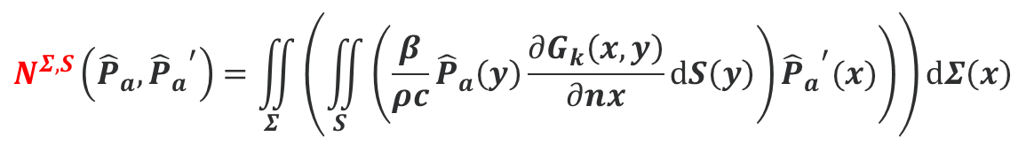

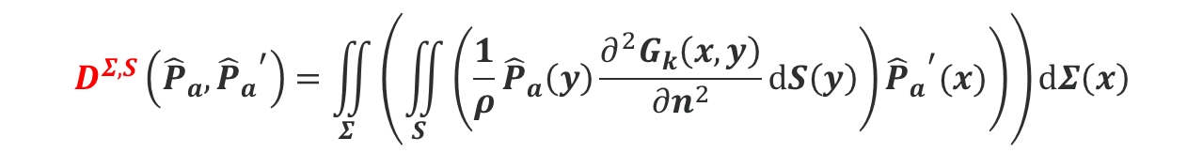

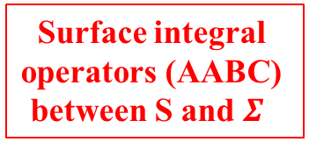
Conference in Honor of Professor Abderrahmane Bendali
HYBRID FINITE AND BOUNDARY ELEMENT METHODS FOR AERO-ACOUSTIC APPLICATIONS
Hybrid Lighthill analogy [8,9,10,11]:
$$\hat{P}={\hat{P}}_{a}+{\hat{P}}_{h}$$
$∀{{\hat{P}}_{a}}^{′}∈H^{1}\left(Ω\right), find {\hat{P}}_{a}∈H^{1}\left(Ω\right)$ /
$$H_{Ω_{FEM}}\left({\hat{P}}_{a},{{\hat{P}}_{a}}^{′}\right)+ω^{2}Q_{Ω_{FEM}}\left({\hat{P}}_{a},{{\hat{P}}_{a}}^{′}\right)+iωB_{Σ}\left({\hat{P}}_{a},{{\hat{P}}_{a}}^{′}\right)+D^{Σ,S}\left({\hat{P}}_{a},{{\hat{P}}_{a}}^{′}\right)+iωN^{Σ,S}\left({\hat{P}}_{a},{{\hat{P}}_{a}}^{′}\right)=ω^{2}F^{Σ,V_{CFD}}\left({\hat{P}}_{h},{{\hat{P}}_{a}}^{′}\right)+iω^{3}G^{Σ,V_{CFD}}\left({\hat{P}}_{h},{{\hat{P}}_{a}}^{′}\right)+ω^{2}K_{Ω_{FEM}}\left({\hat{P}}_{h},{{\hat{P}}_{a}}^{′}\right)$$
$$D^{Σ,S}\left({\hat{P}}_{a},{{\hat{P}}_{a}}^{′}\right)=\iint_{Σ}{\left(\iint_{S}{\left.\left(\frac{1}{ρ}{\hat{P}}_{a}\left(y\right)\frac{∂^{2}G_{k}\left(x,y\right)}{∂n^{2}}ⅆS\left(y\right)\right){{\hat{P}}_{a}}^{′}(x)\right)}\right)}ⅆΣ\left(x\right)$$
$$N^{Σ,S}\left({\hat{P}}_{a},{{\hat{P}}_{a}}^{′}\right)=\iint_{Σ}{\left(\iint_{S}{\left.\left(\frac{β}{ρc}{\hat{P}}_{a}\left(y\right)\frac{∂G_{k}\left(x,y\right)}{∂nx}ⅆS\left(y\right)\right){{\hat{P}}_{a}}^{′}(x)\right)}\right)ⅆΣ\left(x\right)}$$
Surface integral
operators (AABC)
between S and $Σ$

Slide 24


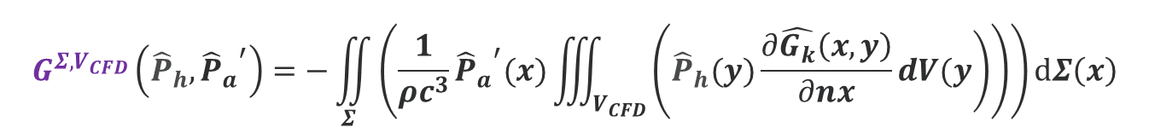

Conference in Honor of Professor Abderrahmane Bendali
HYBRID FINITE AND BOUNDARY ELEMENT METHODS FOR AERO-ACOUSTIC APPLICATIONS
Hybrid Lighthill analogy [8,9,10,11]:
$$\hat{P}={\hat{P}}_{a}+{\hat{P}}_{h}$$
$∀{{\hat{P}}_{a}}^{′}∈H^{1}\left(Ω\right), find {\hat{P}}_{a}∈H^{1}\left(Ω\right)$ /
$$H_{Ω_{FEM}}\left({\hat{P}}_{a},{{\hat{P}}_{a}}^{′}\right)+ω^{2}Q_{Ω_{FEM}}\left({\hat{P}}_{a},{{\hat{P}}_{a}}^{′}\right)+iωB_{Σ}\left({\hat{P}}_{a},{{\hat{P}}_{a}}^{′}\right)+D^{Σ,S}\left({\hat{P}}_{a},{{\hat{P}}_{a}}^{′}\right)+iωN^{Σ,S}\left({\hat{P}}_{a},{{\hat{P}}_{a}}^{′}\right)=ω^{2}F^{Σ,V_{CFD}}\left({\hat{P}}_{h},{{\hat{P}}_{a}}^{′}\right)+iω^{3}G^{Σ,V_{CFD}}\left({\hat{P}}_{h},{{\hat{P}}_{a}}^{′}\right)+ω^{2}K_{Ω_{FEM}}\left({\hat{P}}_{h},{{\hat{P}}_{a}}^{′}\right)$$
$$F^{Σ,V_{CFD}}\left({\hat{P}}_{h},{{\hat{P}}_{a}}^{′}\right)=−\iint_{Σ}{\left(\frac{1}{ρc^{2}}{{\hat{P}}_{a}}^{′}(x)\iiint_{V_{CFD}}{\left(\left.{\hat{P}}_{h}(y)\hat{G_{k}}(x,y)dV(y\right)\right)}\right)ⅆΣ\left(x\right)}$$
Volume Surface integral operators (for sources)
CFD Sources
$$G^{Σ,V_{CFD}}\left({\hat{P}}_{h},{{\hat{P}}_{a}}^{′}\right)=−\iint_{Σ}{\left(\frac{1}{ρc^{3}}{{\hat{P}}_{a}}^{′}(x)\iiint_{V_{CFD}}{\left(\left.{\hat{P}}_{h}(y)\frac{∂\hat{G_{k}}\left(x,y\right)}{∂nx}dV(y\right)\right)}\right)ⅆΣ\left(x\right)}$$

Slide 25






Conference in Honor of Professor Abderrahmane Bendali
HYBRID FINITE AND BOUNDARY ELEMENT METHODS FOR AERO-ACOUSTIC APPLICATIONS
Hybrid Lighthill analogy [8,9,10,11]:
$$\hat{P}={\hat{P}}_{a}+{\hat{P}}_{h}$$
$$\left.\left[H_{Ω_{FEM}}+ω^{2}Q_{Ω_{FEM}}+iωB_{Σ}\right]\left\{{\hat{P}}_{a}^{(n+1)}\right\}=𝓗({\hat{P}}_{h},{\hat{P}}_{a}^{(n)}\right)$$
$$𝓗\left({\hat{P}}_{h},{{\hat{P}}_{a}}_{/S}\right)= \underset{\begin{aligned}MVP at each iteration \\ to update the AABC\end{aligned}}{\underbrace{\left[−D^{Σ,S}−iωN^{Σ,S}\right]\left\{{{\hat{P}}_{a}}_{/S}\right\}}}+\underset{\begin{aligned}MVP at start of iterative process to \\ compute volume sourcesin Ω_{CFD} contribution on the AABC\end{aligned}}{\underbrace{ω^{2}F^{Σ,V_{CFD}}\left\{{\hat{P}}_{h}\right\}+iω^{3}G^{Σ,V_{CFD}}\left\{{\hat{P}}_{h}\right\}}}+\underset{\begin{aligned}Computed at start of iterative process for \\ volume sources in Ω_{FEM}\end{aligned}}{\underbrace{ω^{2}K_{Ω_{FEM}}\left\{{\hat{P}}_{h}\right\}}}$$
$$Domain Decomposition$$
$$Method$$
$$with Overlapping$$
$$Well−posed formulation$$
$$Converge to the exact$$
R$adiation Boundary Condition$
$$\left\{\begin{aligned}&Define ε, {{Nb}_{iter}}^{max}, n=0, {{{\hat{P}}_{a}}_{/S}}^{\left(0\right)} and {{{\hat{P}}_{a}}_{/S}}^{\left(1\right)}≠0 \\ &While\left\|R\left({{{\hat{P}}_{a}}_{/S}}^{\left(n+1\right)},{{{\hat{P}}_{a}}_{/S}}^{\left(n\right)}\right)\right\|>ε and n<{{Nb}_{iter}}^{max} \\ &\left(1\right) Compute 𝓗_{n}\left({\hat{P}}_{h},{{{\hat{P}}_{a}}_{/S}}^{\left(n\right)}\right) MVP \\ &\left(2\right) Solve the linear system for {\left\{{\hat{P}}_{a}\right\}}^{\left(n+1\right)} \\ &\left(3\right)Compute the new residual R\left({{\hat{P}}_{a}}^{\left(n+1\right)},{{\hat{P}}_{a}}^{\left(n\right)}\right) \\ &\left(4\right) n=n+1 \\ &End While \end{aligned}\right.$$
$$MVP by MLFMM$$
$$RAM: \left(N∗{\log_{10}}^{2}N\right)$$
$$CPU: \left(N∗{\log_{10}}^{2}N\right)$$
$$R\left(p,q\right)={\left\|p−q\right\|}/{\left\|q\right\|}$$

Slide 26






Conference in Honor of Professor Abderrahmane Bendali
HYBRID FINITE AND BOUNDARY ELEMENT METHODS FOR AERO-ACOUSTIC APPLICATIONS
Hybrid Lighthill analogy [8,9,10,11]:
Consistent or
Inconsistent 3D
Conservatice
Mapping (on-the-fly)
$$V_{sources}$$
1 $CFD Mesh$
$$(Incompressible DES)$$
$$2 Source Recovery Mesh ({\hat{P}}_{h})$$
$$3 Acoustic Mesh ({\hat{P}}_{a})$$

Slide 27



Conference in Honor of Professor Abderrahmane Bendali
HYBRID FINITE AND BOUNDARY ELEMENT METHODS FOR AERO-ACOUSTIC APPLICATIONS
3D Volume Conservative Interpolation [12]:
.
.
.
.
.
.
.
.
.
.
Conservative
mapping
.
.
10⁷
10⁵
.
.
.
.
.
.
.
Unstructured CFD mesh (Source Mesh)
Tetra Acoustic mesh (Target Mesh)
Pressure located at the
center of the cells (10⁷)
Pressure located at the center
of the cells (10⁵) (P0), at the vertices (P1), …

Slide 28


Conference in Honor of Professor Abderrahmane Bendali
HYBRID FINITE AND BOUNDARY ELEMENT METHODS FOR AERO-ACOUSTIC APPLICATIONS
3D Volume Conservative Mapping [12]:
  Cell Volume Weight (CVW) Interpolation implemented in OpenFOAM
  Computation of intersecting volumes computationally costly (solved by HPC) but very high quality interpolation
    CVW method conserves the integral over the interpolated quantity exactly.
    Computation of the Interpolation Operator $W$ before the time loop and application on the results on-the-fly at the end of the converged time before the export of the quantities (Minimum disk storage).
Cell volume intersections for the CVW method (courtesy [12])

Slide 29

Conference in Honor of Professor Abderrahmane Bendali
HYBRID FINITE AND BOUNDARY ELEMENT METHODS FOR AERO-ACOUSTIC APPLICATIONS
Incompessible DES OpenFOAM computation over a Sphere [13]
Parameters of the DDES case (incompressible)
Inlet/Outlet & Boundary Conditions
Dimensions
Turbulence model | Spalart-Allmaras DDES
Time step | 3.10⁻⁵ s (record 1/3 steps)
Simulated physical time | 0.7 s (record on the last 0.3 s)
Time calculation | ~20h
Computing resources | 16 CPUs (Sandy Bridge machine Intel Xeon E5-2680 2.7 Ghz)
Mesh | Hexahedral
Base size (level 0) | 0.004 m
Sphere size (level 4) | 0.000025 m = Base size / 2⁴
Number of layer in the BL | 5
Thickness of the BL | 0.25 mm
Thickness of near wall prism layer | 0.1 mm
Total Nomber of cells | 12.9 M
Inlet condition (Left Patch) | Constant Ux = 33 m/s
Outlet conditions | Standard Wall Function
Sphere Radius | 0.25m
Duct Length | 8m
Duct Width and Height | 1m
Xmin Patch | -0.25m

Slide 30





Conference in Honor of Professor Abderrahmane Bendali
HYBRID FINITE AND BOUNDARY ELEMENT METHODS FOR AERO-ACOUSTIC APPLICATIONS
Incompessible DES OpenFOAM computation over a Sphere [13]

Slide 31




Conference in Honor of Professor Abderrahmane Bendali
HYBRID FINITE AND BOUNDARY ELEMENT METHODS FOR AERO-ACOUSTIC APPLICATIONS
Acoustic computation (CFD Loading, Frequency Range [200:20:3500]Hz)
Surface Mesh (BEM):
  Nodes: 9 140
  Elements: 18 276
AABC layer; Distance D=10cm
  Nodes: 13 692
  Elements: 27 380
Volume Mesh (FEM)
  Nodes: 172 728
  Elements: 958 959
R
D

Slide 32


Conference in Honor of Professor Abderrahmane Bendali
HYBRID FINITE AND BOUNDARY ELEMENT METHODS FOR AERO-ACOUSTIC APPLICATIONS
Acoustic computation (CFD Loading, Frequency Range [200:20:3500]Hz)
Surface Mesh (BEM):
  Nodes: 35 406
  Elements: 70 808
AABC layer; Distance D=10cm
  Nodes: 35 406
  Elements: 70 808
Volume Mesh (FEM)
  Nodes: 353 667
  Elements: 1 963 883
R
D

Slide 33


Conference in Honor of Professor Abderrahmane Bendali
HYBRID FINITE AND BOUNDARY ELEMENT METHODS FOR AERO-ACOUSTIC APPLICATIONS
Acoustic computation (CFD Loading, Frequency Range [200:20:3500]Hz)
Surface Mesh (BEM):
  Nodes: 9 140
  Elements: 18 276
AABC layer; Distance D=10cm
  Nodes: 13 692
  Elements: 27 380
Volume Mesh (FEM)
  Nodes: 172 728
  Elements: 958 959
Volume Source Mesh (CFD Data)
  Nodes: 471 345
  Elements: 2 875 812

Slide 34



Conference in Honor of Professor Abderrahmane Bendali
HYBRID FINITE AND BOUNDARY ELEMENT METHODS FOR AERO-ACOUSTIC APPLICATIONS
Curle BEM vs Lighthill Hybrid-FEM (2.5kHz)
Curle BEM
Lighthill Hybrid-FEM

Slide 35
Conference in Honor of Professor Abderrahmane Bendali
HYBRID FINITE AND BOUNDARY ELEMENT METHODS FOR AERO-ACOUSTIC APPLICATIONS
Curle BEM vs Lighthill Hybrid-FEM
Sequential (1 proc) | BEM Curle Coarse/Fine | Lighthill Hybrid-FEM (Coarse/Vol Source) | Lighthill Hybrid-FEM (Fine/Vol Source) | Lighthill Hybrid-FEM (Coarse+Box/Vol Source)
1 Freq CPU TIME (mn) | 5 / 95 | 5 / 2.5 (3iter) | 17 / 10 (3iter) | 13 / 6 (3iter)
Total CPU Time (Hour) | 14 / 10D | 14 | 47 | 35
RAM (Gb) | 0.8 / 13 | 0.3 | 1.6 | 0.5

Slide 36



Conference in Honor of Professor Abderrahmane Bendali
HYBRID FINITE AND BOUNDARY ELEMENT METHODS FOR AERO-ACOUSTIC APPLICATIONS
Target Application: SAE Car Body
Surface Mesh
  Number of Nodes: 144 649
  Number of Elements: 289 294
Volume Source:
  Number of Nodes: 708 621
  Number of Elements: 3 564 978
Volume (FEM):
  Number of Nodes: 391 357
  Number of Elements: 1 477 394
AABC surface:
  Number of Nodes: 144 649
  Number of Elements: 289 294

Slide 37

Conference in Honor of Professor Abderrahmane Bendali
HYBRID FINITE AND BOUNDARY ELEMENT METHODS FOR AERO-ACOUSTIC APPLICATIONS
Target Application: SAE Car Body
  Acoustic Load
    1 monopole behind the side mirror
Sequential (1 proc) | Standard BEM | MLFMM | Hybrid-FEM
1 Freq CPU TIME (mn) | 4444 (74H) | 134 (2.3H / 45 iter) | 10 (6 iter)
Total CPU Time (Hour) | 3185 (132D) / 12D DMP16 | 397 / 27H DMP16 | 38.5 / 2H DMP16
RAM (Gb) | 170 | 23 | 12 / 192

Slide 38


Conference in Honor of Professor Abderrahmane Bendali
HYBRID FINITE AND BOUNDARY ELEMENT METHODS FOR AERO-ACOUSTIC APPLICATIONS
Conclusions:
  Presentation of an extension of the FEM Lighthill analogy using an Adaptive Absorbant Boundary Condition usefull for external turbulent flow noise applications (Automotive, Train)
    No neglected terms for aeroacoustic sources in the formulation (Source domain definition different from the acoustic computational domain)
    No constraint on shape and distance for the AABC surface (until simple extrusion of original surface, control the acoustic computational domain)
    Use on-the-fly 3D no-consistent conservative mapping (control the disk storage)
    Extension of MLFMM algorithm to compute Surface/Volume integral operators (savings CPU Time and RAM)
  Application on academic case and very first comparison vs Curle BEM analogy
    Coherent results with Curle BEM analogy
    Very significant saving time and RAM requirements (potential factor 150 speed-up for very large model)
Perspectives and Future Work:
  To reduce peaky results:
    Add space filtering during non-consistent mapping (Hann Window)
    Use averaging between several segments of the time domain CFD results
  Study of the « CFD » source mesh (refinement, dimension/shape of the source domain, etc…)
  Validation against experiments
  Demonstrate impact of volume sources (quadrupoles) on specific cases
  Application on more complex industrial case for Wind Noise
  (SAE Body for Automotive, Pantograph for train or Landing Gear for plane)

Slide 39
Conference in Honor of Professor Abderrahmane Bendali
HYBRID FINITE AND BOUNDARY ELEMENT METHODS FOR AERO-ACOUSTIC APPLICATIONS
References:
  Curle Analogy
    [1] N. Curle, The Influence of Solid Boundaries upon Aerodynamic Sound, Proceedings of the Royal Society A: Mathematical, Physical and Engineering Sciences 231(1187): 505-510, 1955
    [2] M. Watrigant, C. Picard, E. Perrey-Debain and C. Prax, Formulation adaptée de l’analogie acoustique de Lighthill-Curle en Zone Source, Proceedings of the 19th French Congress of Mechanics, Marseille, France, 2009
    [3] C. Schram, A Boundary Element Extension of Curles analogy for Non-Compact Geometries at Low-Mach Numbers, Journal of Sound and Vibration 322(2009): 264-281, 2009
    [4] N. Papaxanthos and E. Perrey-Debain, On the use of integral formulations for the prediction of air flow noise in ducts, Proceedings of the 22th International Congress on Sound and Vibration, Florence, Italy, 2015
  Lighthill Analogy
    [5] M.J., Lighthill, On sound generated aerodynamically. Part I: General theory. Proceedings of the Royal Society of London, 564-587, (1952).
    [6] M., Piellard, C., Bailly, Validation of a hybrid CAA method. Application to the case of a ducted diaphragm at low Mach number; Proceedings of the 14th AIAA/CEAS Aeroacoustics Conference, Vancouver, British Columbia, 2008.
    [7] N., Zerbib, L., Mebarek, A., Heather, M., Escouflaire, Use of OpenFoam coupled with the Finite Element Method for Computational AeroAcoustics , Proceedings of the 4th OpenFOAM User Conference 2016, Cologne – Germany, 2016.
  Adaptive Absorbing Boundary Condition
    [8] S. Alfonzetti, G, Borzi, FEM Solution to High-Frequency Unbounded Problems by means of RBCI, Proceedings International Workshop on Finite Elements for Microwave Engineering, Chios (Greece), May 2002
    [9] N. Zerbib and al , “Méthodes de sous-structuration et de décomposition de domaine pour la résolution des équations de Maxwell. Application au rayonnement d'antenne dans un environnement complexe“, Thesis, INSA Toulouse, 2006.
    [10] A. Bendali and al , “Localized adaptive radiation condition for coupling boundary and finite element methods applied to wave propagation problems“, IMA Journal of Numerical Analysis. 01/2014; 34(3), 2014.
    [11] N. Zerbib and al , “An extension of the adaptive absorbing boundary condition method“, Conference: Antennas and Propagation Society International Symposium, 2007 IEEE.
  Conservative Mapping
    [12] T. Schroder, P. Silkeit, O. Von Estorff, Influence of source term interpolation on hybrid computational aeroacoustics in finite volumes, Proceedings of Internoise 2016, Hamburg, Germany, 2016.
  Validation example of turbulent flow around a sphere (CFD)
    [13] G. Constantinescu, Numerical investigations of flow over around a sphere in the subcritical and supercritical regimes, Physics of fluid, Volume 16, Number 5, May 2004..

Slide 40
Best Wishes Abderrahmane !

