Slide 1
HyAIAI Meeting
Thursday 07th May 2020
Neetu Kushwaha
Post Doc Researcher
Rennes, France
Neetu.kushwaha@inria.fr
Project Supervisors-
Elisa Fromont IRISA/INRIA rba Lacodam team (Rennes)
Alexandre Termier IRISA/INRIA rba Lacodam team (Rennes)
Irina Illina LORIA/INRIA nge – Multispeech team (Nancy)

Slide 2
BACKGROUND

Slide 3
NEETU KUSHWAHA
Post doc Researcher, INRIA, Rennes (France)
Pattern Mining for Neural Networks Debugging: Application to Speech Recognition
(Start Date-01 March 2020 End Date-28th Feb 2022)
Ph. D, Machine Learning, IIT Roorkee (India)
Post-graduation , Computer science and engineering
Graduation, Computer science and engineering

Slide 4
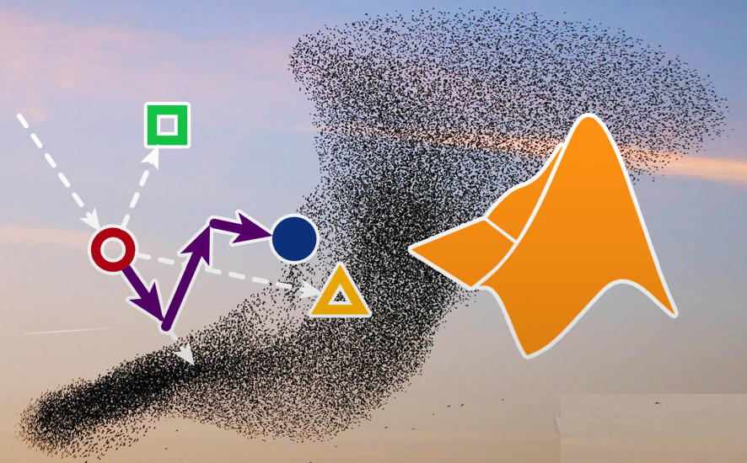
NEETU KUSHWAHA
Ph.D. , IIT Roorkee, Roorkee (India)
Title : Enhanced Metaheuristics Based Clustering Algorithms and Their Applications
Highlights
Exploited the potential of soft computing techniques for data clustering
Developed a stand-alone framework in to compare the design algorithm
with other state of the art algorithms
Developed a system for text document features selection
Developed a recommender system for Movie Lense dataset
Area of Research
Optimization- Metaheuristics
Machine Learning
Supervised Machine Learning
Unsupervised Machine Learning
Clustering
Application of Clustering
Recommender system
Text Clustering

Slide 5
MAIN PUBLICATIONS
Neetu Kushwaha, Millie Pant(2017), “Magnetic optimization algorithm for data clustering”, Pattern Recognition Letters
Neetu Kushwaha, Millie Pant(2017), “Link based BPSO for feature selection in Big data text clustering”, Future Generation Computer Systems
Neetu Kushwaha, Millie Pant(2018), "Modified particle swarm optimization for multimodal functions and its applications”, Multimedia Tools and Applications
Neetu Kushwaha, Millie Pant(2018), " Fuzzy magnetic optimization clustering algorithm with its application to health care Fuzzy Magnetic Clustering Algorithm for Health Care”, Journal of Ambient Intelligence and Humanized Computing
Neetu Kushwaha, Millie Pant(2018), "Textual data dimensionality reduction - a deep learning approach”, Multimedia Tools and Applications

Slide 6
INTRODUCTION OF THE PROJECT

Slide 7
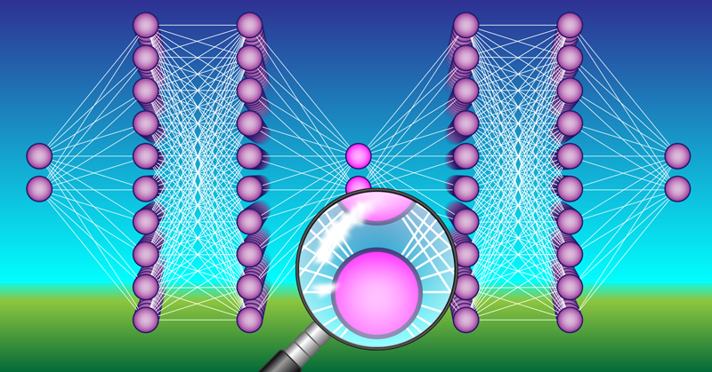
INNER WORKING OF DEEP NEURAL NETWORKS
understanding what an individual neuron or a layer of neurons are computing
It is often unclear exactly how the network processes information in order to solve a problem
To investigate which concepts the neural network discovered when it derived its answer

Slide 8
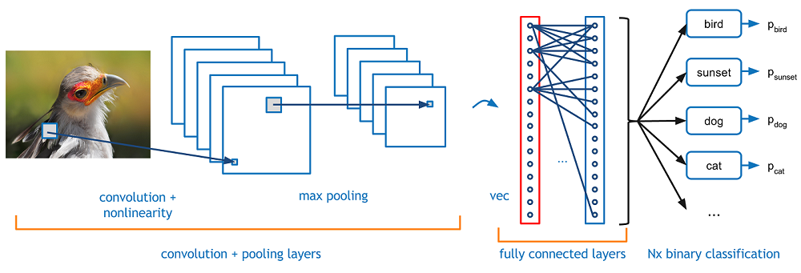
PATTERN MINING IN DEEP LEARNING
Extracting Patterns: Groups of neurons which are commonly highly activated when a network is making wrong predictions on a set of examples.
Highly Activated neurons: Neurons having activation value greater then their individual mean activation value over all test examples
CONVOLUTIONAL NEURAL NETWORK

Slide 9
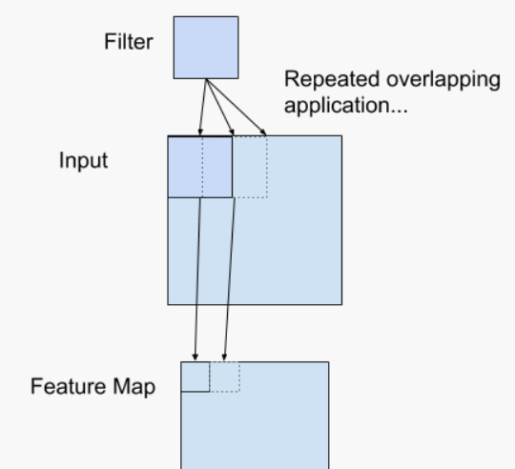
CONVOLUTIONAL NEURAL NETWORK FEATURE MAP
Example of a Filter Applied to a Two-Dimensional Input to Create a Feature Map

Slide 10
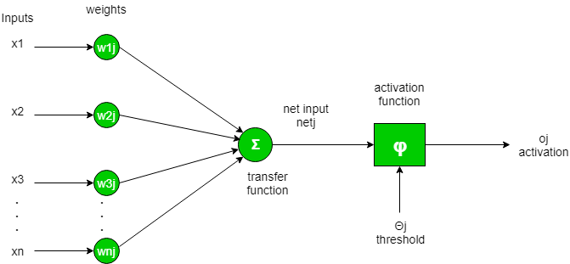
ACTIVATION VALUE OF NEURON IN CNN
Convolution
Non-Linearity

Slide 11
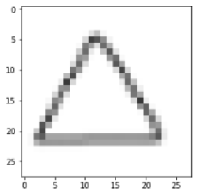
Example
Inactive
CNN Feature Maps After Convolution(32 Filters)
Input Image(Triangle)
Highly Activated

Slide 12
WORK FLOW

Slide 13
WORK FLOW (CONTD…)
(Only Highly Activated Neurons)

Slide 14
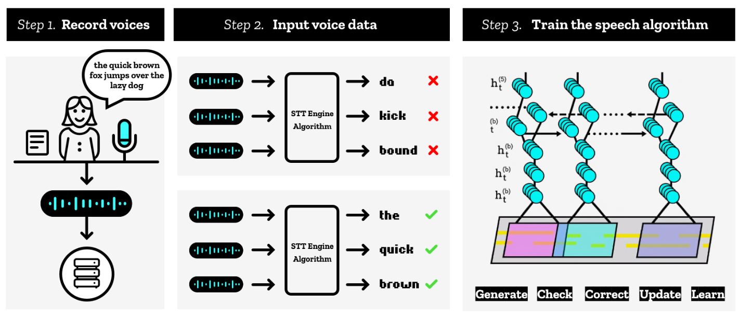
APPLICATIONS
Speech Recognition

Slide 15
[1] Pang Wei Koh, Percy Liang: Understanding Black-box Predictions via Influence Functions. ICML 2017: pp 1885-1894 (best paper)
[2] Chiyuan Zhang, Samy Bengio, Moritz Hardt, Benjamin Recht, Oriol Vinyals: Understanding deep learning requires rethinking generalization. ICLR 2017
[3] Anh Mai Nguyen, Jason Yosinski, Jeff Clune: Deep neural networks are easily fooled: High confidence predictions for unrecognizable images. CVPR 2015: pp 427-436
[4] Christian Szegedy, Wojciech Zaremba, Ilya Sutskever, Joan Bruna, Dumitru Erhan, Ian Goodfellow, Rob Fergus: Intriguing properties of neural networks. ICLR 2014.
[5] Bin Liang, Hongcheng Li, Miaoqiang Su, Pan Bian, Xirong Li, Wenchang Shi: Deep Text Classification Can be Fooled. IJCAI 2018: pp 4208-4215
[7] Takeaki Uno, Tatsuya Asai, Yuzo Uchida, and Hiroki Arimura. Lcm: An efficient algorithm for enumerating frequent closed item sets. In Fimi, volume 90. Citeseer, 2003.
[8] Dumitru Erhan, Yoshua Bengio, Aaron Courville, and Pascal Vincent. Visualizing higher-layer features of a deep network. University of Montreal, 1341(3):1, 2009.
[9] G. Saon, H.-K. J. Kuo, S. Rennie, M. Picheny: The IBM 2015 English conversational telephone speech recognition system", Proc. Interspeech, pp. 3140-3144, 2015.

Slide 17
Thanks

