Slide 1
Accelerating mesh-based CFD simulations
with Deep Learning
Supervisors :
Marc Schoenauer (INRIA)
Michele-Alessandro Bucci (INRIA)
Guillaume Charpiat (INRIA)
Jean-Marc Gratien (IFPEN)
Thibault Faney (IFPEN)
Matthieu Nastorg
matthieu.nastorg@inria.fr

Slide 2
Introduction

Slide 3
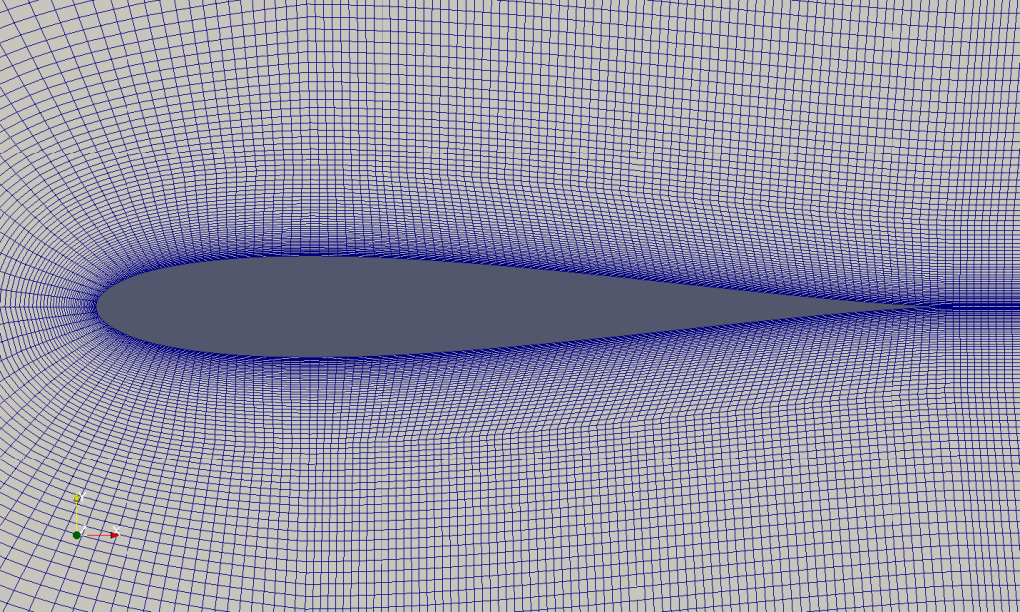
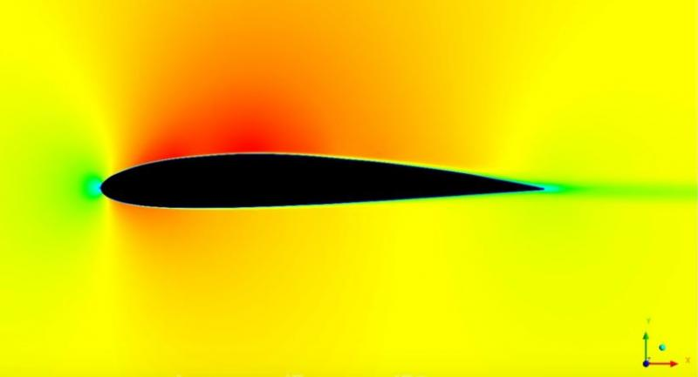
General CFD procedure
Pre-processing
Build geometry
Mesh generation
Set-up boundary conditions
Solver
Specify numerical parameters
Numerical method (FD, FE, FV)
Discretization schemes
Solve the system
Post-processing
Visualize and interpret the results
Analyze flow fields
Make decision for design optimization

Slide 4
Incompressible Navier-Stokes equations
Incompressible Navier-Stokes equations
Splitting scheme strategy
Compute tentative velocity u*
Poisson equation for pressure
Update velocity
Numerical Methods for incompressible viscous flow : Hans Petter Langtangen, Kent-Andre Mardal, Ragnar Winther

Slide 5
Graph Neural Networks to solve
Linear Systems from discretized PDEs
Deep Statistical Solver : Balthazar Donon, Wenzhuo Liu, Antoine Marot, Zhengying Liu, Isabelle Guyon, et al..

Slide 6
Statistical Problem
FEM discretization

Slide 7
Statistical Problem
FEM discretization

Slide 8
Statistical Problem
FEM discretization

Slide 9
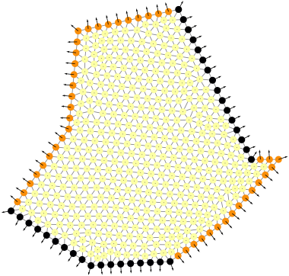
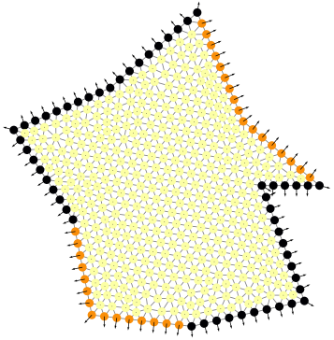
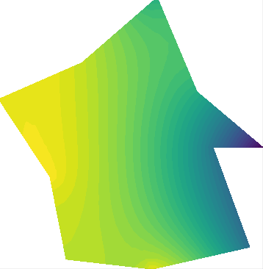
Dataset description
Random 2D domains discretized with GMSH. Coordinates in the unit square. ⋍ 400 - 600 nodes per geometries.
Force function f_{p}(x,y) and boundary function g_{p}(x,y) are defined as polynomials with coefficients r_{i} uniformly sampled in [-10,10] :
Dirichlet
Training set : 50000 samples
Validation set : 10000 samples
Test set : 10000 samples
Neumann

Slide 10
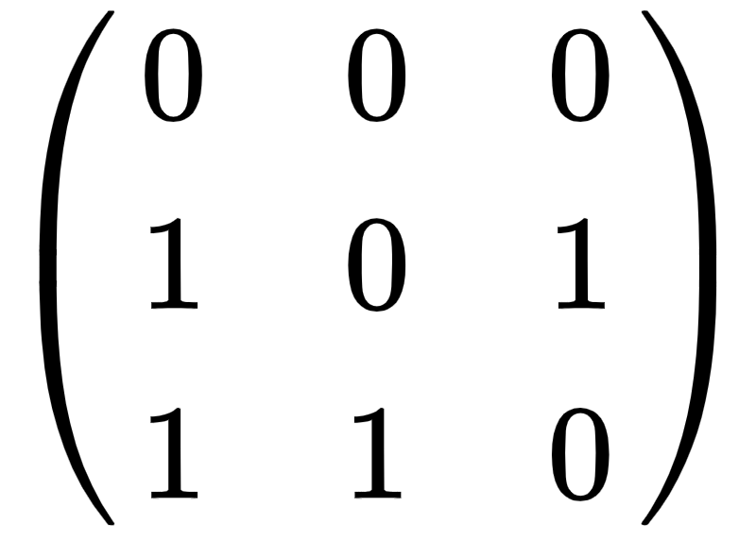
Mesh Graph Structure
“Flow over Cylinder” mesh
Graph : G = (n, A, B)
n : number of nodes in the mesh.
Interaction between nodes : A = (A_{i,j}) ∈ R^{dA}
Local external inputs : B = (B_{i}) ∈ R^{dB}
State of the graph : U = (U_{i}) ∈ R^{dU}
a_{1,2}≠ a_{2,1}
U₁
B₁
U₂
B₂
a_{1,3}≠ a_{3,1}
a_{2,3}= a_{3,2}
U₃
B₃
Adjacency Matrix
Example of graph with 3 nodes

Slide 11
Graph Neural Networks
Graph Neural Networks : extend the idea of convolution on graphs.
(left) CNN on structured grids.
(right) GNN on unstructured grids
Message Passing Neural Networks (MPNNs) : General framework to learn the information shared between the nodes.
Multiple MPNNs layers : a node receives / transmits information to nodes located n layers away.
j
j
i
j
Mathematical expression of the “red” message passing

Slide 12
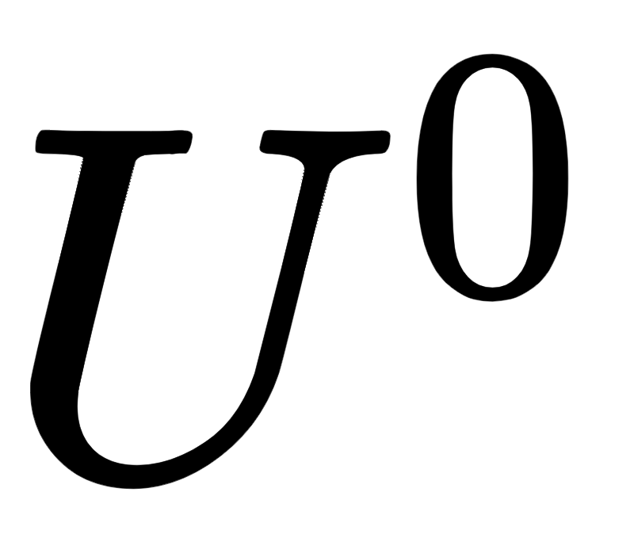
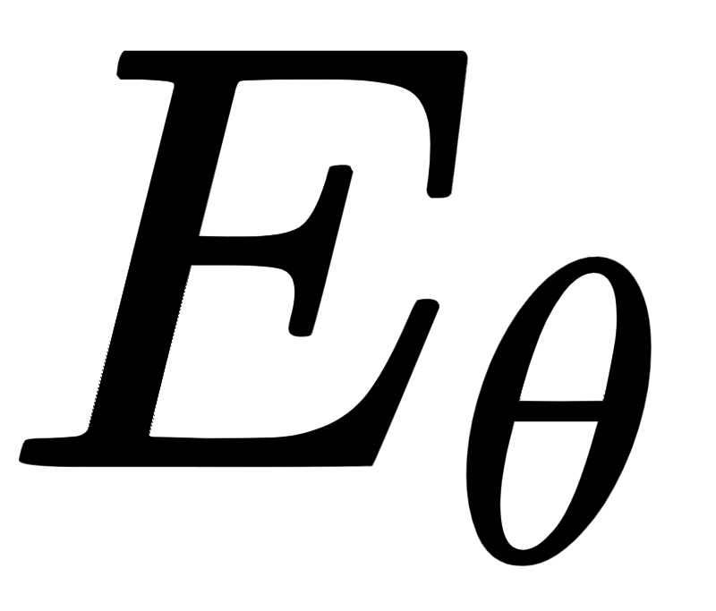
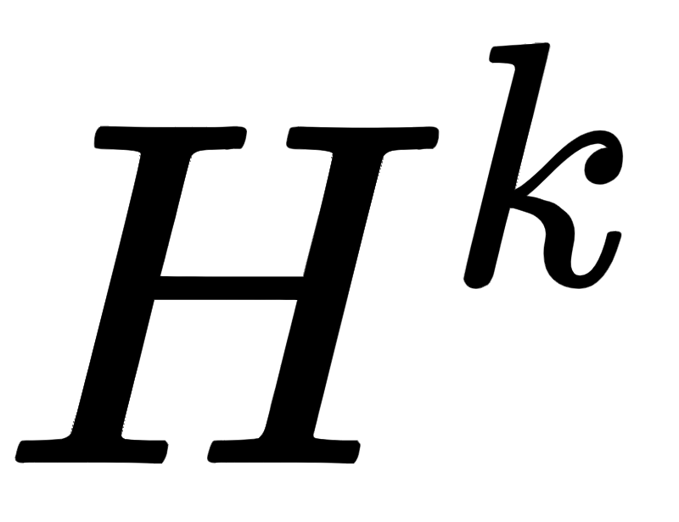
An initial solution U⁰ is encoded to its latent representation H⁰.
...
Trainable function
Û^{k}
Intermediate solution
H^{k}
Intermediate hidden state
Initial process

Slide 13
An initial solution U⁰ is encoded to its latent representation H⁰.
Recurrent process that acts on the latent state H^{k}. Dirichlet nodes are preserved across iterations.
...
Trainable function
Û^{k}
Intermediate solution
H^{k}
Intermediate hidden state
Initial process
Recurrent process on the latent state
Dirichlet

Slide 14
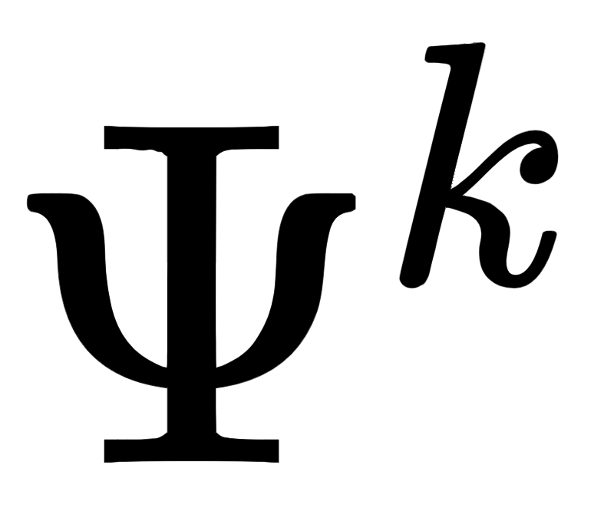
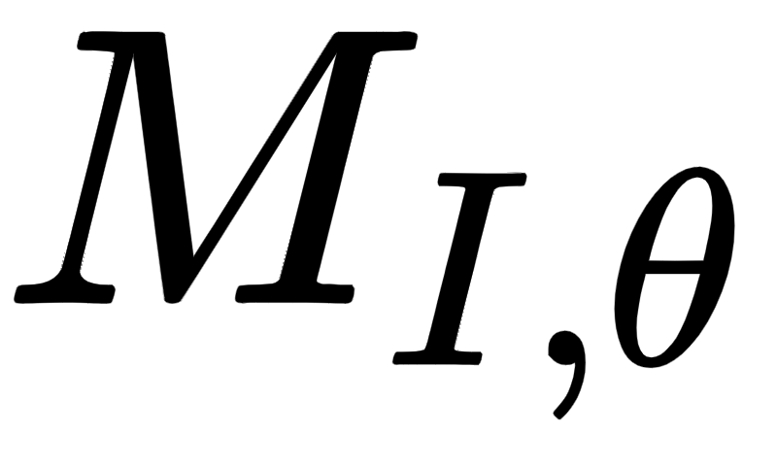
An initial solution U⁰ is encoded to its latent representation H⁰.
Recurrent process that acts on the latent state H^{k}. Dirichlet nodes are preserved across iterations.
Interior nodes are computed in a ResNet-like fashion using a combination of Message Passing Neural Networks and GRU cell.
...
Trainable function
Û^{k}
Intermediate solution
H^{k}
Intermediate hidden state
Initial process
Recurrent process on the latent state
Dirichlet
Interior
Graph info
Node info

Slide 15
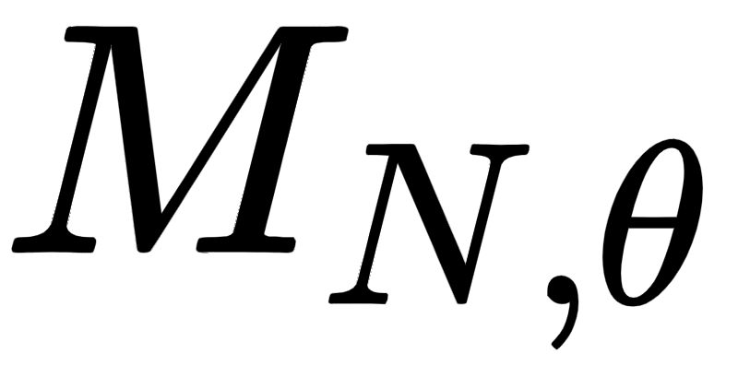
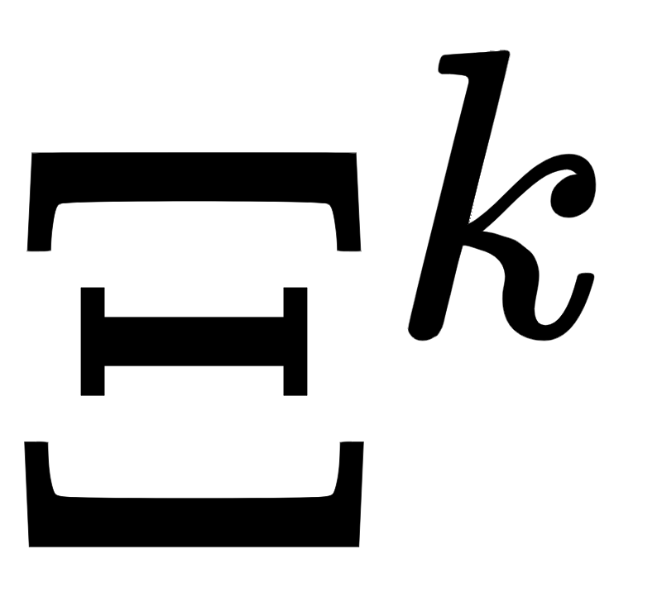
An initial solution U⁰ is encoded to its latent representation H⁰.
Recurrent process that acts on the latent state H^{k}. Dirichlet nodes are preserved across iterations.
Interior nodes are computed in a ResNet-like fashion using a combination of Message Passing Neural Networks and GRU cell.
A specific Message Passing is computed to enforce Neumann boundary conditions.
...
Trainable function
Û^{k}
Intermediate solution
H^{k}
Intermediate hidden state
Initial process
Recurrent process on the latent state
Dirichlet
Interior
Graph info
Node info
Neumann

Slide 16
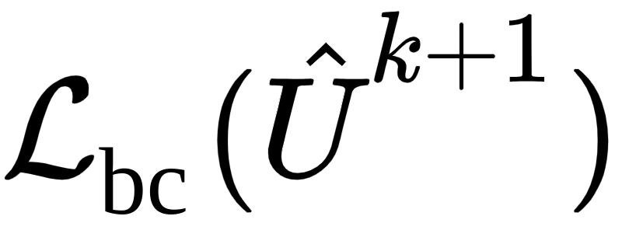
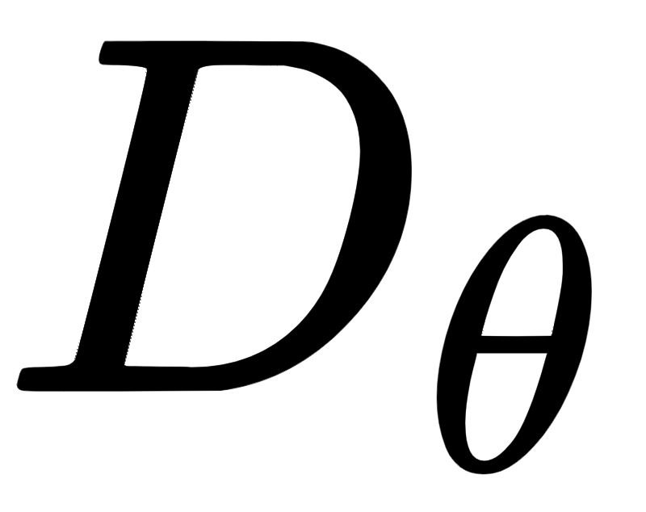
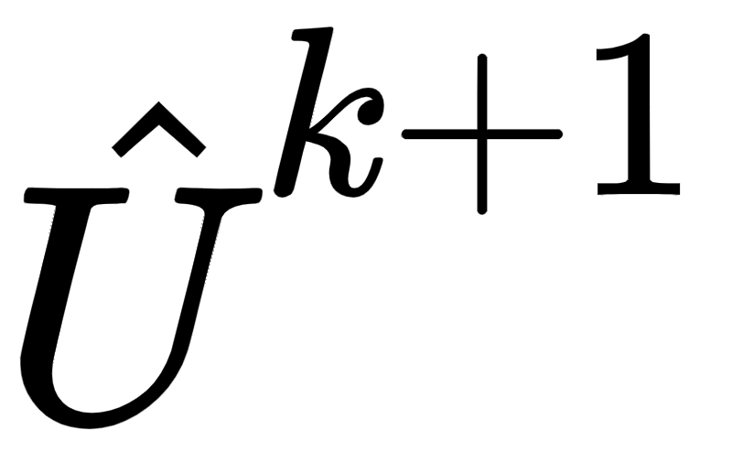
An initial solution U⁰ is encoded to its latent representation H⁰.
Recurrent process that acts on the latent state H^{k}. Dirichlet nodes are preserved across iterations.
Interior nodes are computed in a ResNet-like fashion using a combination of Message Passing Neural Networks and GRU cell.
A specific Message Passing is computed to enforce Neumann boundary conditions.
At each iteration, the latent state H^{k+1} is decoded to a meaningful physical solution Û^{k+1} from which the intermediate losses are computed.
...
Trainable function
Û^{k}
Intermediate solution
H^{k}
Intermediate hidden state
Initial process
Recurrent process on the latent state
Storage of loss functions
Dirichlet
Interior
Graph info
Node info
Neumann

Slide 17
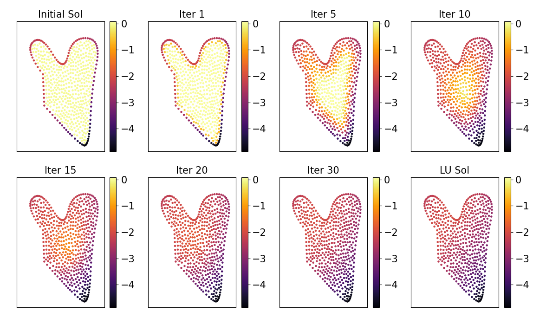
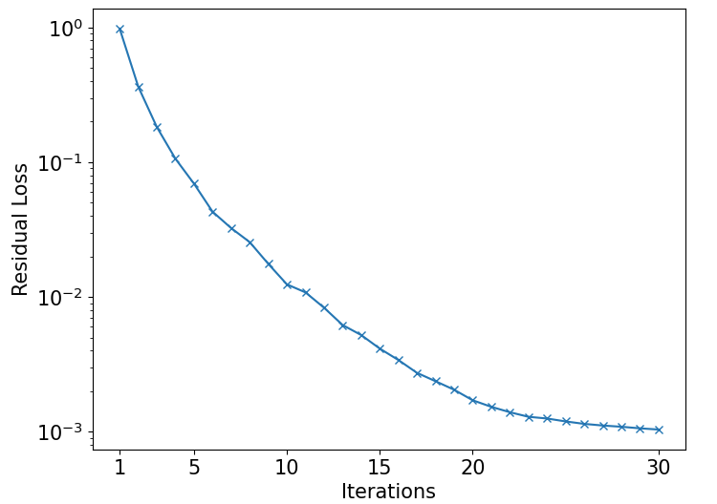
Results - Dirichlet only
Implemented in Pytorch. Training done for 48h on 4 Nvidia GTX 1080i GPUs reaching 400 epochs.
Evolution of the solution of the Poisson problem across iterations - initialized at 0 (top left) to be compared with the LU solution (bottom right)
Evolution of the residual loss across the 30 iterations - Final value of order 1.e-4
Metrics | Residual Loss | RMSE w/ LU | NRMSE w/ LU | Time LU (ms) | Time DSS (ms)
Deep Statistical Solver | 9.4e-4 | 8.2e-3 | 3.e-3 | 2.4 | 1.8
Metrics results

Slide 18
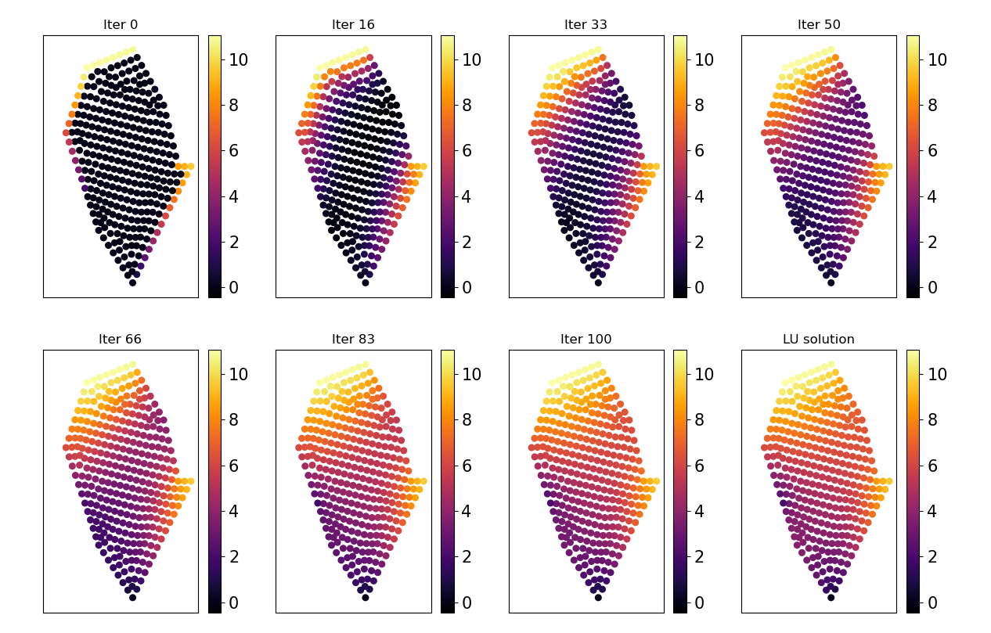
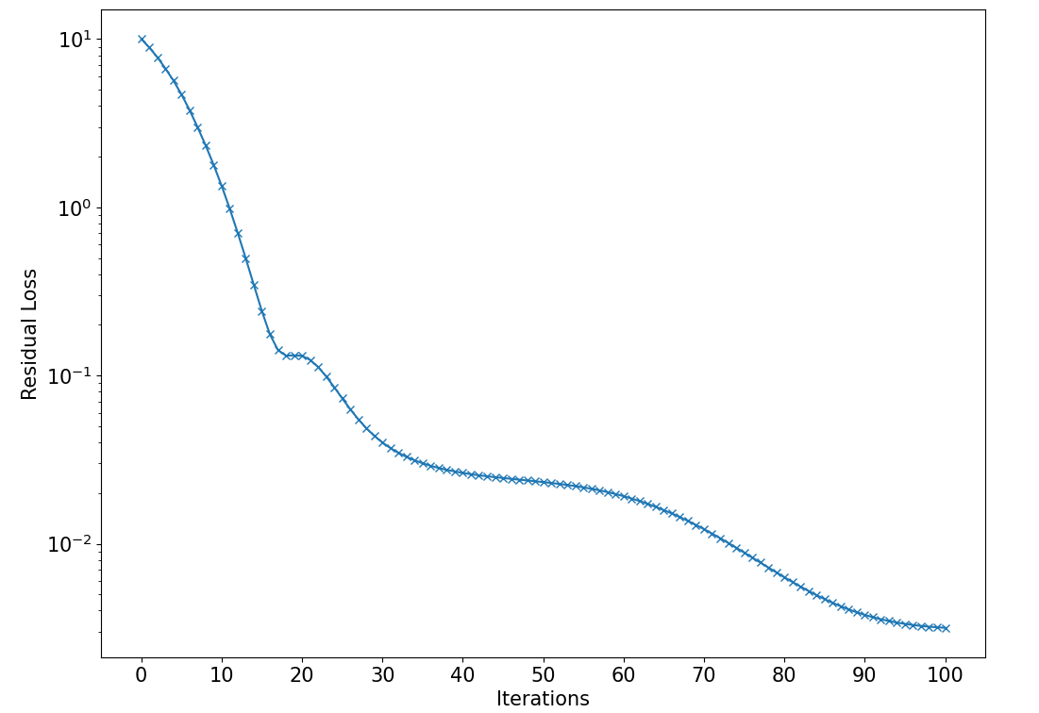
Results - Mixed boundary conditions
Implemented in Pytorch. Training done for 48h on 4 Nvidia GTX 1080i GPUs reaching 400 epochs.
Evolution of the solution of the Poisson problem across iterations - initialized at 0 (top left) to be compared with the LU solution (bottom right)
Evolution of the residual loss across the 100 iterations - Final value of order 1.e-3
Metrics | Residual Loss | RMSE w/ LU | NRMSE w/ LU | Time LU (ms) | Time DSS (ms)
Deep Statistical Solver | 3.0e-3 | 1.6e-1 | 1.4.e-3 | 2.4 | 2.0
Metrics results

Slide 19
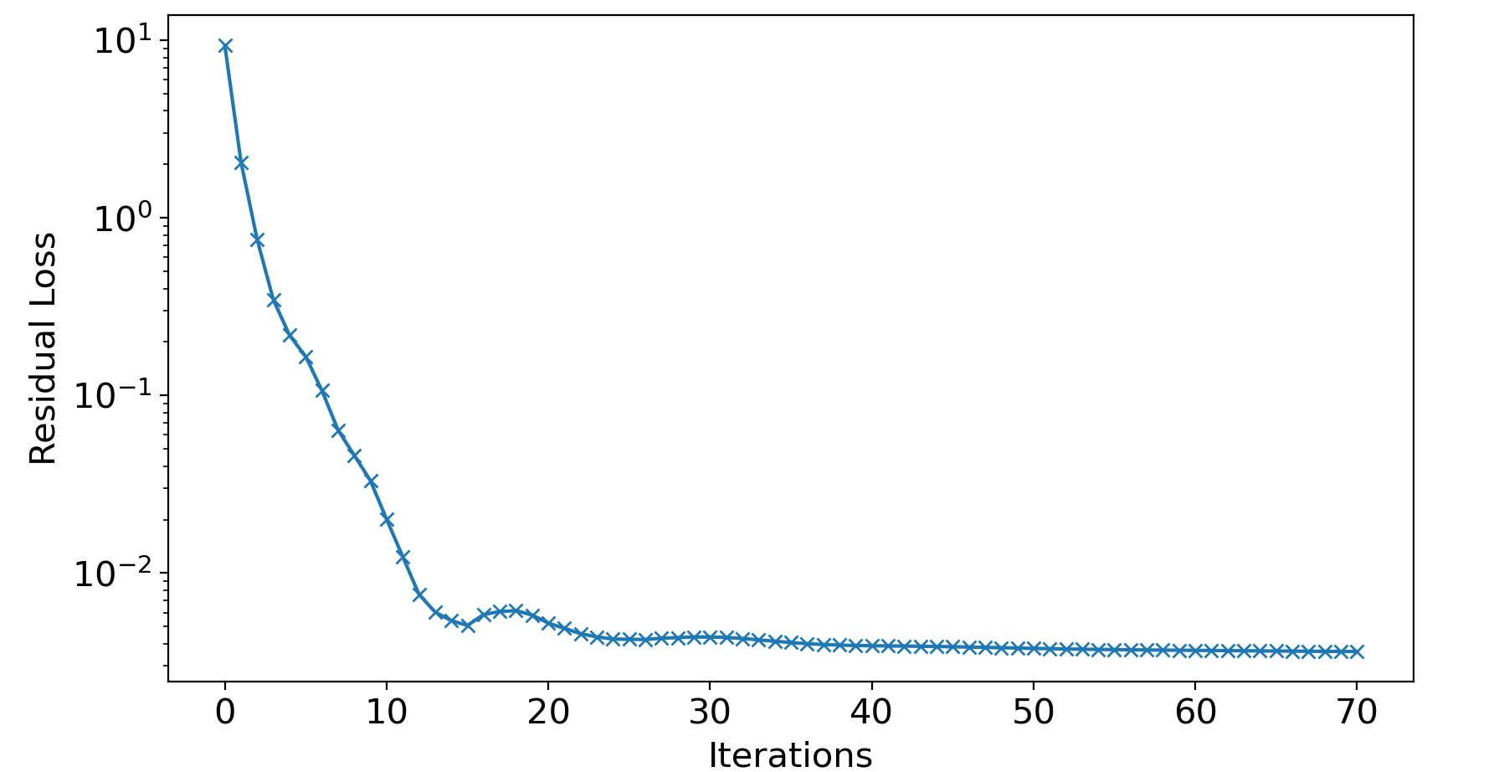
Remarks and limitations
Fixed number of iterations to train the model.
Still limited by the small geometries we consider.
The convergence is not guaranteed by the RNN model.
Training done with 50 iterations : the model converges to a fixed point for a sufficient number of iterations.

Slide 20
Deep Equilibrium Models
Deep Equilibrium Models : S.Bai, J.Z.Kolter, V.Koltun

Slide 21
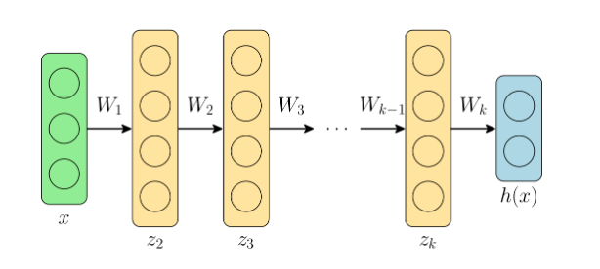
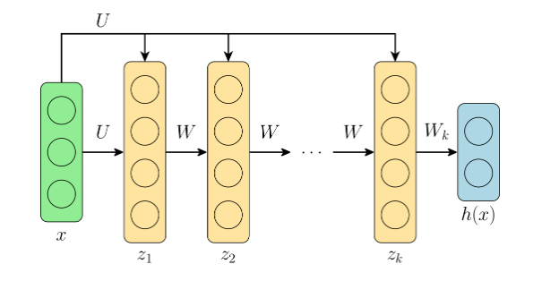
Key idea of DEQ models
k-layer deep network
weight tied network
Replace all different weights W_{i} by the same weight W
What happens when i goes to infinity ? For most “typical” deep layers, the value converges to a fixed point.
The goal of a DEQ model is to directly find this equilibrium point without performing the forward iteration itself, but by directly attempting to find a root of this equilibrium equation.

Slide 22
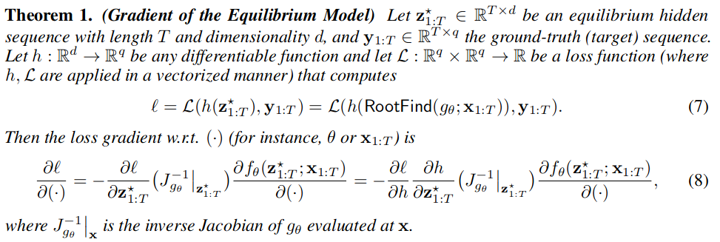
Forward and backward pass
Forward pass :
Fixed point iteration : iterate until we reach the fixed point.
Use alternative methods that provide faster convergence guarantees : Newton or Quasi-Newton methods.
Backward pass :
With a Black-box RootFind : no explicit backpropagation through the exact operations in the forward pass.
Alternative procedure which avoids storing all iterations + requires constant memory :

Slide 23
Computational trick and summary
Computational trick :
One challenge is to compute the exact inverse Jacobian at every intermediate Newton iteration.
Use Broyden’s method : a quasi-newton approach that makes low-rank updates to approximate the inverse jacobian.
This trick can also be employed in the backward pass :
Summary :
Design a function (stable and constrained : e.g using layernorm / batchnorm / LSTM …)
Find the equilibrium point using Broyden’s method.
Backpropagate through the fixed point using Theorem 1 and Broyden’s method.

Slide 24
Convergence of iterations
Issues in DEQ models
slower than conventional deep networks for same accuracy.
number of iterations required to solve for the equilibrium quickly grows over the course of training : approaching instability.
the model is sensitive to architectural choices.
Regularization solution to improve DEQ model’s stability, efficiency and flexibility
Jacobian regularization relates to the contractivity of DEQ’s forward non-linear system and backward linear system.
In both the forward and backward, the spectral radius of the Jacobian at the fixed point directly affects how stable the convergence to the fixed point could be in its neighborhood (i.e the jacobian characterizes the shape of the transformation of the function around the fixed point).
Add an auxiliary term to the training objective to regularize the model conditioning.

Slide 25
How ?
Spectral normalization / Power iterations are too expensive due to successive vector-Jacobian products
Solution proposed is to regularize the Jacobian through its Frobenius norm since :
The Frobenius can be estimated using Hutchinson estimator :
Which can be approximated by Monte-Carlo estimation (sampling M i.i.d ε). Empirically, M = 1 works well.

Slide 26
Autoencoder Loss
If Dirichlet node : Autoencoder is learning well because multiplication by 0 + loss “MSE with ground truth”.
But if we check ||D(E(Ufinal)) - Ufinal||^2 on all nodes the error is high …. (pick at the beginning of residual / mse curves) + decoder has information to minimize the residual instead of being “independant”.
Add loss for the autoencoding process

Slide 27
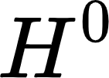
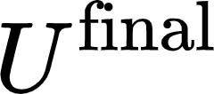
Full Model

Slide 28
Training Loss
Residual
Jacobian Frobenius Norm
Encoder
Decoder

Slide 29
Results - Dataset with 10000 samples (250 - 950 nodes)
Hyperparameters :
Latent dimension : 20
Solver : Broyden (quasi-Newton method)
Tolerance forward : 1.e-6
Threshold forward : 600
Tolerance backward : 1.e-8
Threshold backward : 600
Learning rate : 0.01
Gradient clipping : 0.01
Scheduler : Reduce LR in plateau with step : 0.5
Jacobian spec.rad weight : 1.0
Total number of weights : 7241
If we check ||D(E(U)) - U||^2 around 1.e-5
Exp | Nb nodes | Residual | MSE
Test set | N/A | 2.27e-3 | 1.06e-2

Slide 30
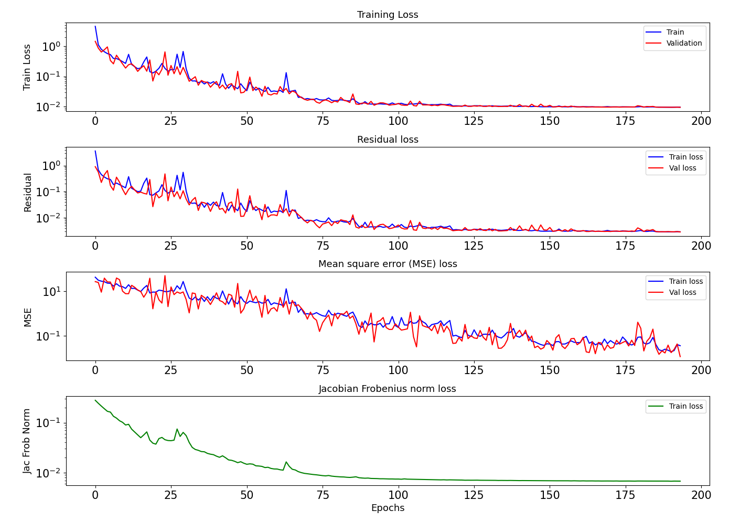

Slide 31
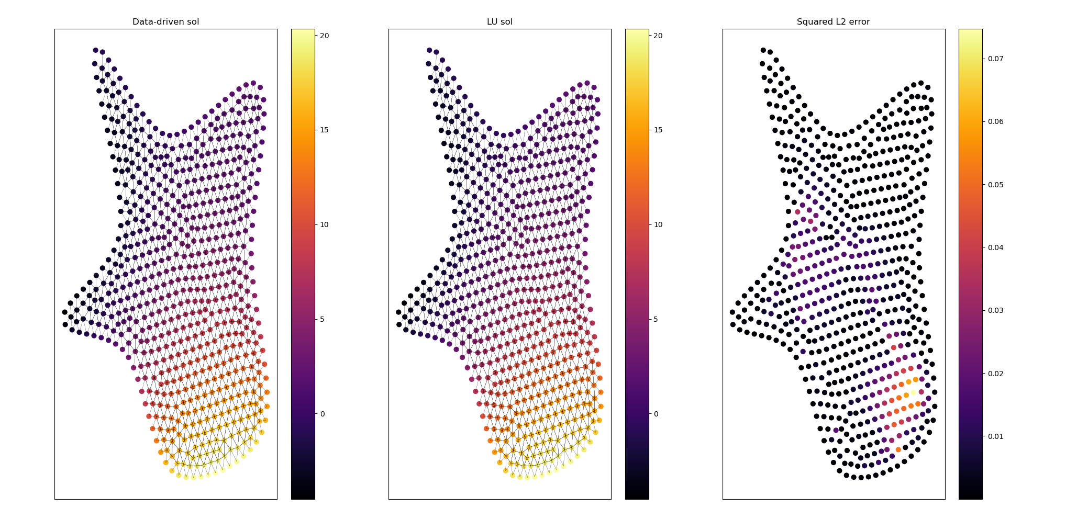
Exp | Nb nodes | Residual | MSE
Samples | 646 | 4.58e-3 | 6.1e-3

Slide 32
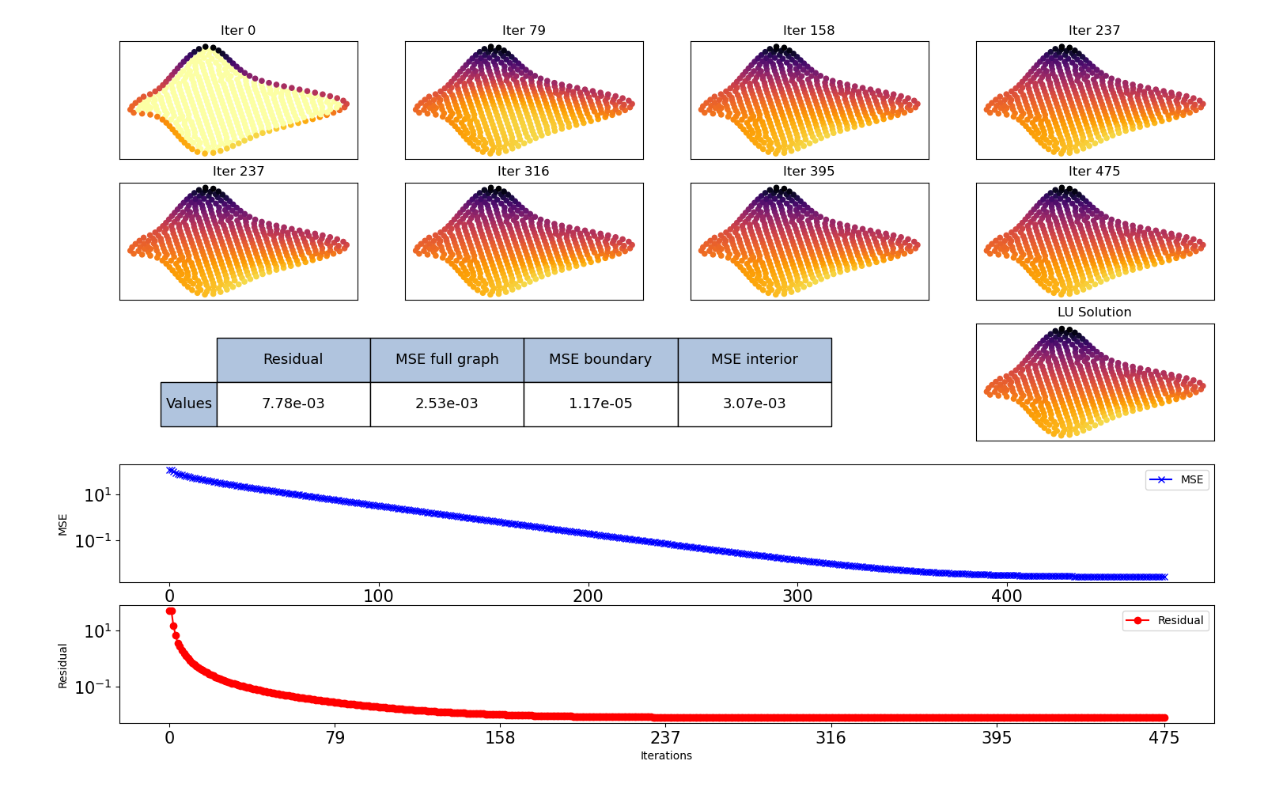
Forward iteration - fw_thres = 1000 - spectral radius = 0.98 - time to compute FP = 0.55s - nb nodes = 471

Slide 33
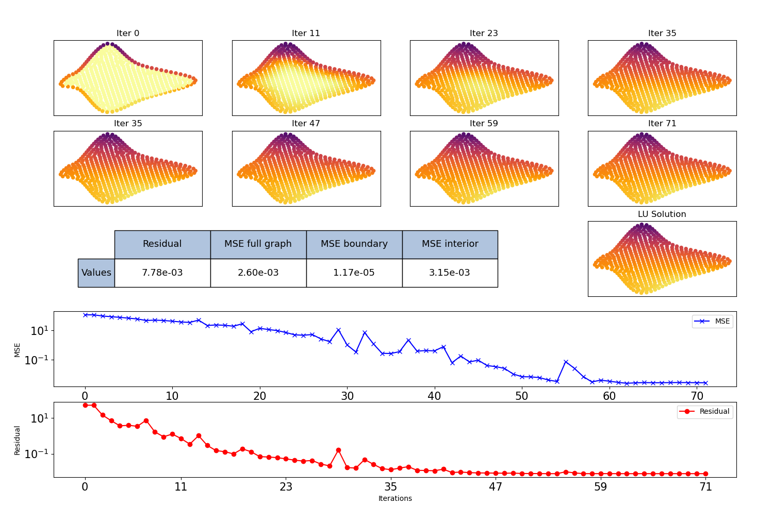
Broyden solver - fw_thres = 500 - spectral radius = 0.98 - time to compute FP = 0.28s - nb nodes = 471

Slide 34
Conclusion and Future Work
Statistical model for unsupervised learning of a solution to the Poisson equation on unstructured grids
Key elements :
Graph Neural Networks to deal with unstructured grids
Higher dimensional latent space
Iterative process (recast as a fixed point iteration with control of the spectral radius)
Future work
Detailed comparison with iterative linear solvers
Test on problems from real CFD simulations
Use as a preconditioner (domain decomposition + multigrid methods)
Discretization-free loss

Slide 35
Additional results
New geometries

Slide 36
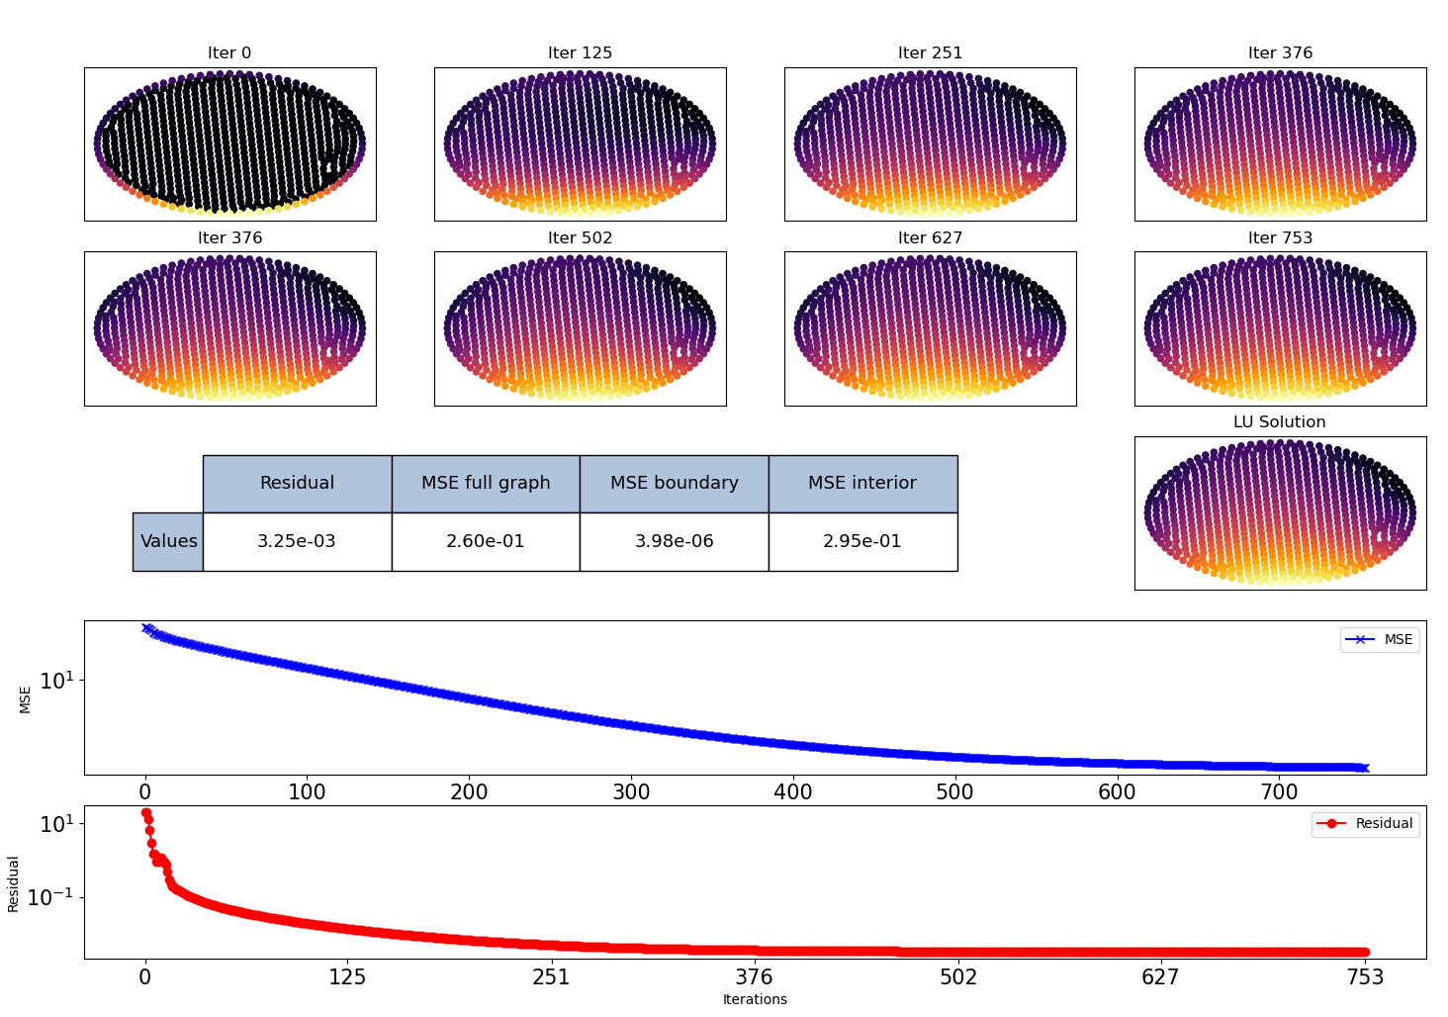
Forward iteration - fw_thres = 1000 - spectral radius = 0.99 - nb nodes = 714

Slide 37
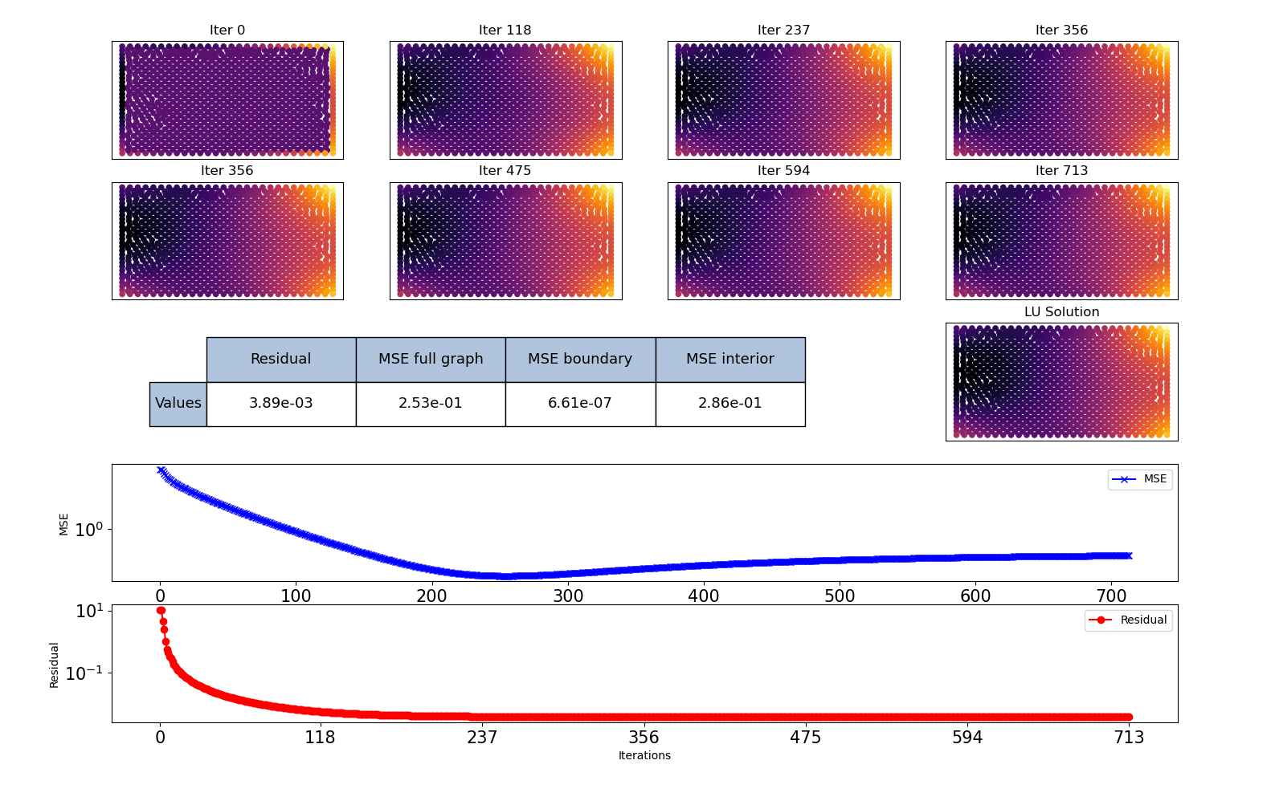
Forward iteration - fw_thres = 1000 - spectral radius = 0.99 - nb nodes = 919

Slide 38
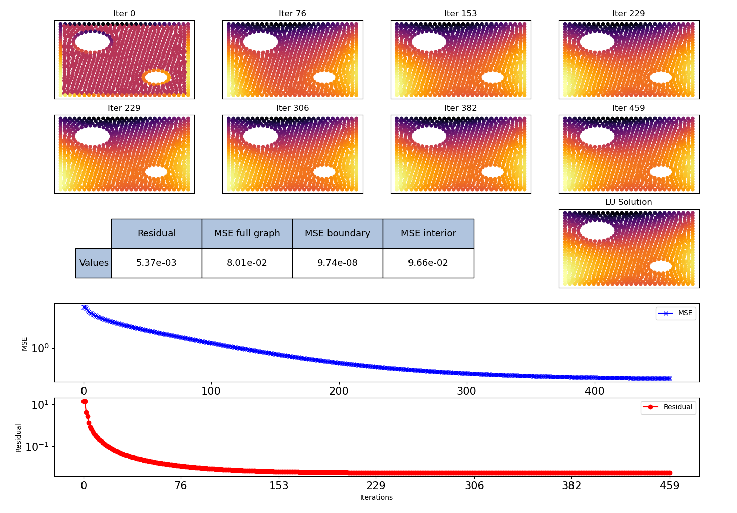
Forward iteration - fw_thres = 1000 - spectral radius = 0.99 - nb nodes = 892

Slide 39
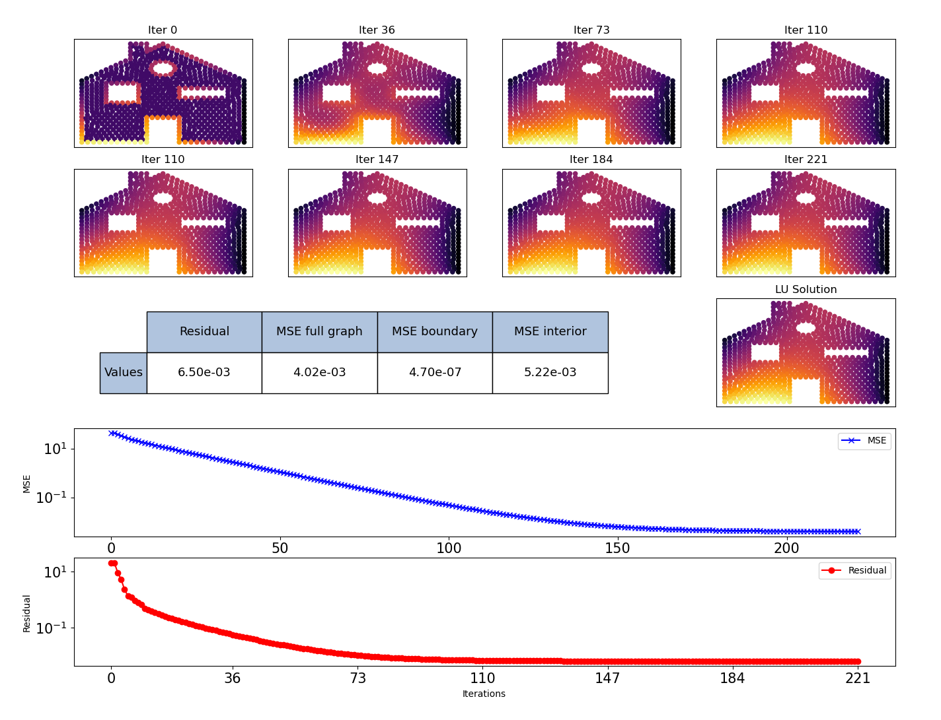
Forward iteration - fw_thres = 1000 - spectral radius = 0.99 - nb nodes = 767

Slide 40
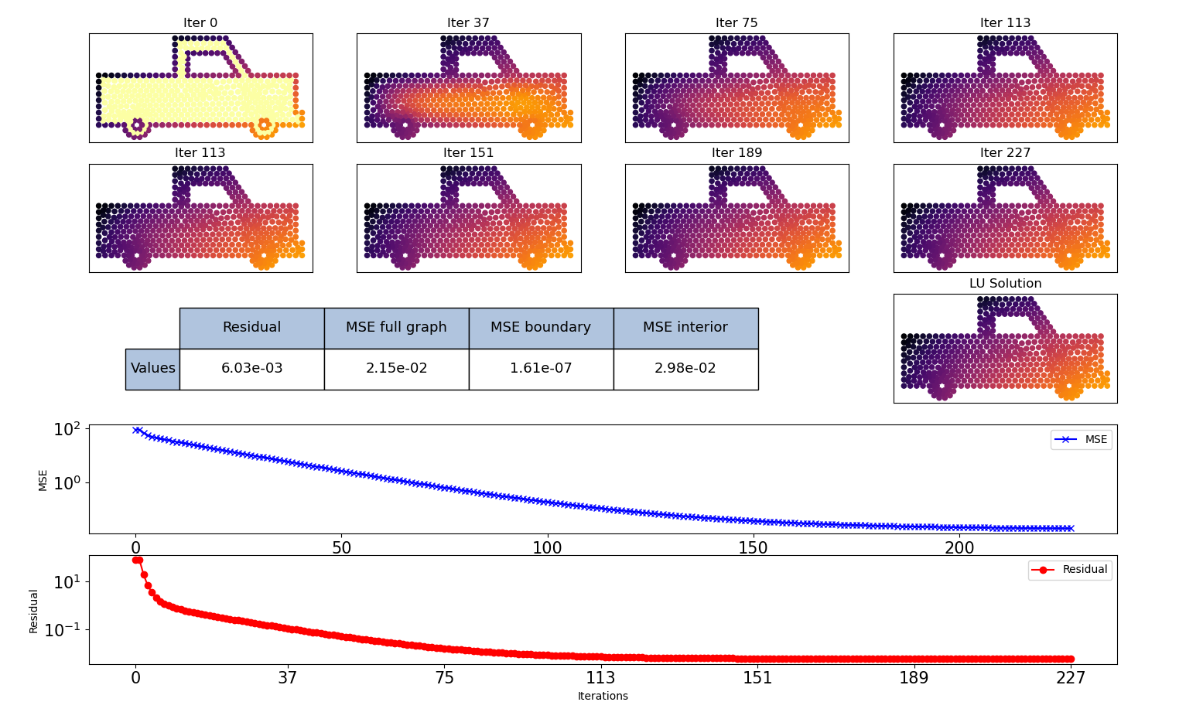
Forward iteration - fw_thres = 1000 - spectral radius = 0.99 - nb nodes = 468

Slide 41
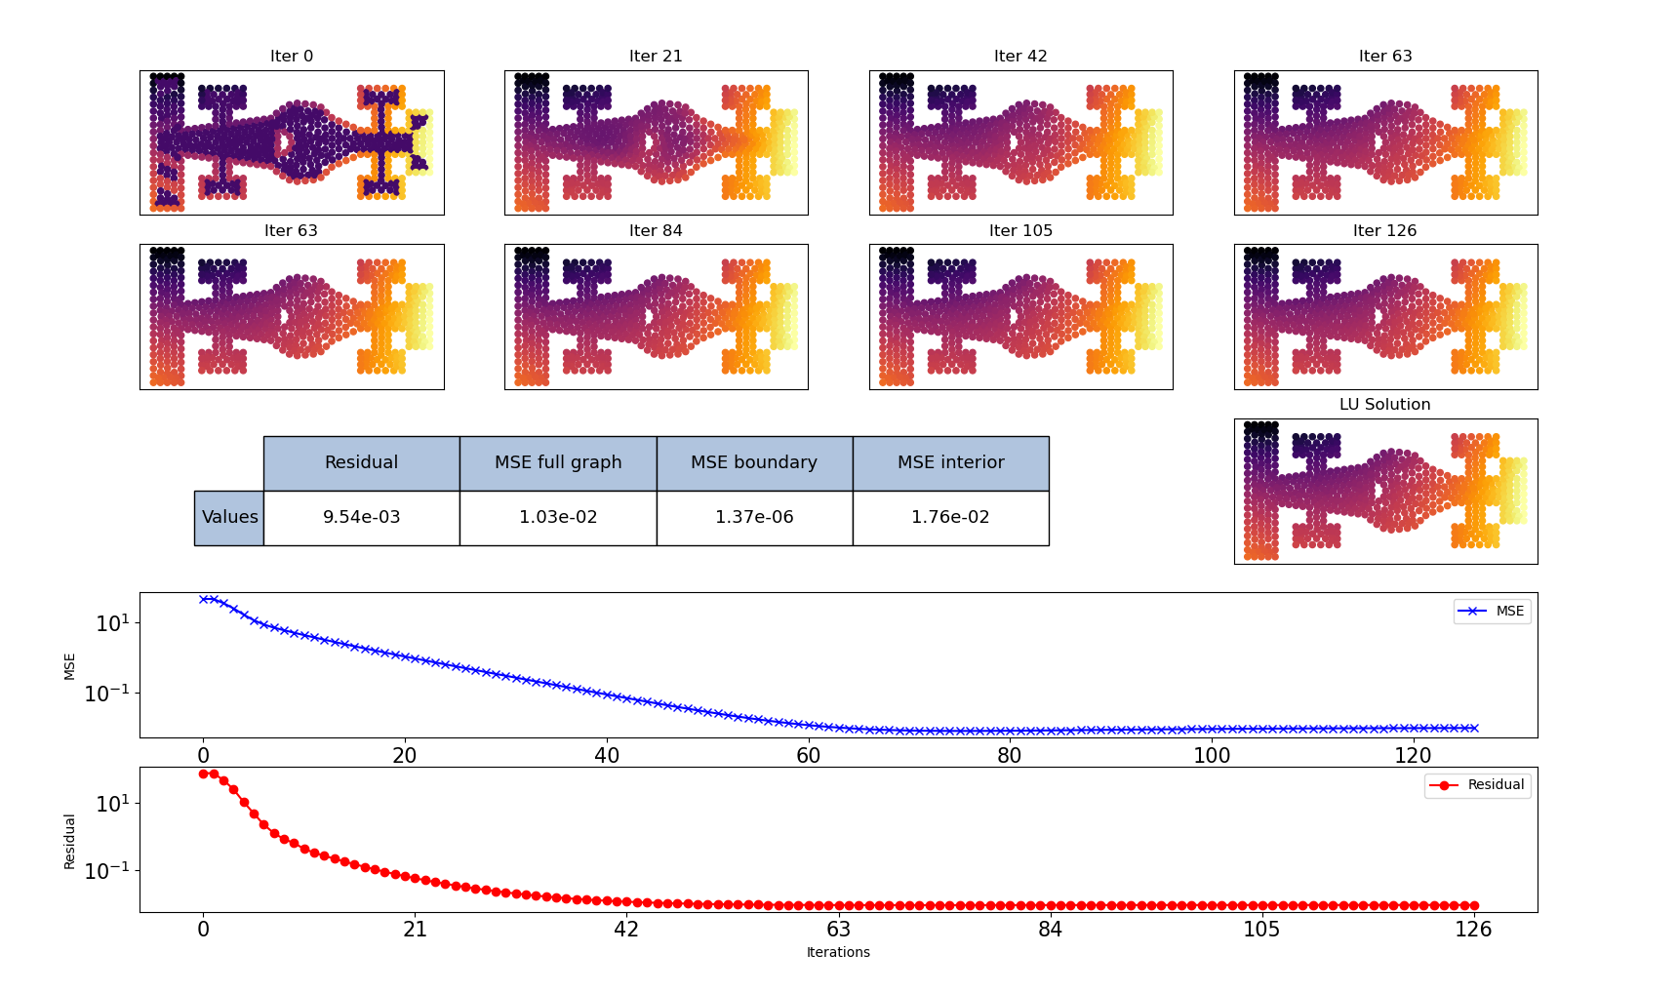
Num nodes : 609

Slide 42
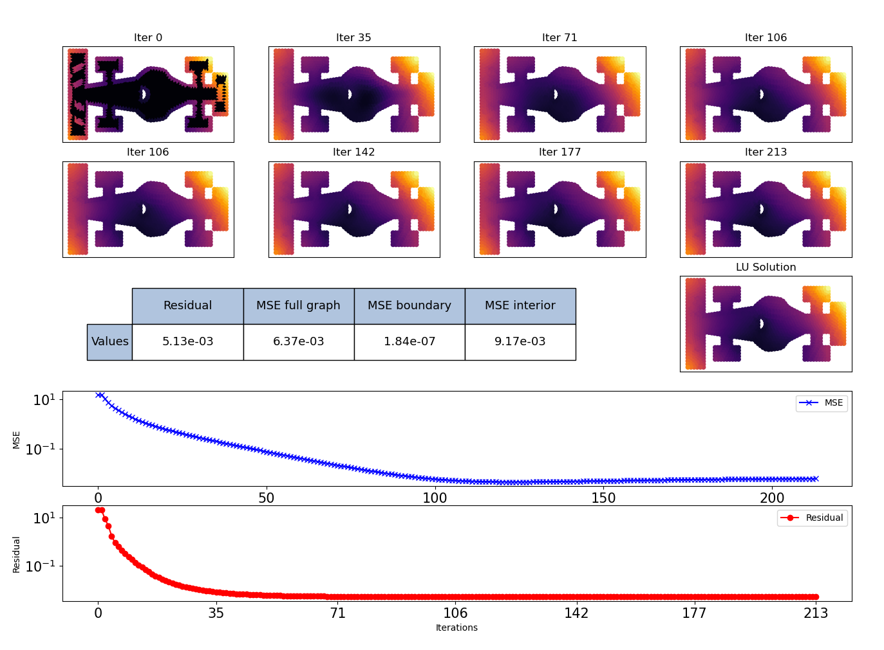
Num nodes : 1206

Slide 43
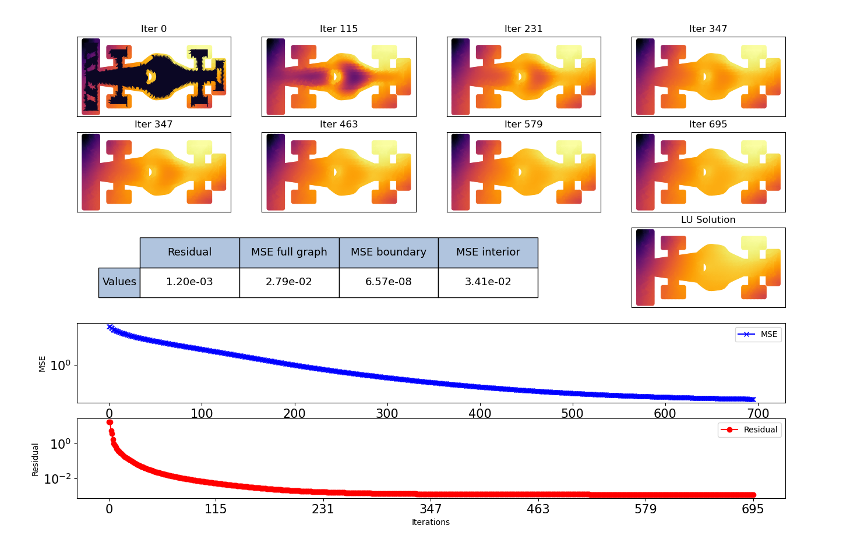
Num nodes : 3882

Slide 44
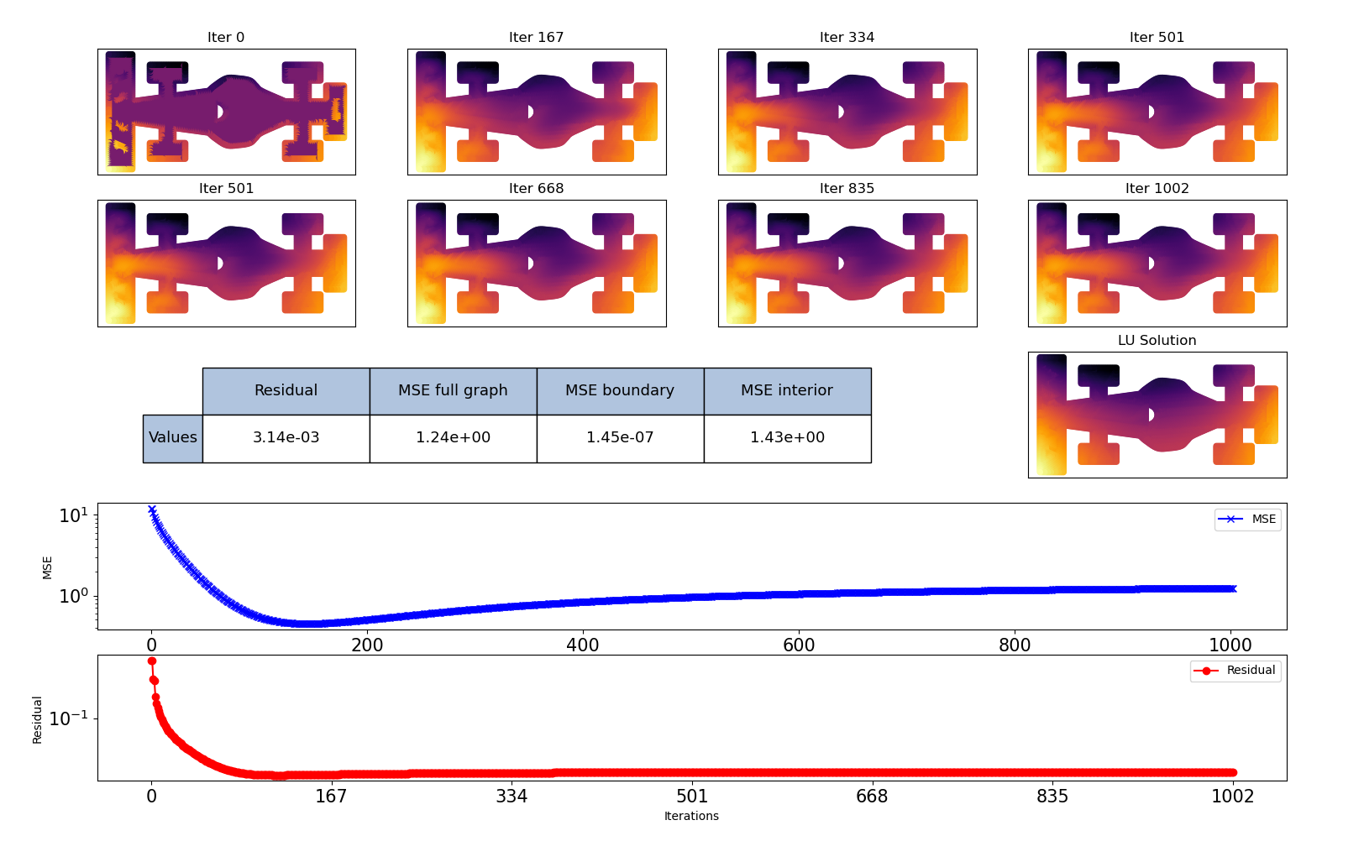
Num nodes : 7596

Slide 45
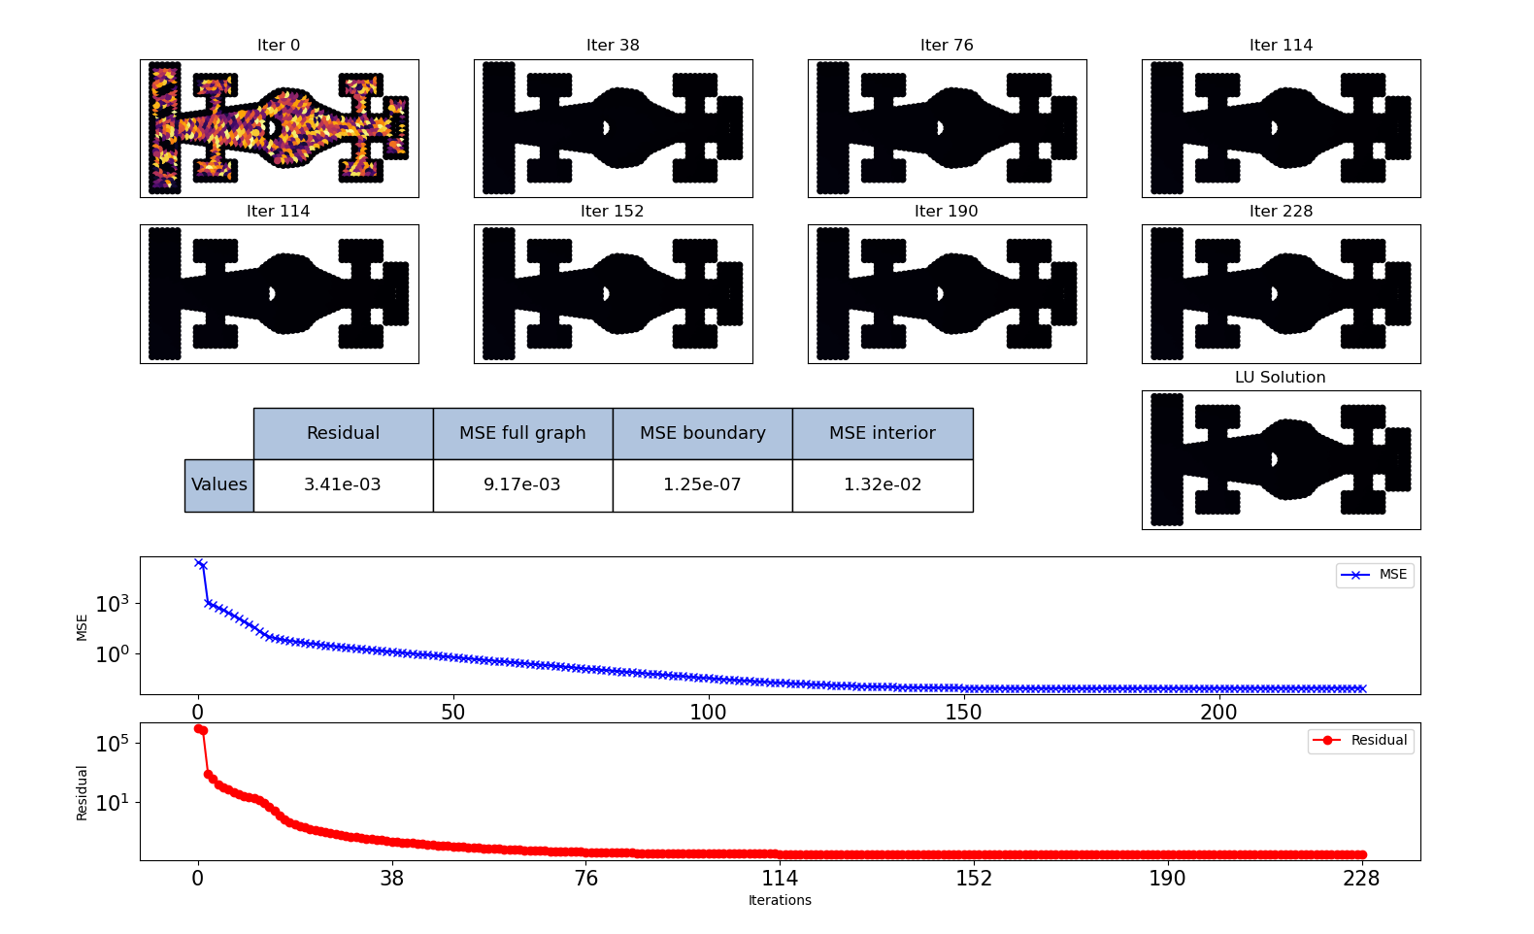
Initial solution : Random values between 50 and 1000
Num nodes : 1219

Slide 46
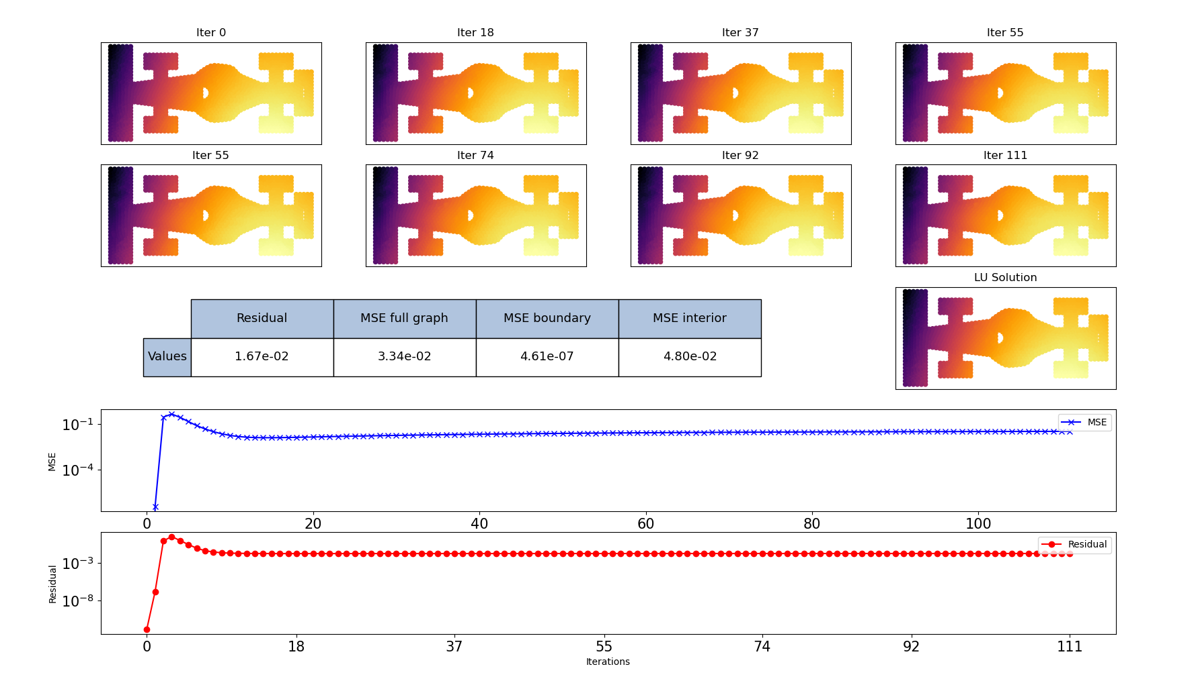
Initial solution : Exact solution
Num nodes : 1219

Slide 47
Conclusion

Slide 48
Recurrent GNN-based algorithm that iteratively solves a Poisson problem with mixed boundary conditions.
The architecture of the model respects the boundary conditions by design.
Work in progress :
Make some improvements on the overall architecture.
Better investigate the treatment of the Neumann boundary nodes.
The model applied on samples with fewer nodes obtained interesting convergence properties that motivate the creation of a hierarchical architecture.
Use case :
The model will be used as a preconditioner for standard iterative methods (e.g. Jacobi, Gauss Seidel).
An exclusive deep learning solution will be considered to mimic multigrids methods.

Slide 49
References
Deep Statistical Solver : Balthazar Donon, Wenzhuo Liu, Antoine Marot, Zhengying Liu, Isabelle Guyon, et al..
Learning Mesh-based Simulation with Graph Networks : Tobias Pfaff, Meire Fortunato, et al..
Introduction to Numerical Methods for Variational Problems : Langtangen, Mardal.
A Comprehensive Survey on Graph Neural Networks : Zonghan Wu, Shirui Pan, Fengwen Chen, et al..
Graph Neural Networks, A Review of Methods and Applications : Jie Zhou, Ganqu Cui, Zhengyan Zhang, et al..
Numerical Methods for incompressible viscous flow : Hans Petter Langtangen, Kent-Andre Mardal, Ragnar Winther
Residual or Gate? Towards Deeper Graph Neural Networks for Inductive Graph Representation Learning : Huang Binxuan, Carley Kathleen M.
Solving incompressible Navier-Stokes equations on heterogeneous parallel architectures : Yushan Wang
Latent Space Physics : Towards learning the Temporal Evolution of Fluid Flow : S.Wiewel, M.Becher, N.Thuerey
Iterative Methods for Sparse Linear Systems : Y.Saad
Poisson CNN : Convolutional neural networks for the solution of the Poisson equation on a Cartesian mesh : A.G.Ozbay, A.Hamzehloo, S.Laizet, et al..
Simulating Continuum Mechanics with Multi-Scale Graph Neural Networks : M.Lino, C.Cantwell, et al..
Solver-in-the-Loop: Learning from Differentiable Physics to Interact with Iterative PDE-Solvers : K.Um, R.Brand, et al…
Learning Neural PDE Solvers with Convergence Guarantees : J.Hsieh, S.Zhao, et al
Machine Learning for Fluid Mechanics : S.Brunton, B.Noack, P.Koumoutsakos
Accelerating Eulerian Fluid Simulation With Convolutional Networks : J.Thomson, K.Schlachter, P.Sprechman

Slide 50
Thank you

