Slide 1


Image reconstruction methods and machine learning techniques: applications to astronomical imaging and space weather - II
.
Università di Genova
DIMA | Dipartimento di Matematica
Anna Maria Massone
Sabrina Guastavino, Edoardo Legnaro, Emma Perracchione, Mattia Rossi
            MASCOT-NUM 2024
            2- 5 April, 2024 Giens Peninsula, Hières

Slide 2
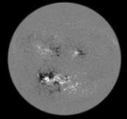
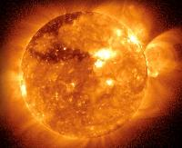
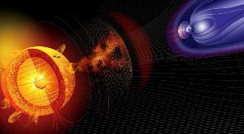
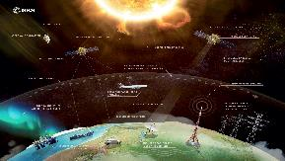
OUTLINE
From yesterday
?
Solar activity → Active Regions (ARs) → Solar flares
?
Solar flares → Coronal Mass Ejections (CMEs)
?
CMEs → Geomagnetic storms

Slide 3
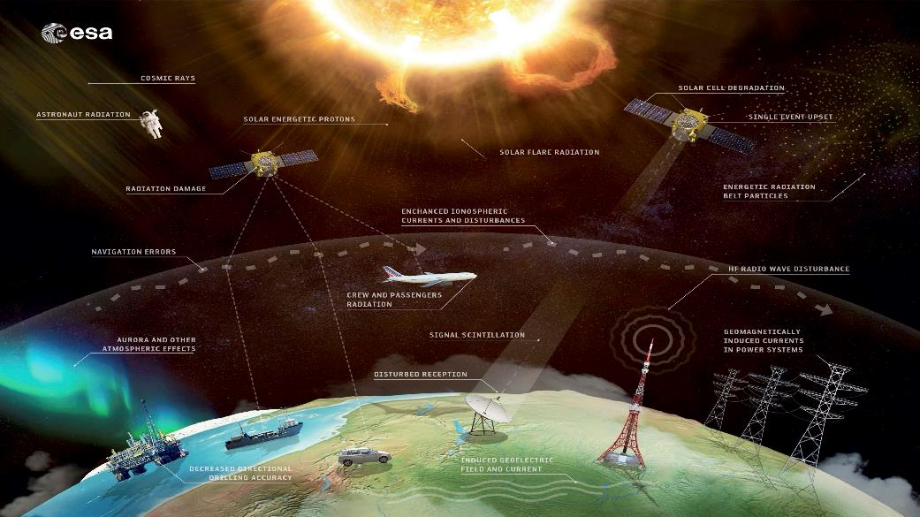
Space Weather
From yesterday

Slide 4
OUTLINE
Space Weather
Solar flares are the most explosive phenomena in the heliosphere, releasing a huge amount of electromagnetic radiation at all wavelengths and, in this way, triggering the whole space weather connection
In order to develop a reliable capability to predict, and hence mitigate, the occurrence and severity of solar eruptive events, with their associated hazardous Space Weather effects at the Earth we need:
To predict solar flare occurrence
To predict the CME’s arrival time
To predict the severity of a geomagnetic storm

Slide 5
OUTLINE
Space Weather
Solar flares are the most explosive phenomena in the heliosphere, releasing a huge amount of electromagnetic radiation at all wavelengths and, in this way, triggering the whole space weather connection
In order to develop a reliable capability to predict, and hence mitigate, the occurrence and severity of solar eruptive events, with their associated hazardous Space Weather effects at the Earth we need:
To predict solar flare occurrence
To predict the CME’s arrival time
To predict the severity of a geomagnetic storm

Slide 6




Space Weather
ARCAFF - AIxtreme
ARCAFF
Active Region Classification And Flare Forecasting
AIxtreme
Physics-based AI for predicting extreme weather and space weather events
ARCAFF has received funding from the
European Union's
HORIZON-CL4-2022-SPACE-01 call
(Project ID 101082164).
Operating period:
01/12/2022 - 30/11/2025
AIxtreme has received funding from the
Fondazione Compagnia di San Paolo's
ARTIFICIAL INTELLIGENCE call.
Operating period:
01/03/2023 - 28/02/2025
https://arcaff.eu
https://sites.google.com/view/aixtreme/home

Slide 7
Space Weather
Flare forecasting

Slide 8
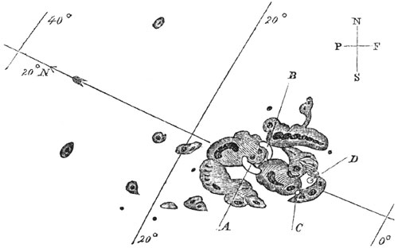
Space Weather
September 1st, 1859: Carrington event
A bit of history
The first documented flare in history was observed on September 1st, 1859 by the astronomer Lord Carrington, who captured by hand in details the sunspots appeared on the Sun. A and B mark the initial positions of an intensely bright event, which moved over the course of five minutes to C and D before disappearing.
The Carrington event has been classified as X45, the most intense event ever observed

Slide 9
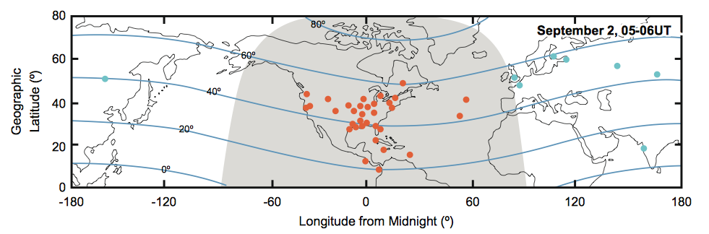
Space Weather
September 1st, Carrington event
Auroras were seen all around the world
Geomagnetic measurements
Places where northern lights have been observed
E.W. Cliver, and W.F. Dietrich. The 1859 space weather event revisited: limits of extreme activity. J. Space Weather Space Clim. 3 (2013) A31

Slide 10
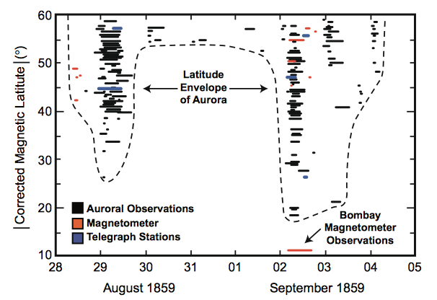
Space Weather
September 1st, Carrington event
14-hour disruption of telegraph lines

Slide 11
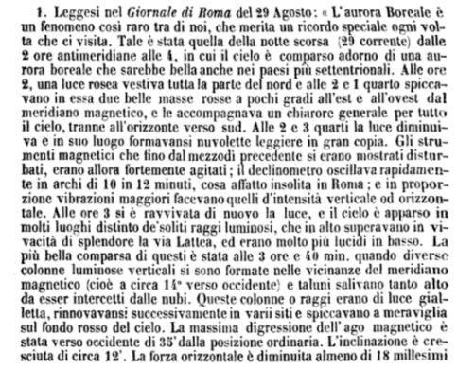
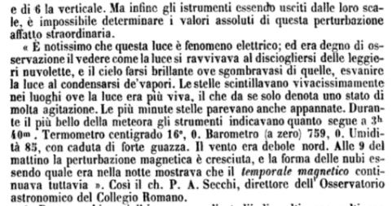
Space Weather
In Rome between 2:00 am and 4:00 am on August 29th, 1859

Slide 12
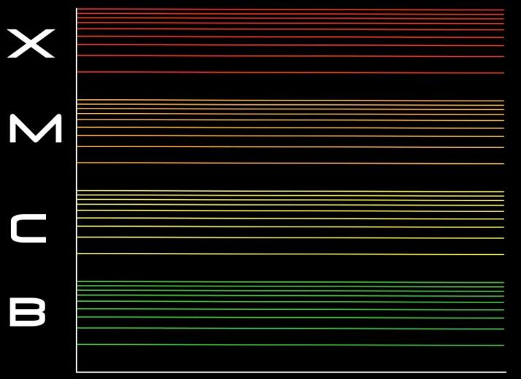
Space Weather
Solar flare classification
Peak flux
Each letter represents a 10-fold increase in the peak energy.
So an X flare is ten times an M flare and 100 times a C flare.
Within each letter class there is a finer scale from 1 to 9.
9•10⁻⁴ W/m²
10⁻⁴ W/m²
9•10⁻⁵ W/m²
10⁻⁵ W/m²
X9 is the maximum intensity foreseen by this classification but:
The ‘‘Halloween’’ event (2003) has been classified as X35 while
The Carrington event has been classified as X45, the most intense event ever observed
9•10⁻⁶ W/m²
10⁻⁶ W/m²
Microflares

Slide 13
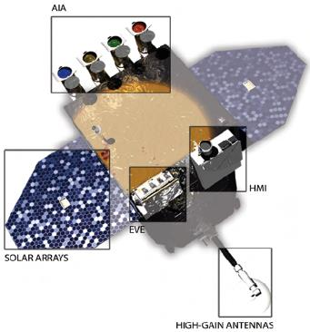
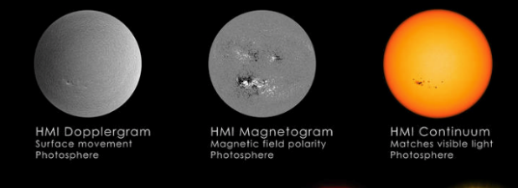
Solar flares prediction: Active Regions (Ars)
AIA
NASA SDO – HMI (Helioseismic and Magnetic Imager)
How can we predict solar flares?
Since February 11th, 2010
every 12 minutes
Solar flares originate from magnetically Active Regions (ARs)
HMI
BUT not all ARs give rise to solar flares!
EVE
the key lies in understanding which ARs give rise to flares and which do not

Slide 14
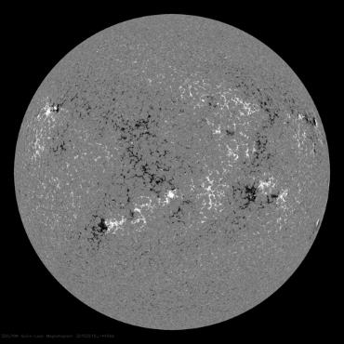
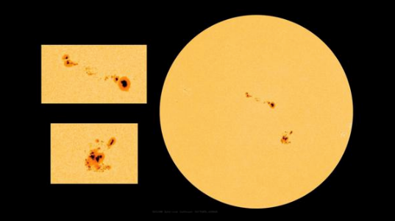
Solar flares prediction: Active Regions (Ars)
HMI – Magnetograms
HMI – Continuum
Sunspots (active regions) are the manifestation of the Sun's magnetism. Tthey are giant magnetic structures that appear on the solar disk as dark regions.
Magnetograms show maps of the magnetic field on the Sun's surface with the colors white to indicate outgoing field lines
positive pole
black to indicate incoming field lines
negative pole

Slide 15
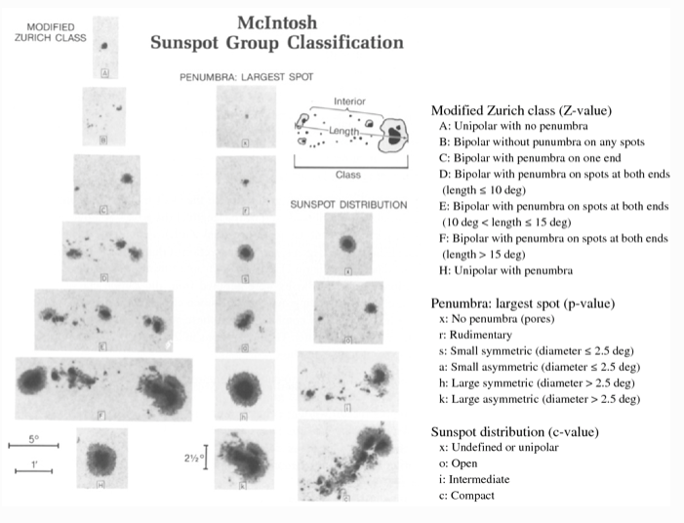
Solar flares prediction: Active Regions (Ars)

Slide 16
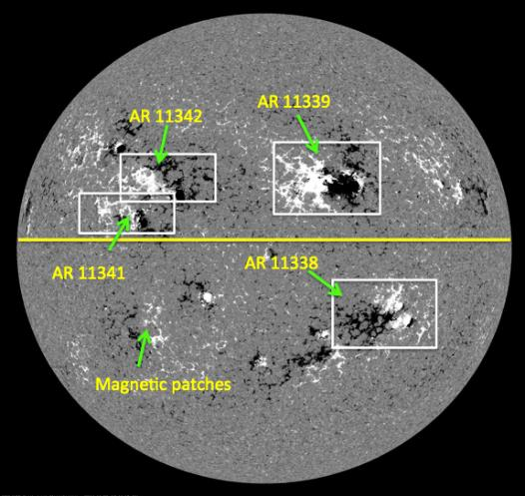
Solar flares prediction: Active Regions (Ars)
Active Regions’ localization
An automated monitoring system, called HARP (HMI Active Region Patches) identifies and labels each active region:
The active region is localized
An HARP number is associated to the AR
The AR is monitored throughout its entire life cycle (every 12 minutes a new magnetogram is provided)

Slide 17
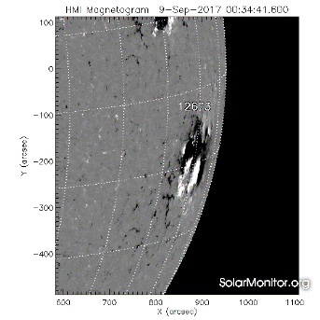
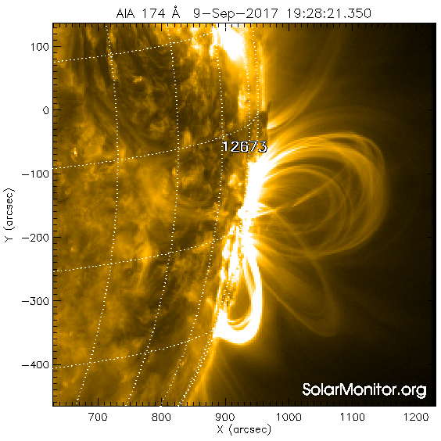
Solar flares prediction: Active Regions (Ars)
The flare forecasting problem is the one to predict whether an AR will produce a flare within a given time interval.
The active region is localized
YES
?
Feature extraction
Will a solar flare of above class C be generated in the next 24 hours?
NO
Two approaches

Slide 18
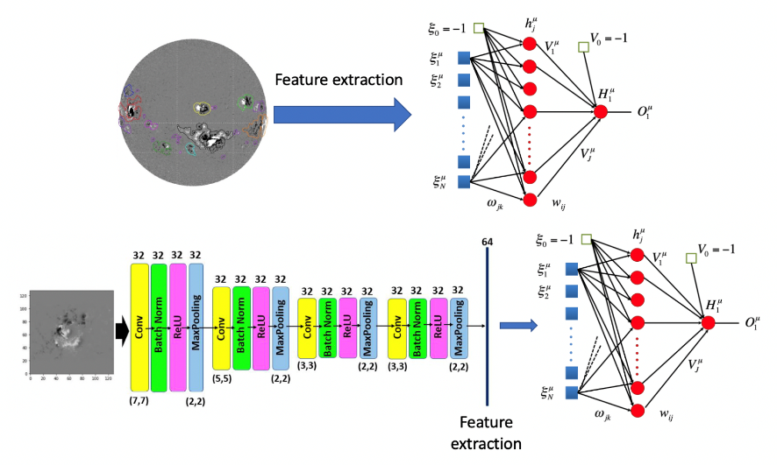
Solar flares prediction
Feature extraction: Machine Learning vs Deep learning
Advantages:
Feature have a physical/morphological meaning
A posteriori feature ranking is possible
Disadvantages:
Feature extraction implies data manipulation
Advantages:
Feature estraction is not needed
Disadvantages:
Do extracted features have physical meaning?

Slide 19
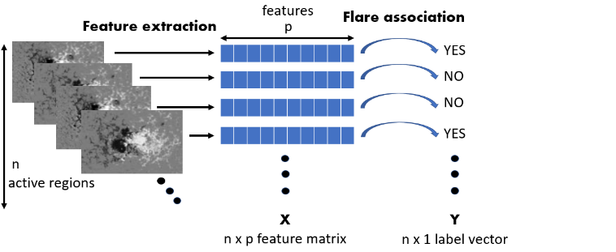
First approach: physical features & ML
Formula
Total unsigned vertical current
Total unsigned flux
Total unsigned vertical helicity
Up to 209 feature extracted from HMI images thanks to the H2020 FLARECAST project

Slide 20
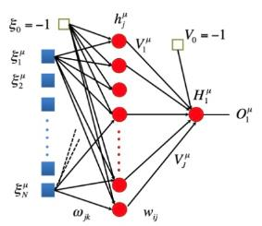
First approach: physical features & ML
Formula
Total unsigned vertical current
Total unsigned flux
Total unsigned vertical helicity
T$raining set {\{(x_{i},y_{i})\}}_{i=1,..,n}$

Slide 21
STIX data formation process
Flare prediction algorithms - FLARECAST
ARCAFF approach
Supervised learning techniques (regression)
  LASSO
  elastic net
  logistic regression
  poisson re-weighted LASSO (PRiL)
  adaptive poisson re-weighted LASSO (APRiL)
Hybrid strategies
  hybrid LASSO
  hybrid logit
  recurrent neural network trained with GA
Multi-task learning techniques
  multi task LASSO
  adaptive multi task LASSO
Unsupervised learning techniques
  K-Means algorithm
  Fuzzy C-Means algorithm
  possibilistic C-Means algorithm
  simulated annealing algorithm
Supervised learning techniques (classification)
  multi-layer perceptrons
  support vector machine
  recurrent neural network
  MLP with negative log-likelihood
  MLP for feature selection
  random forests

Slide 22
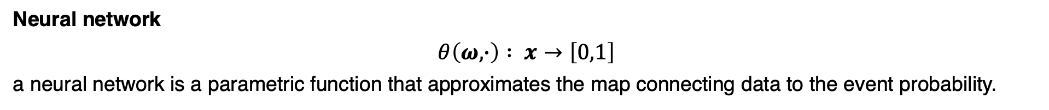
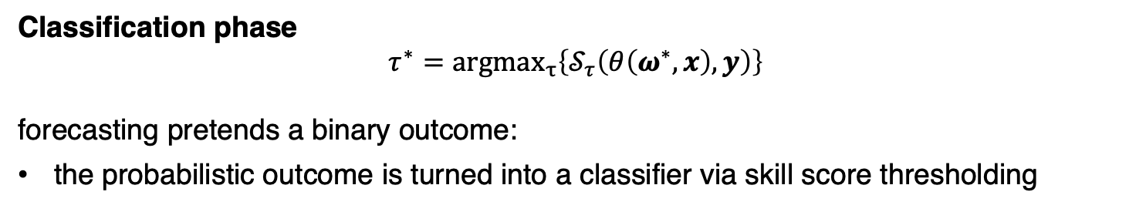
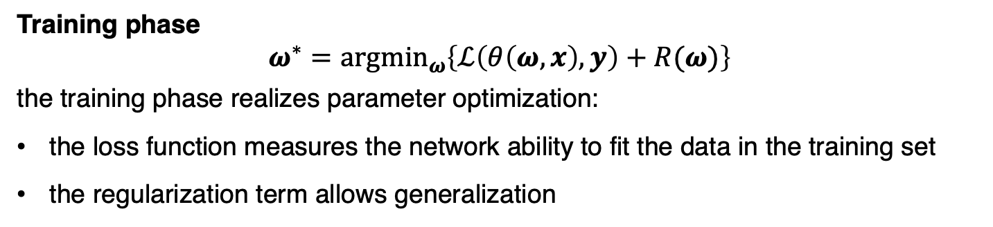
Neural network
Neural network
$θ\left(ω,∙\right) : x→\left[0,1\right]$
a neural network is a parametric function that approximates the map connecting data to the event probability.
Training phase
$$ω^{∗}={argmin}_{ω}\left\{ℒ\left(θ\left(ω,x\right),y\right)+R(ω)\right\}$$
the training phase realizes parameter optimization:
the loss function measures the network ability to fit the data in the training set
the regularization term allows generalization
Classification phase
$$τ^{∗}={argmax}_{τ}\left\{𝒮_{τ}\left(θ\left(ω^{∗},x\right),y\right)\right\}$$
forecasting pretends a binary outcome:
the probabilistic outcome is turned into a classifier via skill score thresholding

Slide 23
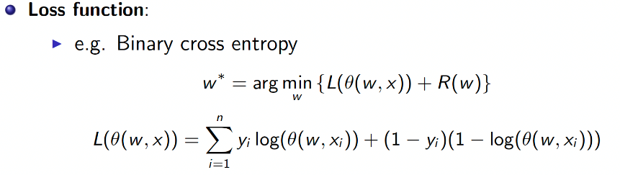
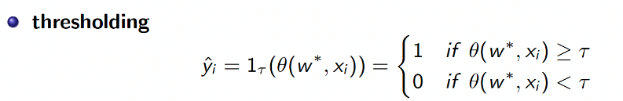
Neural network
Standard approach for classification:

Slide 24
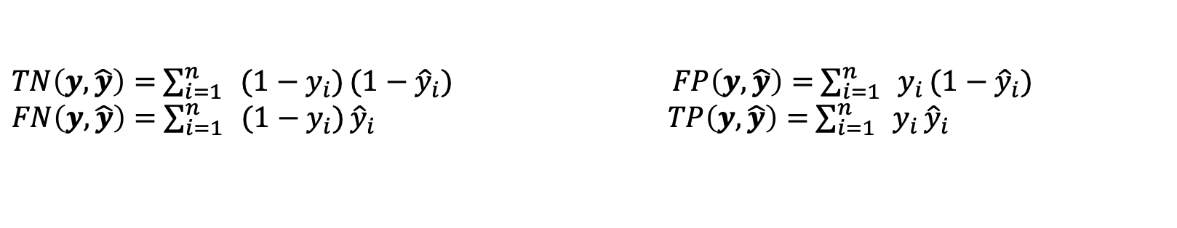
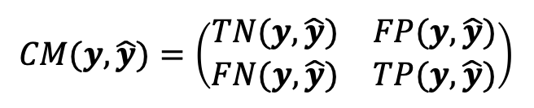
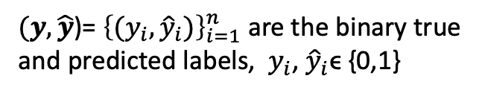

Evaluation metrics for binary classification
In binary classification the goodness of the predictions is evaluated by computing the confusion matrix
$$CM(y,\hat{y})=\left(\begin{matrix}TN(y,\hat{y}) & FP(y,\hat{y}) \\ FN(y,\hat{y}) & TP(y,\hat{y})\end{matrix}\right)$$
$(y,\hat{y}$)= ${\left\{(y_{i},{\hat{y}}_{i})\right\}}_{i=1}^{n}$ are the binary true and predicted labels, ${ y}_{i}$, ${\hat{y}}_{i}$ϵ {0,1}
$TN\left(y,\hat{y}\right)=$ $\sum_{i=1}^{n}{{ (1−y}_{i})}(1−{\hat{y}}_{i}$) $FP\left(y,\hat{y}\right)=$ $\sum_{i=1}^{n}{{ y}_{i}}(1−{\hat{y}}_{i}$)
$FN\left(y,\hat{y}\right)=$ $\sum_{i=1}^{n}{{ (1−y}_{i})}{\hat{y}}_{i}$ $TP\left(y,\hat{y}\right)=$ $\sum_{i=1}^{n}{{ y}_{i}}{\hat{y}}_{i}$
A common skill score is the accuracy
$$ACC(CM(y,\hat{y}))=\frac{TP\left(y,\hat{y}\right)+TN(y,\hat{y})}{TP\left(y,\hat{y}\right)+TN\left(y,\hat{y}\right)+FP\left(y,\hat{y}\right)+FN(y,\hat{y})}$$
If the dataset is imbalanced, e.g. 10% of positive events
ACC can be 0.9 with TP=0 !

Slide 25

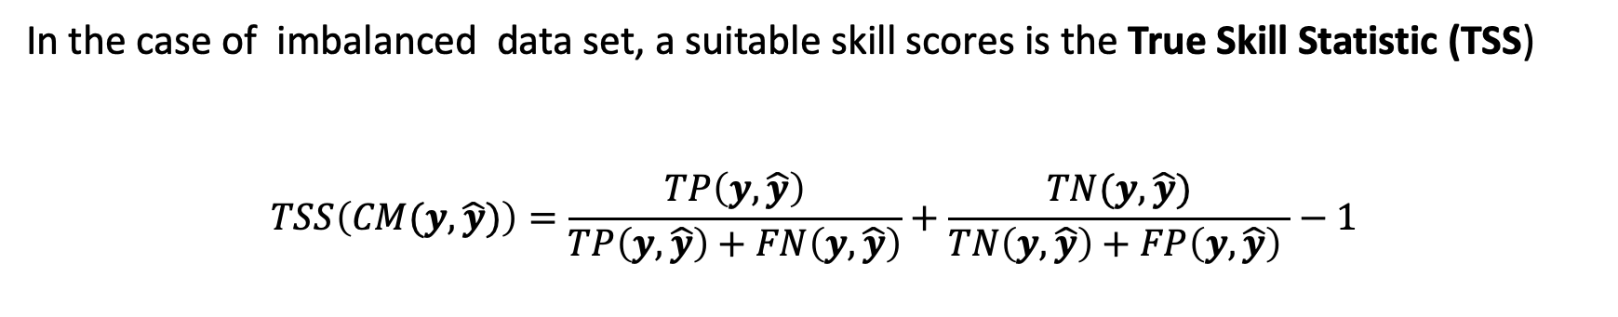
Evaluation metrics for binary classification
In the case of imbalanced data set, a suitable skill scores is the True Skill Statistic (TSS)
$$TSS\left(CM(y,\hat{y})\right)=\frac{TP\left(y,\hat{y}\right)}{TP\left(y,\hat{y}\right)+FN\left(y,\hat{y}\right)}+\frac{TN(y,\hat{y})}{TN\left(y,\hat{y}\right)+FP\left(y,\hat{y}\right) }−1$$
TSS $≤$ 0 if TP=0 !
True positive rate
True negative rate

Slide 26
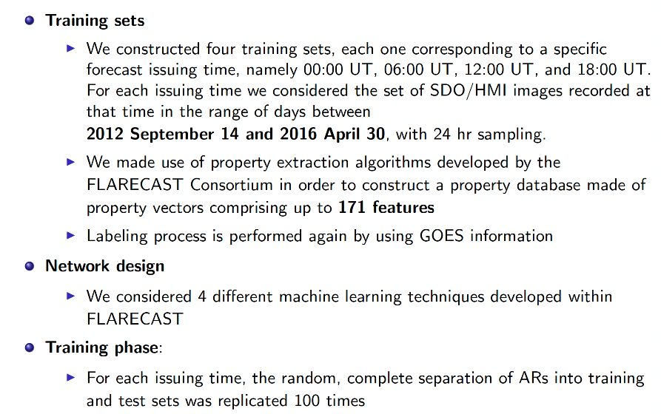
Prediction and feature ranking

Slide 27
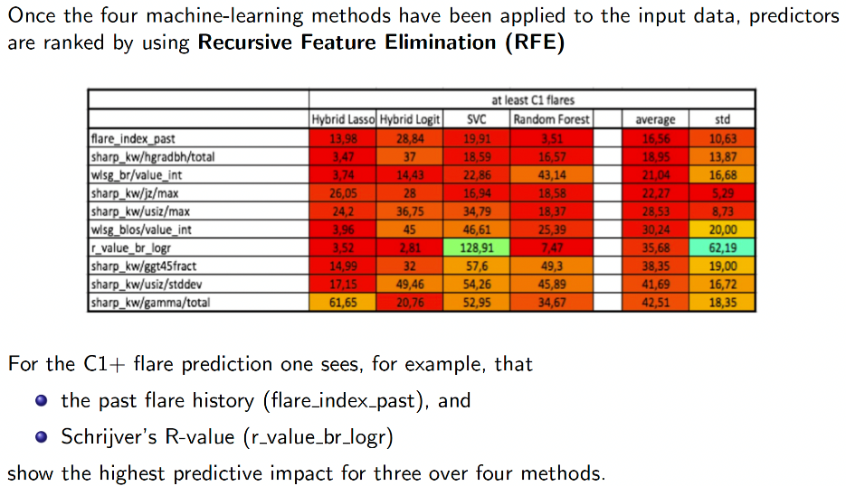
Prediction and feature ranking

Slide 28
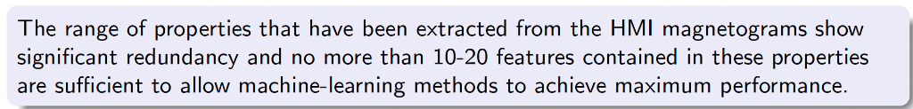
Prediction and feature ranking

Slide 29
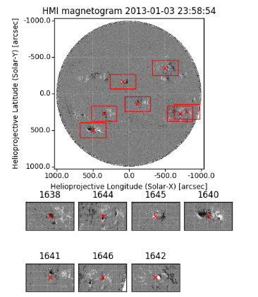
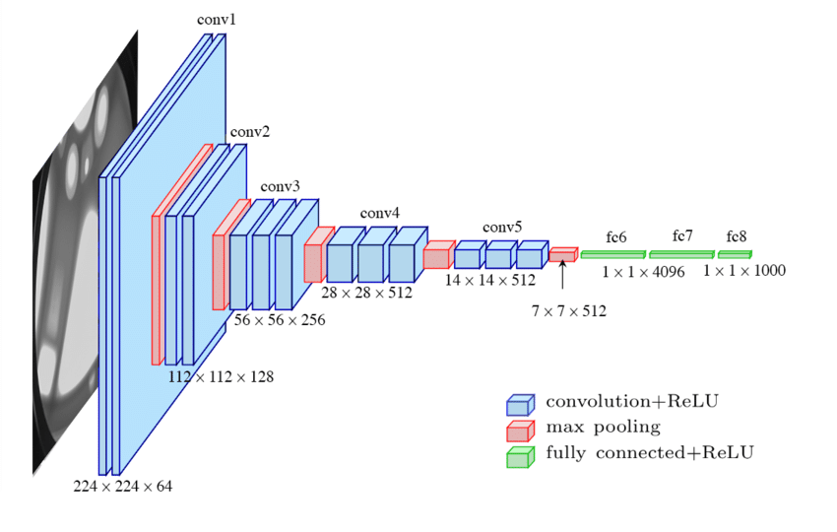
Second approach: DL
The ARCAFF approach
The use of DL for AR classification from cutouts
The use of DL for AR localisation and classification from full disk images
The use of DL for AR localisation and classification from full disk images and probabilistic flare forecasting

Slide 30
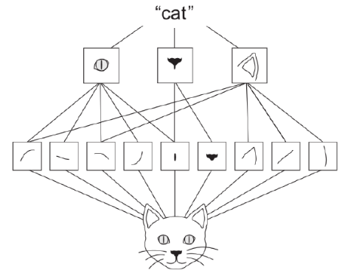
Convolutional Neural Networks (CNNs)
CNN
Convolutional networks were born in 1990. The idea is to mimic the operation process of the visual cortex of the human brain. In fact, they are used for image recognition and processing.
CNNs identify relevant patterns in images
CNNs are made of different layers
The first layers (near the inputs) are considered “low-level features extractors” (low-level features are elementar blocks, edges..),
The last layers are considered “high-level features extractors” (high-level features are constructed from the low-level features and gather further details related to the semantic meaning).

Slide 31
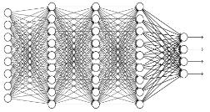
Convolutional Neural Networks (CNNs)
The role of the CNN is to reduce images in a form that is easier to be processed, without loosing features that are crucial characteristics for the image classification, or recognition or forecasting problem..
Convolution
Block that can be repeated many times
ReLu
Max Pooling
Rectified Linear Unit (ReLU) is a common activation function which introduces non-linearity in the representation
Convolution
Fully Connected Feedforward network
Max Pooling
Reduces the size of the representation and provides translation invariance
ReLu
Max Pooling
Flattened

Slide 32
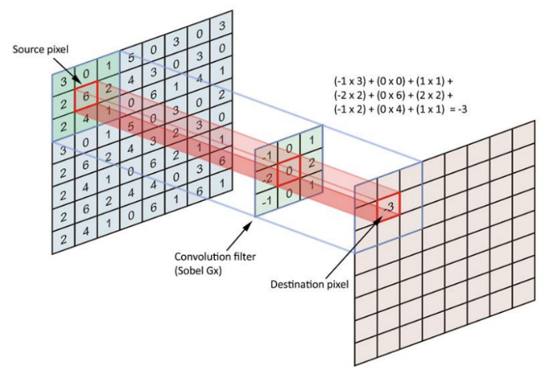
Convolutional Neural Networks (CNNs)
CNN
Convolution: the core of a CNN

Slide 33
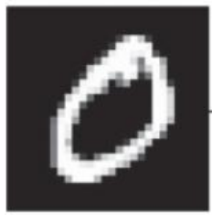
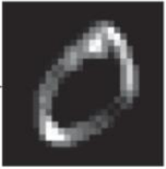

Convolutional Neural Networks (CNNs)
CNN
Kernel or filter
The response map quantifies the presence of the pattern of the filter (or kernel) in the image

Slide 34
Convolutional Neural Networks (CNNs)
Example: convolution step
1 | -1 | -1
-1 | 1 | -1
-1 | -1 | 1
1 | 0 | 0 | 0 | 0 | 1
0 | 1 | 0 | 0 | 1 | 0
0 | 0 | 1 | 1 | 0 | 0
1 | 0 | 0 | 0 | 1 | 0
0 | 1 | 0 | 0 | 1 | 0
0 | 0 | 1 | 0 | 1 | 0
Filter 1
-1 | 1 | -1
-1 | 1 | -1
-1 | 1 | -1
Filter 2
……
8 x 8 image
Each filter detects a small pattern (3 x 3).

Slide 35
Convolutional Neural Networks (CNNs)
The effect of Filter 1
1 | -1 | -1
-1 | 1 | -1
-1 | -1 | 1
Example: convolution step
Filter 1
1 | -1 | -1
-1 | 1 | -1
-1 | -1 | 1
stride=1
1 | 0 | 0 | 0 | 0 | 1
0 | 1 | 0 | 0 | 1 | 0
0 | 0 | 1 | 1 | 0 | 0
1 | 0 | 0 | 0 | 1 | 0
0 | 1 | 0 | 0 | 1 | 0
0 | 0 | 1 | 0 | 1 | 0
Filter 1
1 | 0 | 0 | 0 | 0 | 1
0 | 1 | 0 | 0 | 1 | 0
0 | 0 | 1 | 1 | 0 | 0
1 | 0 | 0 | 0 | 1 | 0
0 | 1 | 0 | 0 | 1 | 0
0 | 0 | 1 | 0 | 1 | 0
Dot
product
3
-1
-3
-1
-1 | 1 | -1
-1 | 1 | -1
-1 | 1 | -1
Filter 2
-3
1
0
-3
-3
-3
0
1
……
8 x 8 image
8 x 8 image
3
-2
-2
-1
Each filter detects a small pattern (3 x 3).

Slide 36
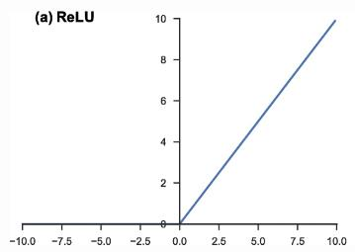
Convolutional Neural Networks (CNNs)
Example: ReLu effect
ReLu(z) = max(0,z)
3
-1
-3
-1
3
0
0
0
-3
1
0
-3
ReLu
0
1
0
0
-3
-3
0
1
0
0
0
1
3
-2
-2
-1
3
0
0
0
4 x 4 image
4 x 4 image

Slide 37
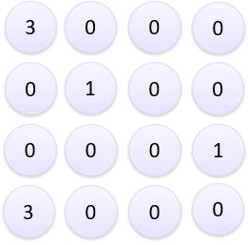
Convolutional Neural Networks (CNNs)
Example: The Max Pooling Effect
Size (2,2)
3

Slide 38
Convolutional Neural Networks (CNNs)
Example: The Max Pooling Effect
Size (2,2)
Stride=2
3
0

Slide 39
Convolutional Neural Networks (CNNs)
Example: The Max Pooling Effect
The Pooling layer allows reducing the spatial size of the Convolved Feature map.
Advantages:
decrease the computational power required to process the data through dimensionality reduction.
extract dominant features which are rotational and positional invariant, thus maintaining the process of effectively training of the model.
Size (2,2)
Stride=2
3
0
0
3
1

Slide 40
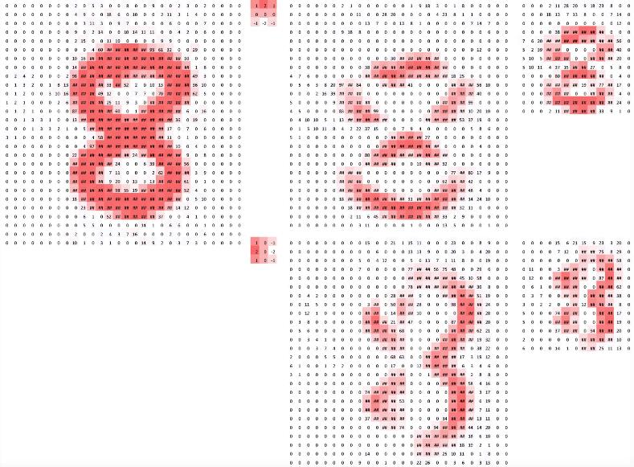
Convolutional Neural Networks (CNNs)
A more complex example
Input image
Feature maps
Kernels
Convolution + ReLu

Slide 41
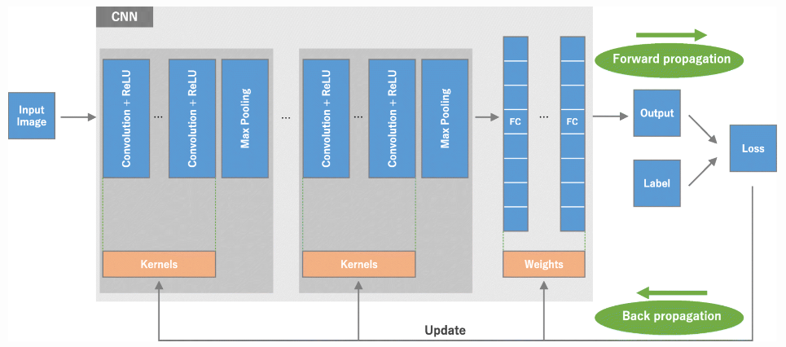
Convolutional Neural Networks (CNNs)
Training of a CNN

Slide 42
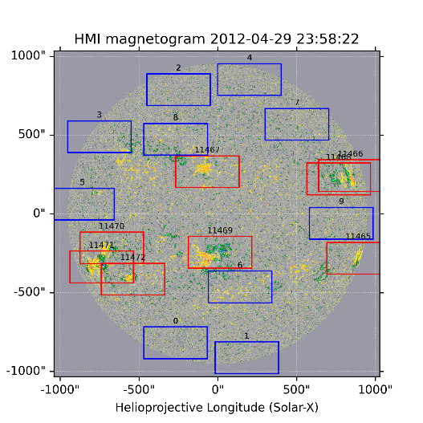
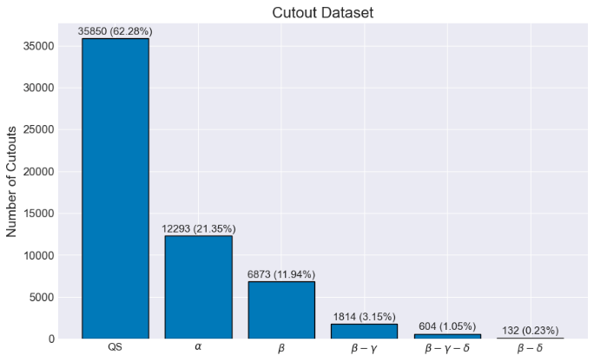
ARCAFF – AR classification from cutouts
The total number of considered cutouts is 57566.

Slide 43
ARCAFF – AR classification from cutouts
We implemented a custom CNN consisting of 5 convolutional layers and a multi-layer perceptron (MLP) with four layers.
Furthermore, we identified the ResNet34, ResNet50, and InceptionV3 architectures from the literature as the most promising for our project. Given the widespread availability of pre-trained weights for these CNN architectures, we have investigated the potential of utilising transfer learning for our specific task.
The transfer learning workflow is the following.
Take the layers from an already trained model.
Freeze these layers to preserve the learned information during subsequent training sessions.
Introduce new, trainable, fully-connected layers on top of the frozen ones, in order to adapt the pre-learned features for predictions on the new dataset.
Proceed to train these newly added layers on our specific dataset.
After this, we fine-tune the model. This involves unfreezing all the layers of the model and re-training it on the new dataset with a low learning rate.

Slide 44
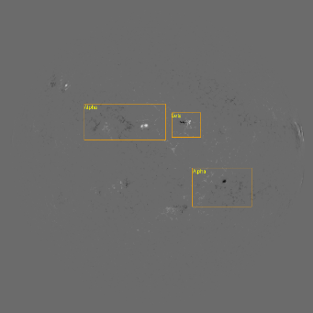
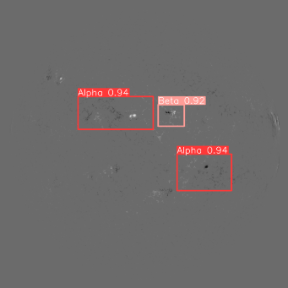
ARCAFF – AR localisation and classification from full disk images
The total number of full disk images at disposal is 3,478. For this detection and classification task, we trained a YOLOv8 model.
YOLO (You Only Look Once) works by taking a single look at the entire image and predicting the objects present along with their locations. It divides the image into a grid and for each grid cell, it predicts bounding boxes, the likelihood that a box contains an object, and class probabilities (what type of object is in the box).
Predicted AR locations and classification
Labeled Test Image

Slide 45



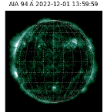









ARCAFF – two more objectives
Flare forecasting using time series of multimodal images
Flare forecasting using multimodal images
Time
Y
X
2D CNNs with multi-channel images
3D Convolutional Neural Network

Slide 46
Prediction of CME’s arrival time

Slide 47

Coronal mass ejections
Coronal Mass Ejections
Coronal Mass Ejections (CMEs) consist of large eruptions of plasma and magnetic field that are typically
triggered by solar flares and they can propagate from the solar corona into the heliosphere.
The observations of CMEs are typically performed by means of remote-sensing instruments that can measure their most significant kinematic parameters, such as the initial propagation speed, the CME mass, and the initial cross section. Examples of telescopes appropriate for measuring remote sensing parameters are coronagraphs on board space clusters such as the Large Angle and Spectrometric Coronagraph (LASCO) on board the Solar and Heliophysics Observatory (SOHO)
Solar wind: the solar wind is a continual stream of protons and electrons from the Sun's outermost atmosphere — the corona

Slide 48




Prediction of CMEs’ travel times
Prediction of CMEs’ travel times
Model-driven approaches (MHD-based equations)
Data-driven approaches (machine or deep learning)
How to combine them?
Physics-driven machine learning
Drag-based model
$\ddot{r}$= CME acceleration
$\dot{r}$ = CME speed
w = solar wind speed
ρ = solar wind density
A = CME impact area
m = CME mass
C = drag coefficient (unknown)
Drag parameter
The Drag equation is completed to a Cauchy problem by including the two initial conditions
$r\left(t_{0}\right)=$ $r_{0}$
$\dot{r}\left(t_{0}\right)=v_{0}$
where $r_{0}$ is the height of the eruption ballistic propagation, and $v_{0}$ is the initial CME speed.

Slide 49


Prediction of CMEs’ travel times
Prediction of CMEs’ travel times
Assuming that the solar wind speed and the drag parameter are constant and homogeneous, the drag equation leads to
This equation can be used to estimate the travel time as the solution of r(t) = 1 AU.
this approach is reliable just if accurate estimates of the parameters A, m, C, ρ, w, $r_{0}$ and $v_{0}$ are at disposal.
Specifically, measurements of A, m, $r_{0}$ , and $v_{0}$ can be provided by coronagraphic instruments such as LASCO.
ρ and w at the CME onset can be provided by in situ instruments (such as WIND, ACE, and CELIAS). These same values can be used in the equations as approximations of average values of the two parameters

Slide 50






Physics-driven loss function
Physics-driven loss function
Idea:
Include the drag-based model in the loss function!
where
$\text{λ}$ is a regularization parameter
$$L_{t}\left(t,f(w,x) \right)={\text{λ} (t−f(w,x))}^{2}+\left(1−\text{λ}\right){(1−r\left(f(w,x),C\right))}^{2}$$
Data-driven term
Physics-driven term
Remark:
$\text{λ}$=1 → only data-driven term → Fully data-driven
$\text{λ}$=0 → only physics-driven term → Fully physics-driven
$\text{λ} ∈\text{(0,1)} \text{(}\text{e}\text{.}\text{g}\text{. }\text{λ}$=0.5) → both terms → Mix
An open issue: how to estimate C?

Slide 51

Physics-driven neural networks
Physics-driven neural networks
$$L_{C}\left(t,N1(x\right))={( 1−r\left(t,N1\left(x\right)\right) )}^{2}$$

Slide 52
Physics-driven neural networks
Physics-driven neural networks
$$L_{t}\left(t,N2(\overline{x}) \right)={\text{λ} (t−N2(\overline{x}))}^{2}+\left(1−\text{λ}\right){(1−r\left(N2\left(\overline{x}\right),N1\left(x\right)\right))}^{2}$$
Data-driven term
Physics-driven term

Slide 53



Physics-driven neural networks
Physics-driven neural networks
First step: train a neural network N1 for learning the parameter C
Input $x_{}$= ${\text{(}v_{0}, m,A,ρ, ω\text{)}}_{}$ , we estimate C through a neural network N1 by minimizing the following loss function
$$L_{C}\left(t,N1(x\right))={( 1−r\left(t,N1\left(x\right)\right) )}^{2}$$
where $r\left(t,N1\left(x\right)\right)$ =
Second step: we add the estimated parameter C = N1(x) as feature of each input x, therefore the new input is
${\overline{x}}_{}$= ${\text{(}v_{0}\text{, }\text{m}\text{, }\text{A}\text{, }\text{ρ}\text{, }ω, N1(x)\text{)}}_{}$, and we train a second neural network N2 by minimizing the following loss
$$L_{T}\left(t,N2(\overline{x}) \right)={\text{λ} (t−N2(\overline{x}))}^{2}+\left(1−\text{λ}\right){(1−r\left(N1\left(x\right),N2(\overline{x})\right))}^{2}$$
Data-driven term
Physics-driven term

Slide 54

Data set
Data set
123 CME events occurred in the time range between 1997 and 2018
In order to perform a statistical assessment of the physics-driven machine learning approach to travel time prediction, we realized 100 random realizations of the training, validation, and test

Slide 55





Data-driven versus phtysics-driven
Data-driven versus physics-driven
Comparison between completely data-driven approach versus the new mix physics-driven approach
Completely data-driven
N1 is switched off
C is not an input of the second N2
$\text{λ}$ = 1
Mix physics-driven approach
N1 is switched on
C is an input of the second N2
$\text{λ}$ = 0.5
$$L_{T}\left(t,N2(x) \right)={ (t−N2(x))}^{2}$$
$$L_{T}\left(t,N2(\overline{x}) \right)=\frac{1}{2}{ (t−N2(\overline{x}))}^{2}+\frac{1}{2}{(1−r\left(N1\left(x\right),N2(\overline{x})\right))}^{2}$$

Slide 56
OUTLINE
MIDA – Methods for Image and Data Analysis
https://mida.unige.it

Slide 57
Thank you!
e-mail: massone@dima.unige.it
MIDA Group | Università degli Studi di Genova, Italy

