Slide 1
Mathematics applied to Science. The use of some techniques for the study of biological phenomena.
Stefano Casagranda, PHD STUDENT 11/10/14
02/04/14

Slide 2
Mi presento!
Stefano Casagranda
Ingegnere Biomedico
Università degli Studi di Pavia-San Francisco SU
PHD Student presso INRIA - Sophia Antipolis
(Institut National de Recherche en Informatique et Automatique)
Team di Lavoro: BIOCORE

Slide 3
Contribute to environmental protection through the development of new energy sources
What BIOCORE does?
Design, modeling, analysis, control and optimize artificial ecosystems
Mathematical methods and computational

Slide 4
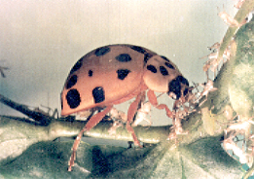
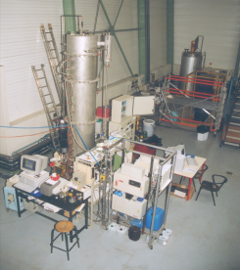
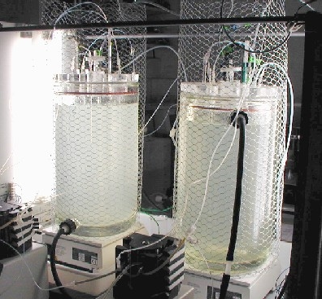
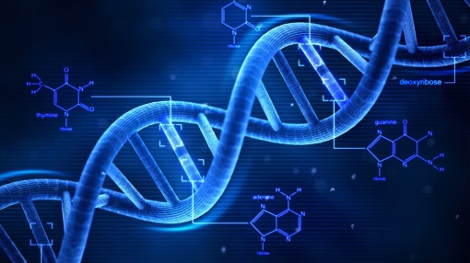
What BIOCORE does?
Study and modeling of
biological phenomena
Water treatment
Gene regulation
Growth of microalgae

Slide 5
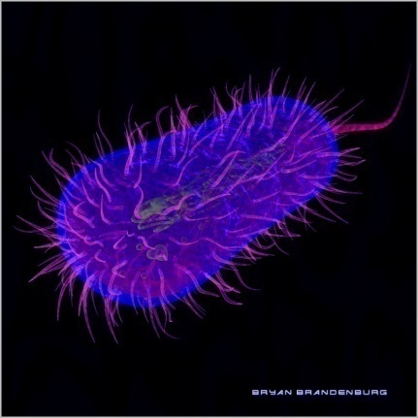
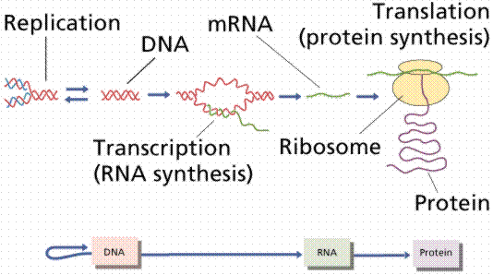
What I do?
Study of cells and of bacteria
Study of DNA, RNA and protein synthesis through mathematical models

Slide 6
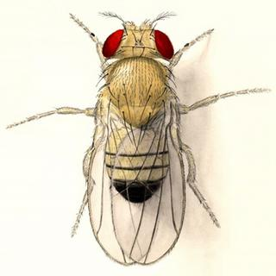
Circadian Clock
Drosophila Melanogaster

Slide 7
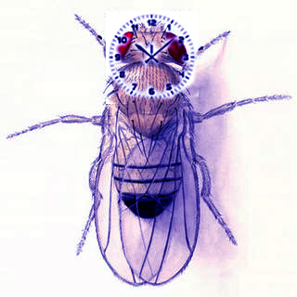
Circadian Clock
It allows for organisms to coordinate their physiological behavior with daily and seasonal changes in the day-night cycle (Biological Clock)
PERIOD GENE
TIMELESS GENE

Slide 8
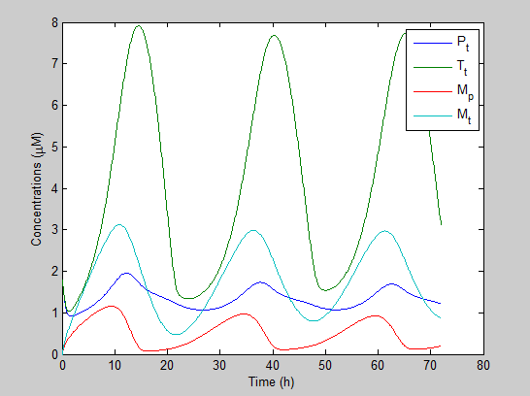
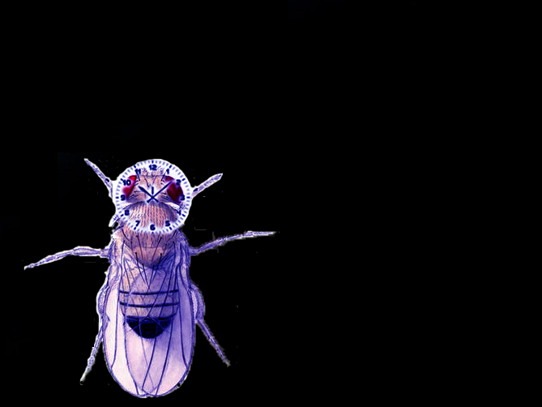
Circadian Clock
Case of continuous darkness

Slide 9
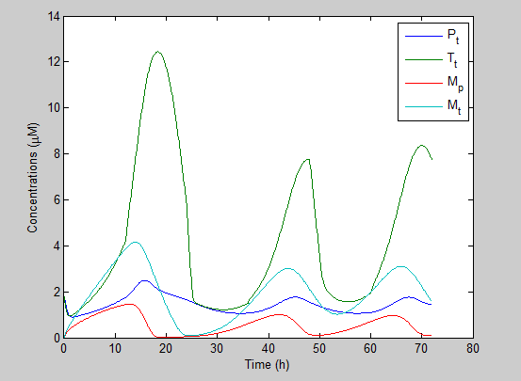
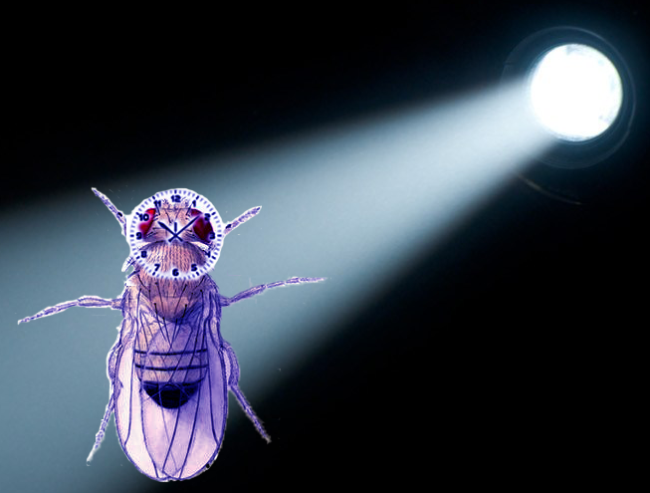
Circadian Clock
Case of 12 hours of light – 12 hours of dark
LIGHT AS A INPUT!

Slide 10
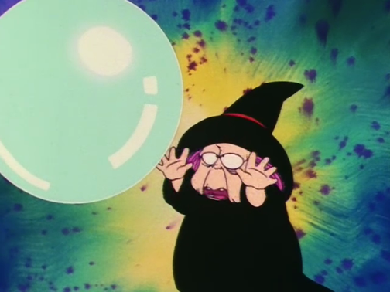
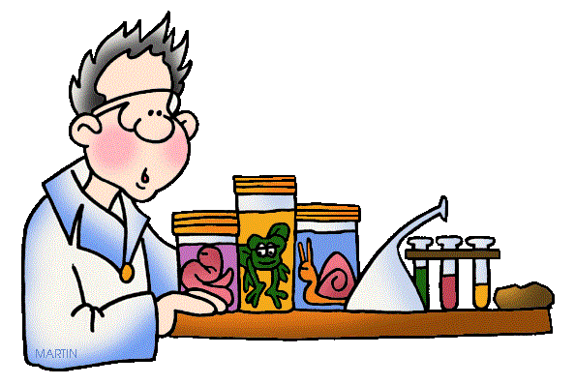
Why is a mathematical model useful?
A mathematical model is a model built using the language and tools of mathematics: its purpose is to better represent a real phenomenon.
A model is used to make predictions on the future 'state' of a phenomenon or system
It is used to help biologists and doctors to understand a particular phenomenon or to simulate experiments in a rapid manner

Slide 11
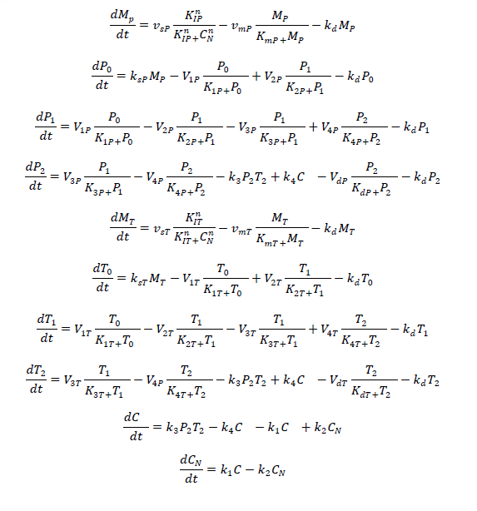
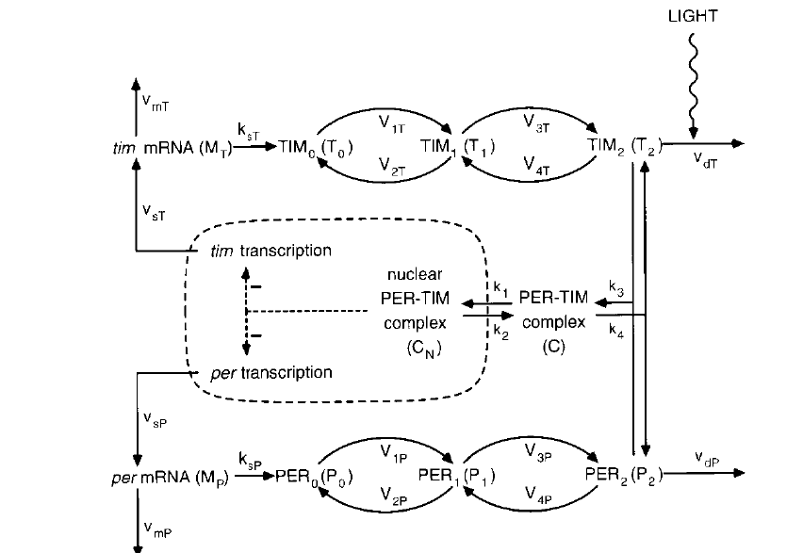
My work…
ODEs

Slide 12
My work…
?????????????

Slide 13
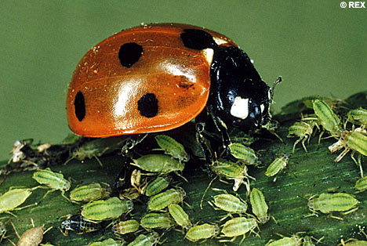
A simple model example
Model of biological control: Ladybirds vs Aphids
Biological purpose: fewer pesticides

Slide 14
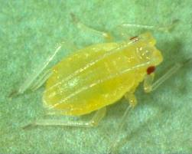
A simple model example
Aphid
Substantial damage to crops
They are mostly female
Every day a female produces 10 children
The population is growing 8 times in a week
Model: Number of aphids next week =
8 X (the number of aphids this week)

Slide 15
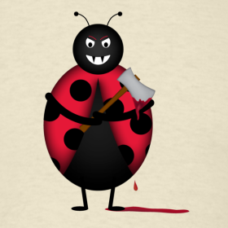
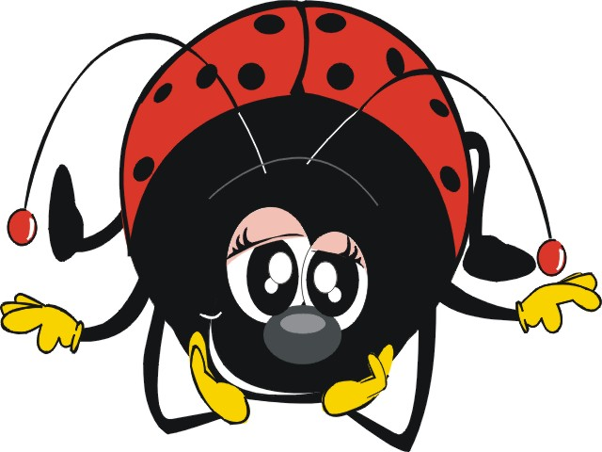
A simple model example
Ladybug
Insect of the average of 5mm
Induce an attitude of sympathy
Predators with a considerable voracity
They can kill and eat over 100 aphids per day

Slide 16
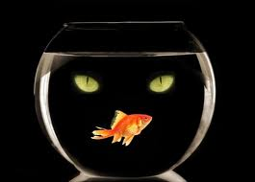
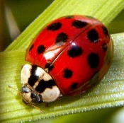
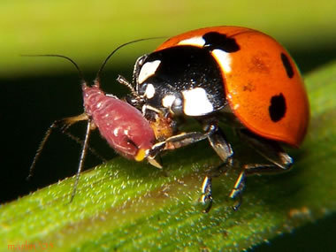
A simple model example
It ‘s a prey-predator model
Aphids continue to reproduce without
the predator
If the ladybugs do not eat the prey they are going
to die
If we put the two species together, the ladybugs will eat aphids

Slide 17
A simple model example
Reproduction
Death
Predation

Slide 18
A simple model example
Number of aphids next week = Number of aphids this week + number of aphids products during the
Week – number of aphids eaten during the week
P(t+1) = P(t) + a x P(t) – b x P(t) x C(t)
Number of ladybugs next week= Number of ladybugs this week+ number of ladybugs born
because of prey – number of ladybugs death
C(t+1) = P(t) + c x P(t) x C(t) - d x C(t)

Slide 19
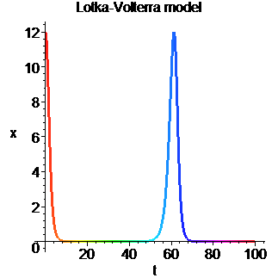
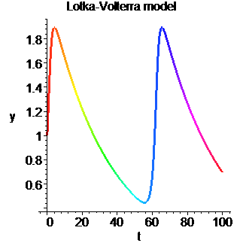
A simple model example
P’(t) = P(t) + a x P(t) – b x P(t) x C(t)
C’(t) = P(t) + c x P(t) x C(t) - d x C(t)

Slide 20
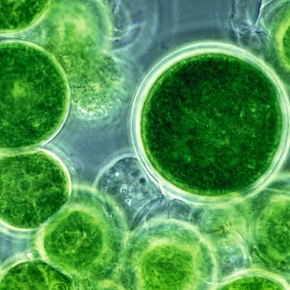
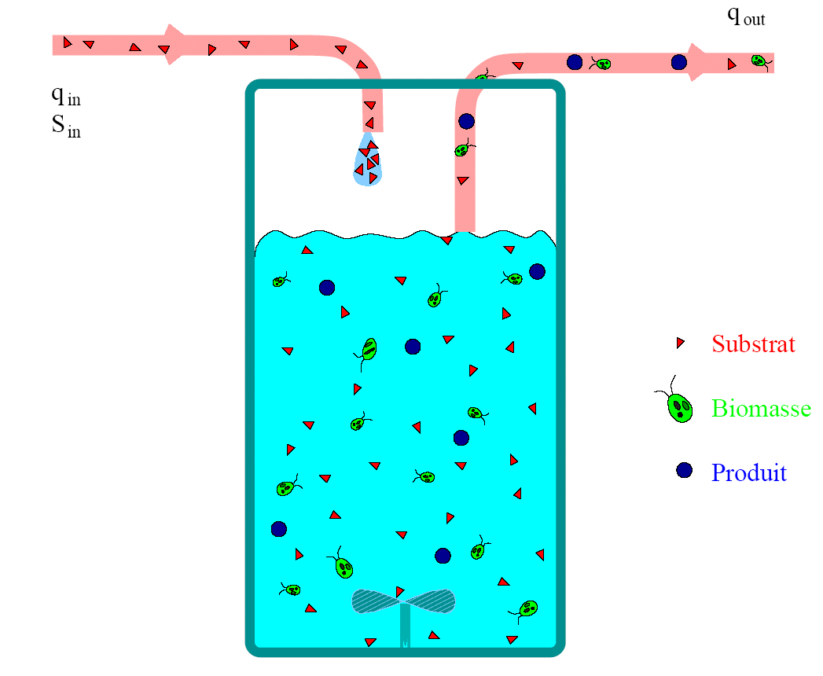
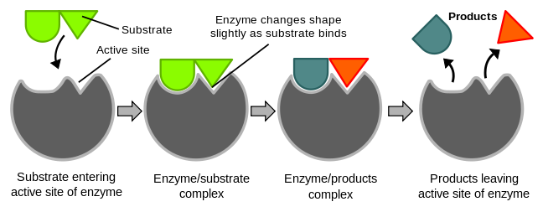
Bioreactor
The bioreactor is a device capable of providing an adequate environment for the growth of biological organisms.
Biomass is biological material derived from living, or recently living organisms
A substrate is a molecule on which an enzyme acts: subsequently, the substrate is converted into a product

Slide 21
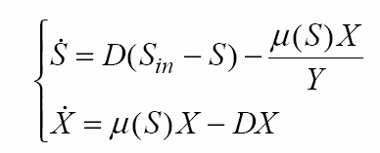
Bioreactor
The bioreactor is a device capable of providing an adequate environment for the growth of biological organisms.

Slide 22
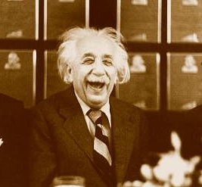
Conclusioni
La scienza è interessante!
https://team.inria.fr/biocore/

Slide 23
Grazie !
Centre de recherche
Sophia Antipolis - Méditerranée
www.inria.fr/sophia

