Slide 1
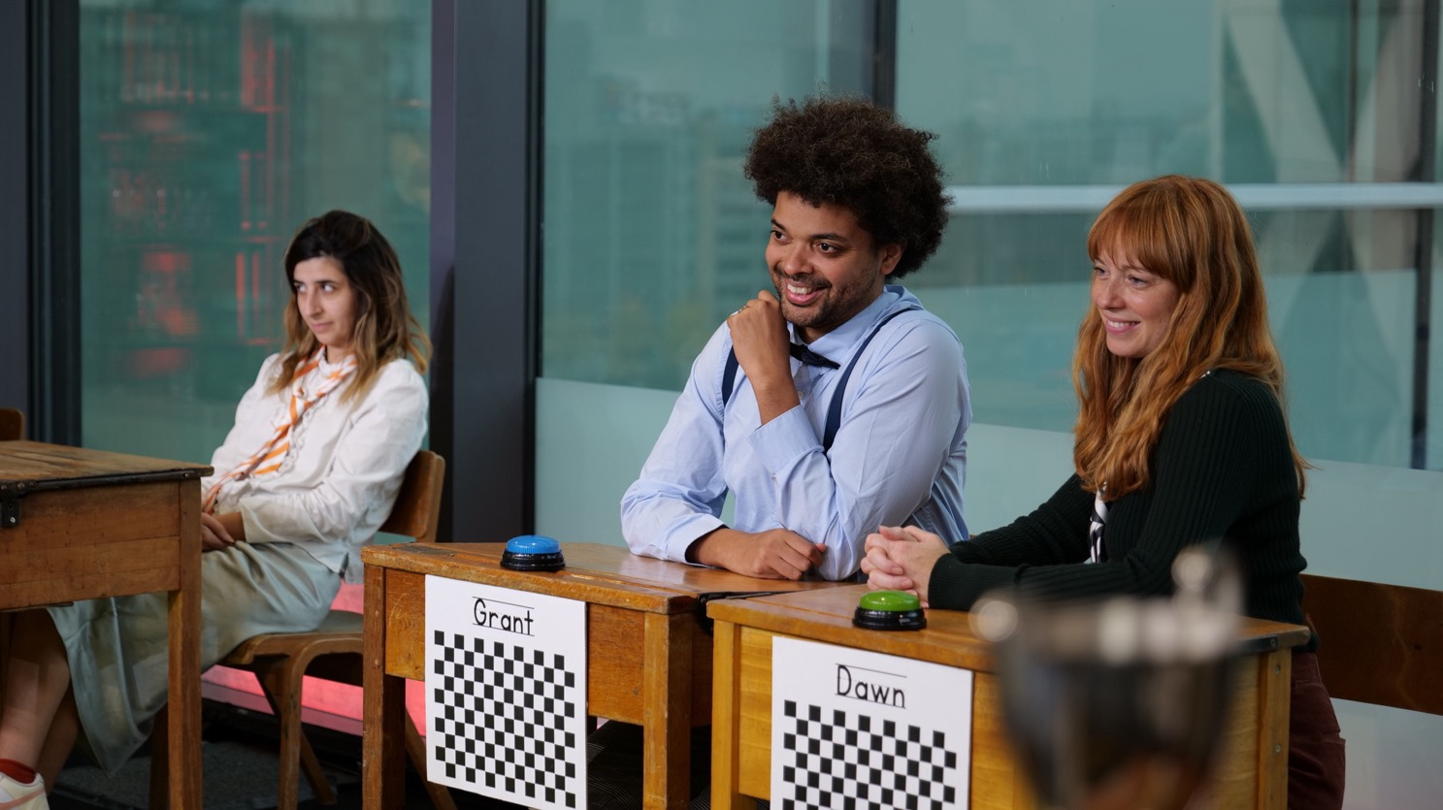
A new dataset for intelligent cinematography
The BBC R&D
OLD SCHOOL DATASET
Stephen Jolly – BBC R&D
28 April 2022

Slide 2
OLD SChool
DATASET CONTENTS
This presentation sets out the contents of the BBC R&D Old School dataset.
It was presented at WICED 2022.
A more detailed inventory can be found within the dataset itself, in the file README.md.
Read the speakers’ notes for more information.
Notes:
highlight

Slide 3
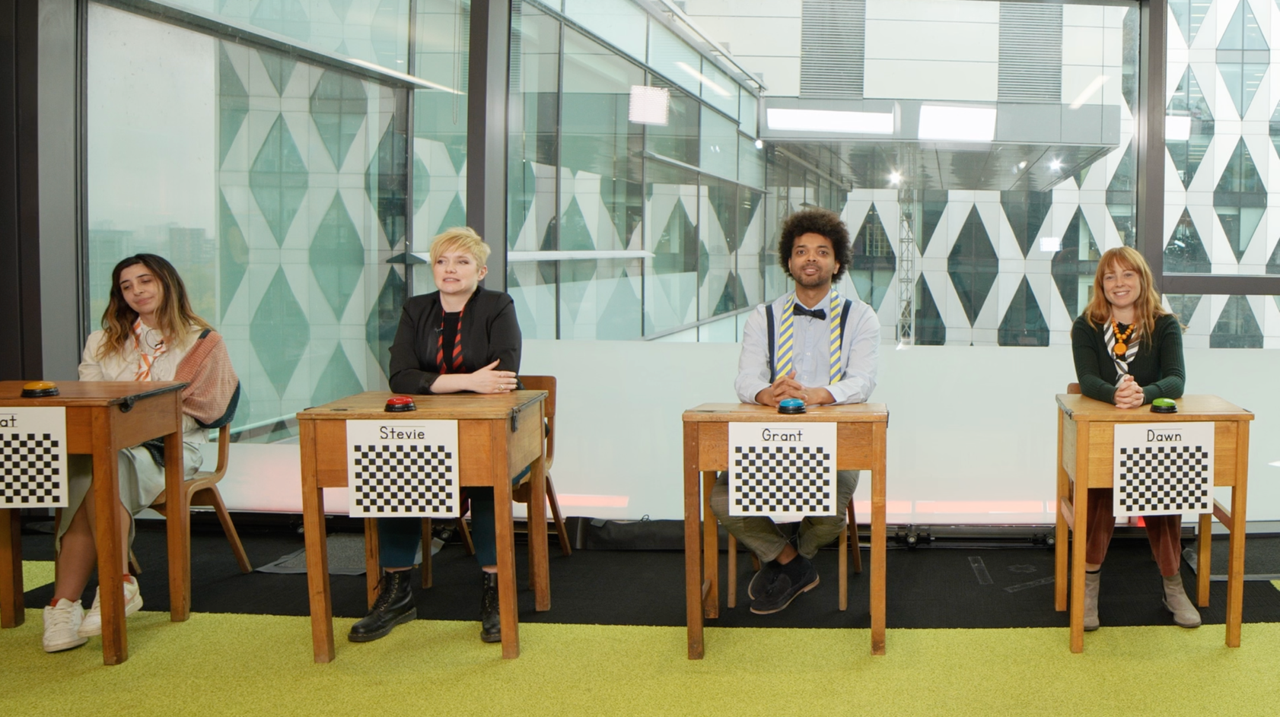
OLD School Dataset
VIDEO
Full resolution (8k) rushes
SD resolution (576p) proxies
(to scale)
Notes:
Two versions of the dataset are provided – one with both full-resolution and low-resolution proxy versions of the video, and one with the full-resolution video removed to make it easier to download and look through the data.

Slide 4
Old School Dataset
video
 | Rushes | Proxies
Resolution | 7680x4320p25 | 720x576p25
Colour Space | YUV420 | YUV420
Video Codec | h.265/HEVC 200Mb/s | h.264/AVC 250kB/s
Audio | Stereo on-camera mic | Stereo on-camera mic
Audio Codec | 48kHz 16-bit PCM | 128kB/s AAC
Notes:
The video formats for the two versions of the video are as shown here

Slide 5
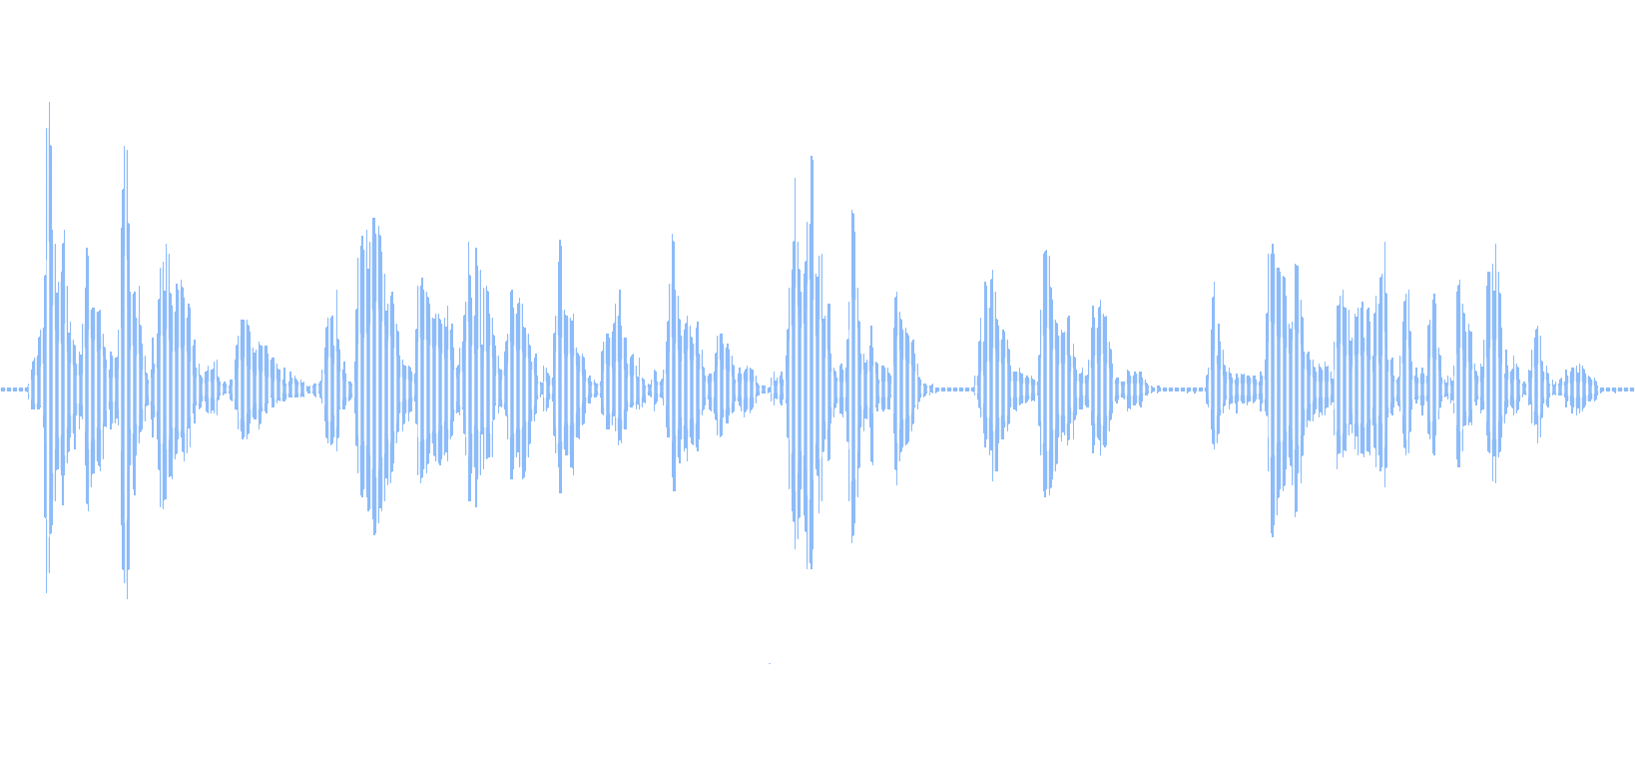
OLD SChool
Audio
Multitrack recordings from Lavalier mics worn by actors
Provided both raw (as recorded) and processed (noise reduction, plosive suppression, loudness levelling, trimming to slate/cut).
In the dataset:
Raw audio (one mono WAV file per mic per take)
Processed audio (one mono WAV per mic per take)
Mixed (one mono WAV per take)
Pro Tools project archive to allow processing to be revisited
Notes:
Mixed audio is provided as mono due to the fact that the location of sources in the stereo mix is likely to vary depending on the framings chosen in the editing process. Automated generation of a stereo mix is left as an exercise for the user.

Slide 6
Old School Dataset
Audio
 | Raw | Processed | Mix
Sampling | 48kHz, 24-bit | 44.1kHz, 24-bit | 48kHz, 24-bit
Channels | 1 | 1 | 1
Encoding | PCM | PCM | PCM
Notes:
The format details for the different kinds of audio are as shown here.

Slide 7
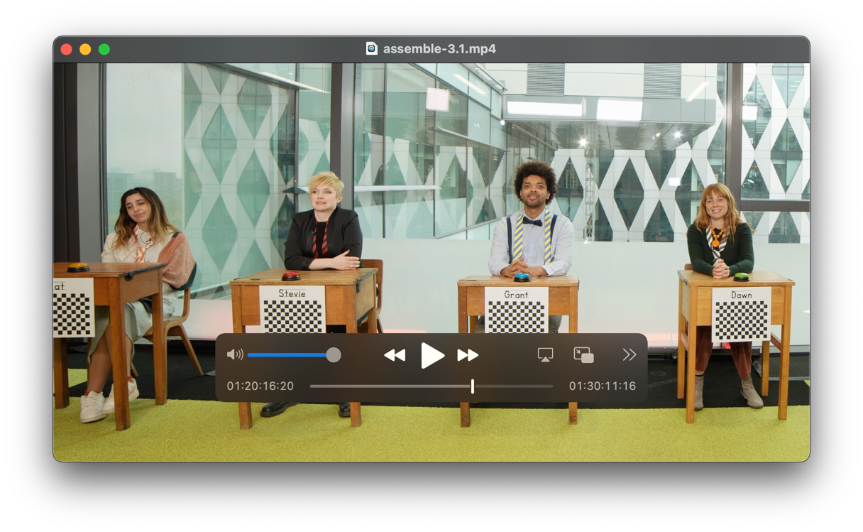
Old School Dataset
Human Edit
A human edit of the programme is included:
As an example
For benchmarking
NB:
Intended to be perfectly watchable, but not a “gold standard”.
“As-live”, not film-style. Although dialogue has been tightened in places.

Slide 8
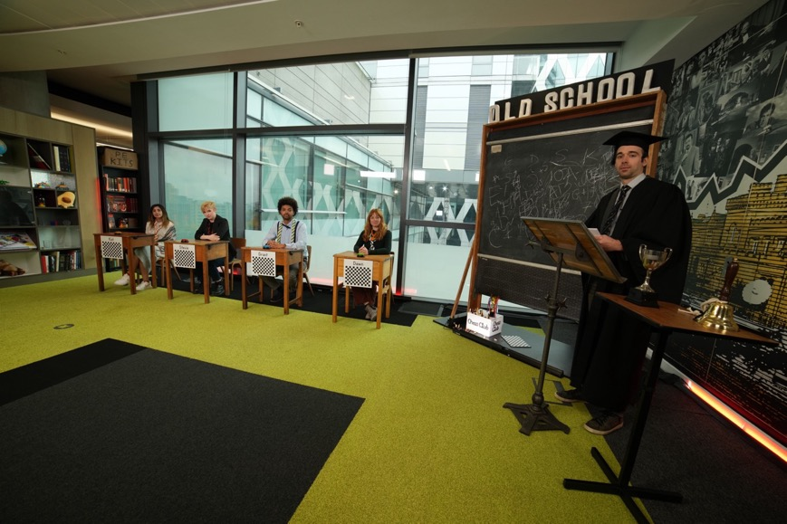
Old School Dataset
Stills
Various stills from on-set

Slide 9
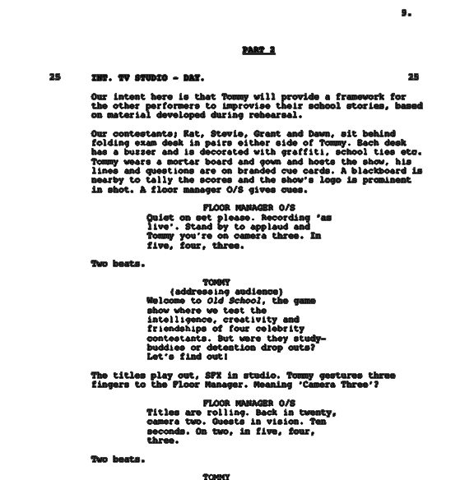
Old School Dataset
Script
The shooting script in:
PDF format
Final Draft (FDX) format*
*well-formed XML
NB:
Only Parts 2-3 shot
Improvisations, ad-libs etc

Slide 10
[
{
"take": "19",
"day": "2",
"scene": "3",
"script_pages_start": "19",
"script_pages_end": "20",
"shot description": "Pasta confrontation",
"lighting_notes": "Lightens up considerably",
"length": "04:30",
"on_day_log_transcription": "HAS boom operator gag",
"director_notes": "Restart 1 min in. Another partial restart 3…",
"faults": "",
"cameras": {
"CAM1":"OS1_0044",
"CAM2":"OS2_0161",
"CAM3":"OS3_0051",
"CAM4":"OS4_0054"
},
"microphones":{
"raw":{
"Stevie":"ACT3-T003-TrX"
},
"clean":{
"Stevie":"ACT3-T003-TrX"
},
"mix":"ACT3-T003"
}
}
]
Old School Dataset
Metadata - Shot Logging
Primary metadata for audio and video
Links audio and video for each take to script and to each other
Director’s notes for edit following review
Notes from on-set, and any technical issues

Slide 11
Old School Dataset
Metadata – AV Sync
[
{
"audio_file" : "ACT2-T001",
"offset" : 66.088,
"score" : 31.23,
"video_file" : "OS1_0012"
},
{
"audio_file" : "ACT2-T002",
"offset" : 29.664,
"score" : 38.27,
"video_file" : "OS1_0013"
},
{
"audio_file" : "ACT2-T003",
"offset" : 24.724,
"score" : 43.58,
"video_file" : "OS1_0014"
}
Sync is via slate, but:
AV sync metadata provided as JSON for convenience
Calculated via cross-correlation –probable 0.01s accuracy, but no guarantees!
“Score” is standard score of cross-correlation peak - >10 is good.
Feedback welcome.
https://github.com/bbc/audio-offset-finder
Notes:
Ids not filenames. (In the future, we hope that this won’t be an issue due to accurate clocks in cameras.)

Slide 12
Old School Dataset
Metadata – Example path
TITLE: Timeline 1
FCM: NON-DROP FRAME
001 AX V C 05:43:45:12 05:44:33:09 01:00:00:00 01:00:47:22
* FROM CLIP NAME: D2T2
002 AX V C 05:44:35:03 05:44:37:05 01:00:47:22 01:00:49:24
* FROM CLIP NAME: D2T2
003 AX V C 05:45:09:17 05:45:34:13 01:00:49:24 01:01:14:20
* FROM CLIP NAME: D2T2
004 AX V C 05:45:36:17 05:46:22:04 01:01:14:20 01:02:00:07
* FROM CLIP NAME: D2T2
005 AX V C 05:46:45:16 05:47:30:22 01:02:00:07 01:02:45:13
* FROM CLIP NAME: D2T2
006 AX V C 05:47:31:24 05:47:38:11 01:02:45:13 01:02:52:00
* FROM CLIP NAME: D2T2
007 AX V C 05:47:39:15 05:47:50:04 01:02:52:00 01:03:02:14
* FROM CLIP NAME: D2T2
008 AX V C 05:48:32:23 05:48:43:04 01:03:02:14 01:03:12:20
* FROM CLIP NAME: D2T3
009 AX V C 05:48:44:00 05:49:07:09 01:03:12:20 01:03:36:04
* FROM CLIP NAME: D2T3
Temporal editing much harder than framing/cutting
For convenience, an example path through the rushes supplied as an EDL (and maybe as JSON?)
Based on human edit.
With or without “tightening” cuts? Advice welcome.

Slide 13
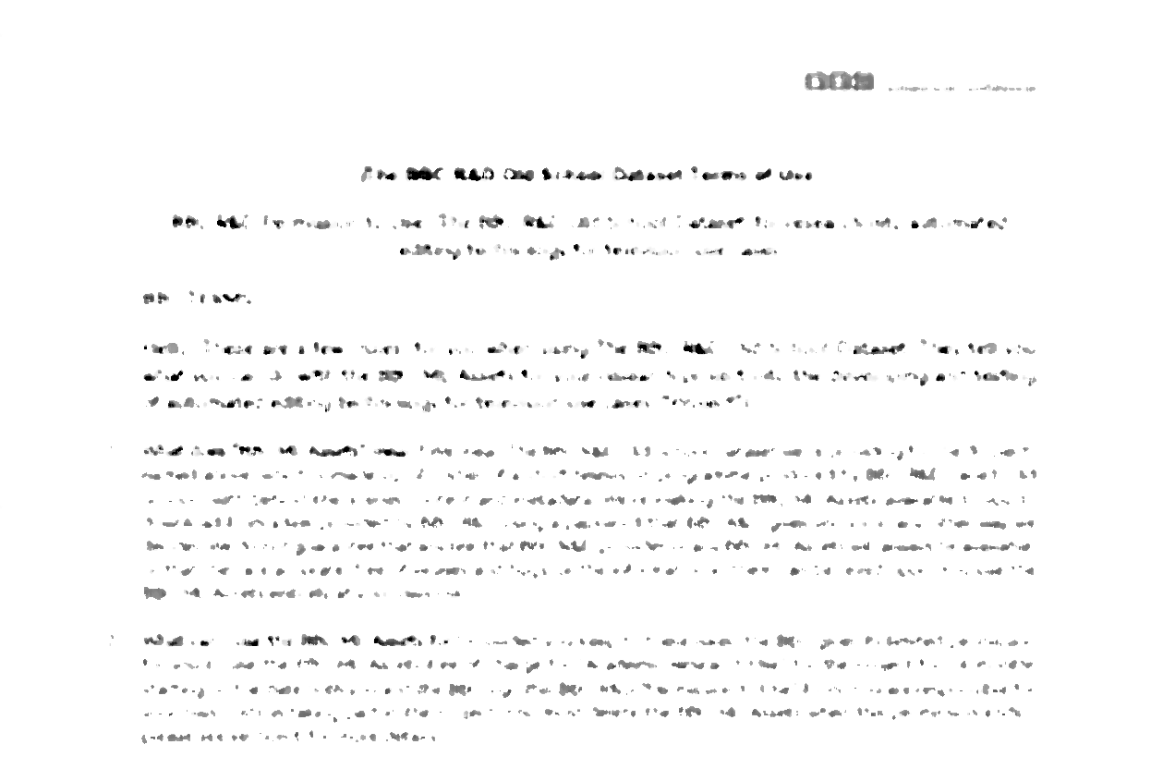
OLD School Dataset
Licensing
Data-sharing agreement
Each researcher signs
Limits on use of data
Intelligent Cinematography research ✅
WICED contest ✅
Can be revisited if necessary
”The dataset is only available to researchers from universities and other reputable academic institutions and relevant public organisation for non-commercial research.“

Slide 14
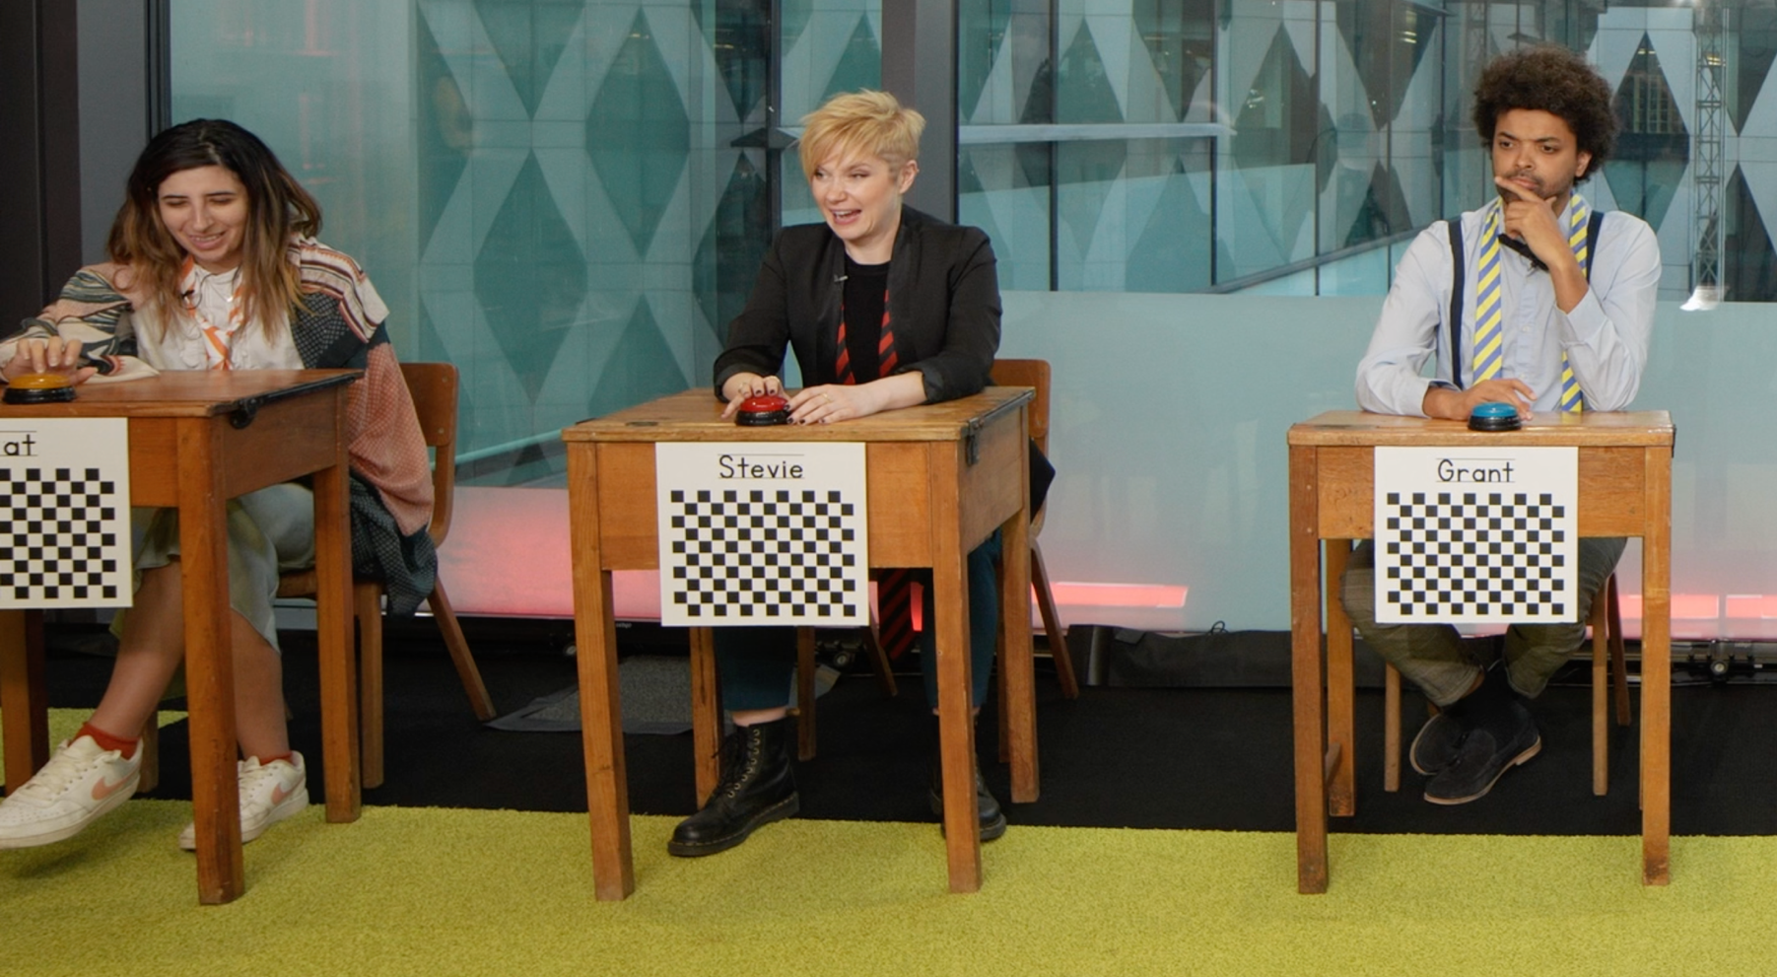
OLD School DATASET
BE aware
Lens Distortion
Notes:
The use of wide-angle lenses introduces some rectilinear distortion to the images, most visible at the edges and in the corners. It may be possible to calculate undistortion parameters from the data (perhaps using the in-vision checkerboards), but this has not yet been explored.

Slide 15
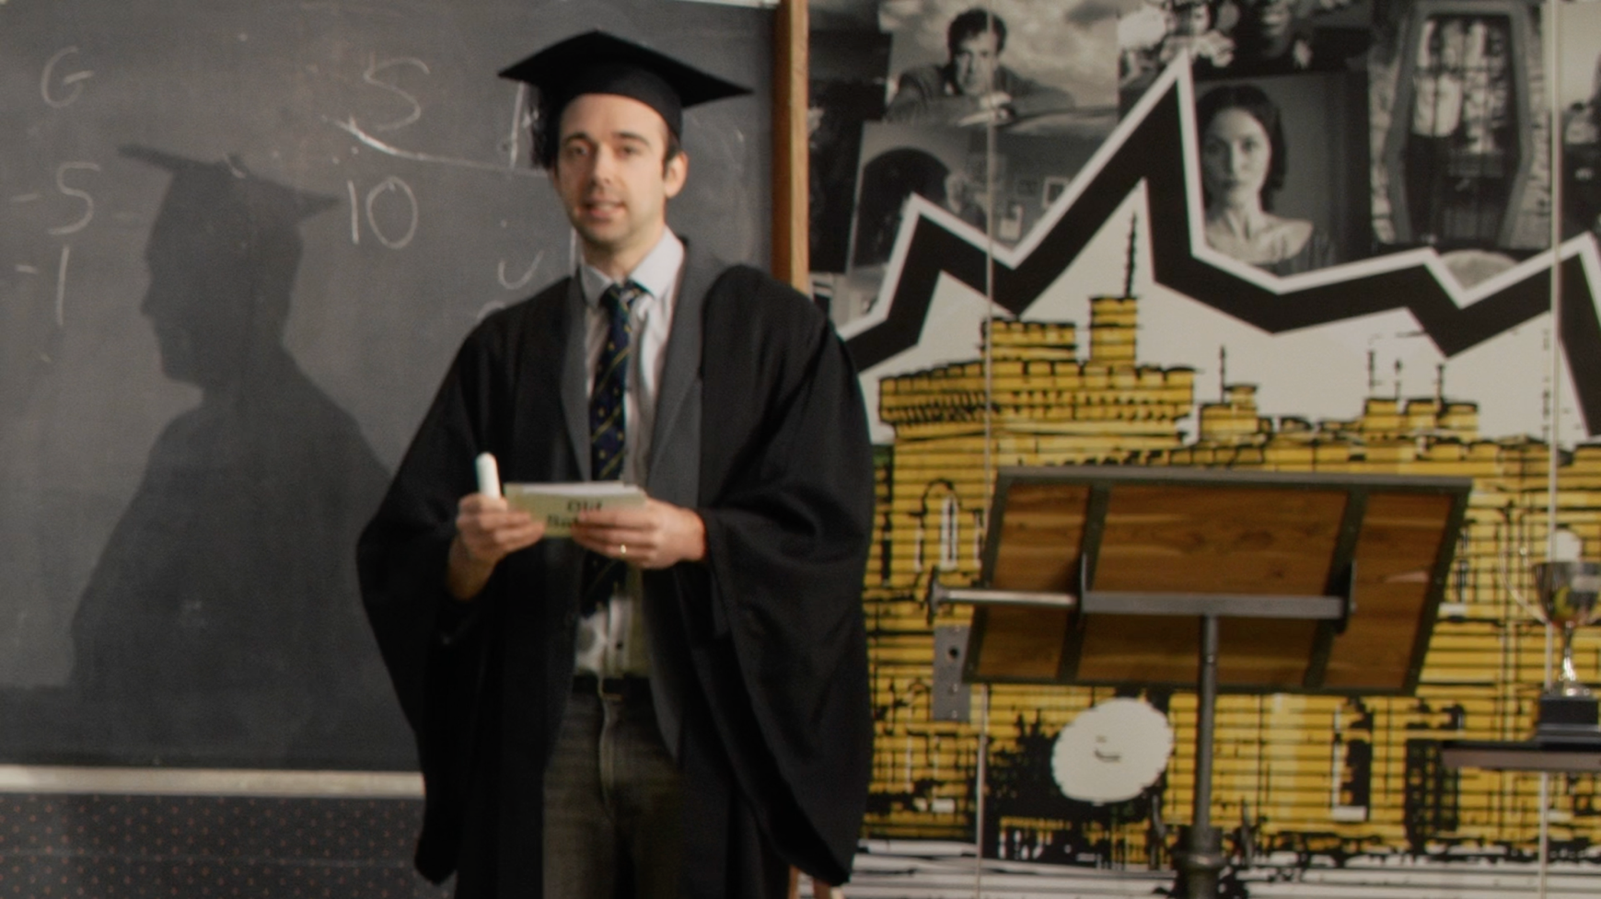
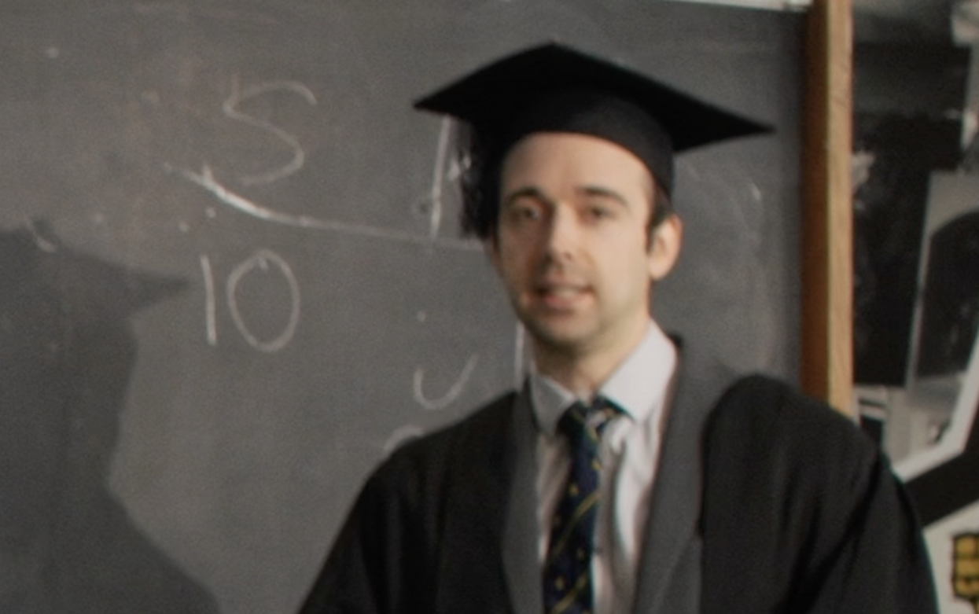
OLD School DATASET
BE aware
Limits of Resolution
Notes:
Framing shots by cropping leads to reduced resolution, which limits the quality of the edited video once the size of the crop becomes smaller than the output resolution of the edit. Care needs to be taken to avoid cutting between sharp wide-angle shots and soft close-ups, which can be distracting to the viewer. It may be possible to improve things using super-resolution techniques, although these can introduce other artefacts.
In addition, the optical resolution of the lenses is lower than the sensor resolution of the cameras in parts of the images, especially in the corners. This may be an issue when taking crops from these areas.

Slide 16
OLD SCHOOL Dataset
Thank you
Stephen Jolly stephen.jolly@bbc.co.uk
Graeme Phillipson graeme.phillipson@bbc.co.uk
bbc.co.uk/rd

